Slide 1

INTERACTIVE E-LEARNING
PLATFORM
Nehal Nityanand Mishra (23106100)
Ram Narayan Maurya (23106076)
Dhruv Rakesh Jain (23106040)
Aditya Khande (23106119)
Project Guide
Ms. Shraddha Dalvi

Slide 2
Outline
Introduction
Literature Survey of the Existing Systems
Limitations of the Existing Systems
Problem Statement
System Design
Technologies and Methodologies
Implementation Screenshots
Conclusion
References

Slide 3
Introduction
Integrated E-Learning Platform: Combines essential features like YouTube video access, note-taking editor, code compiler, secure authentication, and profile management.
Problem Solved: Eliminates the need to switch between multiple tools for learning, coding, and note-taking, while addressing security and language support issues.
Key Features: Includes embedded educational videos, a rich-text note editor, multi-language code compiler, secure Firebase authentication, and user progress tracking.

Slide 4
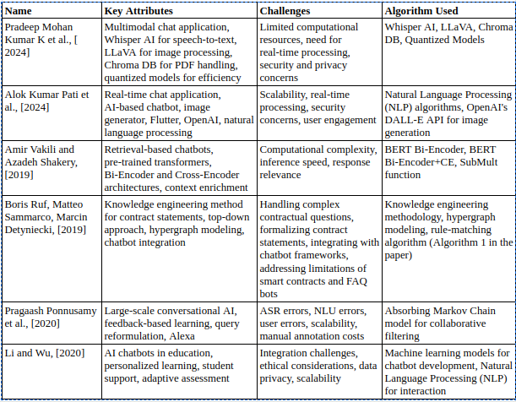
Literature Survey of the Existing System

Slide 5
Problem statement
We are forcing users to switch between tools for video watching, note-taking, and coding. Additionally, and secure authentication are often missing. This platform aims to solve these issues by offering an integrated, interactive, and secure learning experience.

Slide 6
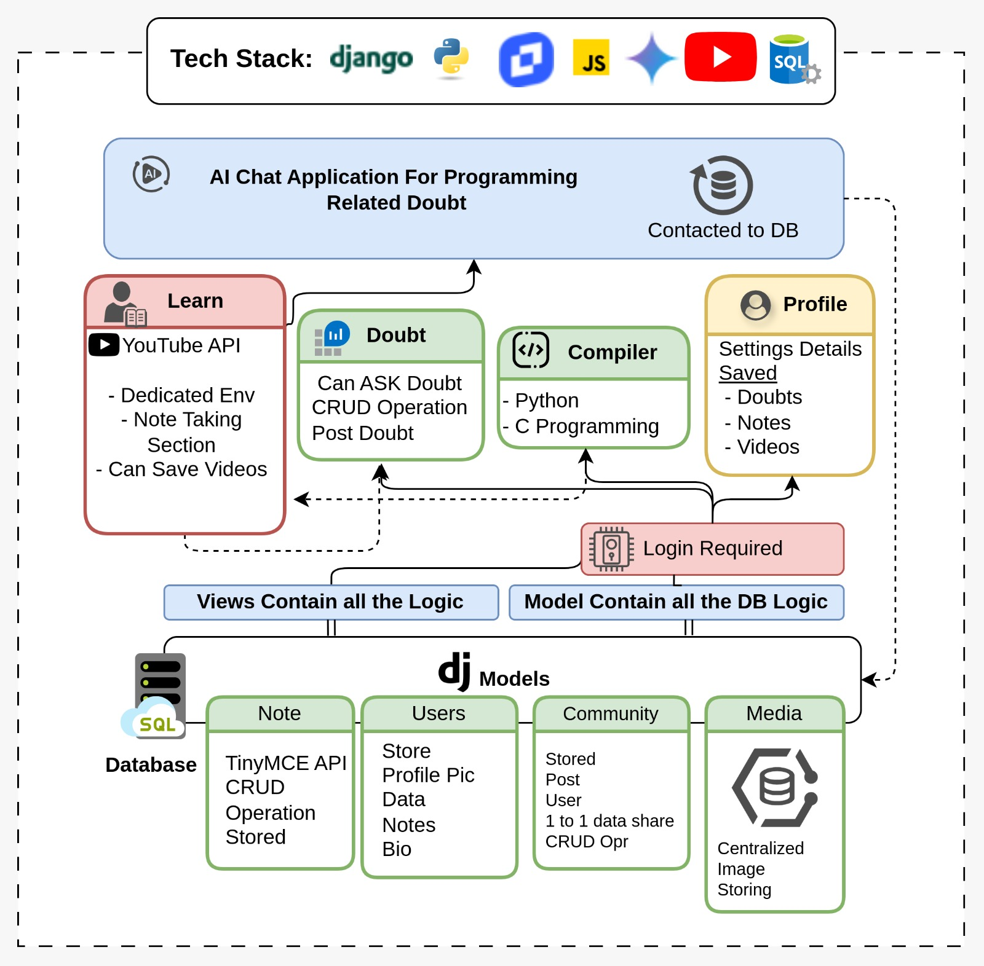
System Design

Slide 7
Technologies
Tools:
Figma: Designs the UI/UX, ensuring an intuitive and user-friendly interface.
JetBrains: Serves as the primary IDE for coding and debugging the application.
Git and GitHub: Manage version control, facilitating collaboration and code management.
Frontend:
Tailwind CSS: Used for styling and layout, providing a responsive and visually appealing interface.
Crispy Forms: Enhances form usability, making it easier for users to input data.
JavaScript: Used for creating interactive animations and enhancing the overall user experience.
Backend:
SQLite: Serves as the database management system, storing user data and application metadata.
Django Channels : To enable real-time communication, Django Channels is integrated alongside Models and Views for backend logic.
Sandbox: Provides a secure environment for users to practice coding and execute code snippets.
API:
YouTube API: Embeds video content seamlessly, enhancing the learning experience.
TinyMCE Editor: Supports note-taking by allowing users to format and edit notes efficiently.

Slide 8
Methodologies
Phase 1: Planning and Design
Project Initiation: Define scope, goals, and timelines.
UI/UX Design: Use Figma for intuitive interfaces.
Technical Feasibility Study: Assess AI and video integration feasibility.
Phase 2: Development
Frontend Development: Implement UI with Tailwind CSS and JavaScript.
Integrate TinyMCE Editor for note-taking.
Use Crispy Forms for usability.
Backend Development:Set up Django framework.
Use Django Channels for real-time communication.
Integrate SQLite for database management.
Implement CRUD operations.
AI and Video Integration:
Integrate Gemini API for AI chat.
Use YouTube API for video embedding.

Slide 9
Implementation Screenshot

Slide 17
Conclusion
The Interactive E-Learning Platform effectively addresses the limitations of traditional online learning systems by integrating key features like YouTube video embedding, a note-taking editor, a multi-language code compiler, and secure user authentication. By combining these functionalities into a single, cohesive platform, it enhances the learning experience through interactivity, accessibility, and ease of use. With Django handling the backend, Bootstrap enhancing the frontend, and secure Firebase authentication, the system ensures both functionality and user security. This comprehensive approach fosters an engaging, efficient, and personalized learning environment for students worldwide.

Slide 18
References
[1]. Pradeep Mohan Kumar K . Building Comprehensive AI Integrated Chat Application using Local Multimodal AI Chat. SSRN, 2024. [SSRN](https://www.ssrn.com/)
[2]. Alok Kumar Pati, Subham Kumar Paul . SMARTCHAT: A Real-Time Chat Application With AI-Based Chatbot And Image Generator. International Journal of Creative Research Thoughts, 2024. [International Journal of Creative Research Thoughts](https://www.ijcrt.org/)
[3]. Amir Vakili and Azadeh Shakery . Enriching Conversation Context in Retrieval-based Chatbots. IEEE/arXiv, 2020. [IEEE/arXiv](https://arxiv.org/)
[4]. Boris Ruf, Matteo Sammarco, Marcin Detyniecki. Contract Statements Knowledge Service for Chatbots. IEEE/arXiv, 2020. [IEEE/arXiv](https://arxiv.org/)
[5]. Pragaash Ponnusamy, Alireza Roshan Ghias, Chenlei Guo, Ruhi Sarikaya . Feedback-Based Self-Learning in Large-Scale Conversational AI Agents. IEEE/arXiv, 2020. [IEEE/arXiv](https://arxiv.org/)
[6].Li and Wu . AI Chatbots for Educational Applications: A Review of Recent Advances. IEEE Access, 2020. [IEEE Access](https://ieeexplore.ieee.org/xpl/RecentIssue.jsp?punumber=6287639)

Slide 19
Thank You...!!

