Slide 1

PET ADOPTION WEBSITE
Asgolkar Ruturaj Vinod (23106100)
Beni Vansh Rakesh (23106076)
Bhoir Swayan Kabir (23106025)
Maurya Ramnarayan Arvind (23106119)
Project Guide
Ms. Shraddha Dalvi

Slide 2
Outline
Introduction
Literature Survey of the Existing Systems
Limitations of the Existing Systems
Problem Statement
System Design
Technologies and Methodologies
Implementation Screenshots
Conclusion
References

Slide 3
Introduction
Real-Time Observation: Stray animals in urban areas suffer from malnutrition, disease, and injury due to harsh conditions and lack of care. Exposure to hazards and inadequate medical attention shortens their life expectancy and worsen their recovery chances.
Current Solution: Shelter and rescue organizations strive to care for and rehome stray animals through adoption events and campaigns. Despite their efforts, limited resources and reach hinder their ability to manage the large number of animals in need
Stray Animal Conditions: The poor health and living conditions of stray animals, combined with inefficient adoption processes, highlight a critical need for action. Chronic health issues from inadequate shelter, poor nutrition, and lack of veterinary care worsen their suffering.

Slide 4
Introduction
Optimize Adoption Efficiency: Features like quick registration, intuitive navigation, and real-time updates on available pets will help users complete adoptions faster, reducing the time animals spend waiting for homes. Additionally, automated follow-ups and reminders will ensure that potential adopters stay engaged throughout the process, minimizing delays and drop-offs
Increase Public Awareness: To increase public awareness, the platform will include comprehensive resources that educate potential adopters about the benefits of adoption and showcase the wide variety of animals available.

Slide 5
Literature Survey of the Existing System
Title | Key Contribution | Challenges/ Insights
Pet Adoption System using Web Technology, Dinesh Suresh Bhadane IEEE (2021) | Proposes a digital platform to streamline pet adoption, improve resource access, and raise awareness about available pets. | Highlights inefficiencies in current methods (e.g., social media) and the need for a structured platform.
AI-Based Pet Adoption System (2022), Sumit Kajbaje | Focuses on a web portal where users can view and manage adoptable animals, using AI to streamline the process. | Overpopulation of animals in shelters, leading to euthanasia. System allows admin control for updating animal info.
Petfinder (1996) | One of the first pet adoption sites, connecting shelters and rescue groups while pioneering multimedia features. | Pioneered multimedia and search features to improve online pet adoption.

Slide 6
Literature Survey of the Existing System
Title | Key Contribution | Challenges/ Insights
AdoptaPet(1999) | A comprehensive database of adoptable animals across the U.S., improving connections between shelters and adopters. | Expansion of search capabilities and inclusion of detailed pet information to increase the adoption rate.
Pet Adoption System (IEEE), Harshvardhan Bale | Discusses overcrowding in shelters and inefficiencies in pet finding methods (flyers, social media) and offers a digital solution. | Stresses the need for better-organized platforms to avoid fraudulent claims and improve adoption outcomes.
Stray Animal Population Control: Methods, Public Health Concern, Ethics, and Animal Welfare Issues, Abubakar Abdulkarim, Mohd Azam Khan Bin Goriman Khan, and Erkihun Aklilu. (2021). | Online platform for pet adoption, care, and donations, fostering community involvement with local animal welfare organizations. | It involves addressing societal stigmas, ensuring user trust, navigating regulatory requirements, and maintaining partnerships with local clinics and adoption agencies.

Slide 7
Problem statement
Stray animals in urban areas suffer from poor health due to harsh conditions and negative interactions. They face malnutrition, disease, and injury, shortening their lives. The inefficient pet adoption process leads to delays and overcrowded shelters, prolonging their suffering and making it harder for them to find homes.

Slide 8
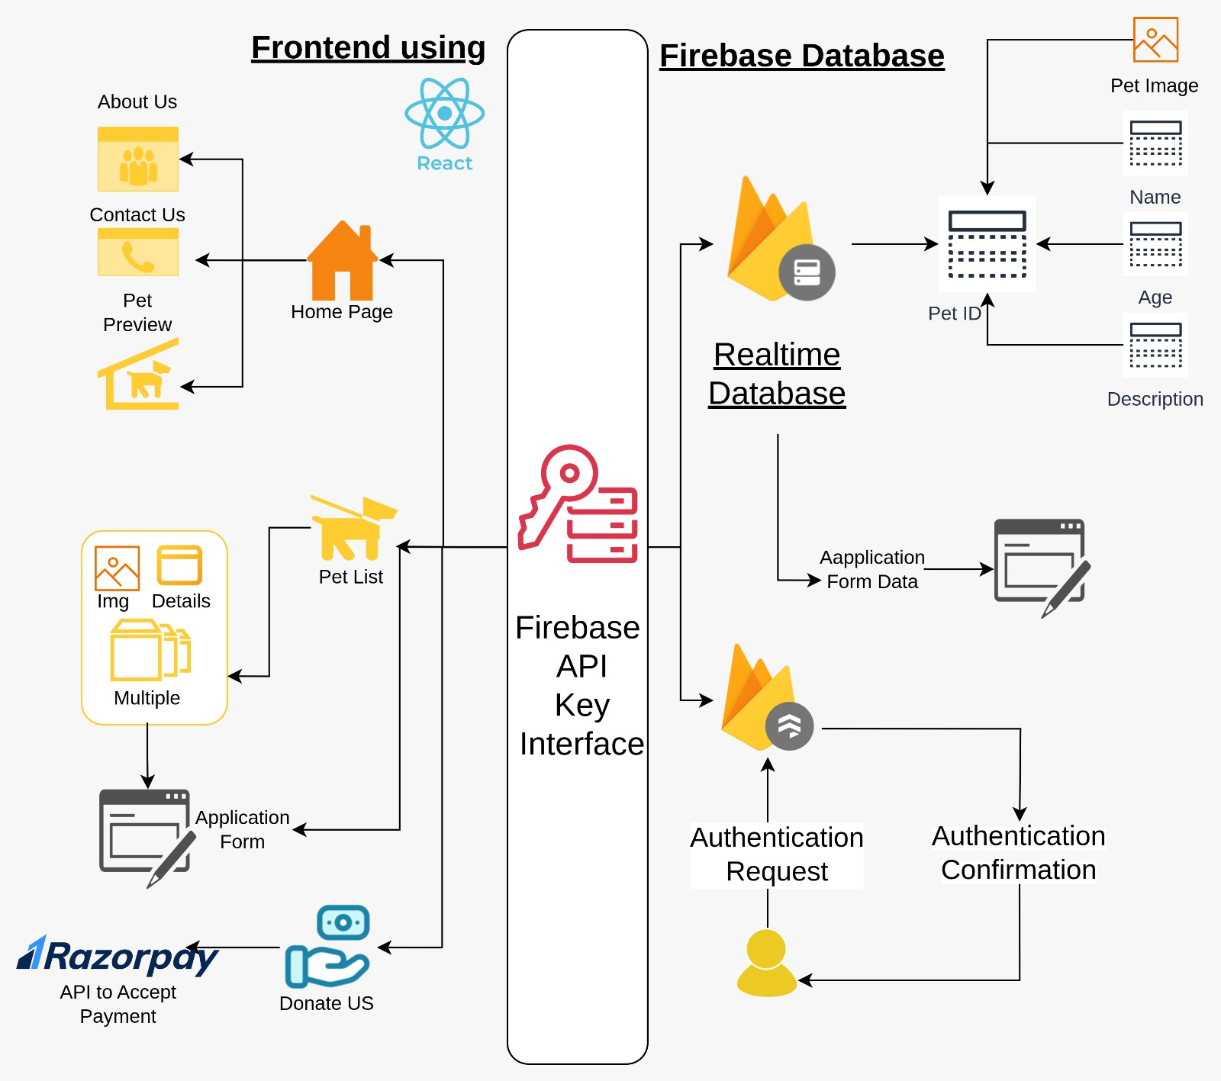
System Design

Slide 9
System Design
Firebase Authentication: Firebase provides multiple sign in methods such sign in with email/password, social login like microsoft, github, facebook. For this project we are using two methods, sign in with email address and sign in with google.
Firebase Firestore Database: Firebase Firestore is a document based database system hosted in cloud which is similar to MongoDB. Here we are using firebase for
Storing Pets Collection
ID
Name
Age
Locations Available
Gender
Type
Breed
Storing Users Collection
ID
Email
Password
Display Name

Slide 10
Technologies and Methodologies
Frontend: HTML, CSS, ReactJS
Backend:
JavaScript: For maintaining and integrating the web app.
NodeJS: A Runtime for testing web application from the terminal.
Firebase Authentication: For signing up the users.
Firebase Firestore: For maintaining a No-SQL database on the cloud.
Node Packages:
React: For building reusable UI components.
React Router: For implementing an SPA (Single Page Application). Using react router, makes the website run smoothly as it doesn’t has to reload for every link clicked.
Firebase: To integrate the firebase API with the application.
Material UI Icons: To use icons in the app.
IDE: Visual Studio Code

Slide 11
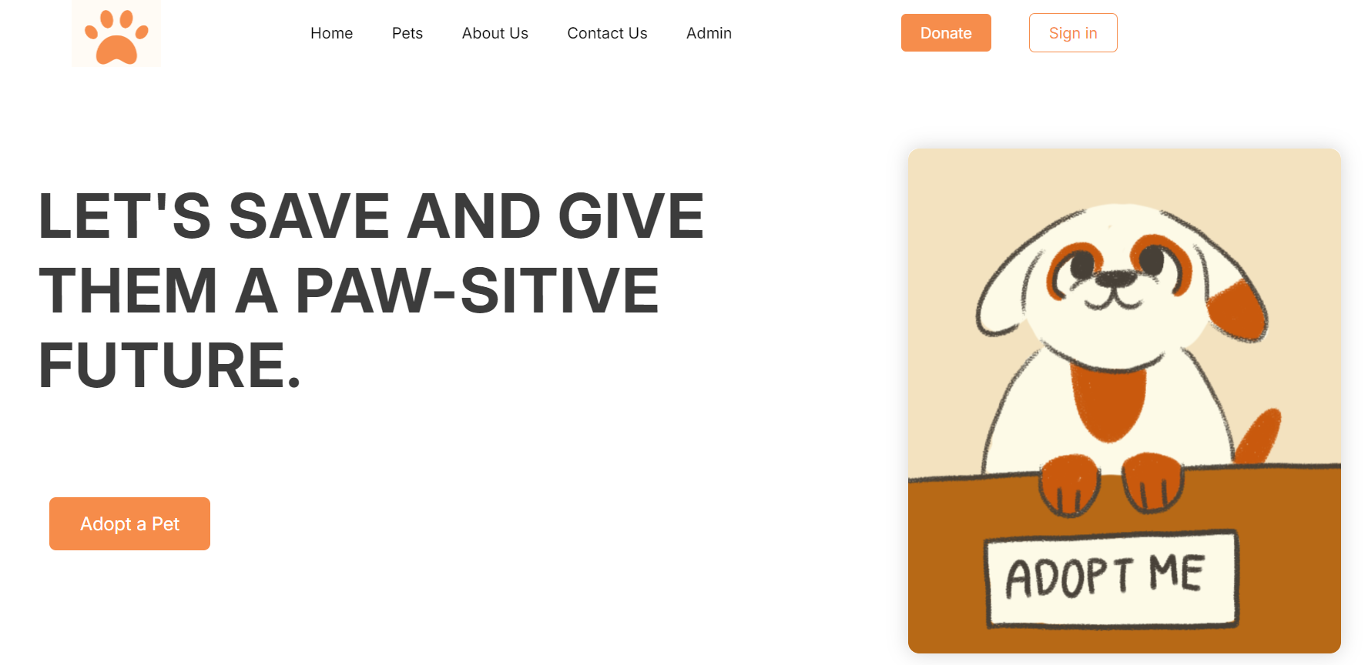
Implementation (Screenshots of implementation)
Home Page

Slide 12
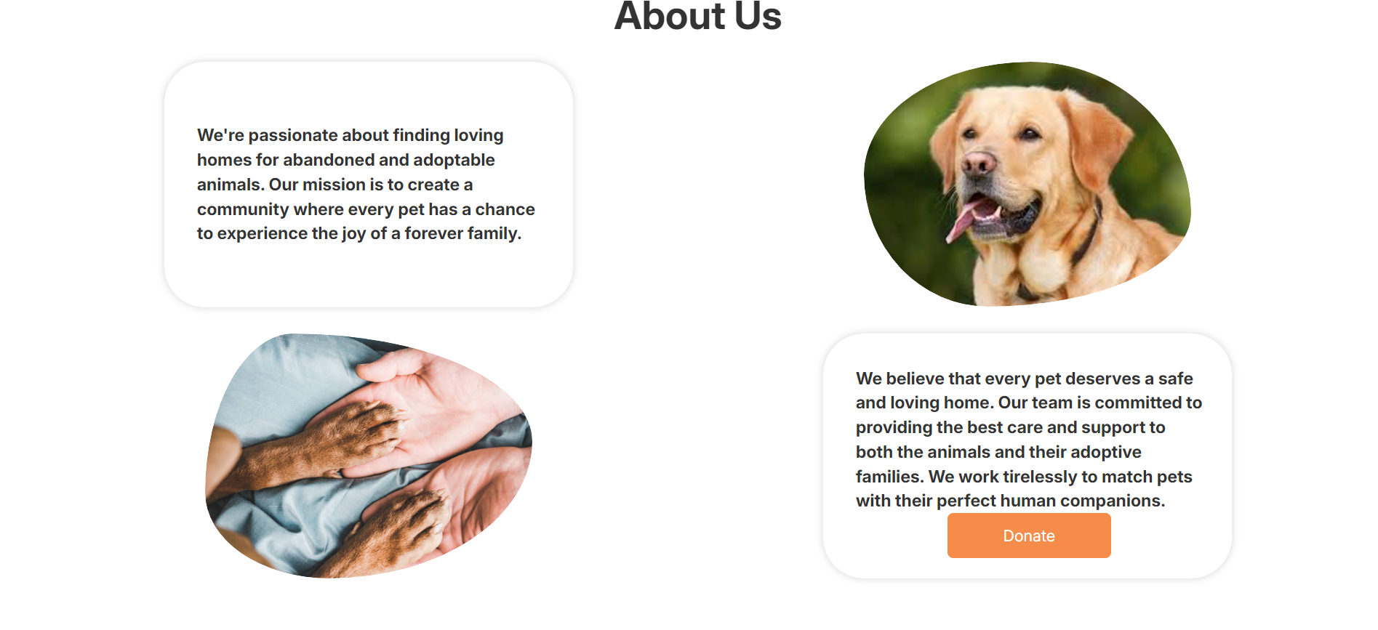
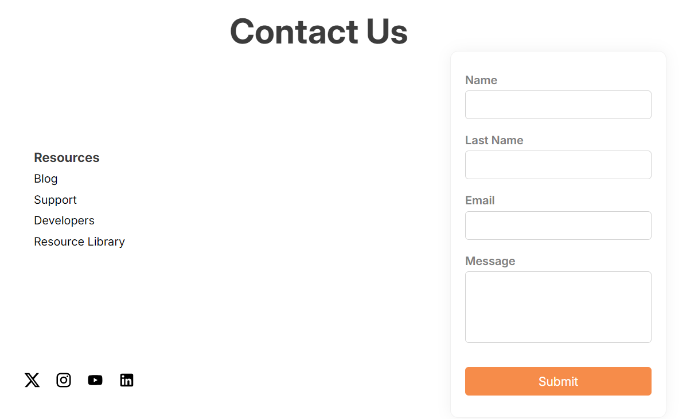
About Us Page
Contact Us Page

Slide 13
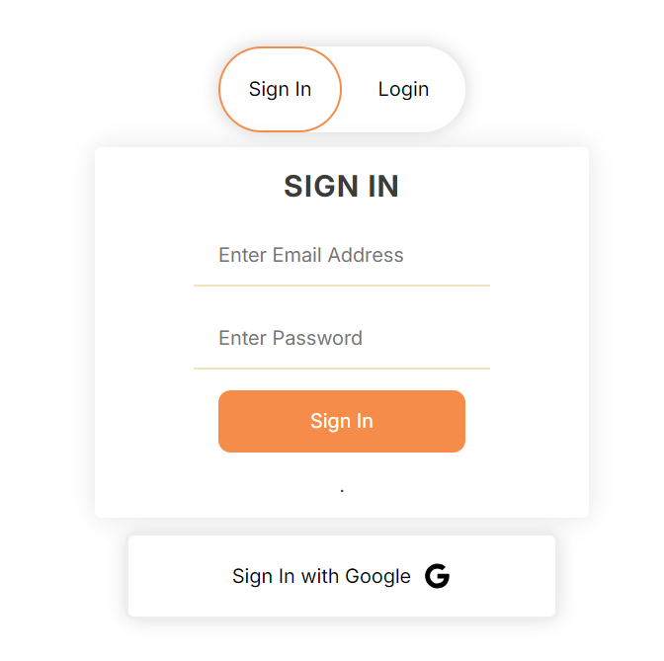
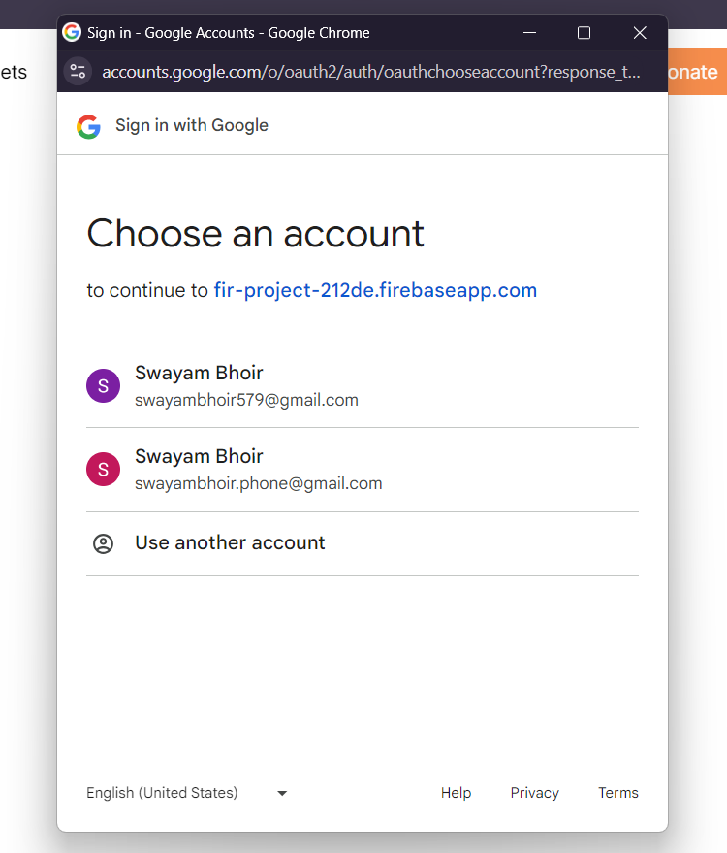
Authentication Page

Slide 14
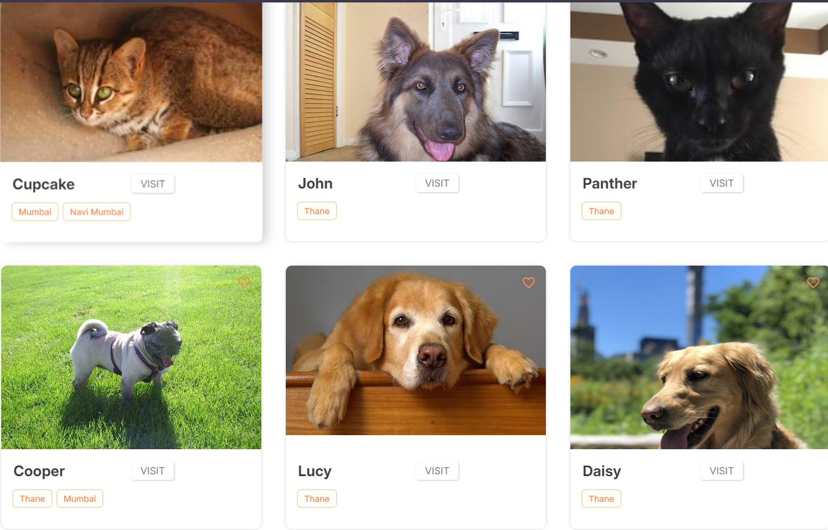
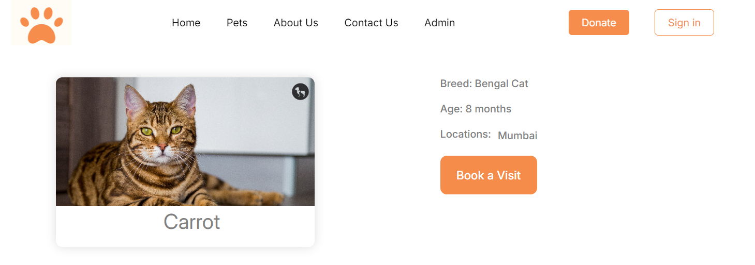
Collection of Pets
Individual Pages
for each pet

Slide 15

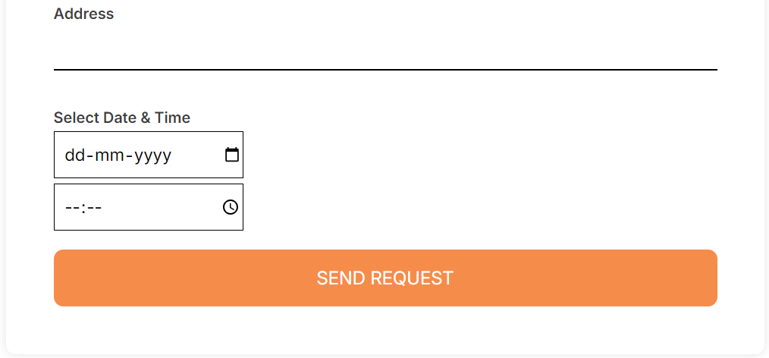
“Booking an appointment” form

Slide 16
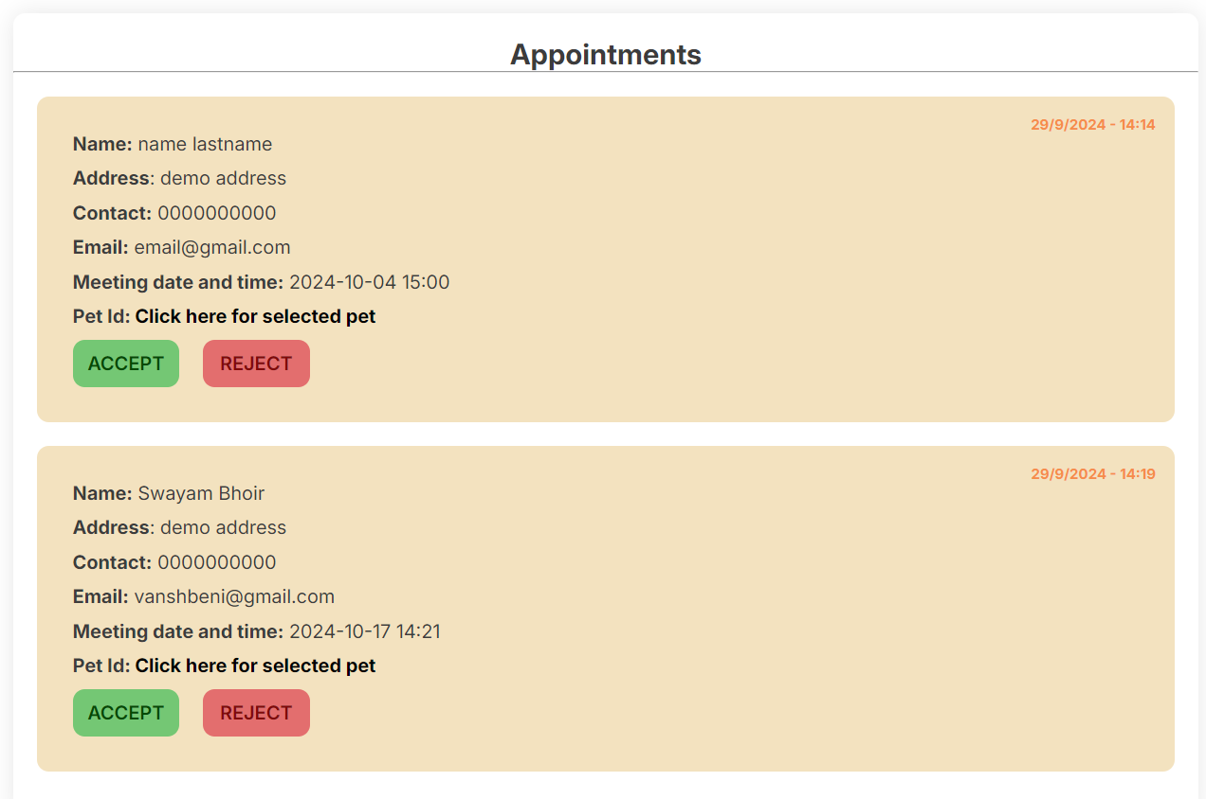
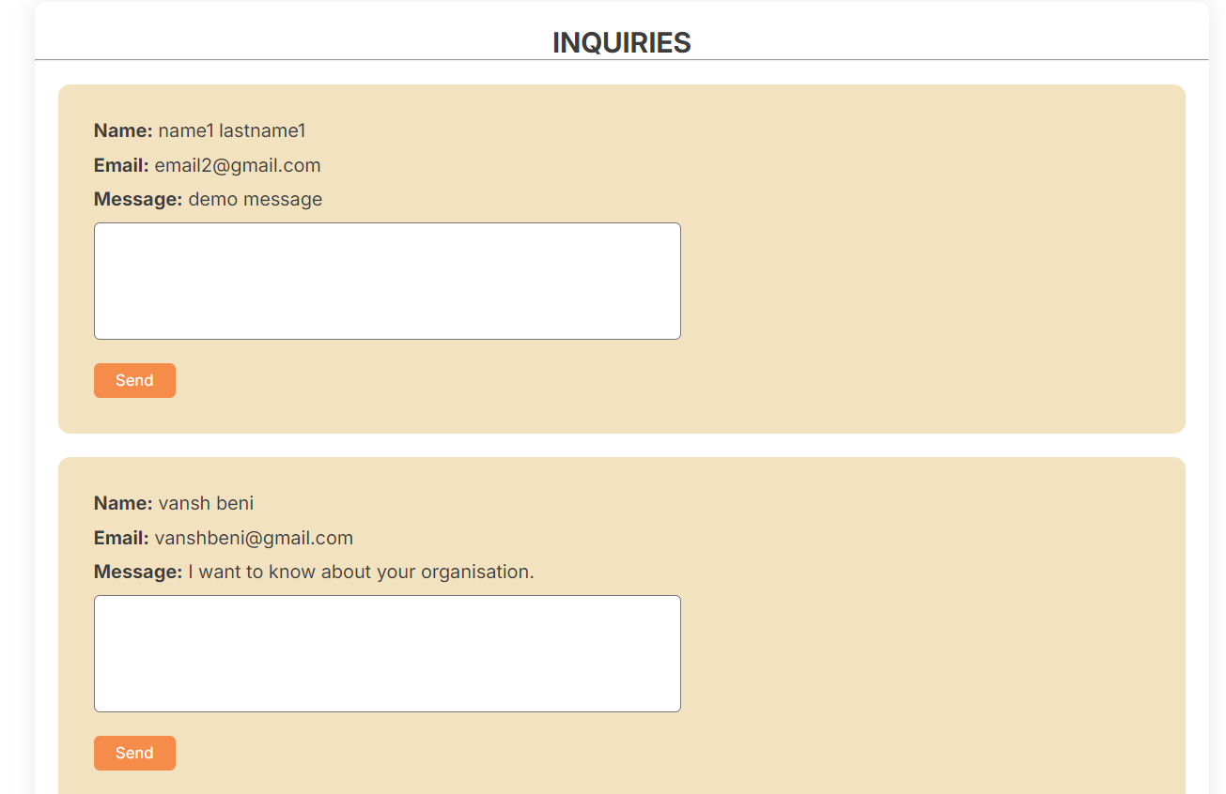
List of Appointments
(visible only for the admins)
List of `Contact Us` requests (visible only for the admins)

Slide 17
Conclusion
Despite their advantages, pet adoption websites face challenges, including limited resources, competition, and the need for ongoing maintenance. To address these issues, it is essential for these websites to continuously evolve and adapt to changing trends and user needs.
Pet adoption websites have emerged as vital tools in connecting animals with loving homes, providing a user-friendly and accessible platform that significantly boosts adoption rates. These platforms play a crucial role by offering intuitive interfaces, comprehensive pet profiles, and features such as search filters and adoption applications, which streamline the adoption process and enhance the user experience.
By focusing on improving design, incorporating innovative features, and effectively managing resources, pet adoption websites can maximize their impact and continue to support animal welfare. Ultimately, these platforms are instrumental in finding homes for animals in need and advancing the mission of responsible pet adoption.

Slide 18
References
[1] Abubakar Abdulkarim, Mohd Azam Khan Bin Goriman Khan, and Erkihun Aklilu. 2021. Stray Animal Population Control: Methods, Public Health Concern, Ethics, and Animal Welfare Issues. World 11, 3 (2021), 319–326. https://cyberleninka.ru/article/n/stray-animal-population-control-methods-public-health-concern-ethics-and-animal-welfare-issues
[2] Sumit Kajbaje, AI-Based Pet Adoption System IRJET, AI-Based Pet Adoption System (2022). https://www.studocu.com/ph/document/western-mindanao-state-university/bs-industrial-engineering/ai-based-pet-adoption-system/59948053
[3] Harshvardhan Bhale, Pet Adoption System (2022)
https://ijrpr.com/uploads/V4ISSUE6/IJRPR14601.pdf
[4] Dinesh Suresh Bhadane, Pet Adoption System using Web Technology IEEE (2021) https://www.researchgate.net/publication/373627974_PET_ADOPTION_SYSTEM_USING_WEB_TECHNOLOGY
[5] https://www.petfinder.com/
[6] https://www.adoptapet.com/

Slide 19
Thank You...!!

