Slide 1
OCEAN DevOps
Retail : Islands - Ocean
DevOps Team Internal use only Confidential

Slide 2

What’s Covered
Scope of DevOps Pipeline
Define Version control system , review tool & CI/D flows for initially covering Routine changes (Source code with T24 language format – post compilation results in Java .classes which can be packaged as Jar file
Deployment workflow for few set of thirdparty artifacts (from Temenos )
Data changes – As of now handled with bcon (binary control) tar file deployment. Once all changes are baselined & part of VCS – it will be another jar deploy
Collective Pipeline View
Details on Implementation covering Routine changes & Thirdparty artifacts
Routine change:
On top of Core product fixes delivered by Temenos, Lloyds has a local customization, that includes around 2300 programs (java compatible code) and templates with data records.
Program changes: jar files
a)Version Control System – with Git
b)Code Review – with Gerrit Tool
c)Changed/updated program can be packaged as ‘JAR’ file using the in-built compiler which can be delivered to deployment tool. Achieved with Jenkins & UrbanCode Deploy
Ear/Zip/Tar/War deployment :
Bcon files ; Browserweb war ; TAFJJEE ear ; TWS ear ; T24 base files
I. Browser components delivered by Temenos.Any modification to web front end appearance, need to be packaged as WAR file &need to be deployed across servers.
II. T24updates: If there is a bug or enhancement in T24 core product, temenos will release an update which needs to be downloaded from Temenos portal & release them in LBG environment

Slide 3




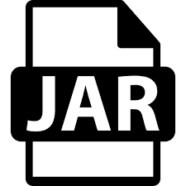


T24_Nopackage_Jar deployment workflow
SCM (Git)
+1 & +2
Compiling
Checkout
Central Repository
Jenkins
T24
No package
JAR
Fetch Latest code
Commit & push
T24_Nopackage_JAR
PROD
Snapshot method
SIT
Snapshot method
QA
Deploy
Developers
Landing Zone

Slide 4
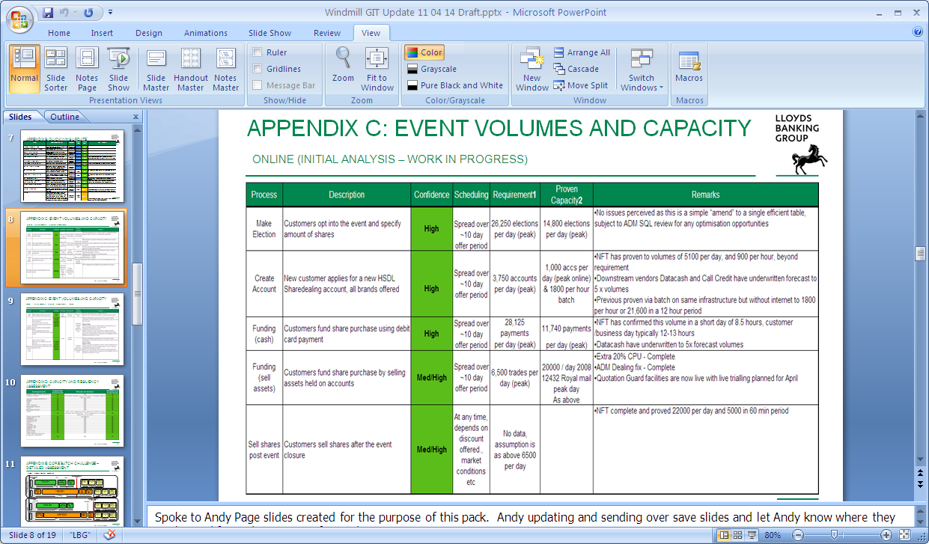



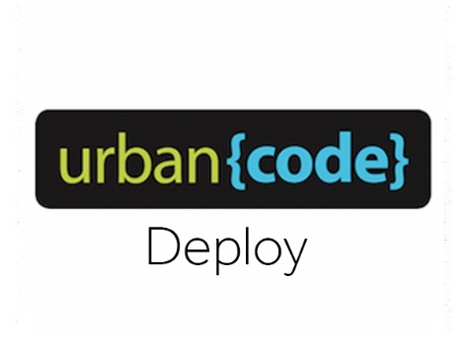





T24 Temenos updates (zip) , Bcon, war &ear deployment Workflow
Source Third Party
1.Collects updates details & ECRM team gets update zip files which needs to be deployed for a particular day .
2. ECRM team will collect Bcon and updated war & ear files which needs to be deployed for a particular day
3. Script needs to be run to upload to Nexus.
4. Jenkins build needs to be triggered to download zip files which will be sent to Ucd 5. Ucd build is triggered for configured environment & subsequent env deployment needs to be done using snapshot process
1. Bcon files
→ Temenos / T24 →ECRM Team
2. war & ear
3. T24-updates
S C R I P T
upload
C
URRENT
DATE
Jenkins
FILE
PATH
Bcon
PROD
QA
DEV
SIT
war & ear
T24 UPDATES
Manual upload via script run

