Slide 1
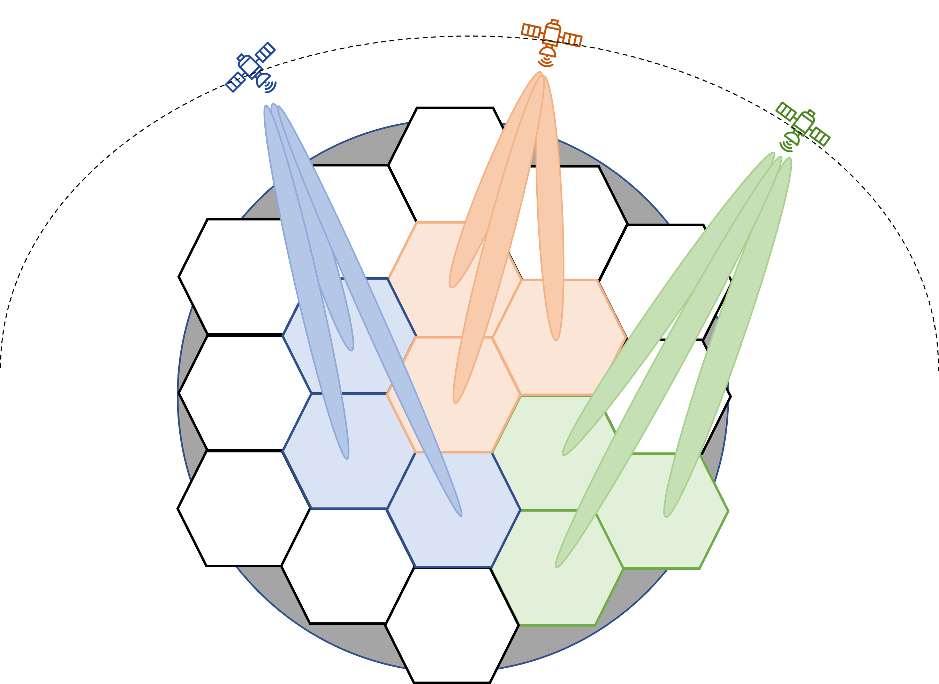

Slide 2
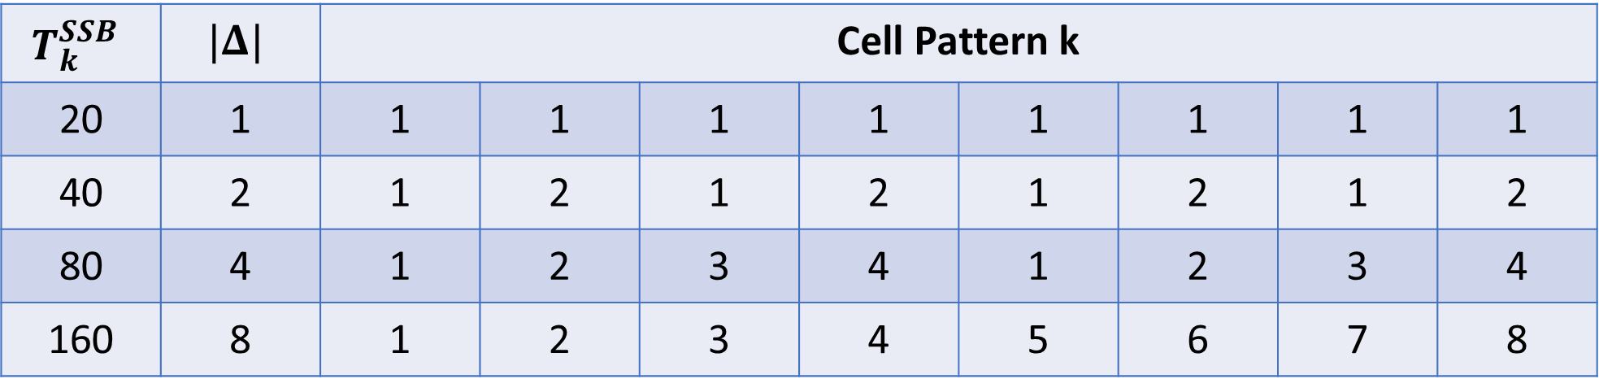
$$T_{k}^{SSB}$$ | $$|Δ|$$ | Cell Pattern k
20 | 1 | 1 | 1 | 1 | 1 | 1 | 1 | 1 | 1
40 | 2 | 1 | 2 | 1 | 2 | 1 | 2 | 1 | 2
80 | 4 | 1 | 2 | 3 | 4 | 1 | 2 | 3 | 4
160 | 8 | 1 | 2 | 3 | 4 | 5 | 6 | 7 | 8
20ms
20ms
20ms
20ms
20ms
20ms
20ms
20ms

Slide 3
Cell Diameter Size (km) | UE Speed (km/hr) | Satellite Speed (km/s) | Time to HO (s)
50 (lower bound) | +500 | 7.56 (NOTE 1) | 6.49
 | -500 |  | 6.74
 | +1200 |  | 6.33
 | - 1200 |  | 6.92
 | Neglected |  | 6.61
1000 (upper bound) | +500 |  | 129.89
 | -500 |  | 134.75
 | +1200 |  | 126.69
 | - 1200 |  | 138.38
 | Neglected |  | 132.28

Slide 4




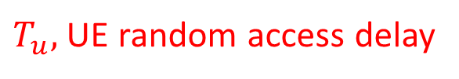


UE starts SSB measurement
$$T_{u}^{i}$$
$$T_{u}^{l}$$
fail to receive SSB
succeed to receive SSB
x
v
t (ms)
$T_{u},$UE random access delay
$$T_{k}^{SSB}$$
$$T_{k}^{SSB}$$
$$T_{k}^{SSB}$$
$$T_{k}^{SSB}$$
SSB
SSB
SSB
SSB
SSB

Slide 5

SSB burst
SSB burst
SSB burst
SSB burst
time
SSB periodicity
SSB periodicity
SSB periodicity

