Slide 1


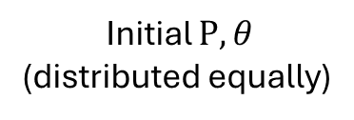
Initial $P,θ$
(distributed equally)
Genetic Algorithm
On eq.(4.1)
Optimized $θ$
Simulated Annealing
On eq.(4.2)
Optimized $P$

