Slide 1


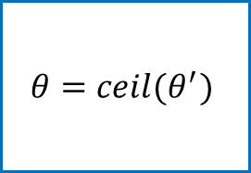

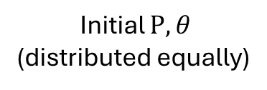
Initial $P,θ$
(distributed equally)
Objective Function $≈$ Taylor Series
Convex Optimization
On eq.(4.10) without (4.10d)
Optimized $θ′$
$$θ=ceil(θ^{′})$$
Sequential quadratic programming
On eq.(4.11)
Optimized $P$

