Slide 1
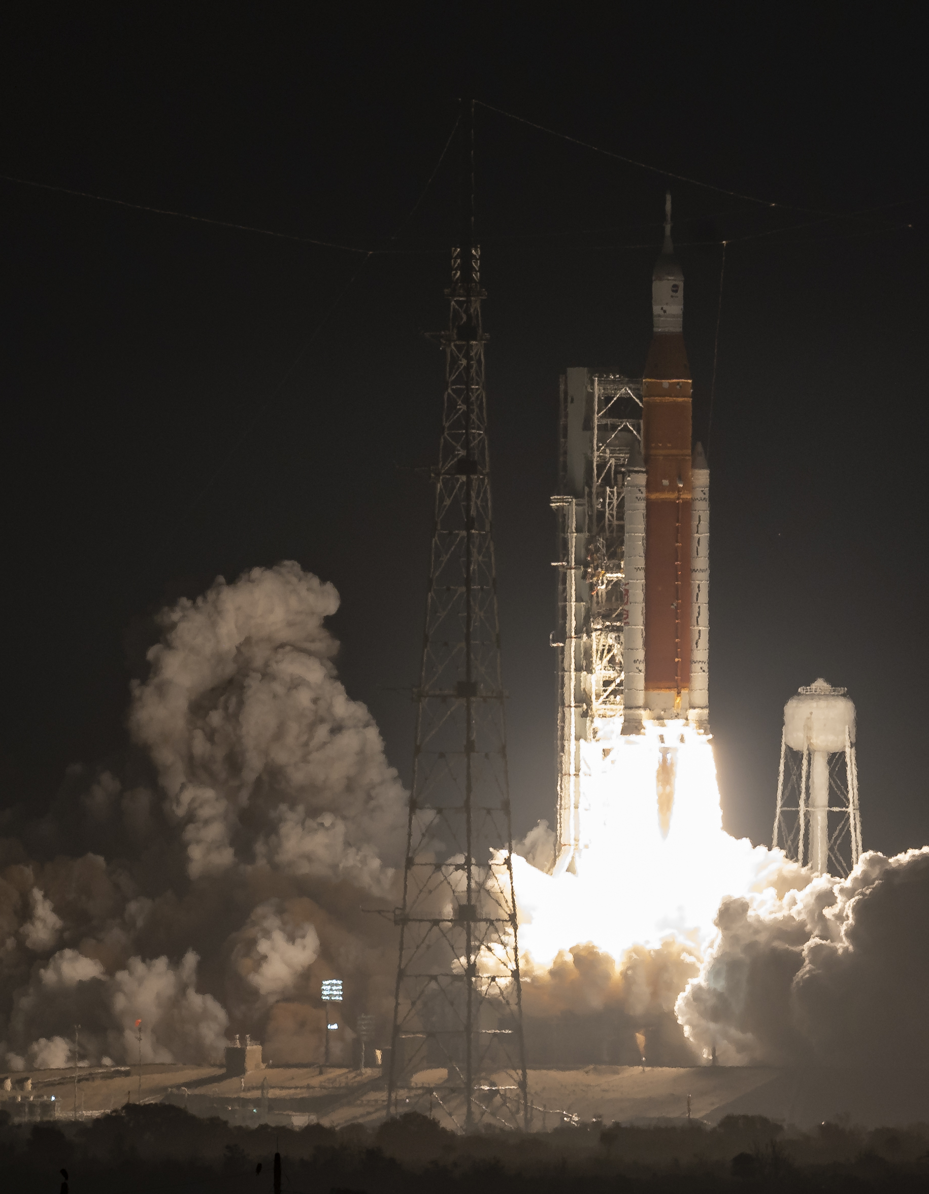
Galileo University
Modeling and
simulation of
a rocket
Stability, coupling
and gain selection
José Barreno · Luis Guzmán
Byron García · José Rivera
Systems Theory II
Notes:
Suggested duration: 30 seconds
We studied a linear rocket model in the pitch plane. Our central question was how to control acceleration and attitude when both actions affect each other. I will explain the model, the tests we performed, and how we used the results to choose the gains and sampling period. The photograph provides context and does not identify a vehicle with the parameters of this model.
Sources: Reporte_ES.pdf, p. 1. Photograph: NASA/Bill Ingalls, Artemis I. https://www.planetary.org/space-images/artemis-i-launch

Slide 2
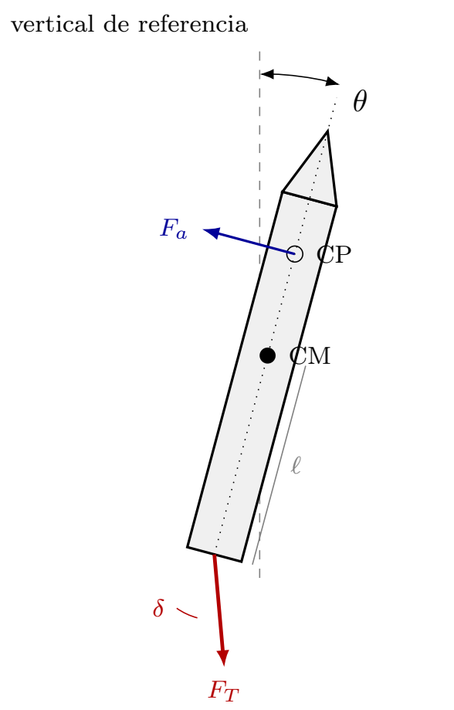
The physical problem
Accelerating while controlling attitude
Vertical reference
Two commands: axial acceleration and pitch
Two main outputs: a and θ
Each command also affects the other channel
Scope: pitch motion during a short ascent interval
02 / 19
Notes:
Suggested duration: 50 seconds
The rocket must follow an acceleration reference and an attitude reference. The nozzle changes the thrust direction to create a control moment. Tilting the vehicle also changes the acceleration represented by our model. In addition, thrust misalignment can induce rotation. This makes the rocket a system with two inputs and two outputs. In the figure, point out the center of mass, the center of pressure and the nozzle deflection. Our scope is a short ascent interval and motion in the pitch plane.
Sources: Reporte_ES.pdf, pp. 1–3. proyectoCohete.pdf, p. 2, Figure 2.

Slide 3
Model and variables
Four states describe the dynamics
State | Meaning
a | Axial acceleration
θ | Pitch angle
ω | Angular rate
δ | Actual nozzle deflection
dx/dt = Ax + Bu
y = Cx
Small angles
Constant mass and inertia
Rigid vehicle
Engine and servo time constants describe gradual responses.
A: 4 × 4 B: 4 × 2 C: 2 × 4 D = 0
03 / 19
Notes:
Suggested duration: 65 seconds
We selected four states: axial acceleration a, pitch angle theta, angular rate omega and actual nozzle deflection delta. The main outputs are a and theta. The IMU can also provide omega, although our observability analysis includes cases in which we use only one output. Input u1 is an axial reference and u2 is an angular reference. Interpreting u1 as a percentage requires a defined normalization. We assume small angles, constant mass and inertia, and a rigid vehicle. These assumptions give us a linear model with four states. The complete equations appear in the backup slides. Matrix A describes internal dynamics, B maps the commands, and C selects the measured outputs. Their dimensions are four by four, four by two and two by four. D is zero, so a finite command has no direct instantaneous feedthrough.
Sources: Reporte_ES.pdf, pp. 2–3. proyectoCohete.pdf, pp. 3–4.

Slide 4
Physical meaning of the equations
Each state equation represents a physical balance
Equation | Physical role
da/dt | Engine response, axial command and gravity coupling
dθ/dt | Angular rate accumulates into pitch angle
dω/dt | Destabilizing aerodynamics, damping and control torques
dδ/dt | Servo response with angle and angular-rate feedback
The term μθ promotes rotation. Nozzle feedback and damping oppose it.
04 / 19
Notes:
Suggested duration: 60 seconds
Each differential equation tells us how one state changes. The acceleration equation combines engine response, the axial command and gravitational coupling. The angle equation is the integral of angular rate. The angular-rate equation balances the destabilizing aerodynamic contribution against damping and the torques produced by the nozzle and thrust misalignment. The nozzle equation includes servo response and feedback from angle and angular rate. K1 affects the axial correction. K2 affects the steering correction, while lambda weights the angular-rate contribution. Keeping delta as a state allows us to study servo lag and nozzle excursion. The full equations remain in the backup slides.
Sources: Reporte_ES.pdf, p. 2, equations (1)–(4). TSII-PROJECT-NB.ipynb, cell 11.

Slide 5
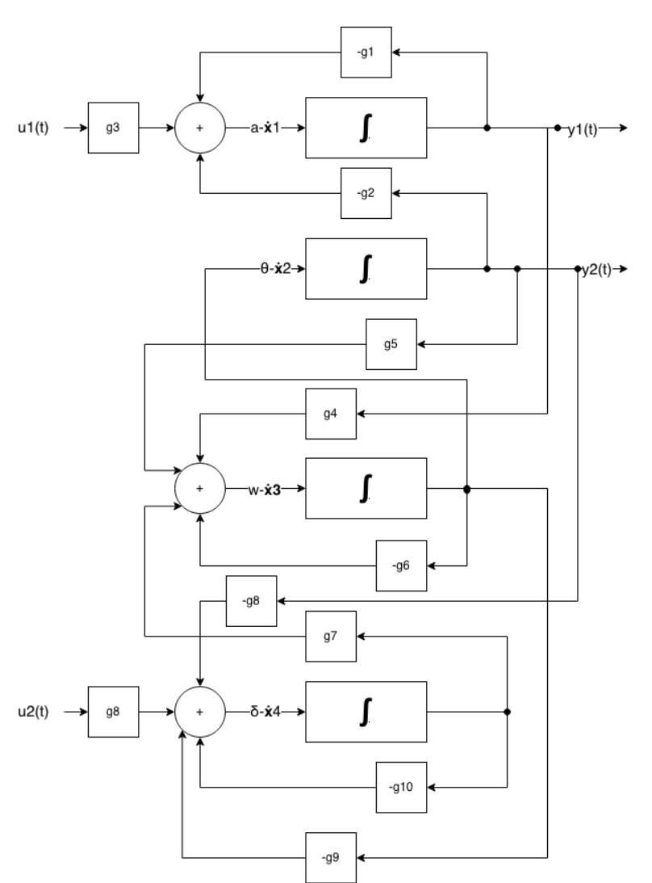
Method
We built the model and checked each signal path
01 States and transfer matrix
02 Poles and time responses
03 Frequency response, sensors and actuators
04 Gains and digital controller
K₁: axial correction
K₂: attitude correction
05 / 19
Notes:
Suggested duration: 55 seconds
We started with the equations, constructed A, B and C, and checked that the four-integrator diagram represents each signal path. Every integrator accumulates the derivative of one state. We then calculated the transfer matrix and eigenvalues. We simulated a pulse, a sine wave and an impulse, applying each to u1, to u2 and to both inputs. Finally, we compared gains against quantitative limits and separated the continuous plant from the digital controller to study sampling. K1 acts on the engine channel and K2 on attitude correction. The calculations used NumPy, SciPy and SymPy, while the report used Matplotlib for its figures. The notebook applies each of three signal types to three input configurations, giving nine cases. Its plots show acceleration and pitch on separate vertical axes because the units differ.
Sources: Reporte_ES.pdf, pp. 2–5, Figure 2.

Slide 6
Stability
Asymptotic stability: deviations from equilibrium decay over time
All nominal poles
have negative real parts
K₁ = 1
Threshold: K₂ ≈ 0.081
K₂ = 0
One positive pole: +0.557
Attitude feedback stabilizes the model with the controller studied
06 / 19
Notes:
Suggested duration: 70 seconds
Asymptotic stability means that deviations from equilibrium decay over time. In this project, we seek asymptotic stability: deviations from equilibrium should decay. All four nominal poles have negative real parts. The complex pair explains the oscillation, while the pole near minus seventeen is mainly associated with the servo. We also used Routh–Hurwitz and a gain sweep. For K1 equal to one, the K2 threshold is approximately 0.081. When K2 is zero, a positive pole of approximately 0.557 appears. Attitude feedback therefore stabilizes the original controller under these conditions. Stability alone still does not guarantee a fast response or satisfactory tracking.
Sources: Reporte_ES.pdf, pp. 4–5. Calculation from the nominal equations.

Slide 7
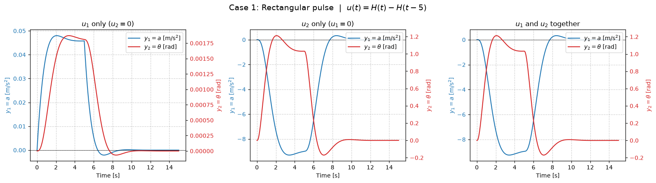
Pulse: the channels interact
The same pulse applied to each input and to both
Tilting the rocket reduces a. Both commands combine by superposition.
After 5 s, the command turns off and the outputs decay toward zero.
Notebook figure (non-editable image). Nominal (1, 0.5). Unit inputs. Blue: a (left). Red: θ (right).
07 / 19
Notes:
Suggested duration: 60 seconds
This is the original rectangular-pulse figure saved in the notebook. Read it from left to right: u1 alone, u2 alone and both inputs together. Blue is acceleration on the left axis. Red is pitch on the right axis. The axes have different units and scales, so curve heights do not give coupling percentages directly. The u1 case mainly accelerates the vehicle and also produces a small pitch response through thrust misalignment. The u2 case strongly changes acceleration through the gravity term. Simultaneous responses add because the model is linear. At five seconds the command turns off and the outputs decay. These are formal unit-input tests.
Sources: TSII-PROJECT-NB.ipynb, cell 16, saved PNG output. Nominal parameters in cell 11. Simulation helper in cell 15.

Slide 8
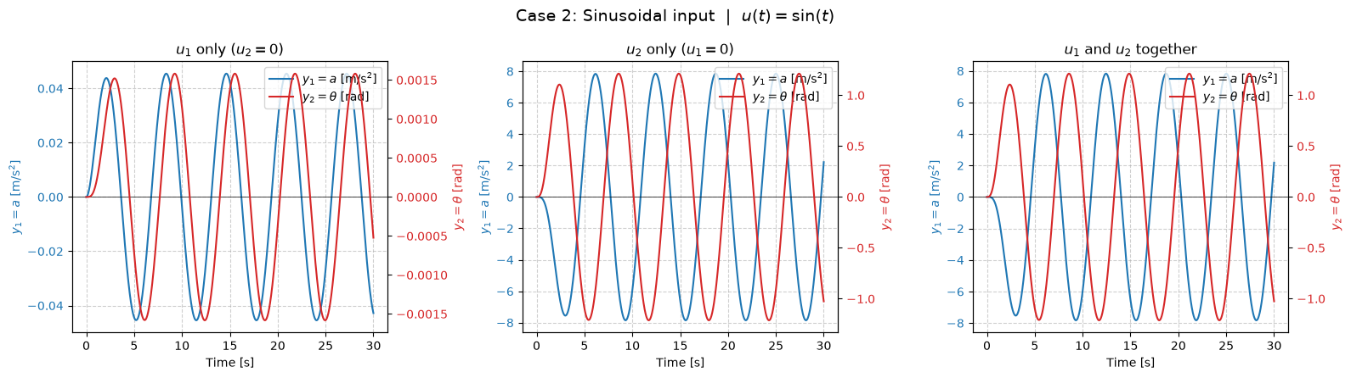
Sine wave: amplitude and phase
At ω = 1 rad/s, the period is 2π seconds
After the transient, both outputs oscillate at the input frequency.
For u₂ only: |G₁₂(j1)| ≈ 7.85 and |G₂₂(j1)| ≈ 1.21.
Notebook figure (non-editable image). Nominal (1, 0.5). Unit inputs. Blue: a (left). Red: θ (right).
08 / 19
Notes:
Suggested duration: 55 seconds
This original notebook figure uses sin(t), so the angular frequency is one radian per second and the period is about 6.28 seconds. After the initial transient, both outputs keep oscillating at that frequency. Their amplitudes and relative phases depend on the transfer functions. In the u2-only case, the axial amplitude is approximately 7.85 and the pitch amplitude is approximately 1.21 for a unit command. These are frequency-response gains at one radian per second, rather than static gains. This connects the time simulation with the frequency analysis. The simultaneous-input panel again shows the combined response.
Sources: TSII-PROJECT-NB.ipynb, cell 17, saved PNG output. Nominal G(j1) from the stated model.

Slide 9
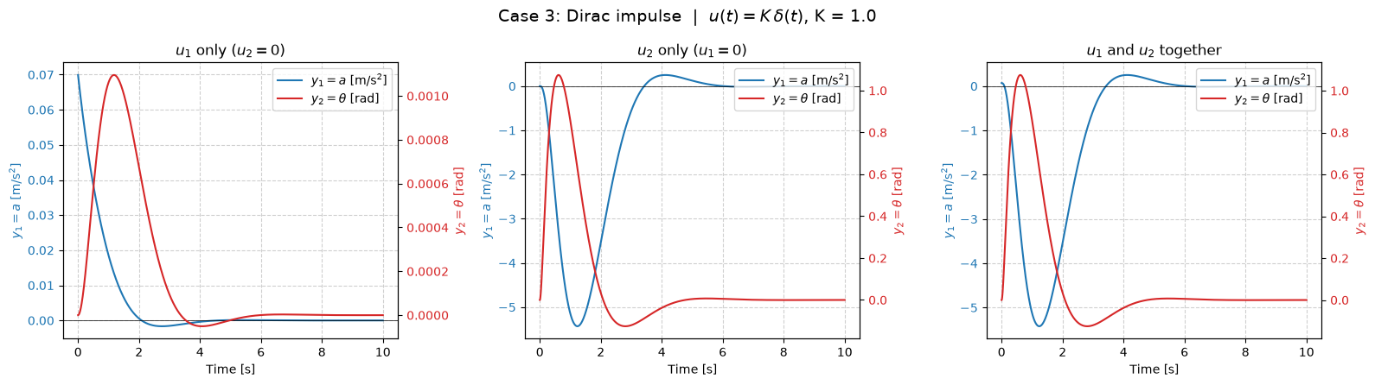
Impulse: natural modes decay
A brief ideal input reveals the transient dynamics
An axial impulse gives a an immediate jump of about 0.070.
The remaining response decays with the stable nominal modes.
Notebook figure (non-editable image). Nominal (1, 0.5). Unit inputs. Blue: a (left). Red: θ (right).
09 / 19
Notes:
Suggested duration: 55 seconds
The impulse is an ideal brief excitation that helps expose the natural dynamics. This figure again compares the two individual input channels and their simultaneous action. The nominal poles make the responses decay toward zero. An impulse in u1 gives acceleration an immediate state jump of about 0.0699. This is consistent with D equal to zero: D excludes direct feedthrough for a finite command, while a Dirac input can change the state by its area multiplied by B. The other response paths pass through additional dynamics. Use the figure to identify decay and oscillation, rather than treating a unit angular excitation as a physically valid large-angle maneuver.
Sources: TSII-PROJECT-NB.ipynb, cell 18, saved PNG output. State-space matrices in cell 11.

Slide 10
Coupling in time
Pitch dominates
the cross-channel effect
Peak axial deviation:
≈ 0.812 m/s²
Main axial response:
≈ 0.459 m/s²
Comparison for u₁ = 10 in model units and u₂ = 5°
10 / 19
Notes:
Suggested duration: 70 seconds
To compare outputs with different units, we fixed the test amplitudes: u1 equals ten in the model scale and u2 equals five degrees. We applied each step separately. The axial command produces a final acceleration of 0.459 meters per second squared. The angular command produces a maximum acceleration reduction near 0.812. Their ratio gives 177 percent. In the reverse direction, the axial command produces about one degree of pitch deviation, compared with the 5.20-degree main response, giving 20.6 percent. These percentages describe the chosen test amplitudes, rather than universal constants of the vehicle.
Sources: Reporte_ES.pdf, pp. 6–7, Table III and Figure 10. Definition: maximum absolute cross-output response divided by the absolute final main-output response.

Slide 11
Frequency response
Channel | BW (rad/s)
G₁₁ | 2.06
G₁₂ | 1.39
G₂₁ | 1.39
G₂₂ | 2.26
Interactions matter within the useful tracking bandwidth
Nominal: both cross-channel ratios fall below 10% for ω > 7.36 rad/s
11 / 19
Notes:
Suggested duration: 65 seconds
Frequency response shows how tracking changes as commands vary more rapidly. The graph presents the magnitudes of the two main channels, normalized by their low-frequency gains. We define bandwidth at the minus-three-decibel crossing. The nominal bandwidth is about 2.06 radians per second for acceleration and 2.26 for pitch. The cross-channel bandwidths are near 1.39. Interactions remain important in the useful tracking band. In the nominal case, both normalized cross-channel ratios fall below ten percent only above 7.36 radians per second, where the direct responses already have substantial attenuation.
Sources: Reporte_ES.pdf, pp. 7–9, Figures 11–13. Nominal G(jω), magnitude relative to G(0).

Slide 12
Observability
Can we reconstruct the states from measurements?
Observable: known inputs and measured outputs reveal the internal state
Measurements used | Rank of O
Acceleration a only | 4
Angle θ only | 4
Acceleration and angle | 4
O = [C; CA; CA²; CA³]
Rank 4:
all four states
are observable
Accuracy in noise requires normalization and a sensor model
12 / 19
Notes:
Suggested duration: 65 seconds
In physical terms, observability lets us infer the internal motion from a history of measured outputs and known commands. Observability asks whether we can reconstruct the states from known inputs and the history of measurements. We form the matrix using C, CA, CA squared and CA cubed. Its rank must be four. We obtained rank four with both sensors, with acceleration alone and with angle alone. Coupling allows unmeasured states to leave information in the measured output. This supports designing an observer for omega and delta. Rank describes an ideal mathematical property. Accuracy in noise requires consistent scales and a sensor model. Unnormalized singular values alone do not establish a physical sensitivity factor.
Sources: Reporte_ES.pdf, p. 9, Table IV. Rank conclusions are retained with a precise interpretation of sensitivity.

Slide 13
Controllability
Which states can the inputs reach?
Controllable: inputs can move the state between arbitrary conditions in finite time
Scenario | Rank
Both inputs | 4
One external command, nominal A | 4
Jammed servo | 3
K₂ = 0 | 3
M = [B AB A²B A³B]
Jammed servo:
δ remains fixed
The original controller is unstable under the steering failures studied
13 / 19
Notes:
Suggested duration: 65 seconds
Controllability concerns reaching arbitrary states through suitable inputs in finite time, within this ideal model. Controllability asks whether the inputs can move the state to any desired condition within the ideal model. With both inputs, the rank is four. If we remove only an external command while retaining the nominal feedback, the rank also remains four. A physical servo failure is different. Setting the derivative of delta to zero reduces the full-system rank to three. We cannot move the jammed nozzle, and the original controller leaves an unstable mode. That does not prove that no redesigned ideal controller could stabilize the remaining three states. Actual engine authority and saturation would need to be checked. Distinguishing a missing command from a physical failure avoids an incorrect conclusion.
Sources: Reporte_ES.pdf, p. 9, Table V. Nominal A for loss of an external command. Last row of A set to zero for a jammed servo.

Slide 14
Gain selection
Design limits
Overshoot ≤ 10%
Settling time ≤ 3 s
Final error ≤ 5%
Deflection ≤ 5°
G₁₁(0) > 0
Grid search: 2400 pairs. The recommended region contains specific gain pairs
14 / 19
Notes:
Suggested duration: 70 seconds
Stability left us with many candidates. We selected design limits of ten percent pitch overshoot, three seconds settling time, five percent final error, five degrees maximum nozzle deflection, and positive static axial gain. We evaluated a grid of 2400 gain pairs. The feasible region meets these limits. Within it, we prefer pairs whose worst coupling is close to the smallest feasible value. The figure reproduces that region using the stated criteria. The outer ranges of K1 and K2 do not imply that every point within a rectangle is equally suitable. We selected K1 equal to 4.5 and K2 equal to 1.3, which meets the criteria.
Sources: Reporte_ES.pdf, pp. 10–11, Figure 15. Region reproduced from the equations and stated criteria, without using the feasible-point count as a conclusion.

Slide 15
Performance comparison
Chosen point: K₁ = 4.5 and K₂ = 1.3
Metric | Nominal | Chosen
Overshoot | 16.39 % | 0.82 %
Settling time | 3.64 s | 1.62 s
Final error | 4.03 % | 3.25 %
Nozzle peak | 2.01° | 4.49°
Coupling: 177% / 21% nominal and 31% / 28% at the chosen point
Overshoot and settling use the final value. Nozzle peak uses both steps
15 / 19
Notes:
Suggested duration: 80 seconds
Here we compare the nominal and recommended pitch responses to a five-degree command. The recommended response has less overshoot and reaches its final value sooner. Overshoot falls from 16.39 to 0.82 percent. Settling time decreases from 3.64 to 1.62 seconds. The final error stays below five percent. The tradeoff is nozzle deflection, which rises from about two degrees to 4.49, close to the five-degree limit. Coupling into acceleration drops from 177 to 31 percent, while the reverse coupling rises from 21 to 28 percent. This is a compromise among design criteria. We measure overshoot relative to the final value and final error relative to the command.
Sources: Reporte_ES.pdf, pp. 10–11, Table VI. Graph: u2 = 5° step and u1 = 0. Peak nozzle excursion: both test steps applied simultaneously.

Slide 16
Sampling and delay
20 updates/s
Chosen T
0.05 s
Maximum T with delay
≈ 0.114 s
The limit is ≈ 2.27 times the chosen period under the assumed delay model
16 / 19
Notes:
Suggested duration: 80 seconds
We then checked whether a computer updating every 0.05 seconds can implement the chosen gains. This corresponds to twenty updates per second. We separated the continuous plant from the controller, held commands with a zero-order hold, and included a one-sample delay. The stability limit for the selected point is approximately 0.1135 seconds with delay. Its ratio to the chosen period is 2.27. At T equal to 0.10 seconds, the response oscillates more and takes around seven seconds to settle, but it remains stable. The result depends on this delay model. The graph shows output samples. The actuator command is the signal held between updates.
Sources: Reporte_ES.pdf, pp. 11–12, Table VII and Figures 16–18. Plant discretized using a zero-order hold, with a delay of exactly one sample.

Slide 17
Variable mass
Fuel consumption changes the dynamics
ρ = m₀ / m(t)
dx/dt = A(t)x + B(t)u
Proposed gain schedule:
Kᵢ(t) = Kᵢ₀ / ρ
Results use frozen coefficients and the scaling assumed in the report
17 / 19
Notes:
Suggested duration: 50 seconds
Mass and inertia change as the rocket consumes fuel, making the model matrices depend on time. The report explores frozen coefficients using rho, defined as initial mass divided by current mass. Under that scaling, reducing the mass to half its initial value lowers the maximum stable sampling period with delay from about 0.114 to 0.058 seconds if gains remain fixed. Dividing the gains by rho recovers a limit near 0.123 seconds. This is a proposal under the assumptions of that extension. Frozen poles do not establish stability for the full flight, and the physical balance of a vehicle expelling gas requires a vehicle-specific formulation.
Sources: Reporte_ES.pdf, pp. 12–13, Figure 20. Values depend on the report's frozen-coefficient scaling. Variable-mass balance: NASA TN D-1838, Section III. https://ntrs.nasa.gov/api/citations/19630009857/downloads/19630009857.pdf?attachment=true

Slide 18
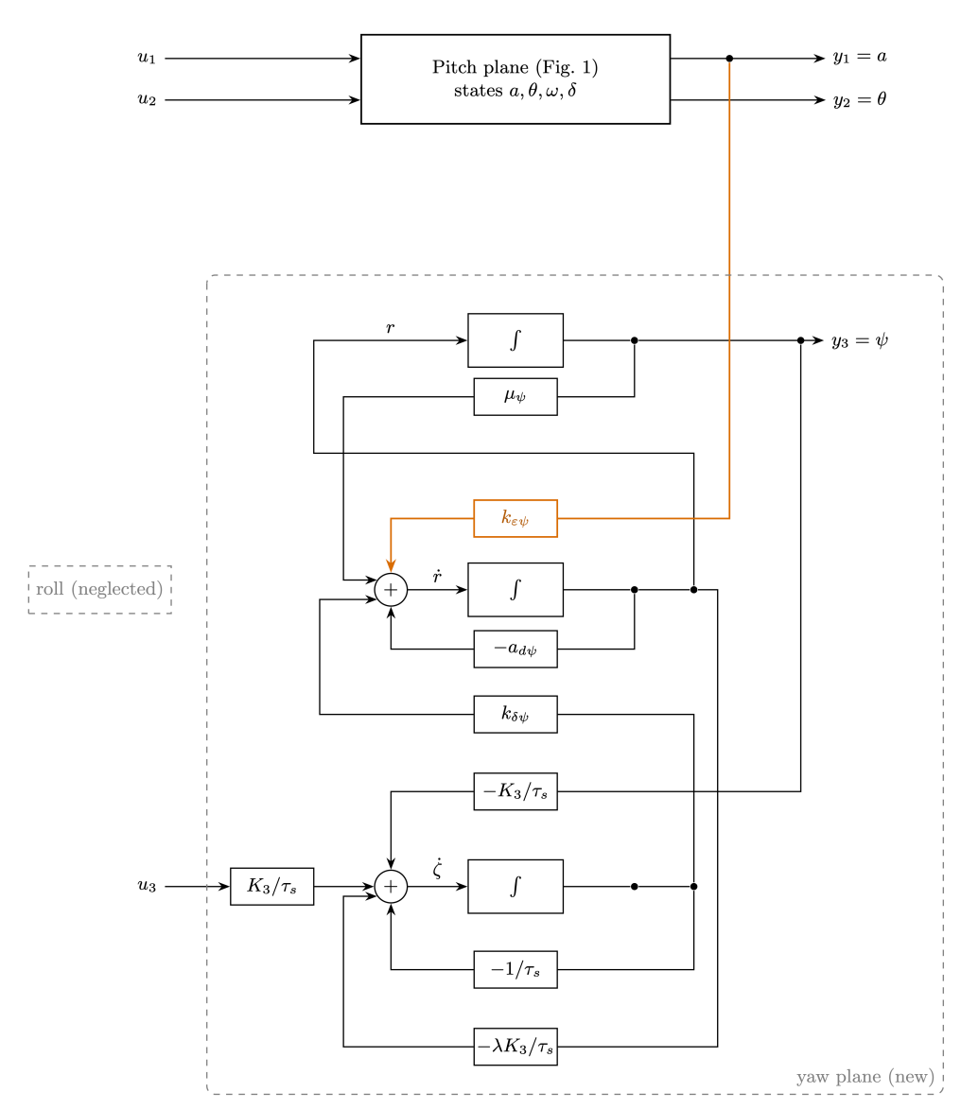
Yaw
A third channel for lateral attitude
Additional states
ψ, r and ζ
7 states
3 inputs and 3 outputs
Acceleration perturbs yaw
in the proposed extension
18 / 19
Notes:
Suggested duration: 45 seconds
To include lateral attitude, we add the yaw angle psi, its angular rate r and lateral nozzle deflection zeta. This gives seven states, three inputs and three outputs. In the proposed model, acceleration enters the lateral rotational balance. This is the only link between the blocks: thrust and pitch can perturb yaw, while the lateral command does not feed back into pitch within these equations. The matrix is block triangular, so its eigenvalues combine those of both blocks. This remains a simplified extension, excluding roll and full three-dimensional dynamics.
Sources: Reporte_ES.pdf, pp. 13–14, equations (8)–(9) and Figure 21.

Slide 19
Conclusions
The chosen gains improve the pitch response
Result | Recommended point
Gains | K₁ = 4.5 K₂ = 1.3
Overshoot / settling time | 0.82 % / 1.62 s
Coupling | 31 % / 28 %
Sampling period | 0.05 s
Acceleration and attitude require a combined analysis
19 / 19
Notes:
Suggested duration: 45 seconds
The main finding is that acceleration and attitude require a combined analysis. Attitude feedback stabilizes the model, but stability alone did not determine our design. The selected gains improve overshoot and settling time while requiring greater nozzle excursion. We also checked state reconstruction and showed that physical failures change the reach of the inputs. Finally, the 0.05-second sampling period is stable under the digital model studied, with margin below the calculated limit. These conclusions apply to the linear model, the chosen test amplitudes and the design limits we adopted.
Sources: Reporte_ES.pdf, pp. 13–14. Summary of verified results.

