Slide 1
Paper 1 Model Diagram
6/10/2024

Slide 2






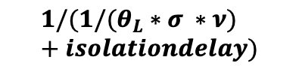




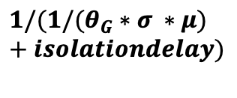
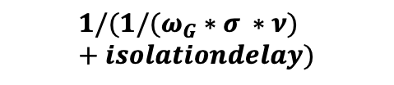


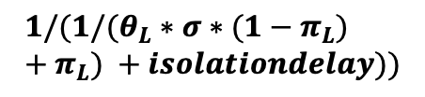
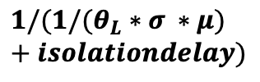





Infectious, Asymptomatic LW
$ε_{IAL}$
Susceptible
Lab Worker (LW)
$$λ_{L}$$
Exposed, Not Infectious LW
$ε_{L}$
Infectious, Pre-Symptomatic LW
$$δ$$
Infectious, Symptomatic, LW
$θ_{L}∗σ$
$$γ_{IAL}$$
$${1/(1/(θ}_{L}∗σ ∗μ)+isolationdelay)$$
$${1/(1/(θ}_{L}∗σ ∗ν)+isolationdelay)$$
$$1/(1/(θ_{L}∗σ∗(1−π_{L})+π_{L}) +isolationdelay))$$
$$γ_{L}$$
Removed
Exposed, Not Infectious, Isolated
Infectious, Pre-symptomatic, Isolated
$$δ$$
Symptomatic or Asymptomatic, Isolated
$ε_{L}$
$$γ_{IS}$$
$$γ_{G}$$
$${1/(1/(θ}_{G}∗σ ∗μ)+isolationdelay)$$
$${1/(1/(ω}_{G}∗σ ∗ν)+isolationdelay)$$
$$1/(1/(χ_{G}∗σ∗(1−π_{G})+π_{G}) +isolationdelay))$$
$$γ_{IAG}$$
Susceptible General Population (GP)
$$λ_{G}$$
Exposed, Not Infectious GP
$ε_{L}$
Infectious, Pre-Symptomatic GP
$$δ$$
Infectious, Symptomatic, GP
$ε_{IAG}$
Infectious, Asymptomatic GP
Notes:
Put this in the appendix, show a simplified slide just with the blue diagram
Show a separate slide with simplified equations showing why the params mattter

