Slide 1
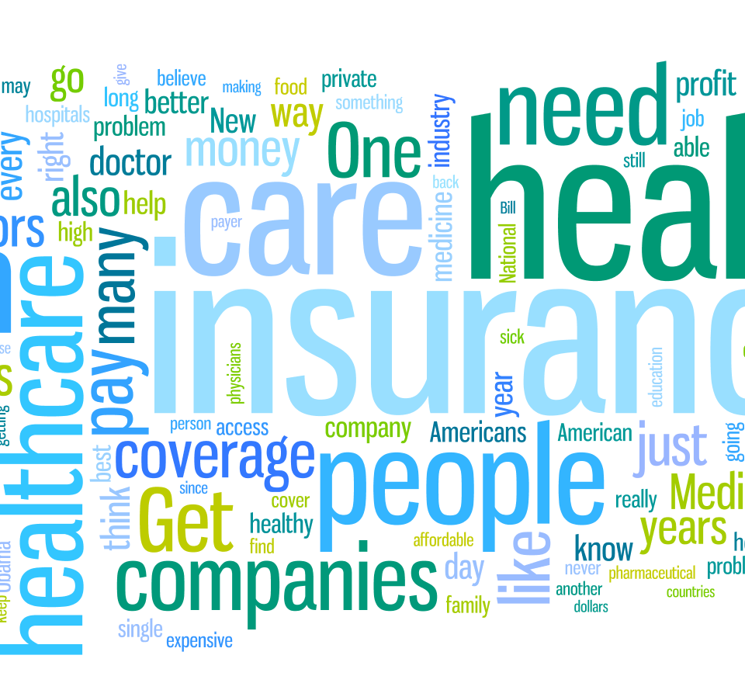
An Appeal for Data: Classifying Medical Appeals

Slide 2
Overview
Definition:
A medical appeal is an official request for reconsideration of a previous denial issued by the BCBSKC medical management department. Appeals can be submitted by providers or members.
Business Request:
The compliance department would like to create reports that can be used to explain what types of denials are causing appeals and whether or not the denials are effective (i.e. whether denials are being upheld or overturned).
The compliance manager has spent hours classifying appeals from 2017 manually, but still has thousands of records left to classify. She has asked if it would be possible to use the sample of records that she has classified (3,247 records) to determine how the other records from 2015 to 2017 should be classified.

Slide 3
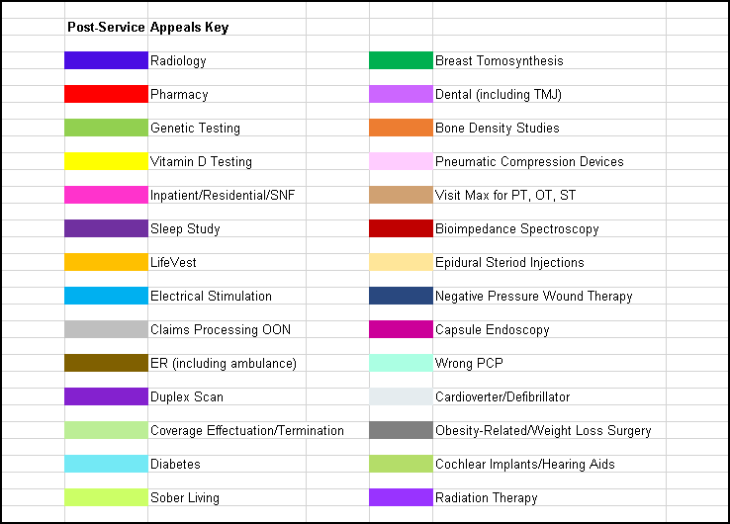
The Data
28 Categories
3,247 Records

Slide 4
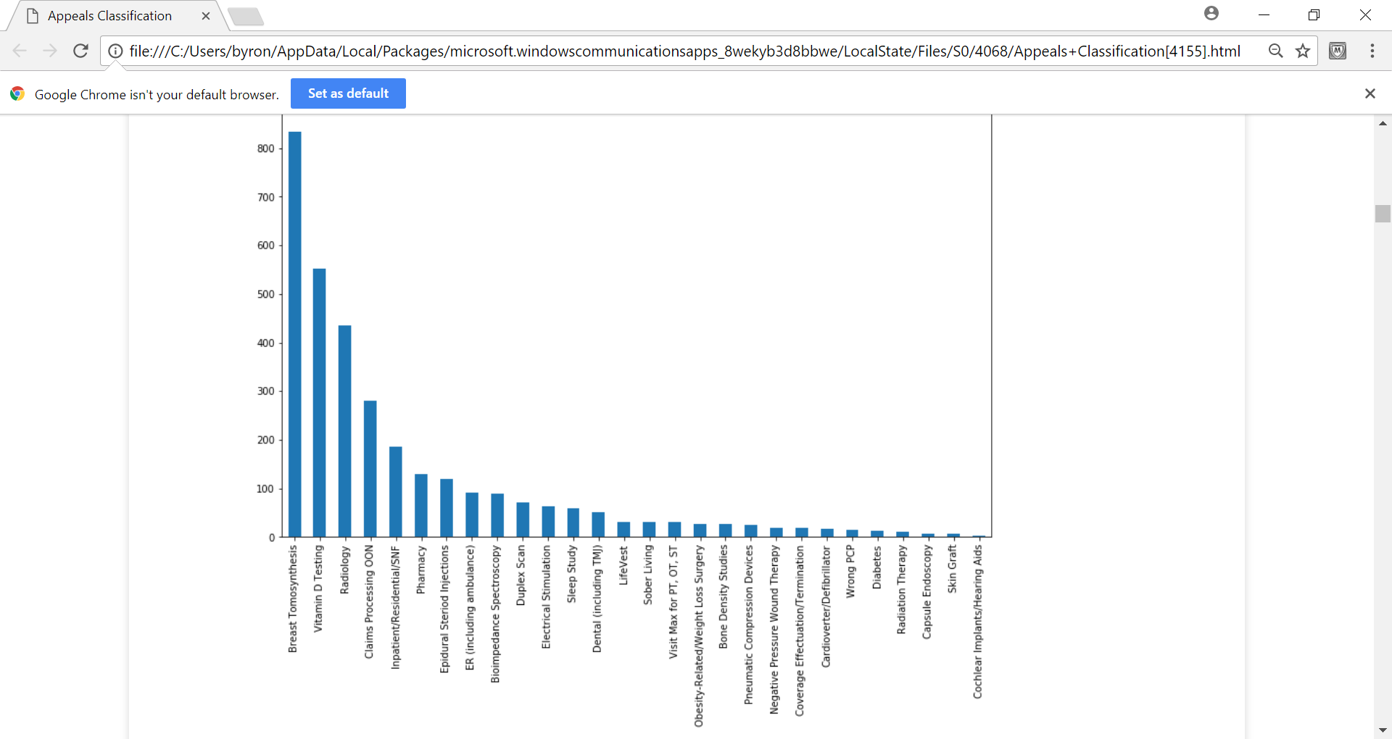
The Data Continued

Slide 5
Data Processing
Stop Words
("of", "dos", "denial", "appeals", "mbr", "behalf", "for", "the", "member", "provider", etc)
Remove Dates
Word Replacement
03.29.16
03/29/16
3/29/2016
'gcm':'diabetes', 'cgm':'diabetes', 'gcms':'diabetes', 'glucose':'diabetes', 'diabetic':'diabetes'
Additional Processing:
Word Counts
Single Words (bag of words)
Exclude words that are in 90% of the appeals records (max_df)

Slide 6
Model Performance
Model | Accuracy
Decision Tree initial | 0.860513
Logistic Regression initial | 0.908718
K Nearest Neighbors initial (k=3) | 0.776410
Logistic Regression 80/20 | 0.912308
Decision Tree 80/20 | 0.867692
Logistic Regression 80/20, binary = True | 0.912308
Logistic Regression 80/20, ngrams | 0.912308
Decision Tree 80/20, ngrams | 0.867692
Random Forest 80/20, ngrams | 0.886154
Logistic Regression 80/20, word replace | 0.913846

Slide 7
Metrics from Best Model
Logistic Regression
91% Accuracy
91% Precision
91% Recall
Denied Service | precision | Recall | Support
Bioimpedance Spectroscopy | 0.95 | 0.95 | 19
Bone Density Studies | 1 | 0.9 | 10
Breast Tomosynthesis | 0.9 | 1 | 167
Capsule Endoscopy | 1 | 1 | 1
Cardioverter/Defibrillator | 1 | 0.75 | 4
Claims Processing OON | 0.91 | 0.98 | 50
Coverage Effectuation/Termination | 0.5 | 1 | 1
Dental (including TMJ) | 0.92 | 0.79 | 14
Diabetes | 1 | 0.5 | 2

Slide 8
Next Steps
Work with compliance to determine if some categories could be excluded.
1
Diabetes and skin graft appeals will be under represented in reports.
Obtain 2015 & 2016 appeals data and add predictions.
2
Ensure no major changes have been made regarding data entry processes.
Determine frequency of updates until a better process can be utilized to classify the data at the time of entry.
3

