Slide 1
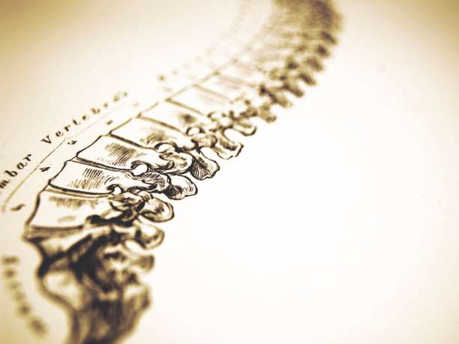
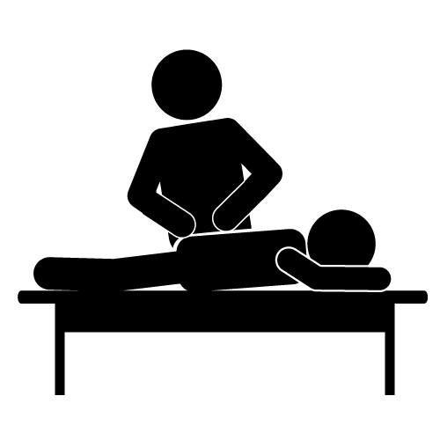
Chiropractic Practice Patterns

Slide 2
Overview
Are there differences in how chiropractors treat their patients?
If yes, what are the primary differences?
Unsupervised Learning Techniques
Hierarchical clustering
K-Means

Slide 3
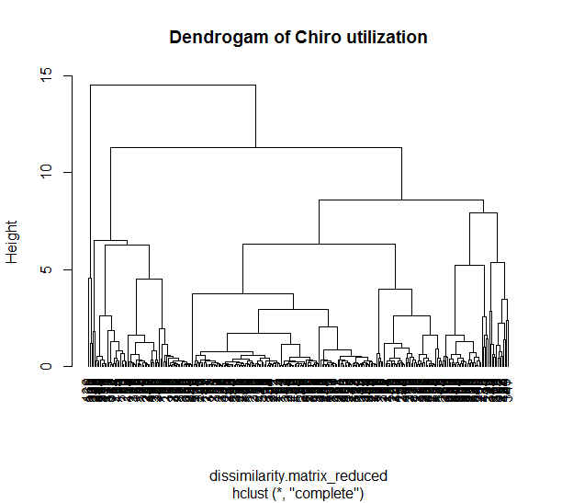
Underlying Data
Prov ID | Acupuncture | Chiro | DME | PT | OP Surg | Other | Lab | X-Rays | Office Visits
3 | 0 | 1.26 | 0 | 0.3 | 0 | 0.23 | 0 | 0 | 0.04
8 | 0 | 1.04 | 0 | 0.1 | 0 | 0.09 | 0 | 0 | 0.07
9 | 0 | 1.56 | 0 | 1.76 | 0 | 0 | 0 | 0 | 0.03
10 | 0 | 1.2 | 0 | 2.1 | 0 | 0 | 0 | 0.02 | 0.06
14 | 0 | 0.94 | 0 | 4.83 | 0 | 0 | 0 | 0 | 0.02

Slide 4
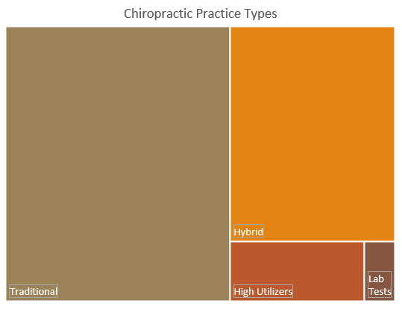
Practice Types
Traditional (168)
Usually 1 chiropractic manipulation
Sometimes therapy
Hybrid (97)
Mix of physical therapy and chiropractic
Usually 2 therapy and 1-2 chiro services
High Utilizers (22)
4 therapy units per visit
2 chiropractic units per visit
Care plans & pain assessments
Some lab
Lab Testers (5)
7 lab tests per visit
Chiro and therapy similar to the hybrid practices

Slide 5
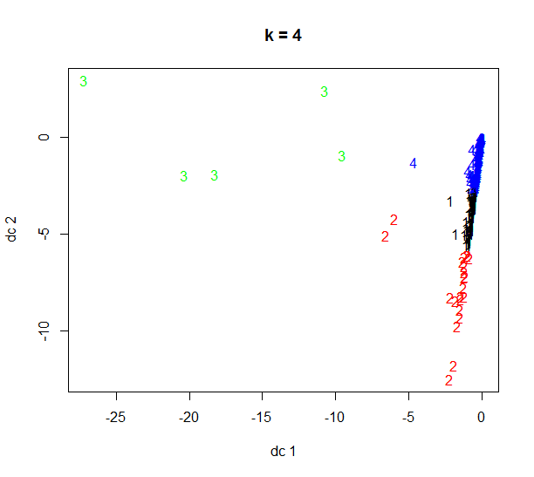
Cluster Graph Separation: .74 Cohesion: .26
1: Hybrids
2: High Utilizers
3: Lab Testers
4: Traditional

Slide 6
Next Steps
Understand the practices that are performing multiple lab tests. Are they treating specific types of patients?
Review the practices that are performing twice as many therapy services as other practices. Is this a billing issue, case mix, or over utilization?
Is there a practice type that has better results than another?

