Slide 1
Do Taxi Cabs Respond to Incentives?
Byron Housten
byron.j.housten@gmail.com
https://github.com/byronhousten/chicago_taxi_trips
https://www.linkedin.com/in/byronhousten/

Slide 2
Executive Summary
Two competing theories on how cab drivers operate¹:
Intertemporal substitution hypothesis – Drivers will work longer on high-wage days
Behavioral economics hypothesis – Higher wages will allow drivers to hit a predetermined quota for that day quickly, therefore working less on a high hourly wage day
19 million taxi rides in 2016 were analyzed, taxis on the road were estimated from the unique taxis that completed at least one trip in the past hour
Results – For every $1 increase in the hourly wage, an additional 43 taxis are estimated to be driving on the road
When specific times during the week were analyzed, this trend – higher wages lead to more taxis operating – remained intact
This lends evidence to support the theory that taxi drivers will keep driving if economic conditions are in their favor

Slide 3
Do taxi cabs drive until they hit a quota and stop? Or… Do they keep driving if they are making more money?
Question

Slide 4
Background
THALER: … And a lot of them would say, well, what we do - I set a target. So renting the cab costs me 100 bucks, and then I have to fill the tank up. Let's say that's another 25 bucks. So I want to make a certain amount above that - say $100. And when I hit that, I go home. Now an implication of that is on days like rainy days, where there's lots of demand, they hit their target early, and they go home…
VEDANTAM: Right, but the interesting thing, of course, is that standard economics would predict that people actually would act rationally - that they would actually work more when the demand is higher, and they would work less when the demand is lower. And of course, what we find is exactly the opposite.
THALER: Exactly.

Slide 5
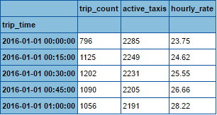
Methodology
19,859,074 taxi rides in 2016
Trips with missing fares were excluded
Trips with $0.00 fares were excluded
Trips greater than $200.00 were excluded
$200.00 is approximately 5 standard deviations above the mean
This excluded unexplainable fares from the data (fares in the thousands) while allowing for a reasonable analysis
Trip times rounded to nearest 15 minutes
Taxis on the road was estimated from counting the unique taxis which completed a trip within the past hour
Hourly rate is total revenue in the past hour divided by unique taxis in the past hour
Sample data

Slide 6
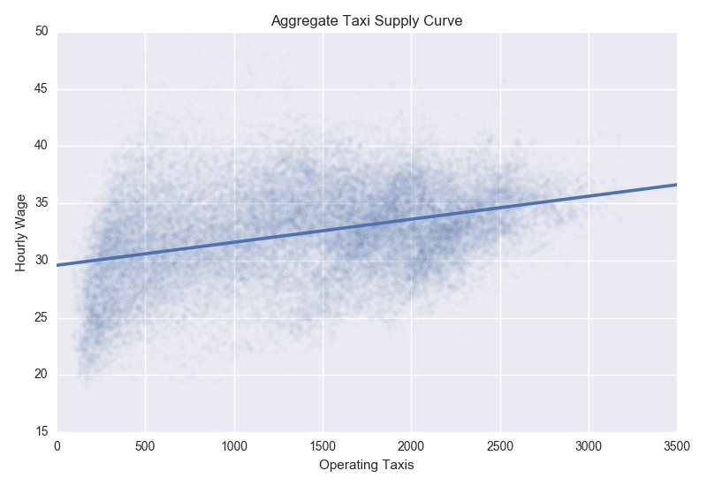
Results
A simple linear regression found that on average, for every $1 increase in the hourly rate of taxis, 63 additional taxis are working.

Slide 7
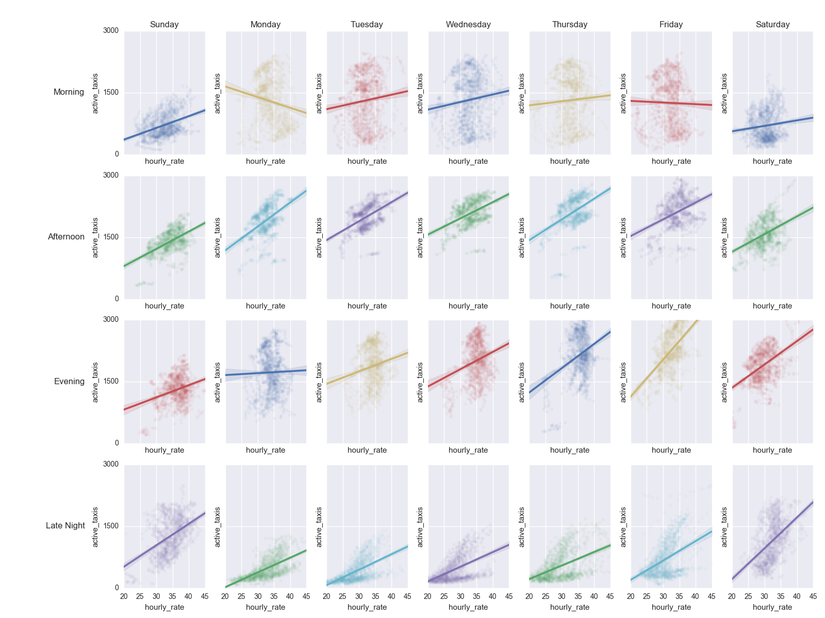
Positively Increasing Supply Curve is Consistent

Slide 8
Limitations
Data was collected per taxi cab
There is no data on the actual drivers
Do not know if a cab is being used by one or multiple drivers
Do not know if the same cab is being used by the same driver(s) on a daily basis
Analysis does not tell how long cabs stay on the road
Imperfect data could lead to skewed results
Possibly legitimate trips over $200
Further analysis could be done with this data set
One idea is to look at daily/weekly revenue on a per cab basis, try to determine any quota targets, and then determine if a cab driver will continue driving past their quota if they are earning a higher hourly wage

Slide 9
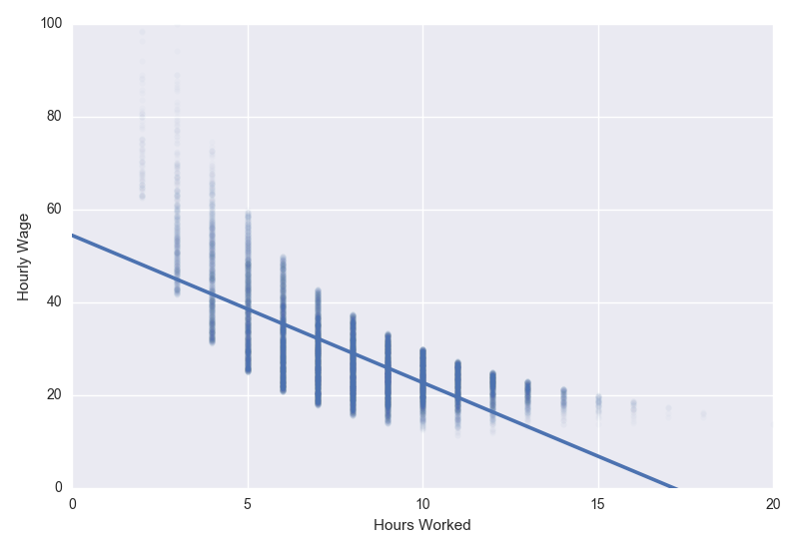
In Contrast to Thaler’s Research
Or, apparently there are multiple ways to build a supply curve
Thaler’s research studied approximately 1800 trip sheets filled out by New York cab drivers
Determined hours worked and average hourly wage per day directly from the trip sheets
Found evidence to support the quota hypothesis:
On high wage days, drivers on average drove fewer hours because they hit their target quota faster
Thaler’s researched focused on individual driver behavior whereas I focused on all cabs working in aggregate since individual driver data was not available
I was able to replicate Thaler’s research with the assumption of a taxi cab being a single driver
Found that drivers did work less hours if the hourly wage was higher

Slide 10
Appendix

Slide 11
Data
105 million trips between 2013-2016
2016 – 19 million trips
Data includes:
Unique trip IDs
Unique taxi IDs
Trip start/end times
Trip duration, length
Fare amount
Payment type
Taxi company
Geolocation data

Slide 12
Data Cleaning
Data Problems:
Imperfect data collection
Geolocation missing values
Trip duration/distance zero values
Fare amount
Missing and zero values
Highly implausible values
Taxis identified by ID – no way to identify actual drivers
Solutions:
Only data problem of concern are fare amounts
Excluded fares with missing or zero values
Excluded fares greater than $200
$200 chosen as exclusion point because it is approximately five standard deviations from the mean

Slide 13
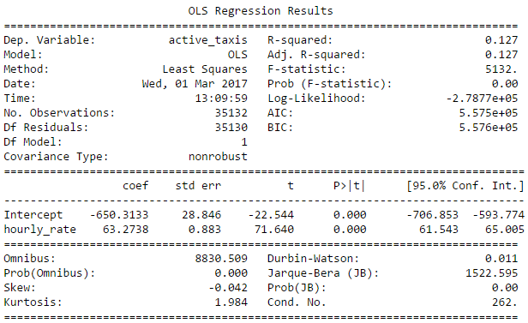
Regression Results for Stats Nerds

Slide 14
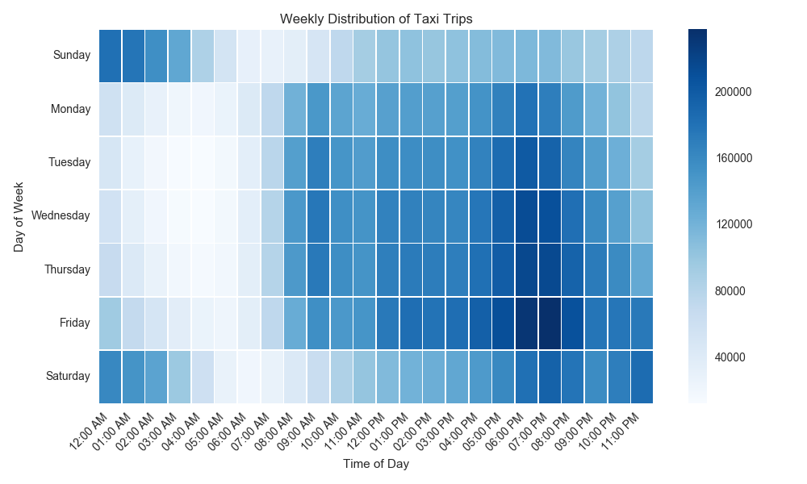
Most trips are taken weeknights & Friday, Saturday nights

Slide 15
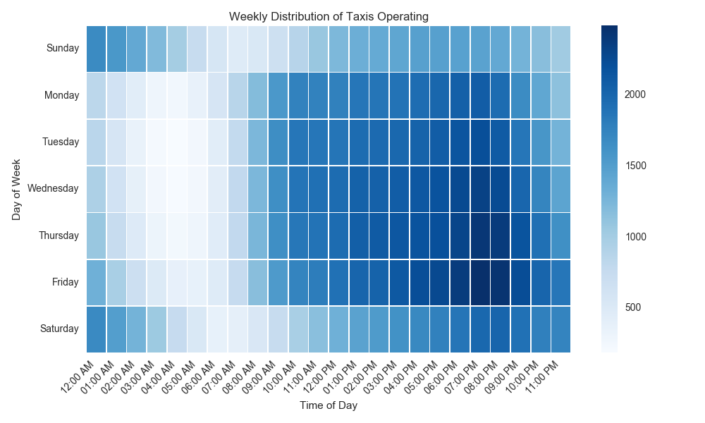
Taxis are on the road to meet trip demand

Slide 16
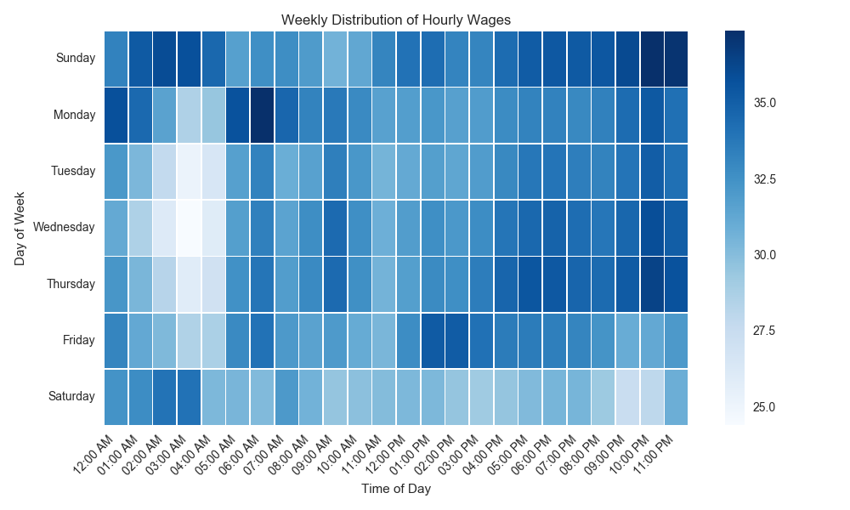
Hourly wages follow no repeating pattern

Slide 17
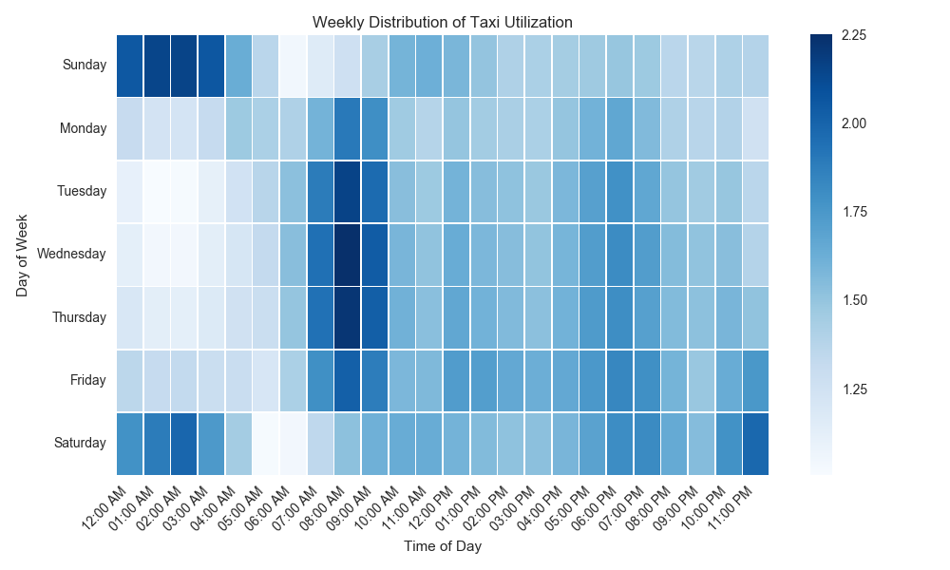
Taxis are busiest weekday mornings, Friday & Saturday night

