Slide 1
Welcome to
CSCI-UA-101 Fall 2021
Intro to Computer Science
Professor Kevin Byron (kbyron@bmcc.cuny.edu)
Department of CS
New York University

Slide 2
CSCI-UA-101 Fall 2021
Intro to Computer Science
Week 0:
Program development cycle
Hello world Java program
Eclipse integrated development environment (IDE)
Command line interface (CLI) navigation
Professor Kevin Byron
Department of CS
New York University

Slide 3
Program development cycle
  What is a computer?
  What is a program?
  Program development cycle
    Understand specifications
    Design logic of solution
    Develop program code
    Test and debug code
    Implement

Slide 4
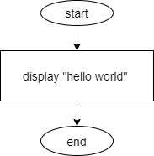
Program development cycle
  Given these specifications:
    Display the message “hello world.” on the console
  This is the logic using a flowchart:

Slide 5
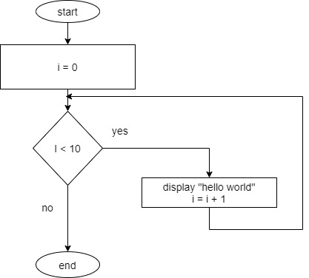
Program development cycle
  Given these specifications:
    Display the message “hello world.” on the console 10 times
  This is the logic using a flowchart:

Slide 6
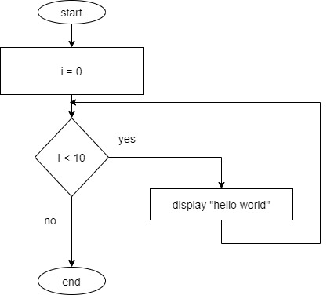
Program development cycle
  Given these specifications:
    Display the message “hello world.” on the console 10 times
  Is there a problem with this logic?

Slide 7
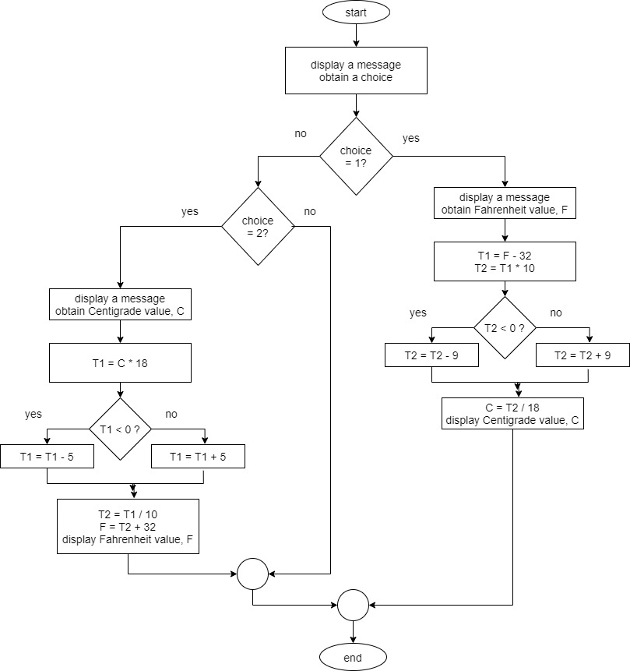
Program development cycle
  Given these specifications:
    Convert a given Fahrenheit temperature to Celsius or a given Celsius temperature to Fahrenheit.
  Is there a problem with this logic?

Slide 8
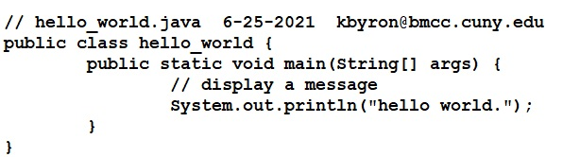
Program development cycle
  Java “source” code to display a message:

Slide 9
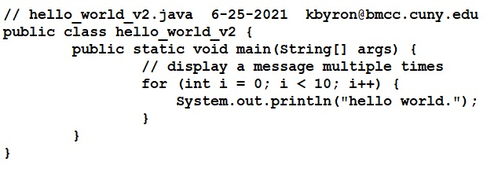
Program development cycle
  Java “source” code to display a message 10 times:

Slide 10
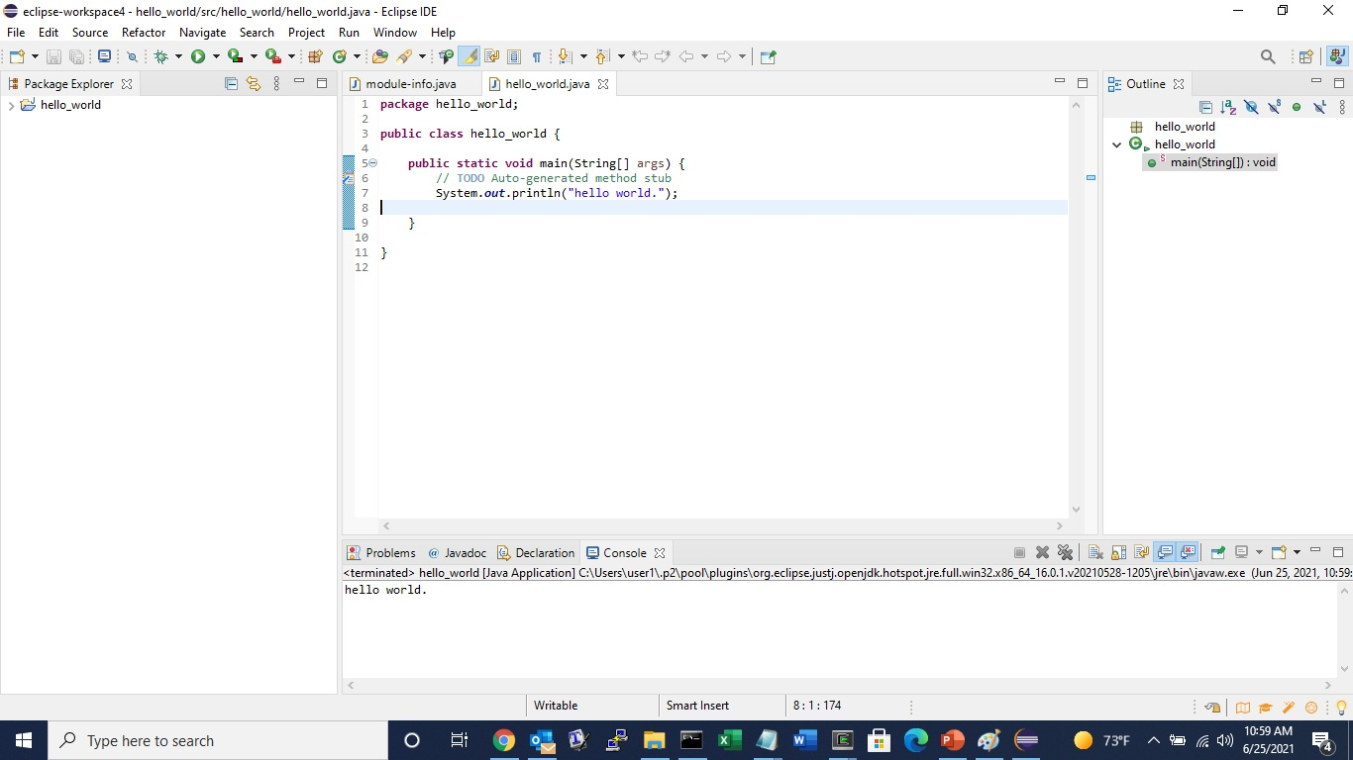
Program development cycle
  Test and debug using Eclipse integrated development environment (IDE)

Slide 11
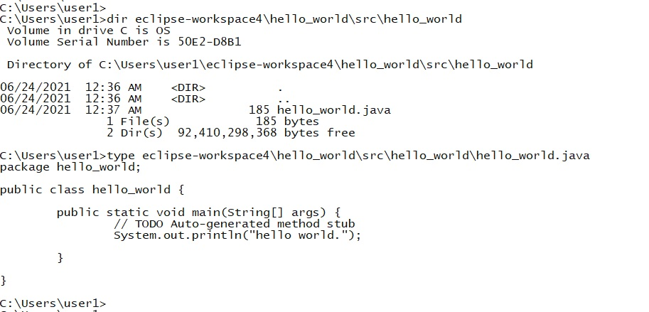
Program development cycle
  Locating source code using command line interface (CLI)

Slide 12
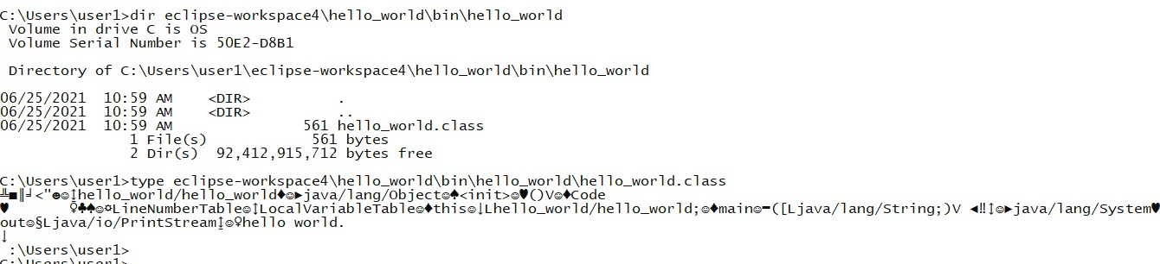
Program development cycle
  Locating executable code using command line interface (CLI)

Slide 13
Assignment
Review video on using Eclipse IDE:
  https://www.youtube.com/watch?v=5h0iAq4W_nc

