Slide 1
Welcome to
CSCI-UA-101 Fall 2021
Intro to Computer Science
Professor Kevin Byron (kbyron@bmcc.cuny.edu)
Department of CS
New York University

Slide 2
CSCI-UA-101 Fall 2021
Intro to Computer Science
Week 0:
Introduction to sorting
Basic sort routines: bubble, insertion, selection
Professor Kevin Byron
Department of CS
New York University

Slide 3
Introduction to sorting
  Sorting fundamentals
  - The ordering of elements in a list is common.
  - Two numeric elements or two string elements are ordered relative to each other.
  - Sorting often precedes searching, e.g., when using a binary search.
  - The sorting algorithm used will determine processing speed.
  Sorting issues to consider
  - choose increasing or decreasing order
  - choose whether equal keys should be swapped
  - for string data, choose case sensitivity vs case insensitivity

Slide 4
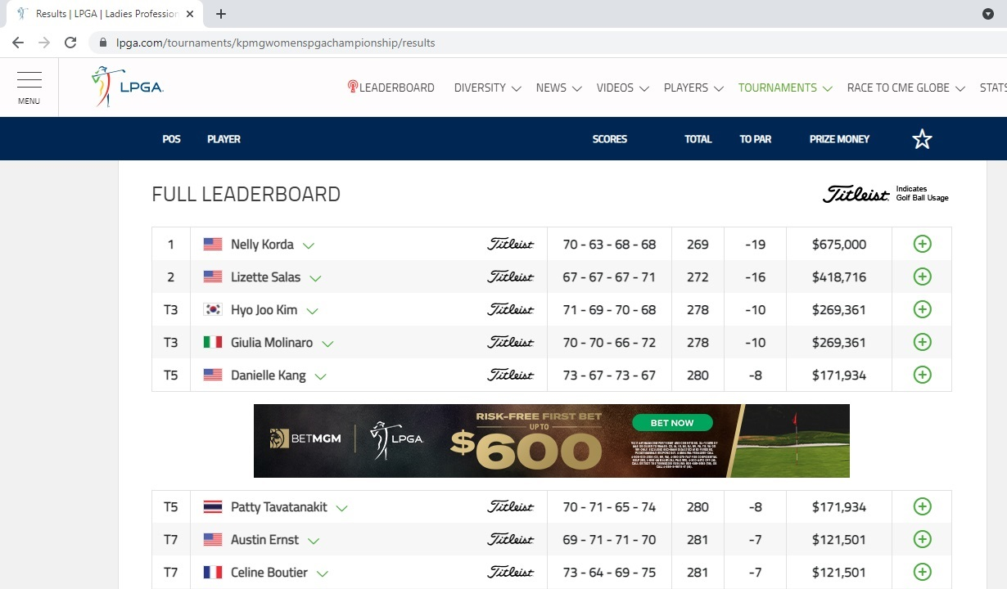
Introduction to sorting
  Consider the ordering of the results in last weekend’s LPGA KPMG golf tournament

Slide 5
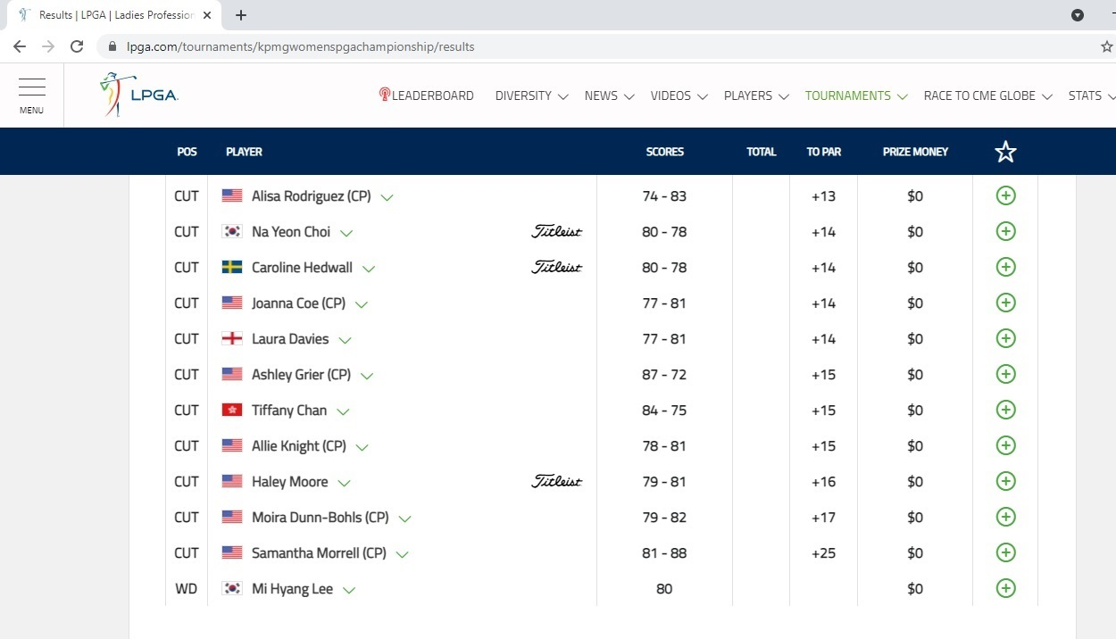
Introduction to sorting
  Out of 156 golfers competing in the event, prizes are determined by score relative to the par for the course

Slide 6
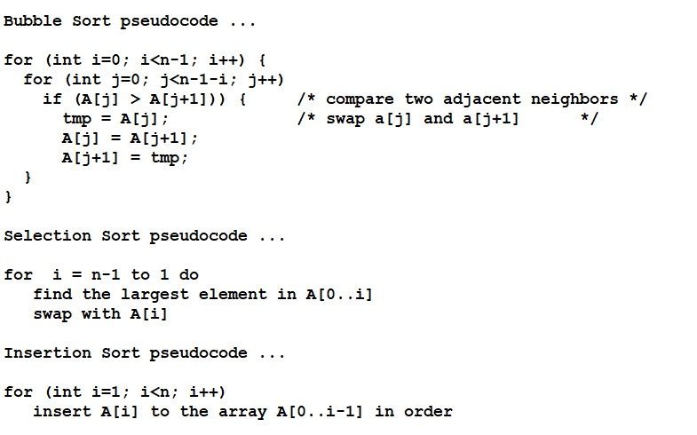
Introduction to sorting - algorithms

Slide 7
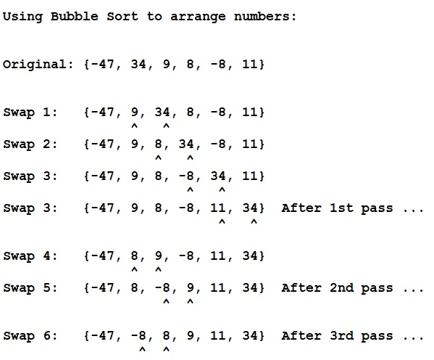
Introduction to sorting

Slide 8
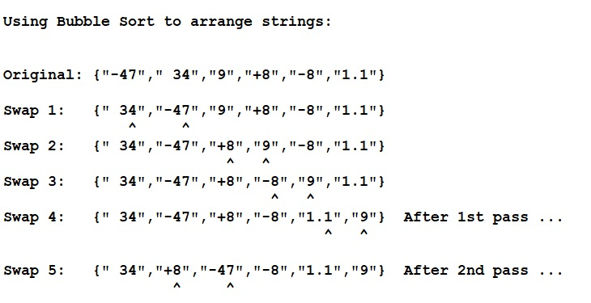
Introduction to sorting

Slide 9
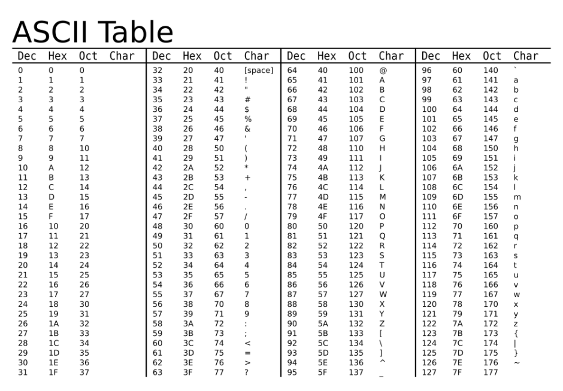
Introduction to sorting

Slide 10
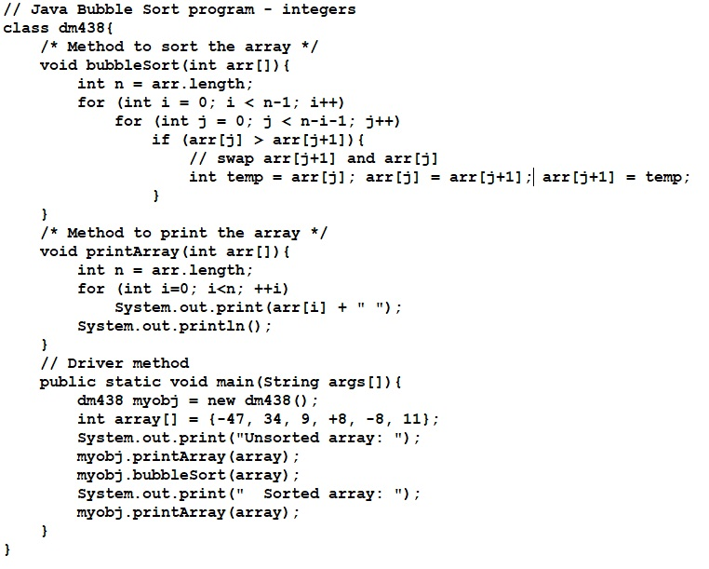
Introduction to sorting

Slide 11
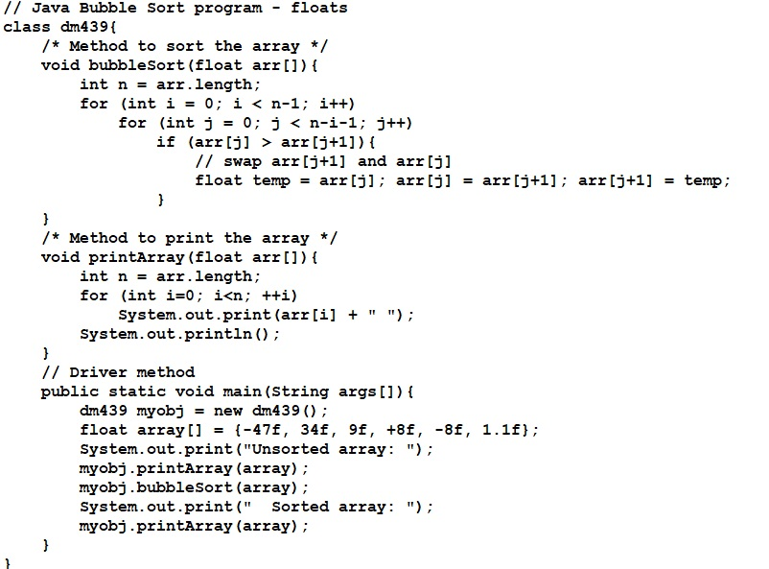
Introduction to sorting

Slide 12
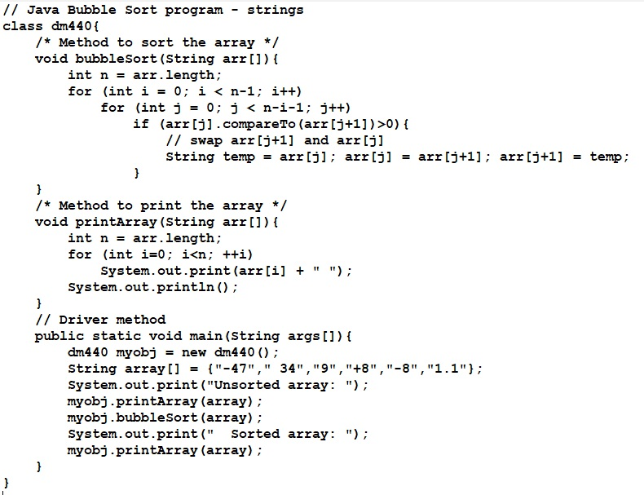
Introduction to sorting

Slide 13
References
https://github.com/byronkf/nyu
https://www.geeksforgeeks.org/bubble-sort/
https://durofy.com/ascii-values-table-generator-in-c

