Slide 1

How to Optimize Lambda
Memory and CPU

Slide 2

If You Learn to Build Scalable Applications, You Can Change Your Career

Slide 3

How I Fixed JWT
Security Flaws in 3 Steps

Slide 4

Why Cassandra Serverless
Is a Game-Changer

Slide 5

Lower Your AWS Lambda Bill by Increasing Memory Size

Slide 6

How to Save Dozens of Hours on Lambda Debugging

Slide 7
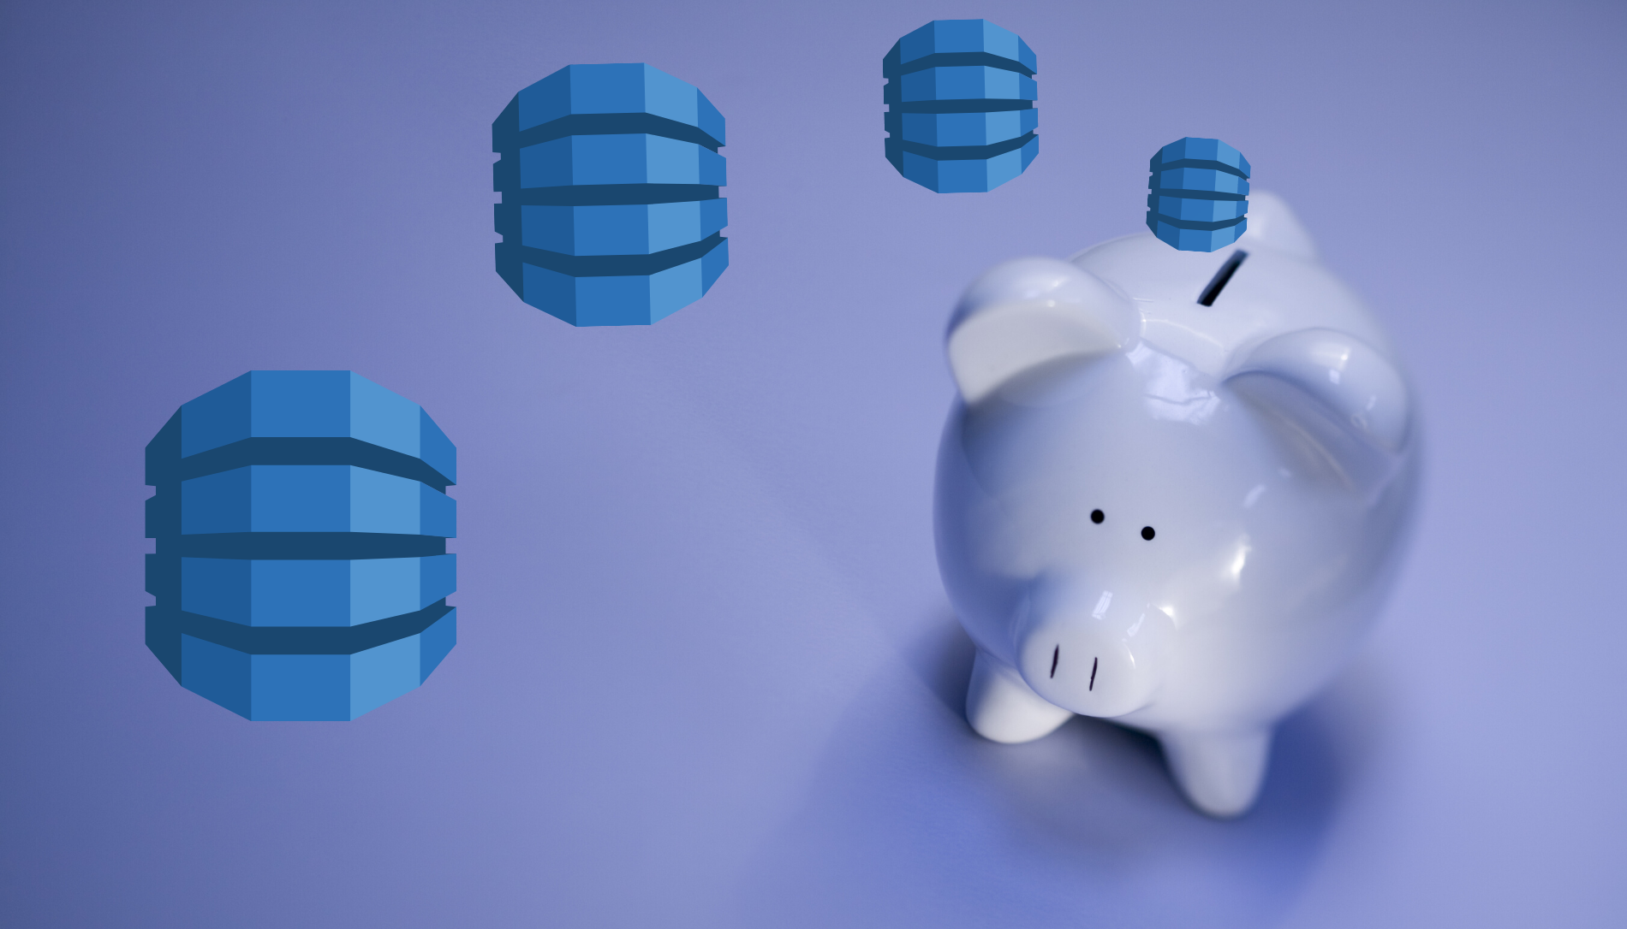
Cost-Efficient Ways to Run DynamoDB Tables

