Slide 1
Report
2016.08.04

Slide 2
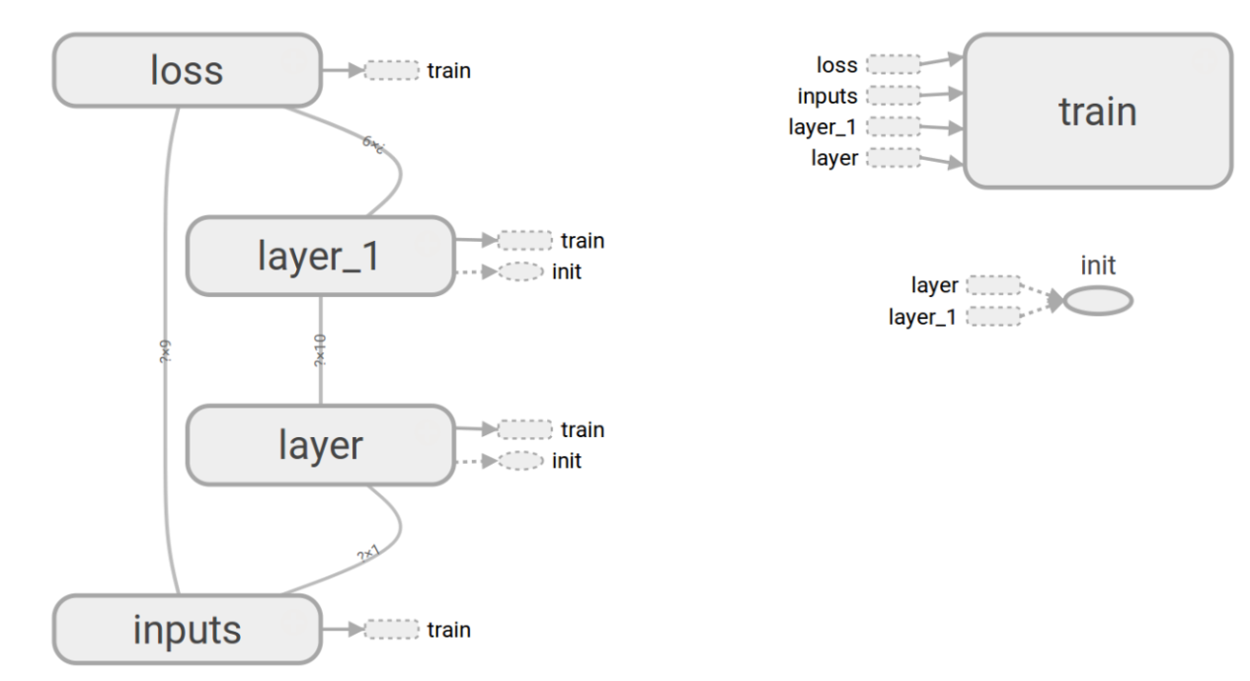
Design idea
Notes:
﻿EXP1:
- Given the "Arrival Rate", predict
- Response Time
- CPU Utilization for Web Workers (avg) containers
- CPU Utilization for MySql container
- Throughput # no need
- Memory utilization for Web Workers (avg)
- Memory utilization for MySql
- CPU Utilization for Load Balancer container
- Memory utilization for Load Balancer
EXP3, EXP5, EXP6, EXP7:
- Given the "Arrival Rate" and "# Containers", predict
- Response Time
- CPU Utilization for Web Workers (avg) containers
- CPU Utilization for MySql container
- Throughput
- Memory utilization for Web Workers (avg) # no mem util
- Memory utilization for MySql
- CPU Utilization for Load Balancer container
- Memory utilization for Load Balancer
EXP13
- Given the "Arrival Rate", "# Web Containers" and "# Spark Containers", predict
- Response Time
- CPU Utilization for Web Workers (avg) containers
- CPU Utilization for Spark Workers (avg) containers
- Throughput
- Memory utilization for Web Workers (avg) containers
- Memory utilization for Spark Workers (avg) containers
- CPU Utilization for VM Worker 1
- CPU Utilization for VM Worker 2
- CPU Utilization for VM Worker 3
- Memory utilization for VM Worker 1
- Memory utilization for VM Worker 2
- Memory utilization for VM Worker 3

Slide 3
Experiments
Exp01
1 input, 3,4,5 outputs
Exp03, Exp05, Exp06, Exp07
2 inputs, 1-5outputs
Exp13
3 inputs, 1-10 outputs

Slide 4
Issues(1)
Original data size
Normalize -> better
How to normalize?
X = (x - min)/(max - min)
X = x/max
Batch size
With big batch size
Show little variance
With small batch size
Better

Slide 5
Issues(2)
How to calculate accuracy?
After normalize?
Since normalized value is [0,1], directly calculate mean of absolute error for each sample
Err = abs(pre- true) / true
Get inf when input is near zero
Transfer the normalized value to original value?
How to deal with negative or (>1) values?
The same way?
Origin prediction = (max – min)*(pre - min) + min
Not done…
Training iterations
Grows with number of outputs

Slide 6
Issues(3)
Loss also grows with number of outputs
# of hidden layers
Show little variance
# of neurons each layer
Big variance if too small (1-3)
Little variance when big enough(10)

Slide 7
Results(1)
Exp01
Calculated by Err = abs(pre- true) / true
3 outputs
[ 0.00896887 0.49391485 0.02195472]
5 outputs
[ 0.00315292 0.51082705 0.0166772 0.04372437 0.03835608]
Small error
Notes:
f_arrival.write(items[11] + '\n')
f_through_put.write(items[12] + '\n')
f_response_time.write(items[13] + '\n')
f_cpu_web.write(items[9] + '\n')
f_cpu_mysql.write(items[7] + '\n')
f_cpu_load.write(items[8] + '\n')
f_mem_web1.write(items[25] + '\n')
f_mem_web2.write(items[29] + '\n')
f_mem_mysql.write(items[17] + '\n')
f_mem_load.write(items[21] + '\n')

Slide 8
Results(2)
Exp03
Err = abs(pre- true) / true
3 outputs
[ 0.47424934 0.24047465 0.30356807]
4 outputs
[ 0.35927937 0.22215937 0.37051417 0.07743499]
Bigger error…
Notes:
# for exp 03 - 07
# arrival rate, throughput, response time, cpu_web, cpu_sql, cpu_load, mem_web, mem_mysql, mem_load, #of containers.
'''
f_exp.write('\t'.join(
[items[10], items[11], items[12], items[8], items[6], items[7], items[16],
items[20], items[85]]) + '\n')
'''

Slide 9
Results(3)
Exp05
Err = abs(pre- true) / true
[ 0.82691209]
[ 0.82336517 1.03356425]
[ 1.99500228 0.94412507 0.11200284 0.10675882]
[ 1.35926203 0.43436915 0.29010584 0.30883578 0.19356288]
Error get bigger when # of outputs increases…
Notes:
# for exp 13
'''
- Given the "ArrivalRate", "# Web Containers" and "# Spark Containers", predict
- Response Time
- CPU Utilization for Web Workers (avg) containers
- CPU Utilization for Spark Workers (avg) containers
- Throughput
- Memory utilization for Web Workers (avg) containers => worker 1
- Memory utilization for Spark Workers (avg) containers => spark master
- VMs CPU and MEM utilization are swarms
'''

Slide 10
Results(4)
Exp06
Err = abs(pre- true) / true
[ inf 0.13602158]
[ inf 0.10577857 0.08625172]
[ inf 0.09913068 0.07940756 0.09911939]
[ inf 0.09466917 0.08207353 0.10621359 0.08874065 0.56970556 0.01700576]
Inf occurred because true value too small…
Notes:
# for exp 13
'''
- Given the "ArrivalRate", "# Web Containers" and "# Spark Containers", predict
- Response Time
- CPU Utilization for Web Workers (avg) containers
- CPU Utilization for Spark Workers (avg) containers
- Throughput
- Memory utilization for Web Workers (avg) containers => worker 1
- Memory utilization for Spark Workers (avg) containers => spark master
- VMs CPU and MEM utilization are swarms
'''

Slide 11
Results(5)
Exp07
Err = abs(pre- true) / true
[ 10.58818829]
[ 4.54083661 1.18361458]
[ 8.88704138 0.7845477 0.24333335]
[ 11.95790782 0.76253212 0.16402783 0.12309244]
[ 1.19509546 0.1862932 0.50169887 0.40736327 0.03671606]
[ 1.24331076 0.21946352 0.52627148 0.4227289 0.03791276 0.79384605]
[ 10.10964915 0.80168407 0.12365553 0.12023216 0.33616738 0.41516328 0.03821085]
Variance a lot when # of outputs increases
Notes:
# for exp 13
'''
- Given the "ArrivalRate", "# Web Containers" and "# Spark Containers", predict
- Response Time
- CPU Utilization for Web Workers (avg) containers
- CPU Utilization for Spark Workers (avg) containers
- Throughput
- Memory utilization for Web Workers (avg) containers => worker 1
- Memory utilization for Spark Workers (avg) containers => spark master
- VMs CPU and MEM utilization are swarms
'''

Slide 12
Results(6)
Exp13
Err = abs(pre- true)
[ 0.16775963]
[ 0.15399162 0.19419926]
[ 0.15616484 0.19727036 0.32018888]
[ 0.16620197 0.18795281 0.29963485 0.04835406]
[ 0.15232968 0.19292085 0.27551204 0.05649389 0.14258791]
[ 0.15083985 0.22740594 0.21824437 0.19341471 0.31705243 0.21727816 0.30000541 0.1620029 0.26445866 0.22830919]
Inf when Err = abs(pre- true) / true
Notes:
# for exp 13
'''
- Given the "ArrivalRate", "# Web Containers" and "# Spark Containers", predict
- Response Time
- CPU Utilization for Web Workers (avg) containers
- CPU Utilization for Spark Workers (avg) containers
- Throughput
- Memory utilization for Web Workers (avg) containers => worker 1
- Memory utilization for Spark Workers (avg) containers => spark master
- VMs CPU and MEM utilization are swarms
'''

Slide 13
Analysis
Generally bad except Exp01
Better when transferred to non-normalized value
Why?
Regression is harder than classification
Generally number of features should be greater than results. (p >> n)
Data show great variance for same input
…

