Slide 1

TensorFlow Basics
Bingyu Shen(申炳宇)
2016.07.28
Notes:
Hello, everyone. I am Frank. Today I will talk about the basic concepts of tensorflow, and show how to build a simple neurol network with tensorflow, This is the contents of this talk.

Slide 2
Outline
01.
Overview
02.
Installation
03.
Examples
04.
Pro & cons
05.
Computation Graph
Notes:
First I will give an overview of tensorflow. Then I will introduce the installation process and some machine learning examples with tensorflow. Next I will talk about the pros and cons of tensorflow framework. And I will explain how to construct a computation graph with tensorflow.

Slide 3
TensorFlow Overview
TensorFlow™ is an open source software library for numerical computation using data flow graphs.
Nodes => mathematical operations
Edges => the multidimensional data arrays (tensors) communicated between nodes.
The flexible architecture allows you to deploy computation to one or more CPUs or GPUs in a desktop, server, or mobile device with a single API.
Quick to install and easy to use
Notes:
It allows machine learning researcher to experiment with deep neural nets more easily.
A Computing graph processor
With Tensors as main data elements
Apart from that, it includes many sequential and parallel operations related with statistical and deep learning.
Similar to other Machine Learning toolkits, but has the support of professional Machine Learning team staff

Slide 4
TensorFlow Installation
Requirements
Python 2.7 or Python 3.3+.
Linux 64 bit or Mac OS
Docker installation
Mobile TensorFlow
iOS, OS X (macOS), Android, Raspberry-PI
The GPU version only supports Linux 64 bit
Cluster(Distributed tensor flow)
Notes:
Many applications can benefit from on-device processing.
e.g. Google Translate
Mobile TensorFlow makes sense when there is a poor or missing network connection, or where sending continuous data to a server would be too expensive.

Slide 5


What can TensorFlow do?
Every Machine Learning methods can be implemented based on tensorflow
Support many sequential and parallel operations related with statistical and deep learning.
Has the support of professional Machine Learning team staff (Google…)
Google Translate
Prisma(Server)
Notes:
Do not expect: do not expect magic things to come from TensorFlow. There is none. A wealth of deep learning frameworks already exist in the wild and TensorFlow is just one of them. It will not give you powerful AI overnight, nor will it help your smartphone to recognize cats. It is a tool for deep learning research that will hopefully make it a bit less cumbersome.

Slide 6
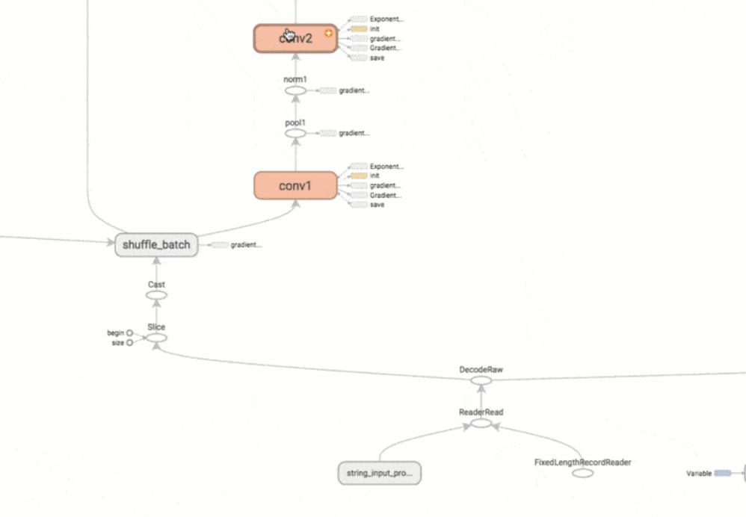
Pros and Cons
(+) Python + Numpy
(+) Computational graph abstraction
(+) TensorBoard for visualization
(+) Data and model parallelism
(-) Slower than other frameworks
(-) Not many pretrained models
(-) Computational graph is pure Python, therefore slow
Notes:
Theano
Torch
Caffe

Slide 7
TensorFlow
Tensor + Flow
Tensor: n-dimensional arrays
Vector: 1-dimensional tensor
Matrix: 2-dimensional tensor
Deep learning processes are flows of tensors
A sequence of tensor operations
Can also represent a number of machine learning algorithms

Slide 8
Architecture
Computational Graph (TensorFlow)
Optimizer
Loss
Operation
Variable
PlaceHolder

Slide 9
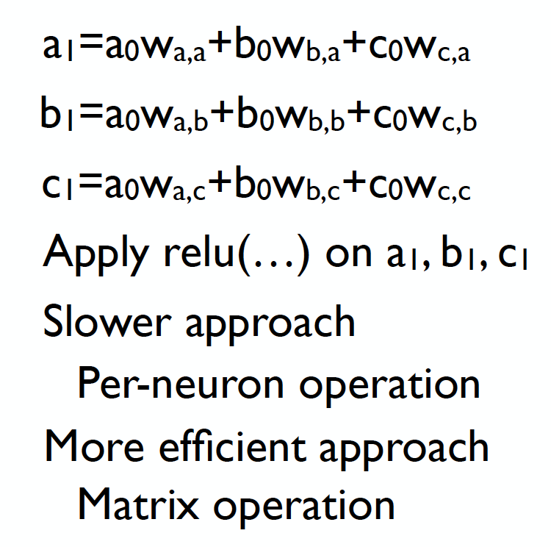
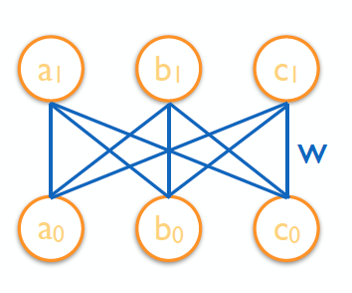
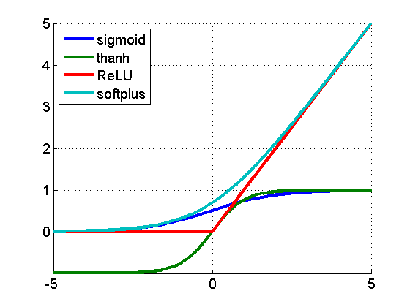
ReLU network
Outputs
Inputs

Slide 10
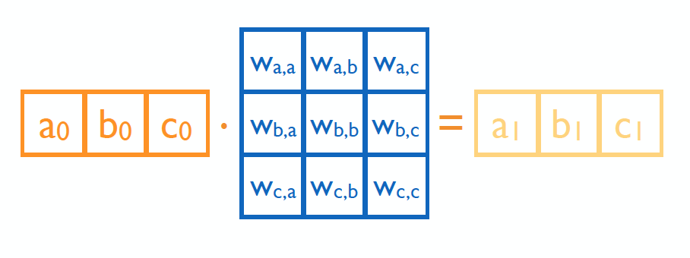
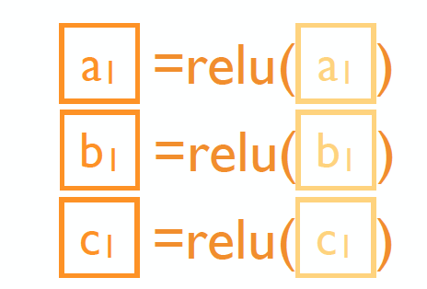
Matrix operation

Slide 11



In TensorFlow

Slide 12
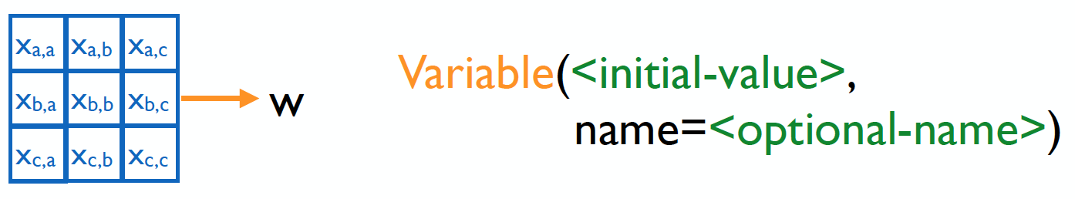
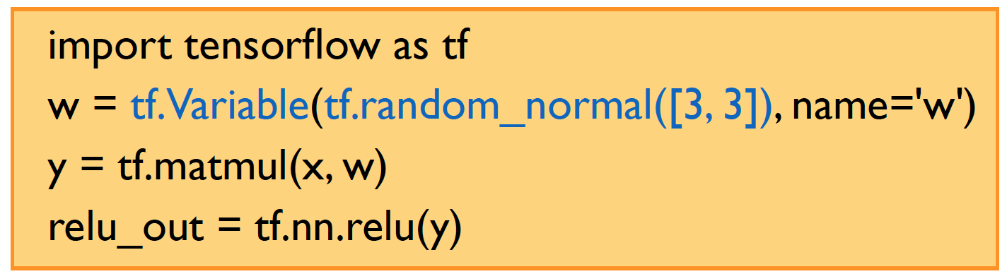
Variables

Slide 13
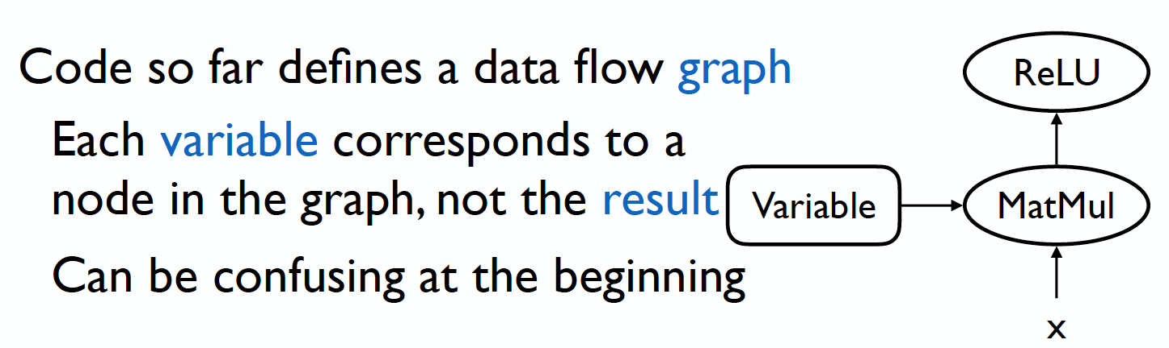
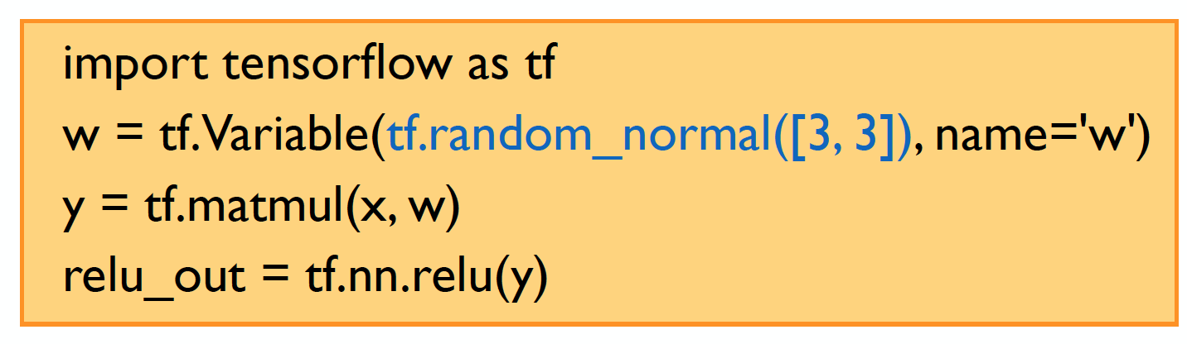
TensorFlow

Slide 14
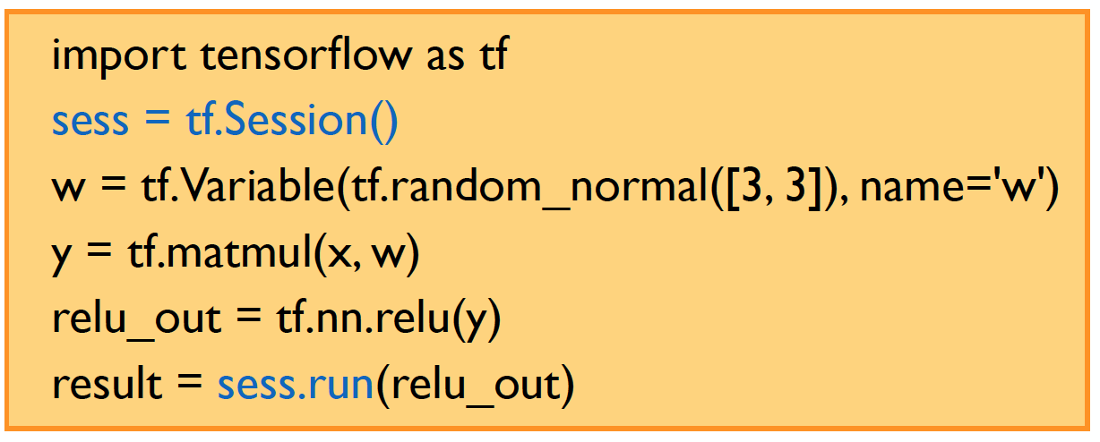
Session

Slide 15
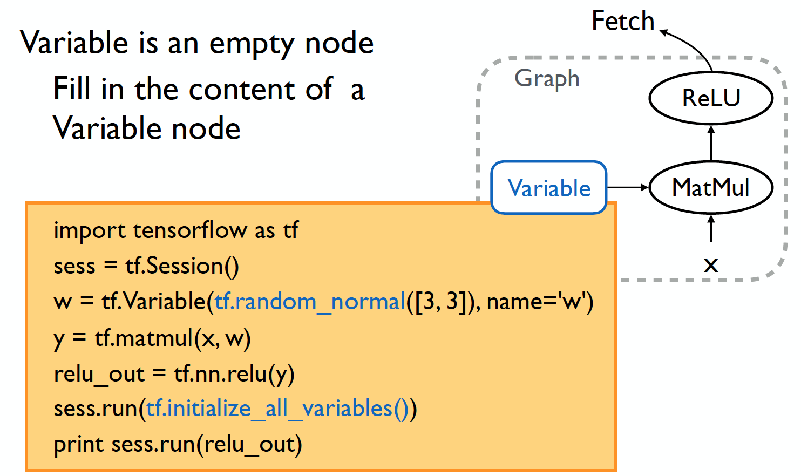
Initialize variable

Slide 16
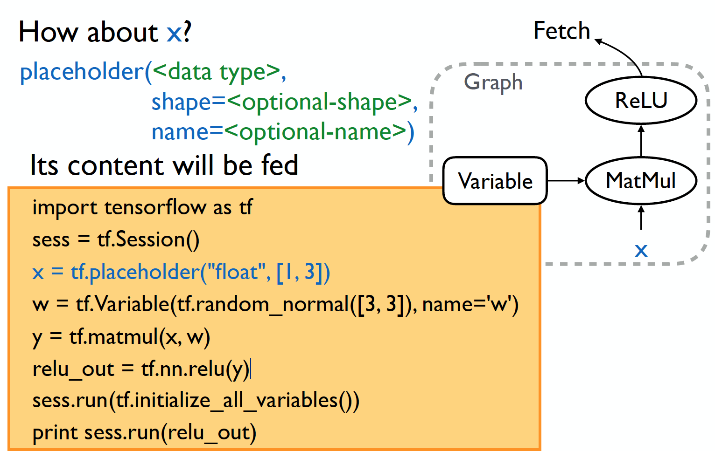
Placeholder

Slide 17
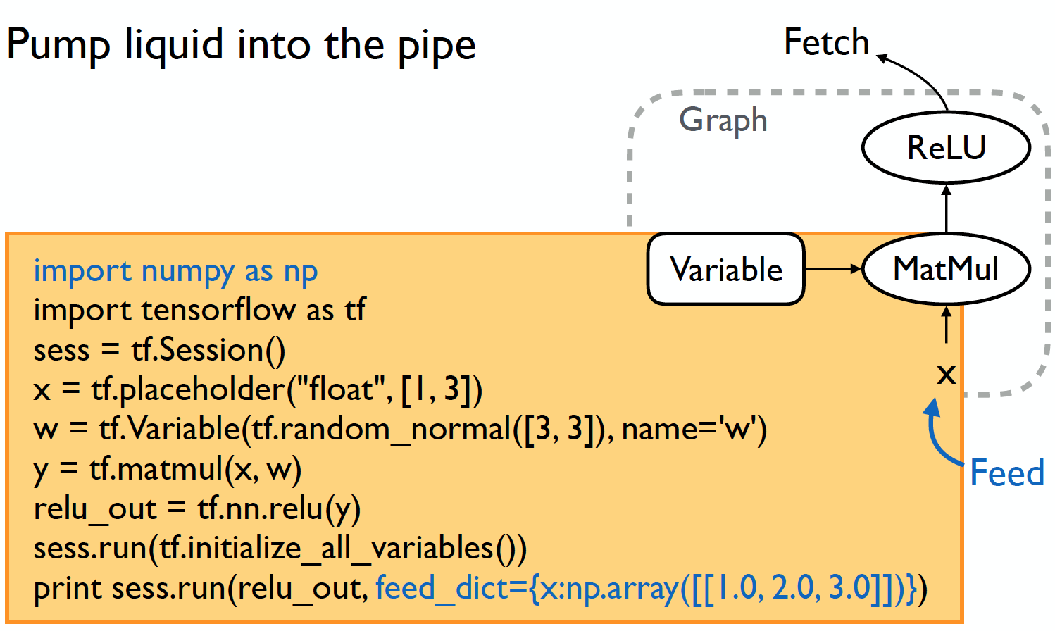
Feed

Slide 18
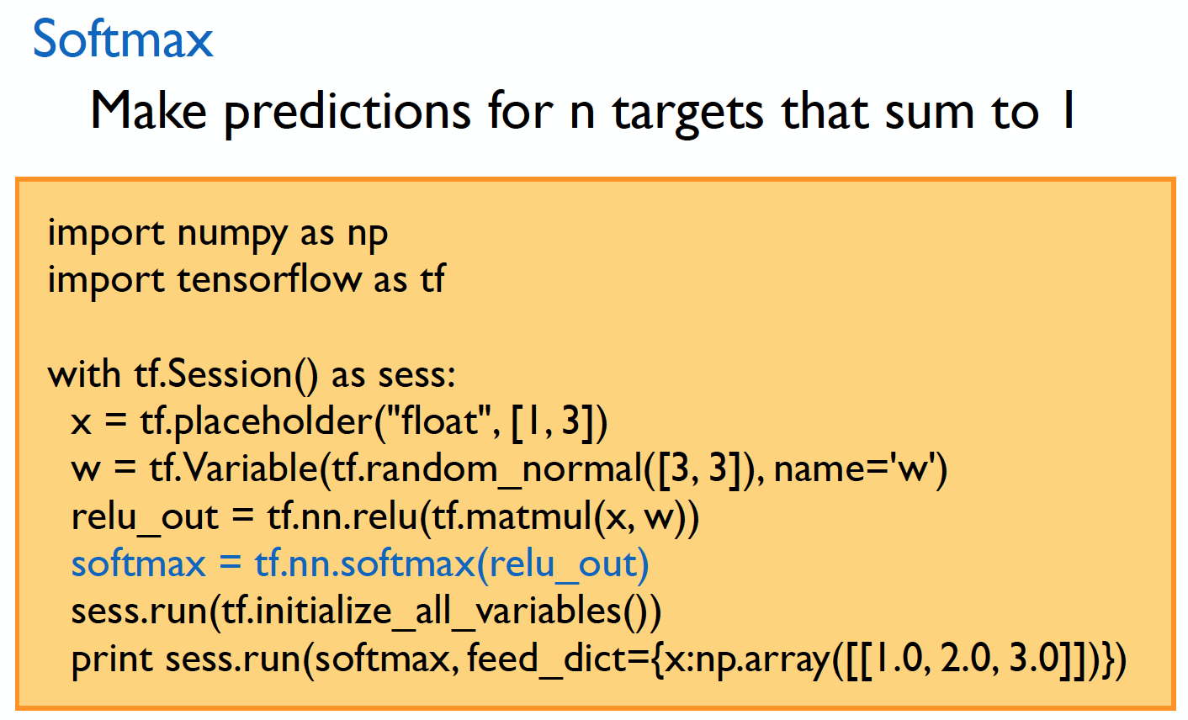
Prediction

Slide 19
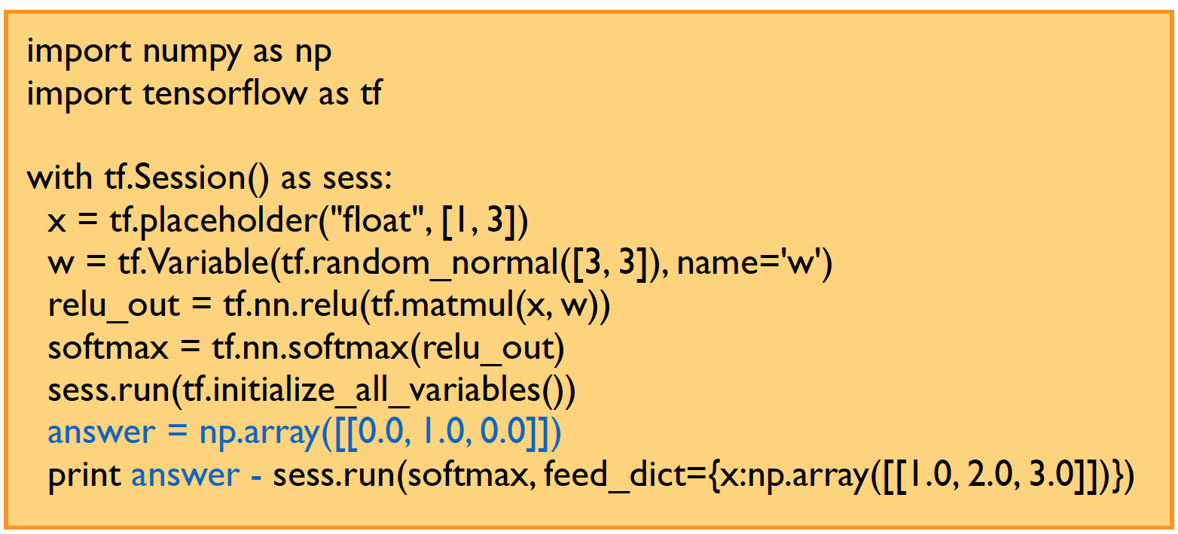
Error

Slide 20
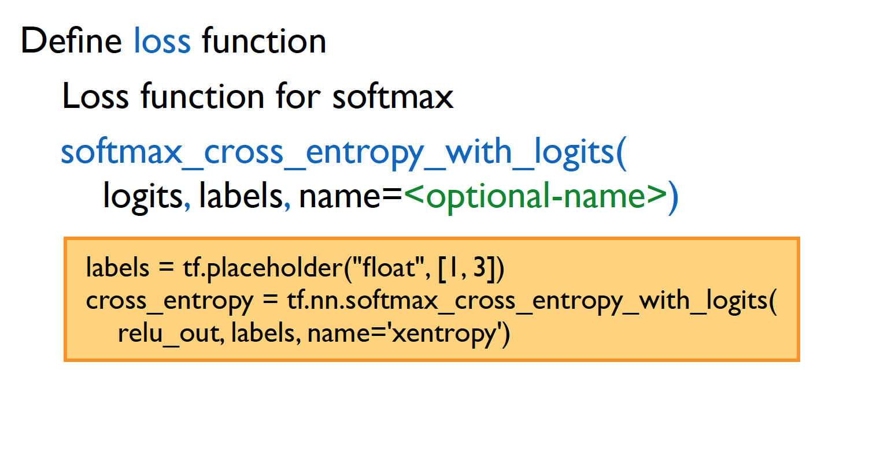
Loss

Slide 21
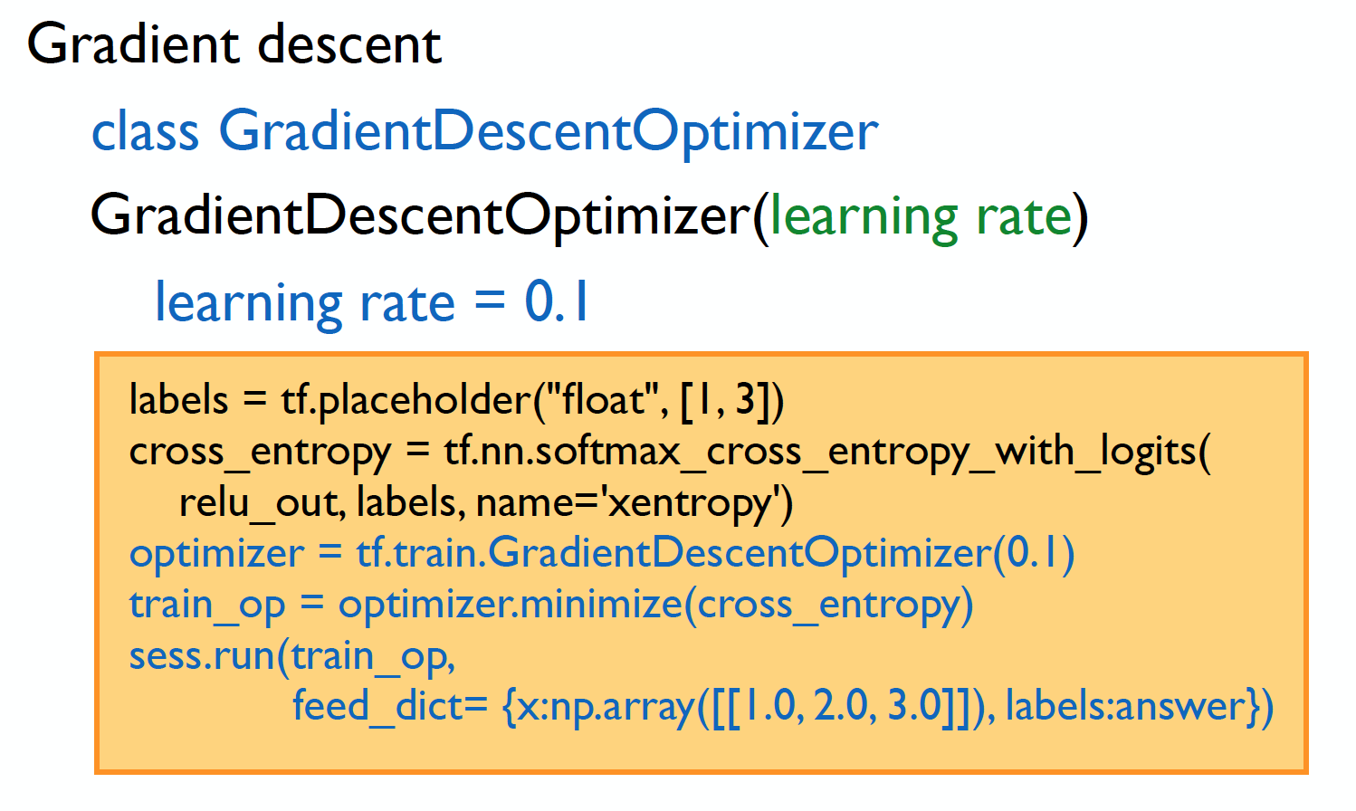
Optimization

Slide 22
Summary
Computational Graph (TensorFlow)
Optimizer
Loss
Operation
Variable
PlaceHolder

Slide 23
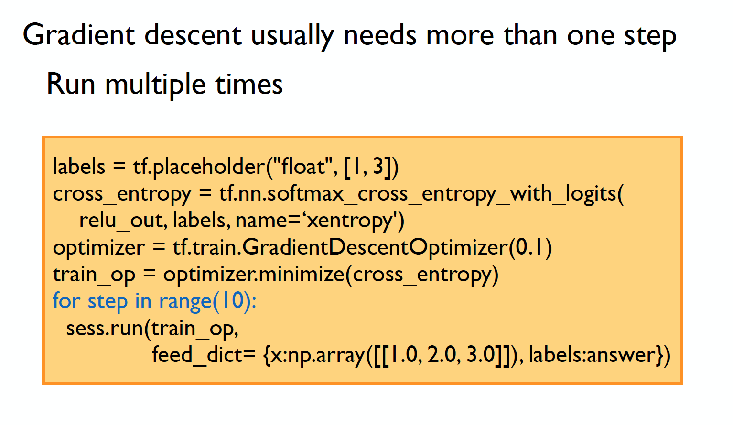
Iterative update

Slide 24
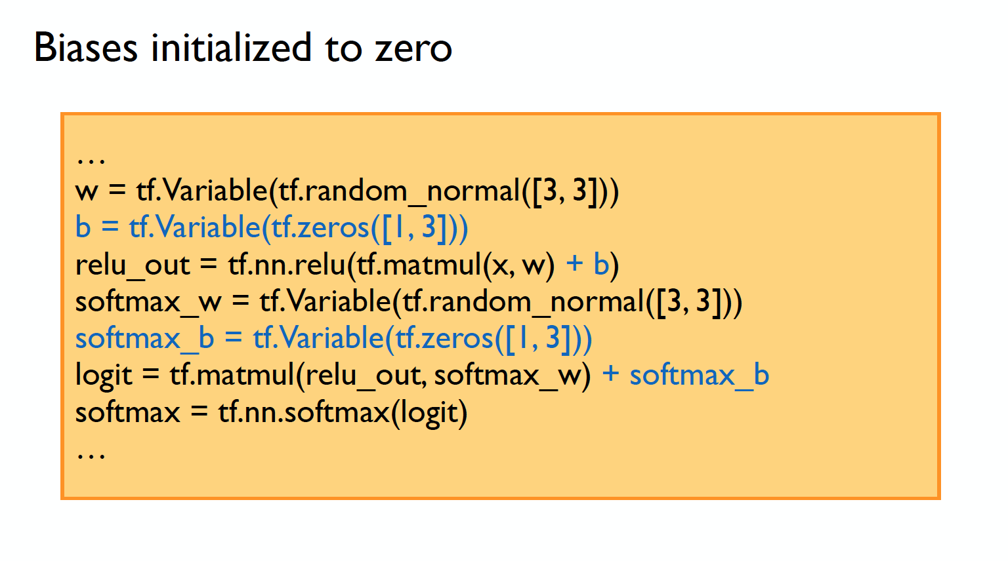
Biases

Slide 25
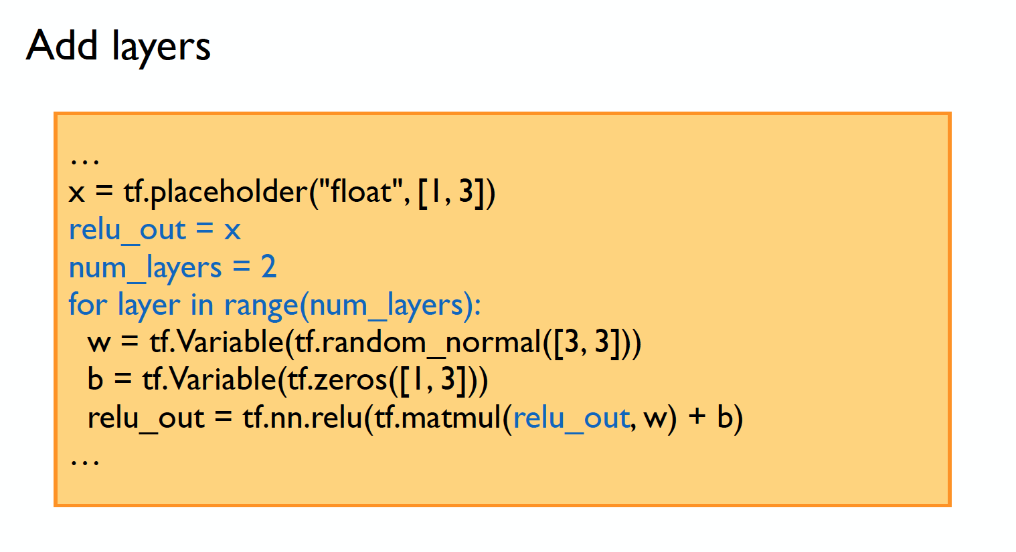
Go deeper

