Slide 1

Paxos
Bingyu Shen
CSE291 Dependable Systems
2021-02-25
adapted from slides of John Ousterhout and Diego Ongaro

Slide 2
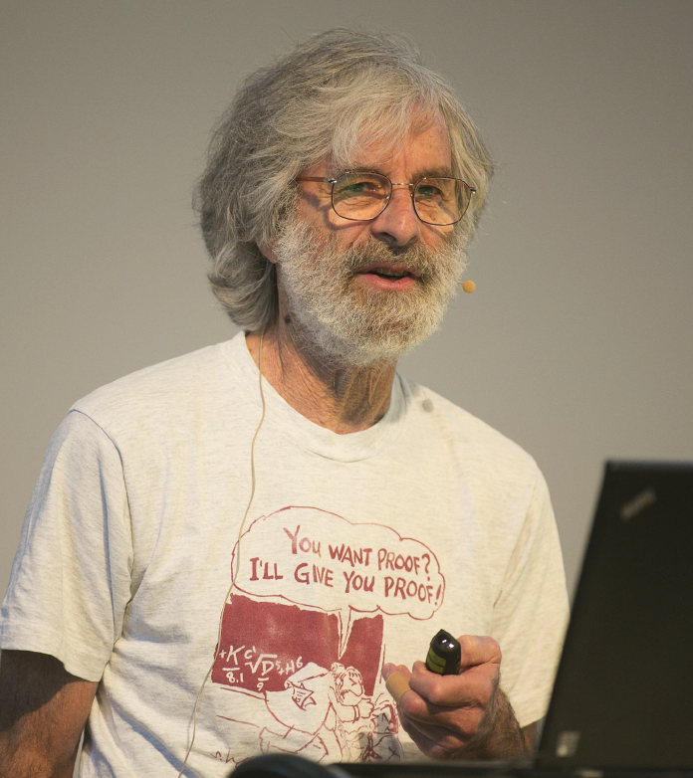
Leslie Lamport
La in Latex
Theory foundation of distributed systems
Temporal Logic (TLA)
specify and reason about concurrent and reactive systems
2013 Turing award
2014 ACM fellow
BS/MS/PhD in math
http://www.lamport.org/

Slide 3
Paxos History
Time, Clocks and Ordering
1978
Paxos published
1989
1984
State Machine Replication

Slide 4
Paxos History
Time, Clocks and Ordering
1978
Paxos published
1989
1984
State Machine Replication
1998
Published on Journal: Part-time parliament
I submitted the paper to TOCS in 1990. All three referees said that the paper was mildly interesting, though not very important, but that all the Paxos stuff had to be removed. I was quite annoyed at how humorless everyone working in the field seemed to be, so I did nothing with the paper. A number of years later, a couple of people at SRC needed algorithms for distributed systems they were building, and Paxos provided just what they needed. I gave them the paper to read and they had no problem with it.
http://lamport.azurewebsites.net/pubs/pubs.html#lamport-paxos

Slide 5
Paxos History
Time, Clocks and Ordering
1978
Paxos published
1989
Paxos made simple
2001
1984
State Machine Replication
1998
Published on Journal: Part-time parliament
The Paxos algorithm, when presented in plain English, is very simple. (2001)
At the PODC 2001 conference, I got tired of everyone saying how difficult it was to understand the Paxos algorithm, published in [122]. Although people got so hung up in the pseudo-Greek names that they found the paper hard to understand, the algorithm itself is very simple. So, I cornered a couple of people at the conference and explained the algorithm to them orally… The current version is 13 pages long, and contains no formula more complicated than n1 > n2.
https://www.microsoft.com/en-us/research/publication/paxos-made-simple

Slide 6
Paxos History
Paxos published
1989
Paxos made simple
2001
Time, Clocks and Ordering
1978
1984
Time, Clocks and Ordering
1998
Published on Journal: Part-time parliament
2015
Paxos made moderately complex

Slide 7

Paxos Made Moderately Complex
This article explains the full reconfigurable multidecree Paxos (or multi-Paxos) protocol. Paxos is by no means a simple protocol, even though it is based on relatively simple invariants. We provide pseudocode and explain it guided by invariants.
Robbert Van Renesse Deniz Altinbuken
Annecdote: Robbert is not a “professor” until 2019.

Slide 8

Goal: Replicated Log
Clients
shl
Consensus Module
State Machine
Consensus Module
State Machine
Consensus Module
State Machine
Servers
Log
Log
Log
add
jmp
mov
shl
add
jmp
mov
shl
add
jmp
mov
shl
Replicated log => replicated state machine
All servers execute same commands in same order
Consensus module ensures proper log replication
System makes progress as long as any majority of servers are up
Failure model: fail-stop (not Byzantine), delayed/lost messages

Slide 9
The Paxos Approach
Decompose the problem:
Basic Paxos (“single decree”):
One or more servers propose values
System must agree on a single value as chosen
Only one value is ever chosen
Multi-Paxos:
Combine several instances of Basic Paxos to agree on a series of values forming the log

Slide 10
Requirements for Basic Paxos
Safety: (Bad things never happen)
Only a single value may be chosen
A server never learns that a value has been chosen unless it really has been
Liveness (as long as majority of servers up and communicating with reasonable timeliness):
Some proposed value is eventually chosen
If a value is chosen, servers eventually learn about it
The term “consensus problem” typically refers to this single-value formulation

Slide 11
Paxos Components
Proposers:
Active: put forth particular values to be chosen
Handle client requests
Acceptors:
Passive: respond to messages from proposers
Responses represent votes that form consensus
Store chosen value, state of the decision process
Want to know which value was chosen (learners in Lamport)
For this presentation:
Each Paxos server contains both components

Slide 12
Strawman: Single Acceptor
Simple (incorrect) approach: a single acceptor chooses value
What if acceptor crashes after choosing?
Solution: quorum
Multiple acceptors (3, 5, ...)
Value v is chosen if accepted by majority of acceptors
If one acceptor crashes, chosen value still available
Proposers
add
jmp
shl
sub
Acceptor
jmp

Slide 13
Problem (1) : Split Votes
Acceptor accepts only first value it receives?
If simultaneous proposals, no value might be chosen
=> Acceptors must sometimes accept multiple (different) values (only one chosen)
s₁
accept?(red)
accepted(red)
s₂
accepted(red)
s₃
accept?(blue)
accepted(blue)
s₄
accepted(blue)
s₅
accept?(green)
accepted(green)
time

Slide 14
Problem (2): Conflicting Choices
Acceptor accepts every value it receives?
Could choose multiple values
Red Chosen
s₁
accept?(red)
accepted(red)
s₂
accepted(red)
s₃
accepted(red)
accepted(blue)
Violate safety
s₄
accepted(blue)
s₅
accepted(blue)
accept?(blue)
time
Blue Chosen
Once a value has been chosen, future proposals must
propose/choose that same value => (2-phase protocol)

Slide 15
Conflicting Choices, cont’d
Red Chosen??
s₁
accept?(red)
accepted(red)
s₂
accepted(red)
s₃
accepted(blue)
accepted(red)
s₄
accepted(blue)
s₅
accepted(blue)
prop(blue)
time
Blue Chosen
s₅ needn’t propose red (it hasn’t been chosen yet)
s₁’s proposal must be aborted (s₃ must reject it)
=> Must order proposals, reject old ones

Slide 16
Proposal Numbers
Each proposal has a unique number
Higher numbers take priority over lower numbers
It must be possible for a proposer to choose a new proposal number higher than anything it has seen/used before

Slide 17
Proposal Numbers
Each proposal has a unique number
Higher numbers take priority over lower numbers
It must be possible for a proposer to choose a new proposal number higher than anything it has seen/used before
One simple approach:
Each server stores maxRound: the largest Round Number it has seen so far
To generate a new proposal number:
Increment maxRound
Concatenate with Server Id
Proposers must persist maxRound on disk: must not reuse proposal numbers after crash/restart
Proposal Number
Round Number
Server Id

Slide 18
Basic Paxos
Two-phase approach:
Phase 1: proposers broadcast Prepare RPCs
Find out about any chosen values
Block older proposals that have not yet completed
Phase 2: proposers broadcast Accept RPCs
Ask acceptors to accept a specific value
Notes:
1. Prepare phase make it safe for the acceptors to accept our proposals.

Slide 19
Basic Paxos
Value
Proposers
Choose new proposal number n
Broadcast Prepare(n) to all servers
When responses received from majority:
If any acceptedValues returned, replace value with acceptedValue for highest acceptedProposal
Broadcast Accept(n, value) to all servers
When responses received from majority:
Any rejections (result > n)? goto (1)
Otherwise, value is chosen
Acceptors
Respond to Prepare(n):
If n > minProposal then minProposal = n
Return(acceptedProposal, acceptedValue)
Respond to Accept(n, value):
If n ≥ minProposal then acceptedProposal = minProposal = n acceptedValue = value
Return(minProposal)
Accept

Slide 20
Basic Paxos
Proposers
Choose new proposal number n
Broadcast Prepare(n) to all servers
When responses received from majority:
If any acceptedValues returned, replace value with acceptedValue for highest acceptedProposal
Broadcast Accept(n, value) to all servers
When responses received from majority:
Any rejections (result > n)? goto (1)
Otherwise, value is chosen
Acceptors
Respond to Prepare(n):
If n > minProposal then minProposal = n
Return(acceptedProposal, acceptedValue)
Respond to Accept(n, value):
If n ≥ minProposal then acceptedProposal = minProposal = n acceptedValue = value
Return(minProposal)
Acceptors must record minProposal, acceptedProposal, and acceptedValue on stable storage (disk)

Slide 21
Basic Paxos Examples
Three possibilities when later proposal prepares:
Previous value already chosen:
New proposer will find it and use it
“Accept proposal 4.5 with value X (from s₅)”
X
s₁
P 3.1
A 3.1 X
s₂
P 3.1
A 3.1 X
s₃
It learns that X has been accepted on s₃
values
P 3.1
A 3.1 X
P 4.5
A 4.5 X
s₄
P 4.5
A 4.5 X
Y
s₅
P 4.5
A 4.5 X
time
“Prepare proposal 3.1 (roundNumber3 from s₁)”

Slide 22
Basic Paxos Examples, cont’d
Three possibilities when later proposal prepares:
Previous value not chosen, but new proposer sees it:
New proposer will use existing value
Both proposers can succeed
X
s₁
P 3.1
A 3.1 X
s₂
P 3.1
A 3.1 X
values
s₃
P 3.1
A 3.1 X
P 4.5
A 4.5 X
s₄
P 4.5
A 4.5 X
Y
s₅
P 4.5
A 4.5 X
time

Slide 23
Basic Paxos Examples, cont’d
Three possibilities when later proposal prepares:
Previous value not chosen, new proposer doesn’t see it:
New proposer chooses its own value
Older proposal blocked
X
s₁
P 3.1
A 3.1 X
s₂
P 3.1
A 3.1 X
values
s₃
P 3.1
P 4.5
A 3.1 X
A 4.5 Y
s₄
P 4.5
A 4.5 Y
Y
s₅
P 4.5
A 4.5 Y
time

Slide 24
Liveness
Competing proposers can livelock:
One solution: randomized delay before restarting
If a leader/proposer finds a higher proposal number from a server s, it monitors s to wait for finishing its operation.
Give other proposers a chance to finish choosing
Multi-Paxos will use leader election instead
s₁
P 3.1
A 3.1 X
P 4.1
A 4.1 X
s₂
P 3.1
A 3.1 X
P 4.1
A 4.1 X
s₃
P 3.1
P 3.5
A 3.1 X
P 4.1
A 3.5 Y
P 5.5
A 4.1 X
s₄
P 3.5
A 3.5 Y
P 5.5
s₅
P 3.5
A 3.5 Y
P 5.5
time

Slide 25
Other Notes
Only proposer knows which value has been chosen
The acceptor does not know whether it has been chosen or not
If other servers want to know, must execute Paxos with their own proposal

Slide 26
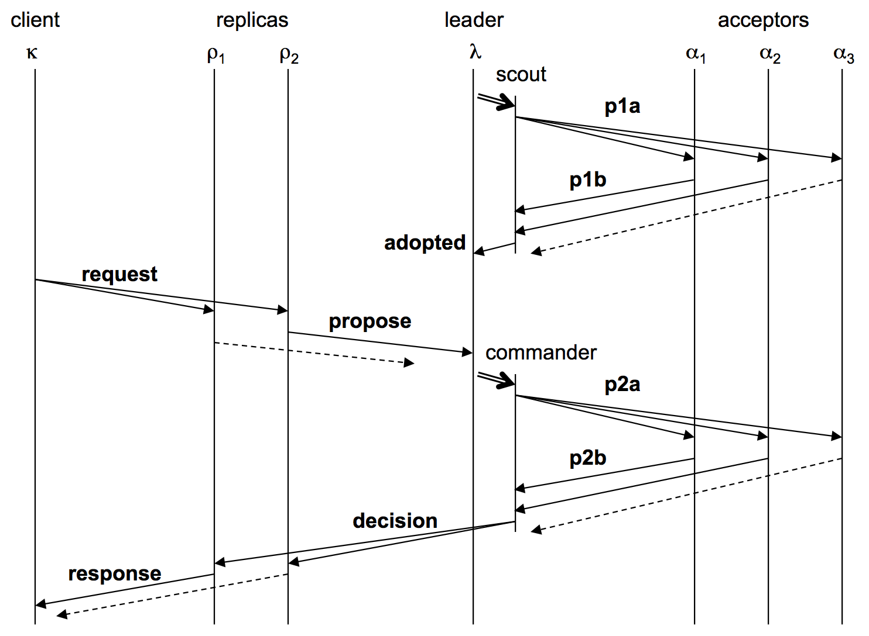
Paxos in the Paper
Proposer
Prepare
Accept

Slide 27
Multi-Paxos
Separate instance of Basic Paxos for each entry in the log:
Add index argument to Prepare and Accept (selects entry in log)
Client sends command to server
Client
Server returns result from state machine to client
shl
Consensus Module
State Machine
Other
Servers
Server
Server waits for previous log entries to be applied, then applies new command to state machine
Server uses Paxos to choose command as value for a log entry
Log
add
jmp
mov
shl

Slide 28
Multi-Paxos Issues
Which log entry to use for a given client request?
Performance optimizations:
Use leader to reduce proposer conflicts
Eliminate most Prepare requests => (most only 1 round of RPCs)
Ensuring full replication (All servers got all log entries)
Client protocol (Survive server crashes)
Configuration changes (safe removal)

Slide 29
1. Selecting Log Entries
When request arrives from client:
Find first log entry not known to be chosen
Run Basic Paxos to propose client’s command for this index
Prepare returns acceptedValue?
Yes: finish choosing acceptedValue, start again
No: choose client’s command
jmp
Known Chosen
1
2
3
4
5
6
7
1
2
3
4
5
6
7
s₁
mov
add
cmp
ret
s₁
mov
add
cmp
sub
jmp
ret
s₂
mov
add
sub
ret
s₂
mov
add
cmp
sub
jmp
ret
s₃
mov
add
cmp
cmp
ret
s₃
mov
add
cmp
shl
ret
Logs Before
Logs After

Slide 30
1. Selecting Log Entries, cont’d
Servers can handle multiple client requests concurrently:
Select different log entries for each
Must apply commands to state machine in log order
State machine can not execute the chosen command util all previous commands have been chosen

Slide 31
2. Improving Efficiency
Using Basic Paxos is inefficient:
With multiple concurrent proposers, conflicts and restarts are likely (higher load → more conflicts; livelock)
2 rounds of RPCs for each value chosen (Prepare, Accept)
Solution:
Pick a leader
At any given time, only one server acts as Proposer
Eliminate most Prepare RPCs
Prepare once for the entire log (not once per entry)
Most log entries can be chosen in a single round of RPCs
Notes:
only a single server can propose at one time
One round of prepare for the whole log. cut in half the number of RPCs
https://stackoverflow.com/questions/64753009/does-anyone-have-any-recommendatation-for-multi-paxos/64759874#64759874

Slide 32
2.1 Leader Election
One simple approach from Lamport:
Let the server with highest ID act as leader
Each server sends a heartbeat message to every other server every T ms
If a server hasn’t received heartbeat from server with higher ID in last 2T ms, it acts as leader:
Accepts requests from clients
Acts as proposer and acceptor
If server not leader:
Rejects client requests (redirect to leader)
Acts only as acceptor
Approach with lease:
Notes:
Pretty likely to have no leaders
1. in practice – a lease-based approach is implemented

Slide 33
2.2 Eliminating Prepares
Recap: Why is Prepare needed?
Block old proposals
Make proposal numbers refer to the entire log, not just one entry
Find out about (possibly) chosen values
Return highest proposal accepted for current entry
Also return noMoreAccepted: no proposals accepted for any log entry beyond current one
We will finally get into a situation that are acceptors are all noMoreAccepted

Slide 34
2.2 Eliminating Prepares
Recap: Why is Prepare needed?
Block old proposals
Make proposal numbers refer to the entire log, not just one entry
Find out about (possibly) chosen values
Return highest proposal accepted for current entry
Also return noMoreAccepted: no proposals accepted for any log entry beyond current one
If acceptor responds to Prepare with noMoreAccepted, skip future Prepares with that acceptor (until Accept rejected – leader change)
Once leader receives noMoreAccepted from majority of acceptors, no need for Prepare RPCs
Only 1 round of RPCs needed per log entry (Accepts)
Notes:
we already know the state of that acceptor
it's about multiple rounds of the algorithm to agree sequential requests from a stable leader with minimal messaging.
Rather than start again with prepare requests it can move immediately to a galloping mode where it sends successive accept messages when it hears a majority of acknowledgments for the previous accept request. This is highly efficient as it needs the minimal number of messages but it only occurs for multiple rounds from a stable leader. This may be interrupted by the leader crashing else a network failure which causes a follower to timeout on an otherwise healthy leader.

Slide 35
3. Full Replication
So far, information flow is incomplete:
Log entries not fully replicated (majority only) Goal: full replication
Only proposer knows when entry is chosen Goal: all servers know about chosen entries
This makes sure that all servers can operate the commands in the state machine with full log history

Slide 36
3. Full Replication
Solution part 1/4: keep retrying Accept RPCs until all acceptors respond (in background)
Fully replicates most entries
Solution part 2/4: track chosen entries
Mark entries that are known to be chosen: acceptedProposal[i] = ∞ (never get overwritten)
Each server maintains firstUnchosenIndex: index of earliest log entry not marked as chosen

Slide 37
3. Full Replication
Solution part 3/4: proposer tells acceptors about chosen entries
Proposer includes its firstUnchosenIndex in Accept RPCs.
Acceptor marks all entries i chosen if:
i < request.firstUnchosenIndex and
acceptedProposal[i] == request.proposal
Result: acceptors know about most chosen entries
(the message is from the same proposer)
log index
1
2
3
4
5
6
7
8
9
acceptedProposal
∞
∞
∞
2.5
∞
3.4
before Accept
... Accept(proposal = 3.4, index=8, value = v, firstUnchosenIndex = 7) ...
∞
∞
∞
2.5
∞
∞
3.4
after Accept
Still don’t have complete info

Slide 38
3. Full Replication
Solution part 4/4: entries from old leaders
Acceptor returns its firstUnchosenIndex in Accept replies
If proposer’s firstUnchosenIndex > firstUnchosenIndex from response, then proposer sends Success RPC (in background)
This means the acceptor is uncertain about some indexes
Success(index, v): notifies acceptor of chosen entry:
acceptedValue[index] = v
acceptedProposal[index] = ∞
return firstUnchosenIndex
Proposer sends additional Success RPCs, if needed

Slide 39
4. Client Protocol
Send commands to leader
If leader unknown, contact any server
If contacted server not leader, it will redirect to leader
Leader does not respond until command has been chosen for log entry and executed by leader’s state machine
If request times out (e.g., leader crash):
Client reissues command to some other server
Eventually redirected to new leader
Retry request with new leader

Slide 40
4. Client Protocol, cont’d
What if leader crashes after executing command but before responding?
Must not execute command twice
Solution: client embeds a unique id in each command
Server includes id in log entry
State machine records most recent command executed for each client
Before executing command, state machine checks to see if command already executed, if so:
Ignore new command
Return response from old command
Result: exactly-once semantics as long as client doesn’t crash

Slide 41
5. Configuration Changes
System configuration:
ID, address for each server
Determines what constitutes a majority
Consensus mechanism must support changes in the configuration:
Replace failed machine
Change degree of replication

Slide 42
5. Configuration Changes, cont’d
Safety requirement:
During configuration changes, it must not be possible for different majorities to choose different values for the same log entry:
New Configuration
Choose v₁ using old configuration
Choose v₂ using new configuration
Old Configuration

Slide 43
5.Configuration Changes, cont’d
Lamport’s solution: use the log to manage configuration changes:
Configuration is stored as a log entry
Replicated just like any other log entry
Configuration for choosing entry i determined by entry i-α. Suppose α = 3 (WINDOW size in the paper):
Notes:
α limits concurrency: can’t choose entry i+α until entry i chosen
Issue no-op commands if needed to complete change quickly
1
2
3
4
5
6
7
8
9
10
C₁
C₂
Use C₀
Use C₁
Use C₂

Slide 44
Other optimizations
Garbage collection
It is safe to remove log entries up to an entry s, if at least f+1 servers have received the decision up to s
Keep state on disk
Write ahead logging （Survive through crashes)
Colocation
acceptors and learners
Read-only operations
RO commands does not change state
Assign RO to an entry with the last chosen entry – no new entry created

Slide 45
Multi-Paxos Limitations
With N replicas, for each command, the leader handles O(N) messages, and non-leader replicas handle only O(1)
Leader is the bottleneck in real implementations
When the leader fails, the state machine becomes temporarily unavailable until a new leader is elected

Slide 46
Paxos Variants
Fast Paxos
Generalized Paxos
Disk Paxos
Cheap Paxos
Vertical Paxos
Egalitarian Paxos
Mencius
Stoppable Paxos

Slide 47
Paxos Variants
Fast Paxos
Generalized Paxos
Disk Paxos
Cheap Paxos
Vertical Paxos
Egalitarian Paxos
Mencius
Stoppable Paxos

Slide 48
Paxos in Real Systems
Google uses the Paxos algorithm in their Chubby distributed lock service. Chubby is used by BigTable, which is now in production in Google Analytics and other products
Amazon Web Services uses the Paxos algorithm extensively to power its platform
Windows Fabric, used by many of the Azure services, make use of the Paxos algorithm for replication between nodes in a cluster
Neo4j HA graph database implements Paxos, replacing Apache ZooKeeper used in previous versions (ZAB ZooKeeper Atomic Broadcast)
Apache Mesos uses Paxos algorithm for its replicated log coordination

Slide 49
Paxos Summary
Paxos is a protocol for solving the consensus problem in an asynchronous distributed environment with processors that can fail by crashing
Basic Paxos:
Prepare phase
Accept phase
Multi-Paxos:
Choosing log entries
Leader election
Eliminating most Prepare requests
Full information propagation

Slide 50
Questions
“The dirty little secret of the NSDI* community is that at most five people really, truly understand every part of Paxos ;-).”
– Anonymous NSDI reviewer
“There are significant gaps between the description of the Paxos algorithm and the needs of a real-world system…the final system will be based on an unproven protocol.”
– Chubby authors

