Slide 1
The problem we try to solve:
Sending reports

Slide 2
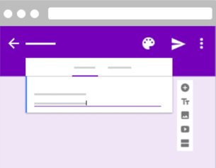
The problem we try to solve:
Sending reports
Existing solution:
Google Forms

Slide 3
Report Management System
(Eiffel Project)
by Bystritsky Bogdan,
Boris Guryev,
Anastatia Kirdyasheva,
Landysh Galieva

Slide 4
This presentation represents the Software Requirements Specification (SRS) document

Slide 5
Scope
Professors activity report
Keep reports on server
Manage administration functions

Slide 6
Product abilities
Create reports
Store reports
Show stored reports
Another functions (in next slide)

Slide 7
Functionality
Cumulative info of a given unit
Courses taught by a laboratory
Number of supervised students by laboratories
Number of research collaboration
Show a list of the all professors awards
Show rating of professors activity

Slide 8

Contraints
The product must be implemented in Eiffel
The product must be able to run in modern web browser.
Data base used in project must be relational.
Server must manage same request at limit time.

Slide 9


Software tools
Front end
Back end

Slide 10




Users characteristics and project concept
Administration of university
Professors
SQLite

Slide 11
Thank you for attention!
You can see our full SRS document in Moodle.

