Slide 1
CREDIT RISK PREDICTION
By Aditya Bagus Pratama
[Notebook Link]

Slide 2
PRELIMINARY
In every company, especially Lending Company, a smooth transaction and credit, especially in paying off a loan, is extremely important
Bad credit, mainly due to defaulted borrowers, is the biggest loss factor for Lending Companies
Losses due to borrowers who fail to pay, are actually caused by the selection of prospective borrowers who are not quite right

Slide 3
GOAL
A Lending Company needs to have a selection system that can predict and classify prospective borrowers who are safe or at risk, so that lending can be right on target.

Slide 4
OBJECTIVES
We will utilize machine learning technology that works quickly in knowing the patterns and characteristics of borrowers, to determine whether a prospective borrower is eligible for a loan or not.

Slide 5
BUSINESS METRICS
Net Profit Margin
company finances will be more stable
Return of Assets
targeted lending, making the capital issued more effective
Minimum Loss
Losses will be reduced due to targeted loans

Slide 6
DATA UNDERSTANDING
The data that will be used for modeling is the Loan Dataset from 2007-2014
There is "target" features which contains the categorization of the borrower based on their “Loan Status”, if the target value is "1" then the borrower has successfully paid, if "0" the borrower is late or failed to pay.

Slide 7
THE BORROWER’S CHARACTERISTICS
Loan Status (loan_status)
Loan Status is feature that will be used to make “Target” features which contains status in which loan is categorized as bad or good and should be accepted or not
Purpose (purpose)
Purpose is contains the purpose of borrowers in applying loan/credit
Loan Amount (loan_amnt)
It contains the amount of loan applied by the borrowers
Loan Grade (grade)
It ranks the loan alphabetically from A to G, in which the bigger a loan close to G grade, the bigger interest will be get

Slide 8
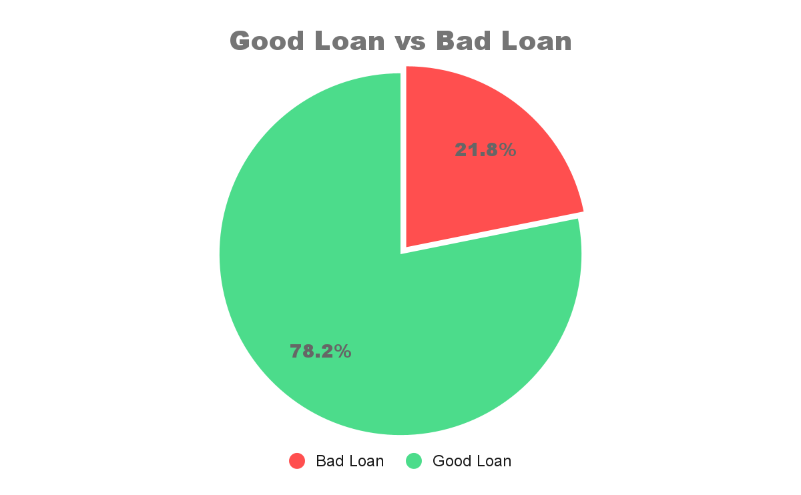

Slide 9
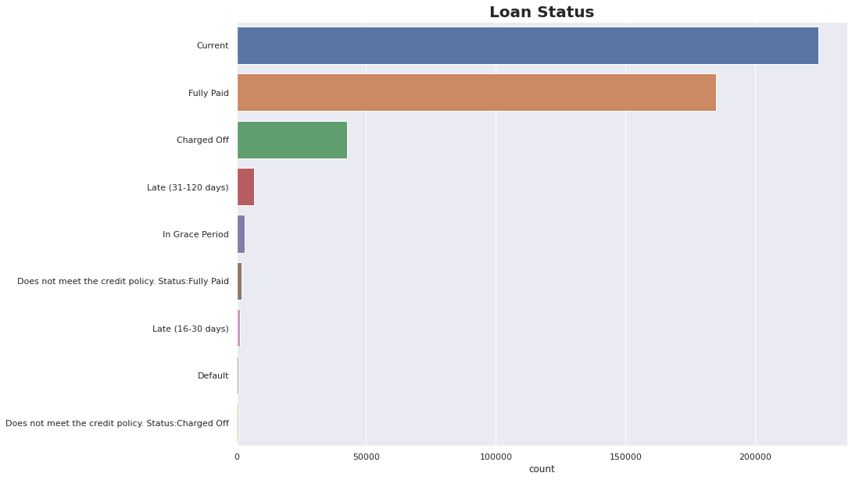
Loan Status View

Slide 10
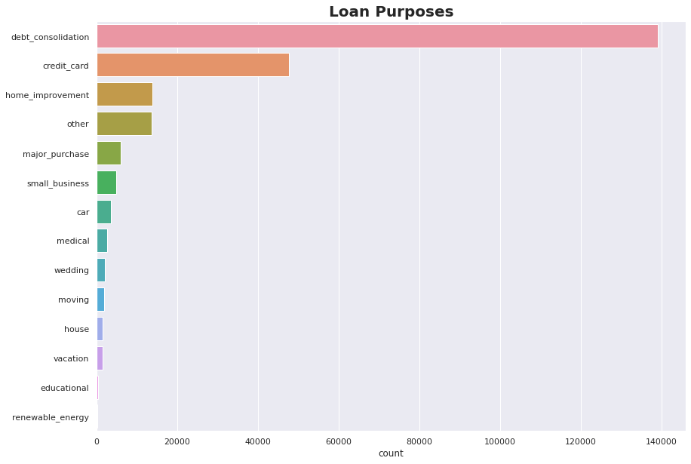
Loan Purpose View
The majority purpose of loan is for Debt Consolidation

Slide 11
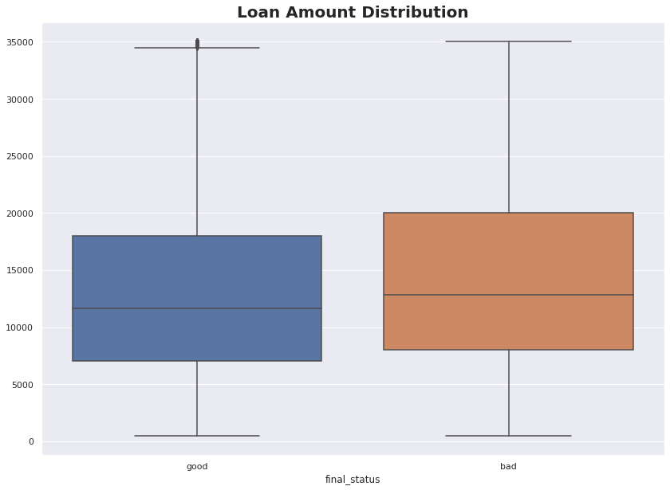
Loan Amount Distribution View
Loan Status | Mean | Std
Good Loan | 13,167 | 7,944
Bad Loan | 14,624 | 8,390
The Mean and
Standard Deviation value in
Bad Loan
is bigger than in the Good Loan

Slide 12
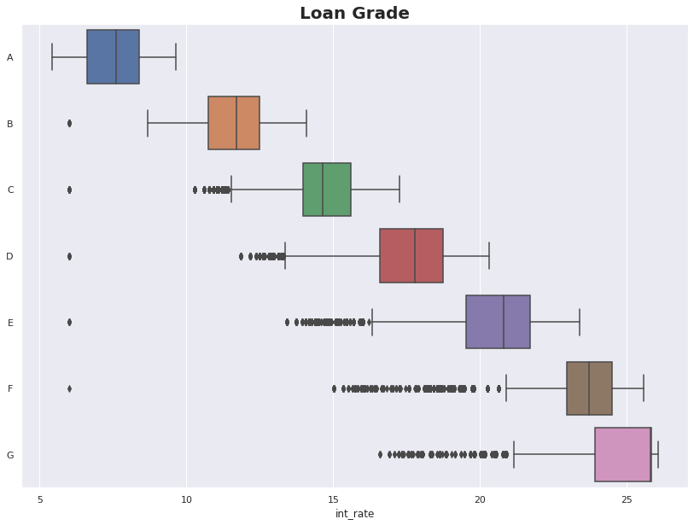
Loan Grade View
Each grade has its own interest rate
Grade A with 7.5% Interest Rate up to Grade G with 24% Interest Rate

Slide 13
DATA PREPARATION
Some preparations have done to before modeling process, are:
Dropping some columns with total and >40% missing values.
Filling up some columns with <40% missing values by assigning mode into categorical data and median into numerical data.
Removing duplicated data
Removing some columns with less correlation into Loan Status
Doing some feature engineering for columns data type

Slide 14
MODELING
The data are splitted into Train Data and Test Data with 80:20 comparison.
The model uses Logistic Regression since we need to do classification with binary target
(good or bad)

Slide 15
ACCURACY RESULT
The model can predict loan status precisely with >95% accuracy
96.1%
for Train Data
95.9%
for Test Data

Slide 16
MODEL PERFORMANCE
PRECISION
87%
Possibility performance to predict a loan is a bad loan in prediction, and is actually bad loan in reality
RECALL
96%
Possibility performance to not wrong in predicting a bad loan as a good loan
F1-SCORE
87%
Combination of Recall and Precision to state the consistency of model in predicting loan status

Slide 17
MODEL ANALYSIS
By using Logistic Regression algorithm, the model has reach 96% accuracy in predicting loan status.
It means, the model can analyze the borrower’s characteristics and classify them into loan status very well. So basically we can use this model in the business process, so that our business metrics can be fulfilled, which means the business risk and loss can be minimized, even profit can be increased.

Slide 18
CONCLUSION
BUSINESS BENEFITS
The model can be used to fulfilled business metrics
BORROWER’S CHARACTERISTIC
Borrowers with bad loan status tend to borrow larger loan amounts than customers with good loan status
PREDICTION RESULT
Model can be used to predict and determine the loan status really well

Slide 19



THANKS !
adityabagusp345@gmail.com
github.com/bytadit
linkedin.com/in/aditya-bagus-pratama

