Slide 1
RON: Reverse Connection with Objectness Prior
Networks for Object Detection
Tao Kong
kt14@mails.Tsinghua.edu.cn
Department of Computer Science and Technology, Tsinghua University

Slide 2
PASCAL VOC 2012
The progress of object detection
100%
Region Based.
R-CNN, Fast(er) R-CNN, R-FCN
ION, HyperNet, OHEM, MR-CNN, etc.
88.4
80%
60%
mean Average Precision (mAP)
deep networks
40%
Region Free.
YOLO, SSD etc.
20%
0%
2008
2009
2010
2011
2012
2013
2014
2015
2016
year

Slide 3
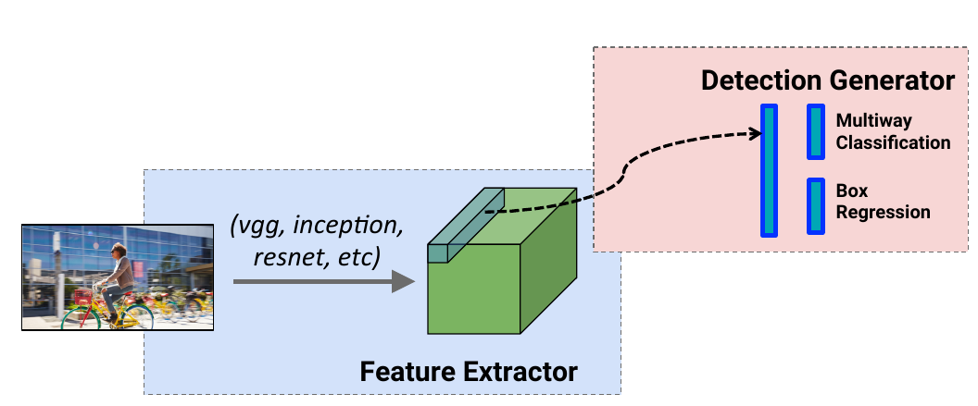
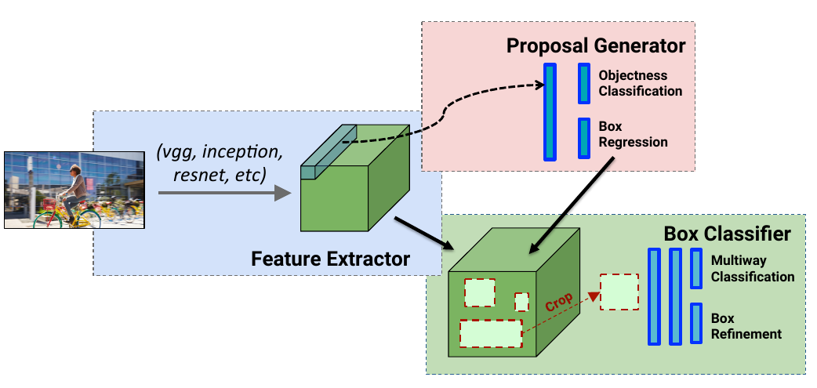
Two object detection architectures
SSD
a) featurized image pyramid
b) Single-shot detector with on CNN
c) Multiple anchors at one level feature
Faster R-CNN
a) Region proposal network
b) Region-wise object detection sub-network
High-speed
No repeated computations
Not easy to train
Strugle with small instances
High-accuracy, easy to train
Easy to follow
Resource/time consuming
Repeated computation with region-wise computing

Slide 4
So, what is the lesson?
√ Feature pyramid works better in locating all scales of objects
from: SSD, HyperNet, ION, MR-CNN
√ Using region proposal network to reduce searching space
from: R-FCN, Faster R-CNN, Fast R-CNN
RON
√ A fully CNN pipeline with no repeated computation can achieve
high detection performance.
from: SSD, R-FCN

Slide 5
So, what is the lesson?
√ Feature pyramid works better in locating all scales of objects
from: SSD, HyperNet, ION, MR-CNN
√ Using region proposal network to reduce searching space
from: R-FCN, Faster R-CNN, Fast R-CNN
RON
√ A fully CNN pipeline with no repeated computation can achieve
high detection performance.
from: SSD, R-FCN

Slide 6
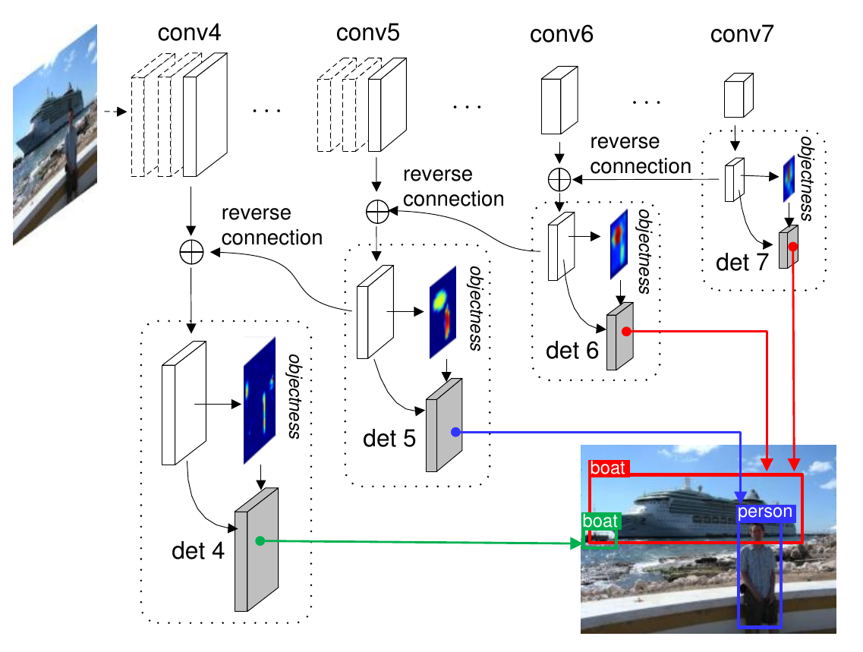
RON: Reverse Connection with Objectness Prior Networks
Objectness Prior
Reverse Connection

Slide 7
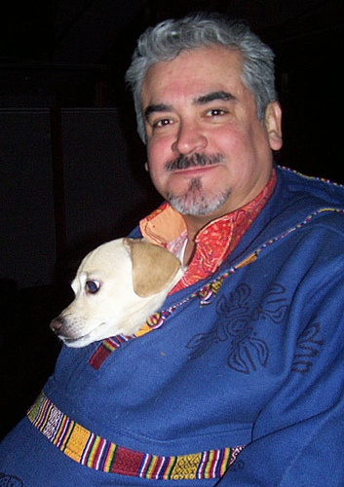
What is reverse connection and why?
detect
detect
detect
Single feature map
detect
Exploring multiple feature directly
detect
detect
Multiple feature concatenation
Multiple feature with reverse connection
detect
detect

Slide 8
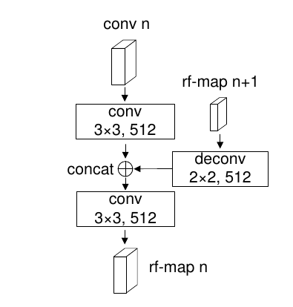
What is reverse connection and why?
a) Simple design
b) The semantic information of former
layers can be significantly enriched
c) Keep the spatial sizes
d) Easy to do multiple level detection
zoom in
detect
detect
A reverse connection block
detect

Slide 9
So, what is the lesson?
√ Feature pyramid works better in locating all scales of objects
from: SSD, HyperNet, ION, MR-CNN
√ Using region proposal network to reduce searching space
from: R-FCN, Faster R-CNN, Fast R-CNN
RON
√ A fully CNN pipeline with no repeated computation can achieve
high detection performance.
from: SSD, R-FCN

Slide 10
From region propsoal boxes to region proposal maps
Faster R-CNN:
Region proposal network (RPN) is fully convolutinal, but detection sub-network is with repeated computation (ROI-Pooling).
Why?
The bbox regression in RPN changes the spatial locations of all boxes, which breaks the anchor's reletionship with its corresponding kernel.

Slide 11
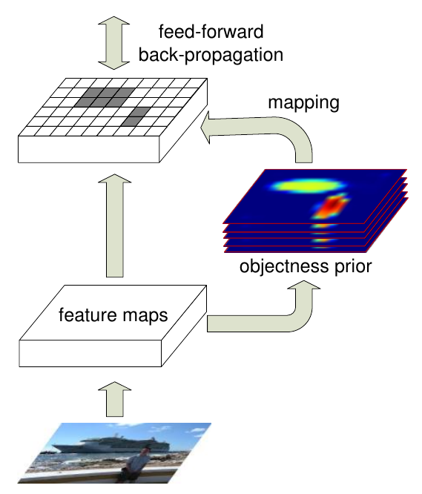
From region propsoal boxes to region proposal maps
Objectness pior:
Share anchors between RPN and detector, make it posible to detect objects with fully ConvNet.
√ No repeated computations, much faster
√ The total network is fully convolutional
√ There are one map for each type of anchors
different from these mask-based methods.

Slide 12
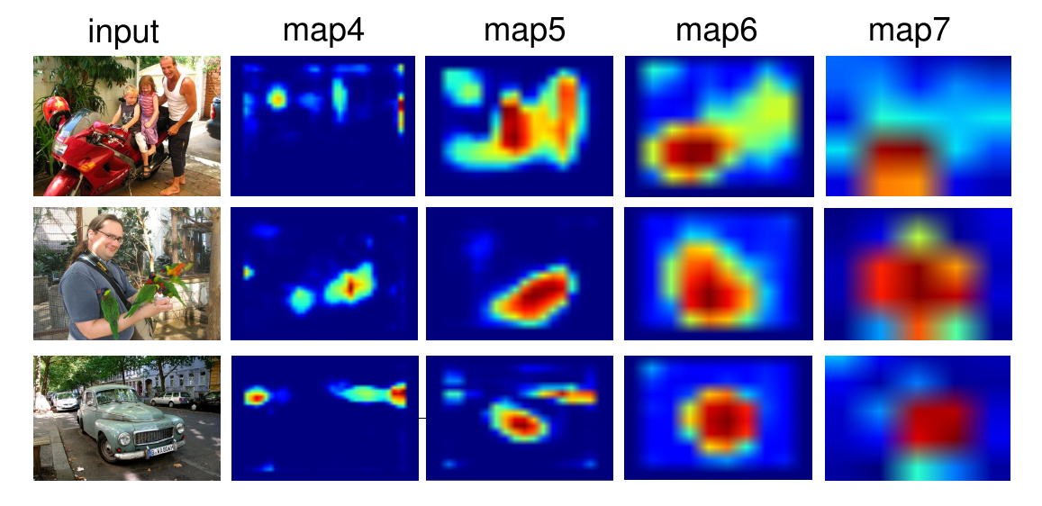
Region proposal maps

Slide 13
So, what is the lesson?
√ Feature pyramid works better in locating all scales of objects
from: SSD, HyperNet, ION, MR-CNN
√ Using region proposal network to reduce searching space
from: R-FCN, Faster R-CNN, Fast R-CNN
RON
√ A fully CNN pipeline with no repeated computation can achieve
high detection performance.
from: SSD, R-FCN

Slide 14
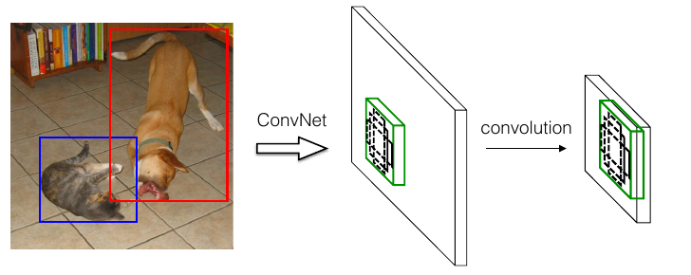
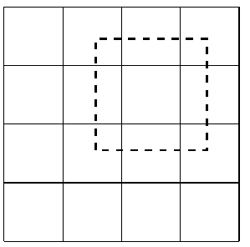
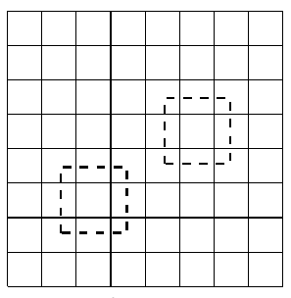
RON bounding box generation
4*4 feature map
Convolutinal output in this position
a) sub-network for objectness
b) sub-network for detection with a)
c) sub-network for bounding box regression
8*8 feature map

Slide 15
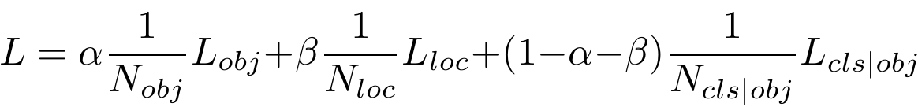
RON optimization
objectness prior
bbox location
detection

Slide 16
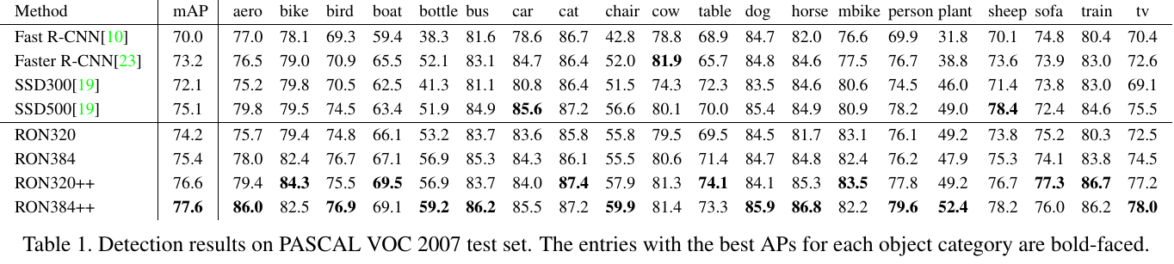
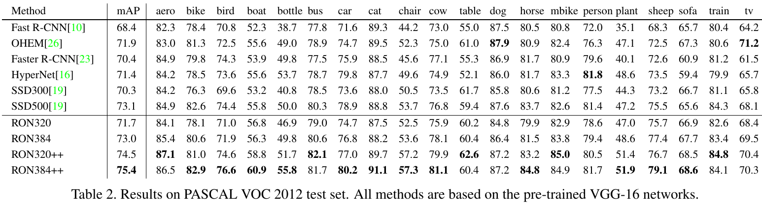
Main results

Slide 17
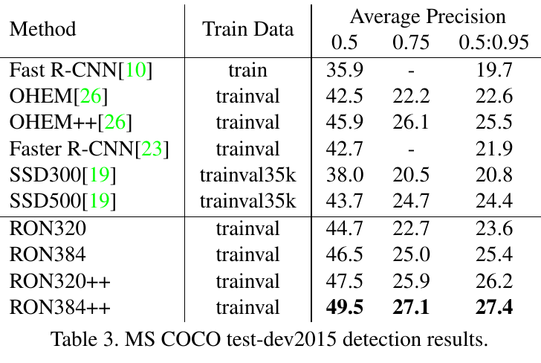
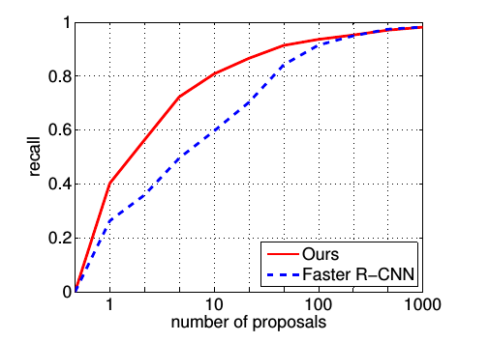
Main results

Slide 18
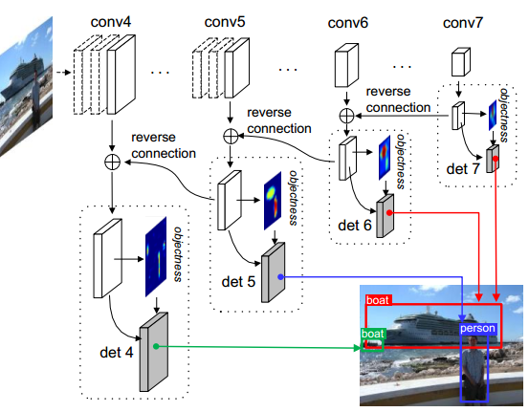
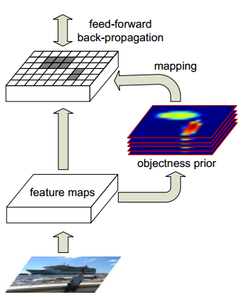
Tao Kong, Fuchun Sun, Anbang Yao, Huaping Liu, Yurong Chen, Ming Lu. RON: Reverse Connection with Objectness Prior Networks for Object Detection, In IEEE Conference on Computer Vision and Pattern Recognition (CVPR), 2017.
Code and model are coming soon!

