Slide 1
SECURE FRAMEWORK FOR IoT ENABLED APPLICATIONS
Name - Gorisha Babbar
Sec - G
Uni. Roll - 2018812
Mentor - Dr. Neha Garg

Slide 2
INTRODUCTION
A security framework, as it pertains to Internet of Things security cameras, is a thorough method of protecting the camera and the data it collects from any attacks. Strong authentication and authorization procedures to manage access, communication channel encryption to safeguard data while it's being transferred, secure boot implementation, and firmware integrity checks to stop unwanted tampering are all included in this framework
CCTV have become a common practice at every store front, home, businesses, governments around the globe have been implementing more and more surveillance and cameras to detect and prevent crimes as well as be helpful in tracking suspicious activities all around the world. This has led to a increased use of cameras all around the globe. Current CCTV cameras are generally useful only after a certain mishap has already happened rather than prevention of such things.
In this project we will be working with Face Detection models and Utilize it to detect whether a given person on the screen is a known entity or an intruder in real time using Machine Learning Libraries like OpenCV coupled with IoT devices to create a security framework based on IoT. Although there are dedicated staff to watch over the live footage from the cameras, human oversight is a common and incurs heavy costs for the businesses to have the appropriate manpower.

Slide 3

By integrating intrusion detection with smart cameras, security surveillance can be improved by utilizing state-of-the-art technology. These smart cameras keep an eye on their surroundings all the time by utilizing cutting-edge technologies like object recognition and motion analysis. The smart cameras immediately send out notifications or initiate automated replies in the event that they discover odd or unlawful activity, such as movements that seem suspicious or unidentified individuals. By utilizing real-time visual analytics and artificial intelligence for improved intrusion detection capabilities, smart cameras become an invaluable asset in protecting a range of environments, from homes to commercial spaces, by enabling a prompt response to potential security threats.

Slide 4
METHODOLOGY
PYTHON
JUPYTER
DLIB
Python is a high-level, general-purpose programming language and is used in this project.
Project Jupyter is a project to develop open-source software, open standards, and services.
Dlib is a general purpose cross-platform software library written in the programming language C++
SQLite
OPEN CV
NUMPY
Software
SQLite is a database engine written in the C programming language.
Practice presenting your deck beforehand with friends or colleagues for feedback, then use this input to refine it further
NumPy is a library for the Python programming language, adding support for large, multi-dimensional arrays and matrices

Slide 5
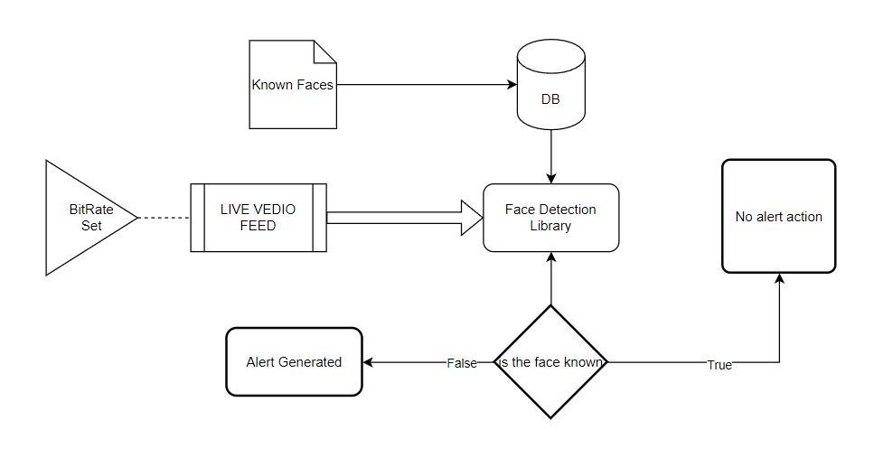
PROPOSED
WORKFLOW
The system presented here composes of five modules:-
1. Live Video Feed
2. Database call
3. ML Model Called (Face Detection Library)
4. Exhaust all Database Entries
5. Output as Predicted Result (SMS Alert Generation)

Slide 6
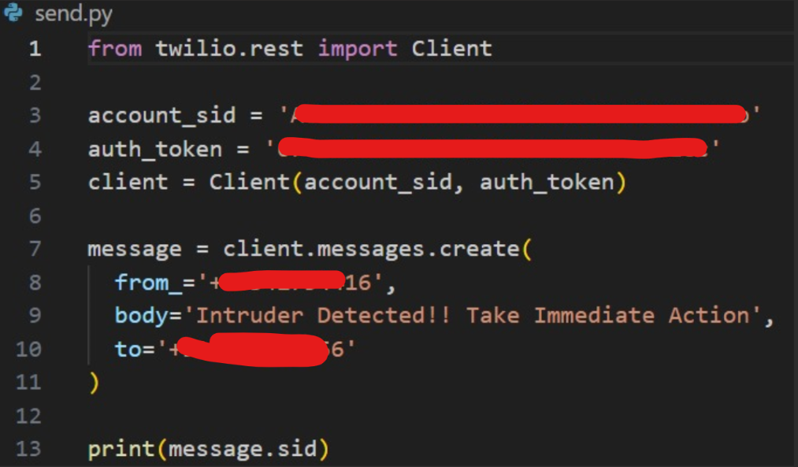
For image classification and face recognition models from DLib namely, Histogram of Oriented Gradients or HOG Face Recognition has been used, which has been trained on extensive image data from Kaggle, achieving an efficiency of above 90 on the test data. (Source : GitHub)
A Snippet of the code for the API call following Intruder Detection leading giving immediate alert
to the user by the means of SMS.

Slide 7
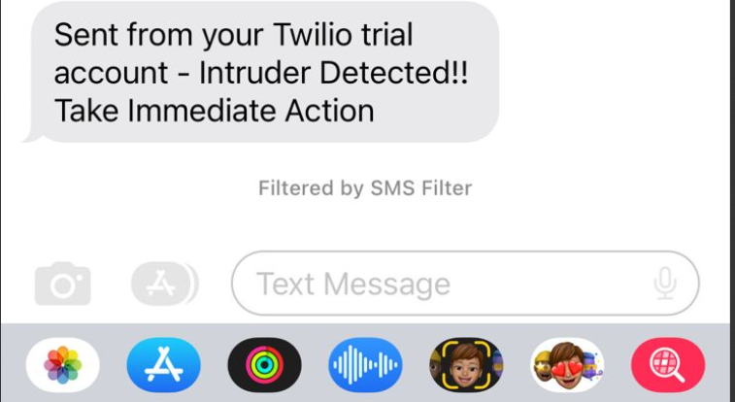
RESULT AND DISCUSSION
By following the described methodology, a fully functional Intrusion Detection System for Internet of Things(IoT) enabled camera feed was deployed, capable of detecting intruding faces in a live stream and using Twilio API delivering a fast and secure message to the respondent via SMS.
As we can see, the project is able to send text messages to the mobile of the respondent and also stores the photograph of the intruder creating a secure environment which can be used from houses to businesses alike for maximizing security through installation of smart cameras.
SMS sent by Twilio API on intrusion detection

Slide 8
CONCLUSION AND FUTURE WORK
Through this project, I have developed a system that can process and identify if a person visiting a camera is a intruder or a known person and give alert to the user immediately. It also stores a database with the names of all the known persons which can also be added to later on. For better portability we have used SQLite which is not a standalone application and comes embedded with the latest version of Python ensuring the code runs on IoT platforms like smart camera.
Although this model was fairly accurate on test data, and performs very well in such scenarios it is still not a hundred percent fool proof and is prone to error. A human along with such a detection system could greatly aid the human as well as the overall accuracy and crime detection on crime scene.

Slide 9
There are numerous directions to take in order to improve the intrusion detection system in the future. Enhancing the system's resilience in difficult situations, such dim lighting or obscured vistas, might be a top concern. Furthermore, adding machine learning models for behavior analysis and anomaly detection could improve the system's capacity to discern between legitimate activity and possible dangers.
Additionally, investigating the integration of edge computing technologies to locally analyze data on smart cameras can help lower latency and improve responsiveness of the system. Working along with other cutting-edge technologies, such as cloud-based services and the Internet of Things (IoT), may create new opportunities for scalability and remote monitoring.

Slide 10

THANK YOU!
Please keep this slide for attribution

