Slide 1
Convnets

Slide 2
Covnets: An approach for Image classification
A convnet takes as input tensors of shape (image_height, image_width, image_channels) (not including the batch dimension).
In our approach for MNSIT initially, we used standard Keras dense layers. Dense implements the operation: output = activation(dot(input, weight) + bias)
Now, we will be using the 2D convolution layer (e.g. spatial convolution over images). What does this mean?
The fundamental difference between a densely layer and a convolution layer is this: Dense layers learn global patterns in their input feature space (for example, for a MNIST digit, patterns involving all pixels), whereas convolution layers learn local patterns. In the case of images, patterns found in small 2D windows of the inputs. In the previous example, these windows were all 3 × 3.

Slide 3
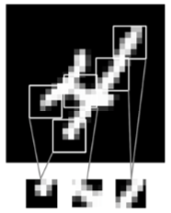
Conv2D layer learning

Slide 4
Why is this “patch” extracted? Why the need?
Regular Neural Nets don’t scale well to full images. In MNSIT, images are only of size 28x28x3 (28 wide, 28 high, 3 color channels), so a single fully-connected neuron in a first hidden layer of a regular Neural Network would have 28*28*3 = 2352 weights. This amount still seems manageable, but clearly this fully-connected structure does not scale to larger images. For example, an image of more respectable size, e.g. 200x200x3, would lead to neurons that have 200*200*3 = 120,000 weights.
The huge number of parameters would quickly lead to overfitting.

Slide 5
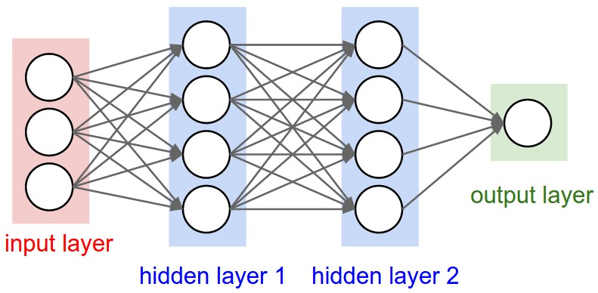
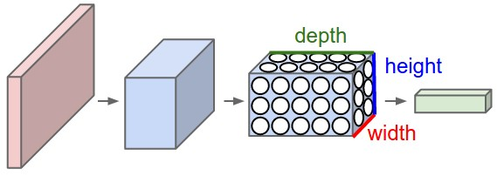
Regular Neural Network
Covnet

Slide 6
So whats the difference then?
As we read, the neurons in a layer will only be connected to a small region of the layer before it, instead of all of the neurons in a fully-connected manner. That is they will reduce the parameters by only learning a certain subset of weights.
The covnet layer will compute the output of neurons that are connected to local regions in the input, each computing a dot product between their weights and a small region they are connected to in the input volume.

Slide 7
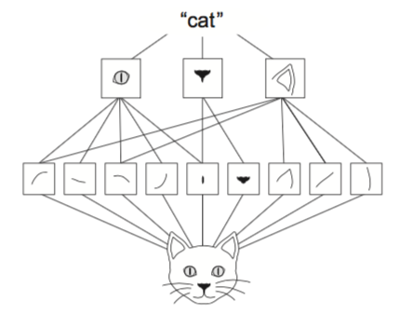
Key Characteristics of Covnets
They can learn spatial hierarchies of patterns. A first convolution layer will learn small local patterns such as edges, a second convolution layer will learn larger patterns made of the features of the first layers, and so on. This allows convnets to efficiently learn increasingly complex and abstract visual con- cepts (because the visual world is fundamentally spatially hierarchical).
Notes:
The visual world forms a spatial hierarchy of visual modules: hyperlocal edges combine into local objects such as eyes or ears, which combine into high-level concepts such as “cat.”

Slide 8
Key Characteristics
The patterns they learn are translation invariant. After learning a certain pattern in the lower-right corner of a picture, a convnet can recognize it anywhere: for example, in the upper-left corner. A densely connected network would have to learn the pattern anew if it appeared at a new location. This makes convnets data efficient when processing images (because the visual world is fundamentally translation invariant): they need fewer training samples to learn representations that have generalization power.

Slide 9
Covnets and MNSIT data
In the MNIST example, the first convolution layer takes a feature map of size (28, 28, 1) and outputs a feature map of size (26, 26, 32): it computes 32 filters over its input. Each of these 32 output channels contains a 26 × 26 grid of values, which is a response map of the filter over the input, indicating the response of that filter pattern at different locations in the input.
Convolutions operate over 3D tensors, called feature maps, with two spatial axes (height and width) as well as a depth axis (also called the channels axis). For an RGB image, the dimension of the depth axis is 3, because the image has three color channels: red, green, and blue. The convolution operation extracts patches from its input feature map and applies the same transformation to all of these patches, producing an output feature map. This output feature map is still a 3D tensor: it has a width and a height.

Slide 10
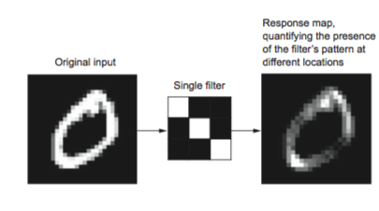
Covents, A visual Image
Convolutions are defined by two key parameters: Size of the patches extracted from the inputs—These are typically 3 × 3 or 5 × 5. In the example, they were 3 × 3, which is a common choice. Depth of the output feature map—The number of filters computed by the convolution. The example started with a depth of 32 and ended with a depth of 64.

Slide 11
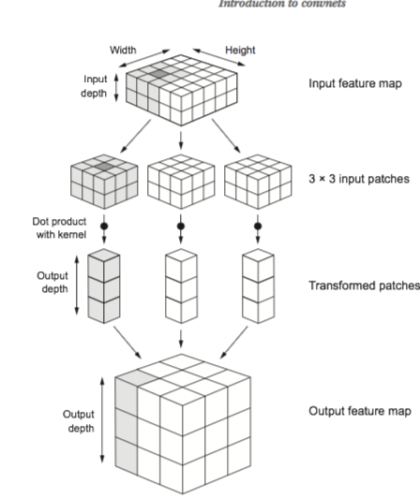
Covnets, steps

Slide 12
Steps in words
A convolution works by sliding these windows of size 3 × 3 or 5 × 5 over the 3D input feature map, stopping at every possible location, and extracting the 3D patch of surrounding features (shape (window_height, window_width, input_depth)). Each such 3D patch is then transformed (via a tensor product with the same learned weight matrix, called the convolution kernel ) into a 1D vector of shape (output_depth,).
All of these vectors are then spatially reassembled into a 3D output map of shape (height, width, output_depth). Every spatial location in the output feature map corresponds to the same location in the input feature map (for example, the lower-right corner of the output contains information about the lower-right corner of the input)

Slide 13
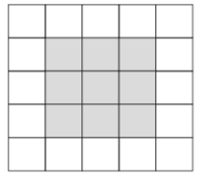
Covnets: Details
Why does the first layer use width and height of 26*26 when our input space width and height was 28*28. This is because of our choice of extracting 3*3 windows
So the output from that layer are 3*3 grids which has shrunk by exactly two tiles.

Slide 14
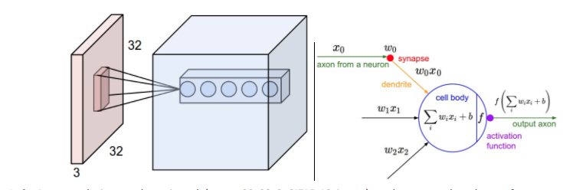
Local vs. Full connectivity
Left: An example input volume in red (e.g. a 32x32x3 image), and an example volume of neurons in the first Convolutional layer. Each neuron in the convolutional layer is connected only to a local region in the input volume spatially, but to the full depth (i.e. all color channels). Note, there are multiple neurons (5 in this example) along the depth, all looking at the same region in the input - see discussion of depth columns in text below. Right: The neurons from the Neural Network chapter remain unchanged: They still compute a dot product of their weights with the input followed by a non-linearity, but their connectivity is now restricted to be local spatially.

Slide 15
Why local connectivity
A fully connected layer occupies most of the parameters, and hence, neurons develop co-dependency amongst each other during training which curbs the individual power of each neuron leading to over-fitting of training data.
The result is that convnets learn local, translation-invariant features, and are highly data efficient on perceptual problems. They dont need tens of thousands of images, hundreds will suffice.

Slide 16
Max Pooling and Downsampling
Downsampling effectively means to resize images smaller (reduce height and width).
In the convnet example, you may have noticed that the size of the feature maps is halved after every MaxPooling2D layer. For instance, before the first MaxPooling2D layers, the feature map is 26 × 26, but the max-pooling operation halves it to 13 × 13. That’s the role of max pooling: to aggressively downsample feature maps.

Slide 17
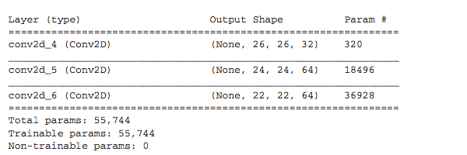
Why do we need the max pooling layer?
Why downsample feature maps this way? Why not remove the max-pooling layers and keep fairly large feature maps all the way up?

Slide 18
Why max-pooling?
The final feature map has 22 × 22 × 64 = 30,976 total coefficients per sample. This is huge. If you were to flatten it to stick a Dense layer of size 512 on top, that layer would have 15.8 million parameters. This is far too large for such a small model and would result in intense overfitting.
It isn’t conducive to learning a spatial hierarchy of features. The 3 × 3 windows in the third layer will only contain information coming from 7 × 7 windows in the initial input. The high-level patterns learned by the convnet will still be very small with regard to the initial input, which may not be enough to learn to classify digits (try recognizing a digit by only looking at it through windows that are 7 × 7 pixels!). We need the features from the last convolution layer to contain information about the totality of the input.

Slide 19
Why max-pooling?
In short, the reason to use downsampling is to reduce the number of feature-map coefficients to process, as well as to induce spatial-filter hierarchies by making successive convolution layers look at increasingly large windows (in terms of the fraction of the original input they cover).

