Slide 1
public void main()
{
printf(”Hello,
my name is Mariusz”);
}

Slide 2
{ }

Slide 3

Nothing
to do here

Slide 4
{nenio}

Slide 5
{nihil}

Slide 6
{NULL}

Slide 7
new Presentation(NULL);

Slide 8
70%
55%
50%
NullPointerException
NumberFormatException
IllegalArgumentException

Slide 9

ANY OS
Null reference
Causing errors since 1965
Press any key to continue_

Slide 10
// Null reference:
// „The billion dolar // mistake”

Slide 11


Slide 12
typeof(NULL);

Slide 13
String s;

Slide 14
String s;
Stack
Heap
s=0x0
0x0
0

Slide 15
String s;
s = ”test”;
Stack
Heap
s=0x4f
0x0
0
0x4f
”test”

Slide 16
&NULL

Slide 17
Priviledge escalation

Slide 18
Process1 (user)
0x0
physical memory
0x3
Process2 (kernel)
0x0

Slide 19
Process1 (user)
0x0
*func
physical memory
0x3
Process2 (kernel)
0x0

Slide 20
Process1 (user)
0x0
*func
physical memory
0x3
*func
Process2 (kernel)
0x0

Slide 21
Process1 (user)
0x0
*func
physical memory
0x3
*func
Process2 (kernel)
0x0
*func

Slide 22
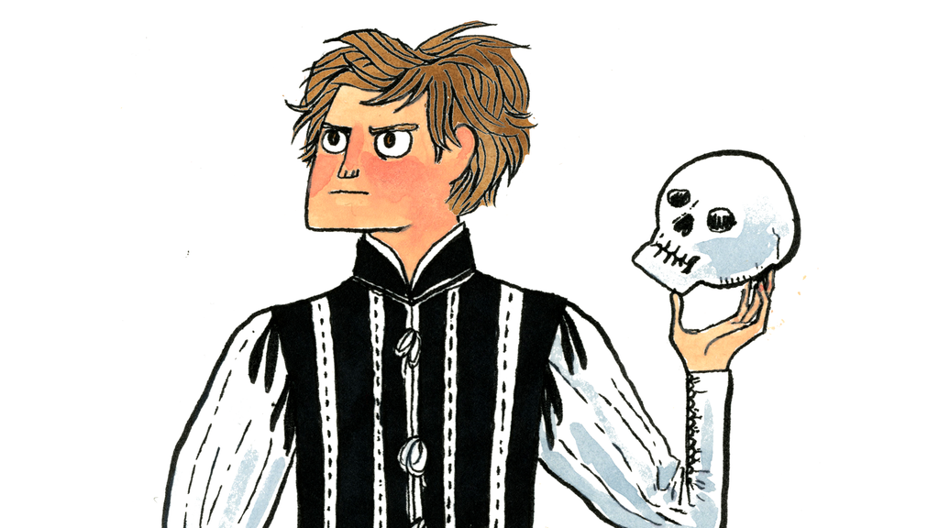
NULL OR NOT NULL THAT IS THE QUESTION

Slide 23
public Employee getByName(String name)
{
int id = database.find(name);
if(id == 0)
{
return null;
}
return new Employee(id);
}

Slide 24
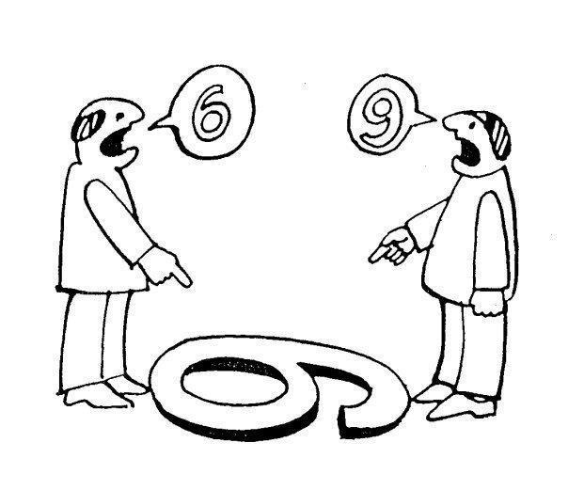
Computer Thinking
vs
Object Thinking

Slide 25

Hello, is it a software department?
Yes.
Let me talk to your employee „Jeffrey” please.
Hold the line please
Hello.
Are you NULL?

Slide 26
getByNameOrNullIfNotFound
public Employee getByName(String name)

Slide 27
Slow Failing
vs
Failing Fast

Slide 28

Use NULL and die slowly, killing others on the way

Slide 29
public Employee getByName(String name)
{
Employee e = employees.get(name);
if(e == null)
{
throw new
EmployeeNotFoundException();
}
return e;
}

Slide 30
if(!employees.containsKey(name))
{
throw new EmployeeNotFoundException();
}
return employees.get(name);

Slide 31
Iterator found = Map.search(name);
if(!found.hasNext())
{
throw new EmployeeNotFoundException();
}
return found.next();

Slide 32
NullObjectPattern

Slide 33
class Employee
{
static readonly Employee Null = new NullEmployee();
private class NullEmployee : Employee
{
public override void SomeMethod()
{
//purposfully provides no behavior
}
}
}

Slide 34
public Employee getByName(String name)
{
Employee e = employees.get(name);
if(e == null)
{
return Employee.Null;
}
return e;
}

Slide 35
MayObjectPattern

Slide 36
public interface Maybe<T>
{
bool HasValue();
T Value();
}

Slide 37
public class Some<T> {
private readonly T t;
public Some(T t) {
this.t = t;
}
public bool HasValue() {
return true;
}
public T Value() {
return t;
}
}

Slide 38
public class None<T> {
public bool HasValue() {
return false;
}
public T Value() {
throw new NotImplementedException;
}
}

Slide 39
public Employee getByName(String name)
{
Employee e = employees.get(name);
if(e == null)
{
return new None<Employee>();
}
return new Some<Employee>(e);
}

Slide 40
(λ)

Slide 41
public Employee getByName(String name,
Func errorFunc)
{
Employee e = employees.get(name);
if(e == null)
{
errorFunc();
}
return e;
}

Slide 42
var throwIfNotFound = () => throw new EmployeeNotFoundException();
var employee = getByName(”Bob”, throwIfNotFound);

Slide 43

NULL
USE WITH

Slide 44
class Presentation
{
~Presentation()
{
printf(”thanks, bye”);
}
}

