Slide 1
public void main()
{
printf(”Hello,
my name is Mariusz”);
}

Slide 2
{ }

Slide 3

Nothing
to do here

Slide 4
{nenio}

Slide 5
{nihil}

Slide 6
{NULL}

Slide 7
new Presentation(NULL);

Slide 8
70%
55%
50%
NullPointerException
NumberFormatException
IllegalArgumentException

Slide 9

ANY OS
Null reference
Causing errors since 1965
Press any key to continue_

Slide 10
// Null reference:
// „The billion dolar // mistake”

Slide 11


Slide 12
typeof(NULL);

Slide 13
String s;

Slide 14
String s;
Stack
Heap
s=0x0
0x0
0

Slide 15
String s;
s = ”test”;
Stack
Heap
s=0x4f
0x0
0
0x4f
”test”

Slide 16
&NULL

Slide 17
Priviledge escalation

Slide 18
Process1 (user)
0x0
physical memory
0x3
Process2 (kernel)
0x0

Slide 19
Process1 (user)
0x0
*func
physical memory
0x3
Process2 (kernel)
0x0

Slide 20
Process1 (user)
0x0
*func
physical memory
0x3
*func
Process2 (kernel)
0x0

Slide 21
Process1 (user)
0x0
*func
physical memory
0x3
*func
Process2 (kernel)
0x0
*func

Slide 22
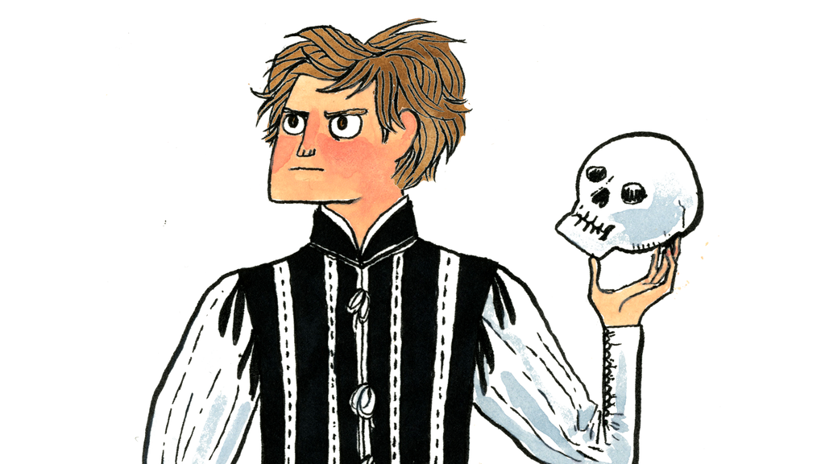
NULL OR NOT NULL THAT IS THE QUESTION

Slide 23
public Employee getByName(String name)
{
int id = database.find(name);
if(id == 0)
{
return null;
}
return new Employee(id);
}

Slide 24
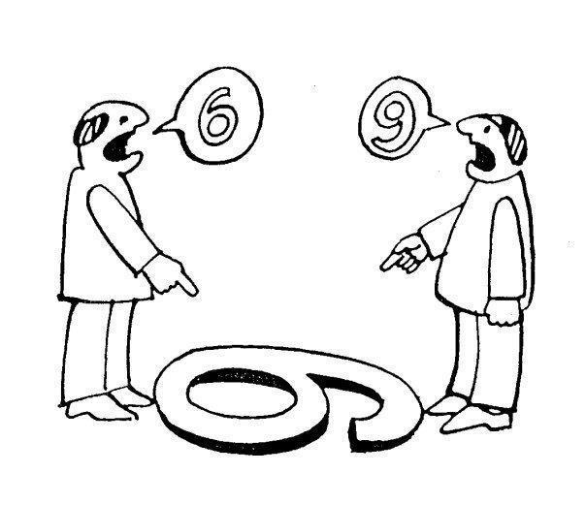
Computer Thinking
vs
Object Thinking

Slide 25
Hello, is it a software department?

Slide 26
Hello, is it a software department?
Yes.

Slide 27
Hello, is it a software department?
Yes.
Let me talk to your employee „Jeffrey” please.

Slide 28
Hello, is it a software department?
Yes.
Let me talk to your employee „Jeffrey” please.
Hold the line please

Slide 29
Hello, is it a software department?
Yes.
Let me talk to your employee „Jeffrey” please.
Hold the line please
Hello.

Slide 30
Hello, is it a software department?
Yes.
Let me talk to your employee „Jeffrey” please.
Hold the line please
Hello.
Are you NULL?

Slide 31

Hello, is it a software department?
Yes.
Let me talk to your employee „Jeffrey” please.
Hold the line please
Hello.
Are you NULL?

Slide 32
getByNameOrNullIfNotFound
public Employee getByName(String name)

Slide 33
Slow Failing
vs
Failing Fast

Slide 34

Use NULL and die slowly, killing others on the way

Slide 35
public Employee getByName(String name)
{
Employee e = employees.get(name);
if(e == null)
{
throw new
EmployeeNotFoundException();
}
return e;
}

Slide 36
if(!employees.containsKey(name))
{
throw new EmployeeNotFoundException();
}
return employees.get(name);

Slide 37
Iterator found = Map.search(name);
if(!found.hasNext())
{
throw new EmployeeNotFoundException();
}
return found.next();

Slide 38
NullObjectPattern

Slide 39
class Employee
{
static readonly Employee Null = new NullEmployee();
private class NullEmployee : Employee
{
public override void SomeMethod()
{
//purposfully provides no behavior
}
}
}

Slide 40
public Employee getByName(String name)
{
Employee e = employees.get(name);
if(e == null)
{
return Employee.Null;
}
return e;
}

Slide 41
MayObjectPattern

Slide 42
public interface Maybe<T>
{
bool HasValue();
T Value();
}

Slide 43
public class Some<T> {
private readonly T t;
public Some(T t) {
this.t = t;
}
public bool HasValue() {
return true;
}
public T Value() {
return t;
}
}

Slide 44
public class None<T> {
public bool HasValue() {
return false;
}
public T Value() {
throw new NotImplementedException;
}
}

Slide 45
public Employee getByName(String name)
{
Employee e = employees.get(name);
if(e == null)
{
return new None<Employee>();
}
return new Some<Employee>(e);
}

Slide 46
(λ)

Slide 47
public Employee getByName(String name,
Func errorFunc)
{
Employee e = employees.get(name);
if(e == null)
{
errorFunc();
}
return e;
}

Slide 48
var throwIfNotFound = () => throw new EmployeeNotFoundException();
var employee = getByName(”Bob”, throwIfNotFound);

Slide 49

NULL
USE WITH

Slide 50
class Presentation
{
~Presentation()
{
printf(”thanks, bye”);
}
}

