Slide 1
public void main()
{
printf(”Hello,
my name is Mariusz”);
}

Slide 2
{ }

Slide 3

Nothing
to do here

Slide 4
{nothing}

Slide 5
{nichts}

Slide 6
{ничего}

Slide 7
{nenio}

Slide 8
{nihil}

Slide 9
{NULL}

Slide 10
new Presentation(NULL);

Slide 11
70%
55%
50%
NullPointerException
NumberFormatException
IllegalArgumentException

Slide 12

ANY OS
Null reference
Causing errors since 1965
Press any key to continue_

Slide 13
// Null reference:
// „The billion dolar // mistake”

Slide 14


Slide 15
typeof(NULL);

Slide 16
String s;

Slide 17
String s;
Stack
Heap
s=0x0
0x0
0

Slide 18
String s;
s = ”test”;
Stack
Heap
s=0x4f
0x0
0
0x4f
”test”

Slide 19
&NULL

Slide 20
Priviledge escalation

Slide 21
Process1 (user)
0x0
physical memory
0x3
Process2 (kernel)
0x0

Slide 22
Process1 (user)
0x0
*func
physical memory
0x3
Process2 (kernel)
0x0

Slide 23
Process1 (user)
0x0
*func
physical memory
0x3
*func
Process2 (kernel)
0x0

Slide 24
Process1 (user)
0x0
*func
physical memory
0x3
*func
Process2 (kernel)
0x0
*func

Slide 25
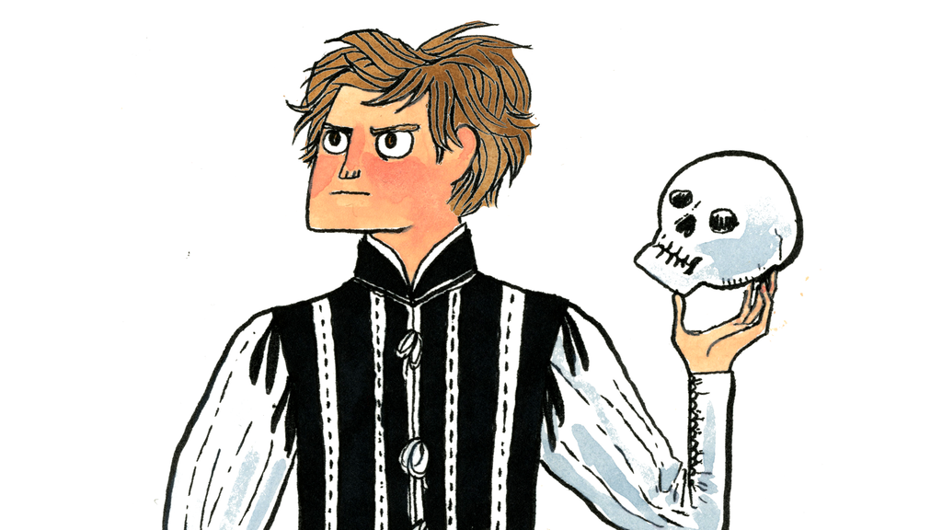
NULL OR NOT NULL THAT IS THE QUESTION

Slide 26
public Employee getByName(String name)
{
int id = database.find(name);
if(id == 0)
{
return null;
}
return new Employee(id);
}

Slide 27
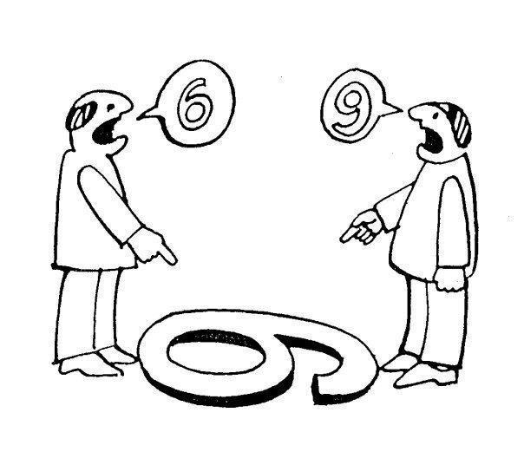
Computer Thinking
vs
Object Thinking

Slide 28

Hello, is it a software department?
Yes.
Let me talk to your employee „Jeffrey” please.
Hold the line please
Hello.
Are you NULL?

Slide 29
getByNameOrNullIfNotFound
public Employee getByName(String name)

Slide 30
Slow Failing
vs
Failing Fast

Slide 31

Use NULL and die slowly, killing others on the way

Slide 32
public Employee getByName(String name)
{
Employee e = employees.get(name);
if(e == null)
{
throw new
EmployeeNotFoundException();
}
return e;
}

Slide 33
if(!employees.containsKey(name))
{
throw new EmployeeNotFoundException();
}
return employees.get(name);

Slide 34
Iterator found = Map.search(name);
if(!found.hasNext())
{
throw new EmployeeNotFoundException();
}
return found.next();

Slide 35
NullObjectPattern

Slide 36
class Employee
{
static readonly Employee Null = new NullEmployee();
private class NullEmployee : Employee
{
public override void SomeMethod()
{
//purposfully provides no behavior
}
}
}

Slide 37
public Employee getByName(String name)
{
Employee e = employees.get(name);
if(e == null)
{
return Employee.Null;
}
return e;
}

Slide 38
(λ)

Slide 39
public Employee getByName(String name,
Func errorFunc)
{
Employee e = employees.get(name);
if(e == null)
{
errorFunc();
}
return e;
}

Slide 40
var throwIfNotFound = () => throw new EmployeeNotFoundException();
var employee = getByName(”Bob”, throwIfNotFound);

Slide 41

NULL
USE WITH

Slide 42
class Presentation
{
~Presentation()
{
printf(”thanks, bye”);
}
}

