Slide 1
Expectations for Cloud Ready Applications
Speaker
Day, Month Year

Slide 2
Healthcare Cloud Platforms
Objectives
OSFI Kubernetes
OSFI Openshift Origin
OSFI Openshift Enterprise
Azure Public
BDPaaS?

Slide 3
Health Care Cloud Overview
Speaker Name

Slide 4
Health Care Cloud | Enterprise Cloud Strategy
Enabling teams to deliver value safely, quickly and sustainably in the Healthcare Cloud. Providing for an orderly adoption of Healthcare Cloud services with visibility into who is utilizing, what is being used, how much we are spending, and what risks we are being exposed to.
Internal Business Partners
Internal Technical Partners
UHG- Enterprise
External Clients
Vendors
Offering Choices with flexibility & Agility in the offerings and bundling of those offerings.
Lowest cost option regardless of platform.
No vendor lock-in.
Ease to scale and agility to chose when.
Education and strategy considerations.
End to end audit and compliance traceability.
Agile & proactive approach to development of modules.
Solutions pre-assembled via business portfolio (i.e. Data analytics).
Provide a library of reusable modules.
Inner-Source/ Coaching/Training materials& opportunities.
Security Framework with no interruption to application or services.
Delivering Value at the lowest risk to the business.
Meetings Compliance & Security Policies.
Monitoring/ remediation/ reporting on risk.
Offering out services priced to break-even.
Multiple Vendor Options to meet various business needs across the organization.
Multi-channel/market approach consolidates investment in common platforms/ services & capabilities.
Product interoperability existing CSP security and compliance.
Cost Savings by leveraging power in numbers.
IaaS/PaaS strategy.
Help vendor maximize cost/value proposition
New Vendor Service models:
Micro-service injections
Blended data/code ownership
New life cycles
Partners

Slide 5

Health Care Cloud | Team Maturity Expectations
Level 0
Level 1
Level 2
Level 3
Level 4
Level 5
Source code management
using Git, EGH and Pull Requests
Partially automated test/build process (CI) (e.g. Jenkins)
Fully automated test/build process (CI) (e.g. Sonar)
Partially automated deployment process (CD)
Logging/Monitoring in place across all env’s (e.g. Ruxit)
Service based (API-centric) design leveraging containers
IAC in place as part of the CI/CD pipeline (e.g. Chef)
Serverless UI/Single Page Web App (SPA)
API calls routed through public cloud edge networks or using cloud based DNS configuration
Reality: teams are not at the expected maturity level needed to move to the cloud. Expectation: Only teams/apps at Level 5 consider migrating to Public Cloud with confidence.
Data and API/Service/ Business Logic tiers migrated to public cloud platform

Slide 6



Health Care Cloud | Who moves to the Public Cloud?
Application Categories
Even if a team demonstrates readiness for the public cloud, it does not entitle them to deploy to the public cloud.
Teams must demonstrate a use case for the Public Cloud offerings based upon one or more of the following criteria:
Commerciality: The application or service is intended for external commercial uses. Commercial applications, or apps that are used externally that have the potential for “viral” user uncertainty, are good candidates for public cloud (with proper scaling).
Volatility: Applications that have very high load peaks compared to its average, also known as seasonality of the workload. We need to manage the volatility on the public cloud to ensure we do not impact other services and reduce cost if planning for the worse case.
Data Gravity: Big data is difficult, costly and time consuming to move back and forth between data centers. Application requiring a large amount of data should be hosted close to the data.
Integration Gravity: Applications that are deployed to public cloud should not have multiple dependencies on integrations located in the Optum data center. Integration should only be through streaming methods or API.
User Gravity: If the users are all in the UHG network (and if the data is all in the data center), then the application should be hosted in the Optum Data Center.
PII/PHI: The presence of PII/PHI is a factor used when evaluating workload placement, but it is not the only criteria. The volatility of the workload and data gravity has more weight when making workload placement. Additionally, the controls in place assume the presence of PII/PHI and the controls are mandatory.

Slide 7

Cloud | Private Cloud Journey Team Experience
Dev. Team Cloud Journey
Crawl
Walk
Run
Marathon
Cloud Aligned
Portfolio/Application on Cloud Readiness
Team Maturity Assessment
Revise Architecture- Modernized
Leverage Training Materials
Engage Sprint 0 team
Cloud Enabled
Cont’d Training/ Coaching
Onboard to Non-Prod
Finalize Target Architecture
POC /Pilot
Cloud Ready
Immutable Containers
CI/CD & gitops
Decouple the data
Design for scaling
Observability
Cross Cloud
Multi-cluster deployment
True devops
Serverless if applicable
Mature operation
Self-healing application
Advanced data management
0-1 month 1-3 months 3-6 Months 6-8 Months

Slide 8
Cloud | Public Cloud Journey Team Experience
Dev. Team Cloud Journey
Crawl
Walk
Run
Marathon
Cloud Aligned
Portfolio/Application on Cloud Readiness
Team Maturity Assessment
Revise Architecture- Modernized
Leverage Training Materials/ Workshops/ Redbox
Engage Coaching Team
Cloud Enabled
Cont’d Training/ Coaching
Develop in Redbox
Finalize Target Architecture
Leverage Automated Modules
POC Ready
Cloud Ready
Immutable Infrastructure
IAC/ EAC
CI/CD
API Calls
Cross Cloud
Use Self-Service CSP selection based on Client Needs/Price
Zero Trust Networking is Realized
Serverless is Common practice
Machine Learning Applied to Operations
2-4 months. 4-6 months. 6-9 Months TBD

Slide 9
Cloud Ready Applications
Speaker Name

Slide 10
Health Care Cloud | What is Cloud Readiness?

Slide 11
Health Care Cloud | Cloud Readiness Vs Cloud Native

Slide 12
12 Factor Application
Speaker Name

Slide 13
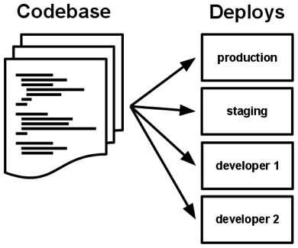

#1 Codebase
One Codebase should be used to track all changes to the application
Git
Subversion
Each Codebase can have numerous different deploys for all of the environments needed
Prod Deploy
Non Prod Deploy
Stage Deploy

Slide 14


#2 Dependencies
Dependencies should be explicitly declared and isolated
Handled by common tools such as gradle or maven
Eliminates Dependency on system-level tools or libraries.
Notes:
https://github.optum.com/EAIP/meme-http/blob/master/build.gradle#L45

Slide 15
#3 Config
Configurations should be stored within environment variables
Within Kubernetes this can be done via your deployment yaml or through configmaps
Be cautious of storing a password in environment variables as if the container or runtime is compromised these passwords can be accessed
Better to mount a secret volume and point at the password directory within Kubernetes
Notes:
https://github.optum.com/OPTUMSource/blank/blob/master/web/src/main/resources/application.yml
https://github.optum.com/DataExternalization/eligibility-api-consumer/blob/master/src/main/resources/application.yml#L143 and https://github.optum.com/DataExternalization/eligibility-api-consumer/blob/master/osedeploy.yaml#L92

Slide 16
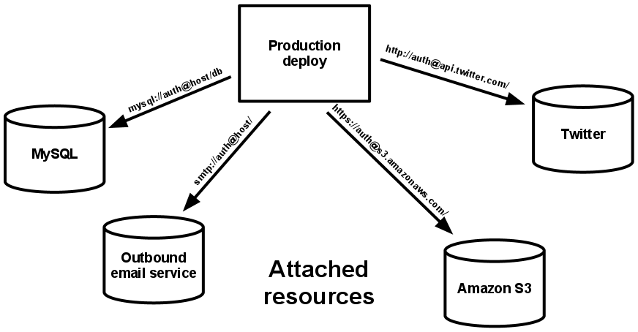
#4 Backing Services
Think of backed databases, caches, etc as attached resources.
Code should be agnostic of the backed
Easily switch between different types of databases with no code change

Slide 17
#5 Build, Release, Run
Build – Code that has been compiled and has all of the needed dependencies downloaded by the dependency manager
Release – A release combines the built code with the current deployments configuration. A package that is
Run – An app running in an execution environment that is comprised of numerous processes

Slide 18
#6 Processes
Execute the app as one or more stateless processes
Any data that needs to be persisted should use a persistent data backend
Avoid using sticky sessions at all costs. Session data should be stored in a datastore such as Redis or Memchaced

Slide 19
#7 Port Binding
Each Application should be bound to a specific port so that it can be easily accessed by other applications
Should not rely on a runtime injection of a webserver
An exception to this would be a consumer that pulls and pushes data but does not expose anything itself
If one app is a backing service for another app the details on this port can be stored within the config.
Within Kubernetes you can rely on internal DNS Names to map to the containers IP and Port
Notes:
https://github.optum.com/DataExternalization/eligibility-api-consumer/blob/master/osedeploy.yaml#L245

Slide 20
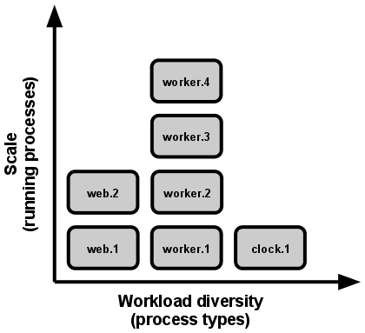
#8 Concurrency
Each type of workload should be handled by creating a new process
In order to achieve concurrency duplicate processes can be spun up and load can be split across them.
Container Orchestration Engines Handle a lot of this for you (Kubernetes, Openshift)
Notes:
https://github.optum.com/DataExternalization/eligibility-api-consumer/blob/master/osedeploy.yaml#L33

Slide 21
#9 Disposability
Applications need to be able to be torn down and restarted quickly
In a containerized world containers can move to a different physical node at any point
SIGTERM can be utilized when a graceful shutdown happens
A queue can be used for crash events where events are placed back in the queue in the event of a timeout
Notes:
https://github.optum.com/gist/aaronkorver/3f130bb388766ee95441f09a70e0f82b

Slide 22
#10 Dev/prod parity
Time Gap – Within hours or minutes after a developer writes code it should be deployed to production
Personnel Gap – A developer who writes code should be involved during the deployment and also monitor the applications behavior
Tools Gap – Tools used in a development environment should be identical to those used in production. In a containerized world this is very possible. Eliminates many one of issues that arise
Notes:
https://github.optum.com/gist/aaronkorver/3f130bb388766ee95441f09a70e0f82b

Slide 23
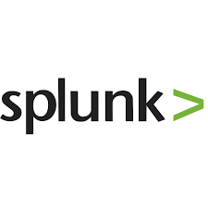


#11 Logs
Logs should be an event stream
Send them to stdout and stderr for aggregation
Have a collector running such as Fluentd or Filebeat that ships the logging over to an analytics tool such as Splunk or Elasticsearch

Slide 24
#12 Admin Processes
Run admin/management tasks as one-off processes
Keep admin tasks in source control and packaged alongside the application to ensure it is run in the same environment as the application.

Slide 25
Data Centric Applications in Cloud
Speaker Name

Slide 26
Data Centric Applications in Cloud
Initially Figured Data Services Would be Further Down the Road
Storage and networking bandwidth requirements made data services prohibitively slow in cloud environments
Some advantages to applications don’t apply to data products (e.g. horizontal scalability, etc.)
Software not designed to run under container orchestration systems
However
Storage and networking infrastructure have made amazing strides recently
Open source communities are creating Kubernetes compatible versions of software
Cloud Advantages for Data Stores and Analytics Workloads
Leveraging elastic compute resources for exploratory and periodic analytics work loads
Dynamically provision test environments
Usage based chargeback models
Flexibility, Scalability, et.
Given advancements in infrastructure and stateful software we’re pushing ahead with offering data services within OSFI

Slide 27


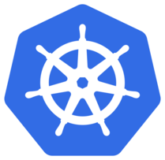














Data Centric Applications - Strategy
Data Scientists
Developers
Data Engineers
Data Analysts
OSFI
BDPaaS
Member
Provider
Big Data Tools
ML / DL Tools
Data Services
Bring-Your-Own
Claims
Clinical
Data Catalog
Traditional Big Data Tools
Elastic Compute – Self-service, multi-tenant
YARN – Multi-tenant
Flexible Storage – HDFS with S3, Volume Plugins
Big Data Storage - MapRFS
Compute
RAM
CPUs
GPUs
Storage
NAS/FLASH
SSD/HDD
Availability Zones – Optum Data Centers
On-Premises DC

Slide 28





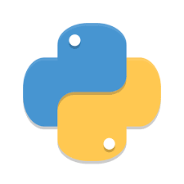
How to Run Data Centric Tools in OSFI
Reusable and customizable Big Data tools will be published and managed in Optum Helm Chart repo
Master
Worker
HDFS with S3
MapRFS / BDPaaS
ISCSI Block Storage - Flash
NFS NAS/Flash
Optum Object-Store
Worker
Clone Optum Chart repo
Customize Charts
Create and test build pipeline
Deploy applications
Manage versions
LLAP
Applications
Big Data Store

