Slide 1
WASI on Component Model Sharing and Discussion
WAMR community
Aug 2023

Slide 2
Background and purpose
There is a PR (Rebase the Phase Process on CG's process) about requiring WIT file for the WASI definition
It is one step of moving WASI to the component model-based
WASI CG is going to vote on Rebase the Phase Process on CG‘s process on 9/7
We spent some time understanding the component model and what WASI on CM means for the WAMR community
We are sharing our understanding with the community participants and collecting feedback
Please note some of our understanding might be wrong since the time is quite short

Slide 3
Current status
Everything is based on core modules, and we are mostly doing static linking
Wasm-ld, mostly like the native linker (on the symbol, relocation tables)
Working well on C/C++ based modules, also ok with Rust-based modules
WASI defines the system calls provided by the runtime in C-like witx format
Wasi-libc (file, clock, thread, socket..) is supported with WASI-preview1
Distributed with C/C++ header files, library binary in Wasm core module
Libc is implemented by calling WASI interfaces
WAMR already supports dynamic linking in the interpreter, and Sony’s patch for supporting AoT is under review
Only pass arguments by values
No way to pass data by memory now, WasmGC and mem.ref are good native Wasm solutions

Slide 4
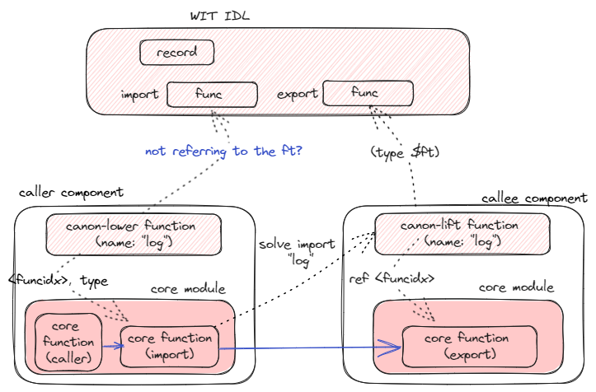
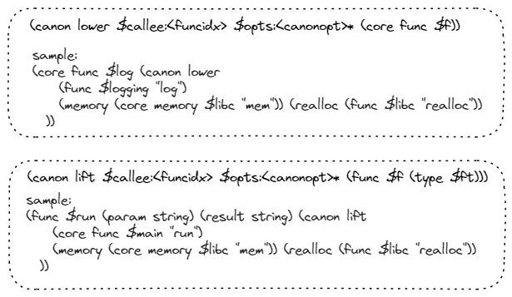
The Component Model Basic
package local:multi-worlds
interface types {
record coord {
x: u32,
y: u32,
}
record monster {
name: string,
hp: u32,
pos: coord,
elite: bool
}
type error = u32
}
world caller {
use types.{coord, error, monster}
import get-positions: func(m: list<monster>) -> list<coord>
export run: func()
}
world callee {
use types.{coord, error, monster}
export get-positions: func(m: list<monster>) -> list<coord>
}
WIT file
Notes:
public static ArrayList<Coord> getPositionsOuter(ArrayList<Monster> m) {
ArrayList<wit.worlds.Game.Cleanup> cleanupList = new ArrayList<>();
int address13 = Memory.malloc((m).size() * 36, 4).toInt();
for (int index14 = 0; index14 < (m).size(); ++index14) {
Monster element = (m).get(index14);
int base = address13 + (index14 * 36);
byte[] bytes = ((element).name).getBytes(StandardCharsets.UTF_8);
Address.fromInt((base) + 4).putInt(bytes.length);
Address.fromInt((base) + 0).putInt(Address.ofData(bytes).toInt());
Address.fromInt((base) + 8).putInt((element).hp);
int address = Memory.malloc(((element).pos).size() * 8, 4).toInt();
for (int index = 0; index < ((element).pos).size(); ++index) {
Coord element0 = ((element).pos).get(index);
int base1 = address + (index * 8);
Address.fromInt((base1) + 0).putInt((element0).x);
Address.fromInt((base1) + 4).putInt((element0).y);
}
Address.fromInt((base) + 16).putInt(((element).pos).size());
Address.fromInt((base) + 12).putInt(address);
Address.fromInt((base) + 20).putByte((byte) (((element).elite ? 1 : 0)));
switch (((element).desc).tag) {
case 0: {
String payload = ((element).desc).getF0();
Address.fromInt((base) + 24).putByte((byte) (0));
byte[] bytes4 = (payload).getBytes(StandardCharsets.UTF_8);
Address.fromInt((base) + 32).putInt(bytes4.length);
Address.fromInt((base) + 28).putInt(Address.ofData(bytes4).toInt());
break;
}
case 1: {
ArrayList<String> payload7 = ((element).desc).getF1();
Address.fromInt((base) + 24).putByte((byte) (1));
int address11 = Memory.malloc((payload7).size() * 8, 4).toInt();
for (int index12 = 0; index12 < (payload7).size(); ++index12) {
String element8 = (payload7).get(index12);
int base9 = address11 + (index12 * 8);
byte[] bytes10 = (element8).getBytes(StandardCharsets.UTF_8);
Address.fromInt((base9) + 4).putInt(bytes10.length);
Address.fromInt((base9) + 0).putInt(Address.ofData(bytes10).toInt());
}
Address.fromInt((base) + 32).putInt((payload7).size());
Address.fromInt((base) + 28).putInt(address11);
cleanupList.add(new wit.worlds.Game.Cleanup(address11, (payload7).size() * 8, 4));
break;
}
default: throw new AssertionError("invalid discriminant: " + ((element).desc).tag);
}
cleanupList.add(new wit.worlds.Game.Cleanup(address, ((element).pos).size() * 8, 4));
}
wasmImportGetPositionsOuter(address13, (m).size(), wit.worlds.Game.RETURN_AREA);
ArrayList<Coord> array = new ArrayList<>(Address.fromInt((wit.worlds.Game.RETURN_AREA) + 4).getInt());
for (int index17 = 0; index17 < (Address.fromInt((wit.worlds.Game.RETURN_AREA) + 4).getInt()); ++index17) {
int base16 = (Address.fromInt((wit.worlds.Game.RETURN_AREA) + 0).getInt()) + (index17 * 8);
array.add(new Coord(Address.fromInt((base16) + 0).getInt(), Address.fromInt((base16) + 4).getInt()));
}
Memory.free(Address.fromInt(Address.fromInt((wit.worlds.Game.RETURN_AREA) + 0).getInt()), (Address.fromInt((wit.worlds.Game.RETURN_AREA) + 4).getInt()) * 8, 4);
Memory.free(Address.fromInt(address13), (m).size() * 36, 4);
for (wit.worlds.Game.Cleanup cleanup : cleanupList) {
Memory.free(Address.fromInt(cleanup.address), cleanup.size, cleanup.align);
}
return array;
}

Slide 5
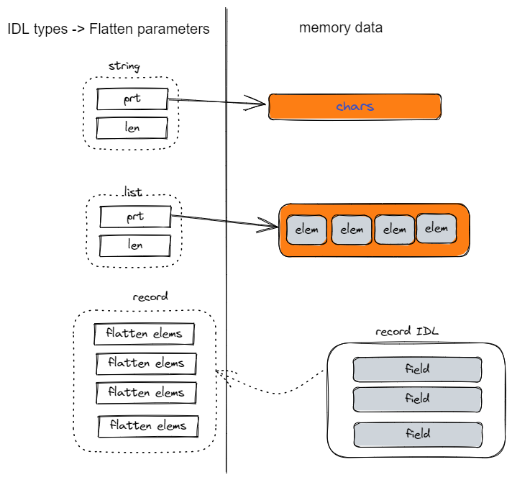
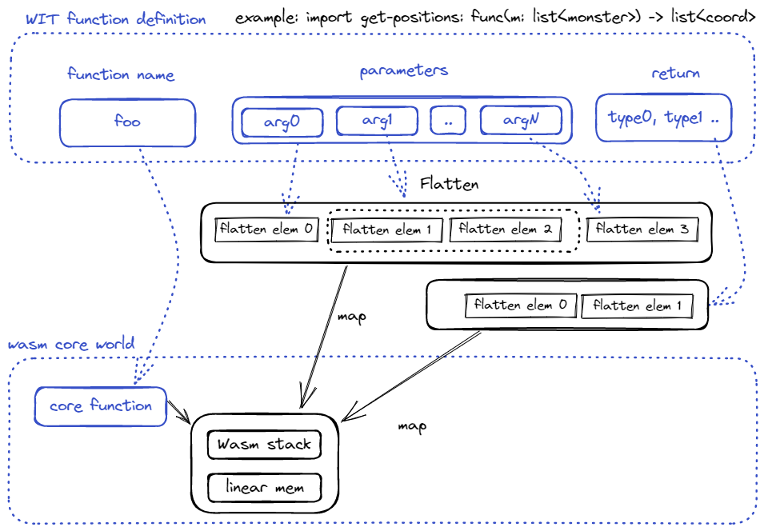
Flatten the WIT parameters

Slide 6
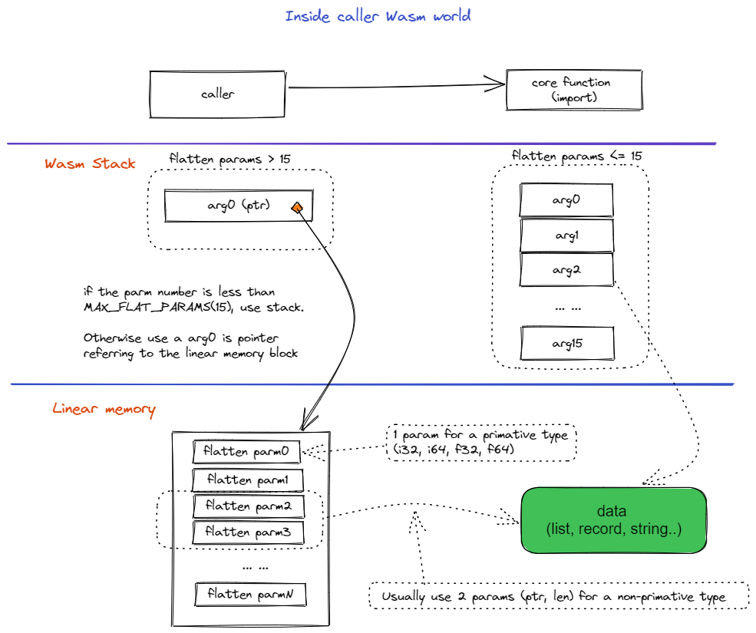
Before calling core Wasm function import
This page is totally under the Wasm core spec
Data layout and wasm stack format are defined for a WIT IDL according to the Component Model Proposal
Data format is complex so we need tools like wit-bindgen to generate source files with programming API

Slide 7
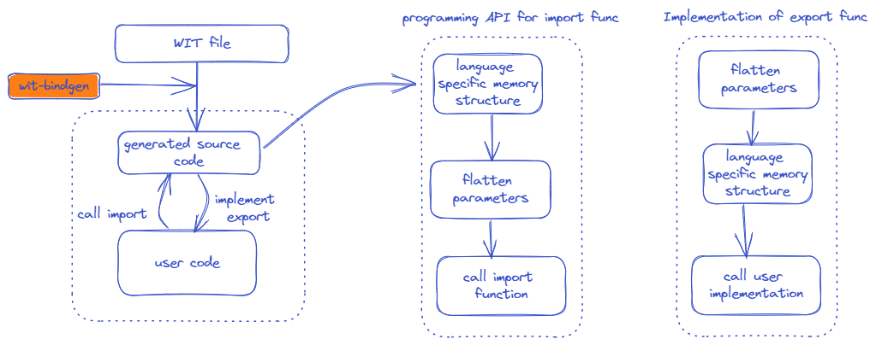
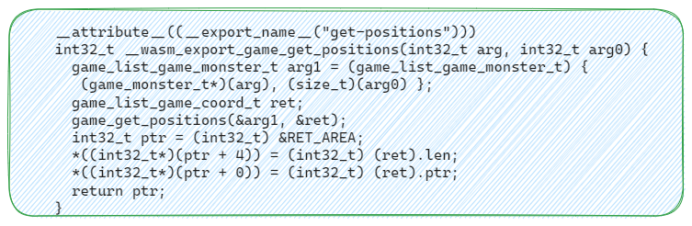
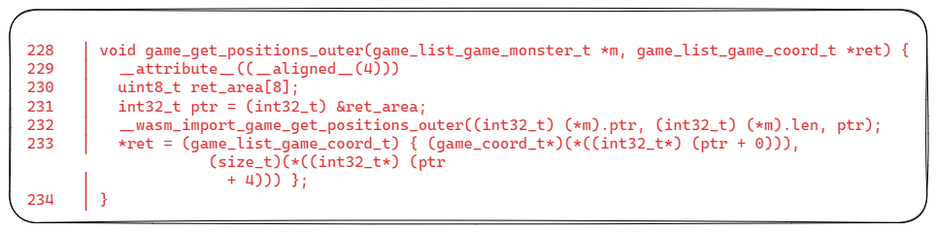
Wit-bindgen
Construct the Java ArrayList from the given list address and length
Java import
@Import(name = "get-positions", module = "$root")
private static native void wasmImportGetPositions(int p0, int p1, int p2);
public static ArrayList<wit.imports.local.multiWorlds.Types.Coord> getPositions(ArrayList<wit.imports.local.multiWorlds.Types.Monster> m) {
int address = Memory.malloc((m).size() * 24, 4).toInt();
for (int index = 0; index < (m).size(); ++index) {
wit.imports.local.multiWorlds.Types.Monster element = (m).get(index);
int base = address + (index * 24);
byte[] bytes = ((element).name).getBytes(StandardCharsets.UTF_8);
Address.fromInt((base) + 4).putInt(bytes.length);
Address.fromInt((base) + 0).putInt(Address.ofData(bytes).toInt());
Address.fromInt((base) + 8).putInt((element).hp);
Address.fromInt((base) + 12).putInt(((element).pos).x);
Address.fromInt((base) + 16).putInt(((element).pos).y);
Address.fromInt((base) + 20).putByte((byte) (((element).elite ? 1 : 0)));
}
wasmImportGetPositions(address, (m).size(), wit.worlds.Caller.RETURN_AREA);
ArrayList<wit.imports.local.multiWorlds.Types.Coord> array = new ArrayList<>(Address.fromInt((wit.worlds.Caller.RETURN_AREA) + 4).getInt());
for (int index2 = 0; index2 < (Address.fromInt((wit.worlds.Caller.RETURN_AREA) + 4).getInt()); ++index2) {
int base1 = (Address.fromInt((wit.worlds.Caller.RETURN_AREA) + 0).getInt()) + (index2 * 8);
array.add(new wit.imports.local.multiWorlds.Types.Coord(Address.fromInt((base1) + 0).getInt(), Address.fromInt((base1) + 4).getInt()));
}
Memory.free(Address.fromInt(Address.fromInt((wit.worlds.Caller.RETURN_AREA) + 0).getInt()), (Address.fromInt((wit.worlds.Caller.RETURN_AREA) + 4).getInt()) * 8, 4);
Memory.free(Address.fromInt(address), (m).size() * 24, 4);
return array;
}
C export
C import

Slide 8
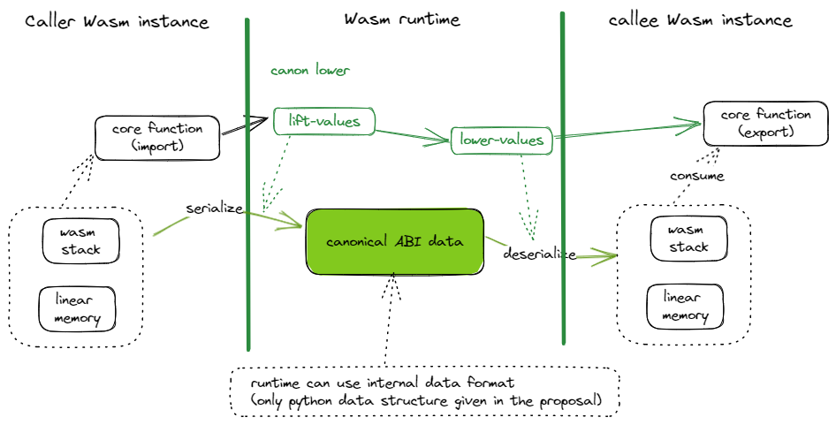
Inter-component Call procedure

Slide 9
The WASI-preview1 vs WASI-preview2
;;; Read from a file descriptor.
;;; Note: This is similar to `readv` in POSIX.
(@interface func (export "fd_read")
(param $fd $fd)
;;; List of scatter/gather vectors to which to store data.
(param $iovs $iovec_array)
;;; The number of bytes read.
(result $error (expected $size (error $errno)))
)
/// Read from a descriptor, without using and updating the descriptor's offset.
///
/// This function returns a list of bytes containing the data that was
/// read, along with a bool which, when true, indicates that the end of the
/// file was reached. The returned list will contain up to `length` bytes; it
/// may return fewer than requested, if the end of the file is reached or
/// if the I/O operation is interrupted.
///
/// In the future, this may change to return a `stream<u8, error-code>`.
///
/// Note: This is similar to `pread` in POSIX.
read: func(
this: descriptor,
/// The maximum number of bytes to read.
length: filesize,
/// The offset within the file at which to read.
offset: filesize,
) -> result<tuple<list<u8>, bool>, error-code>
;;; A file descriptor handle.
(typename $fd (handle))
;;; A region of memory for scatter/gather reads.
(typename $iovec
(record
;;; The address of the buffer to be filled.
(field $buf (@witx pointer u8))
;;; The length of the buffer to be filled.
(field $buf_len $size)
)
)
;;; A region of memory for scatter/gather writes.
(typename $ciovec
(record
;;; The address of the buffer to be written.
(field $buf (@witx const_pointer u8))
;;; The length of the buffer to be written.
(field $buf_len $size)
)
)
(typename $iovec_array (list $iovec))
(typename $ciovec_array (list $ciovec))
Function read defined in WIT
Function read defined in WITX

Slide 10
WASI on Component mode impacts/Concerns
How to reuse the massive libc-based libraries (static and dynamic linking)?
A new libc implementation built on the preview2 interface? Continue the wasi-libc evolvement?
Leads to no way to establish a core-module-based ecosystem (can we afford this?)
Given that WASI is the foundation of the module ecosystem
Static linking is still questionable with CM (core function type, miss symbol/relocation) and we still largely need static linking (and the dependent module ecosystem)
CM performance impact needs to be evaluated
How to make it simpler for the modules from the same language and compilation convention?
Increased footprint (memory, binary), quality challenge by the complexity

Slide 11
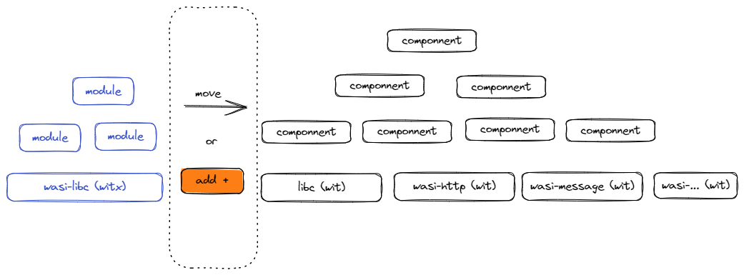
Wasm Ecosystem Growing Options
Still problematic in expanding module sharing to more languages beyond C/C++/Rust, also in the dynamic linking
How to do static linking?
No core-module based ecosystem?

Slide 12
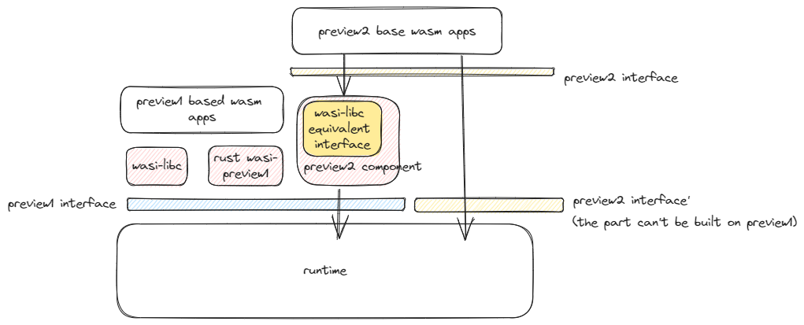
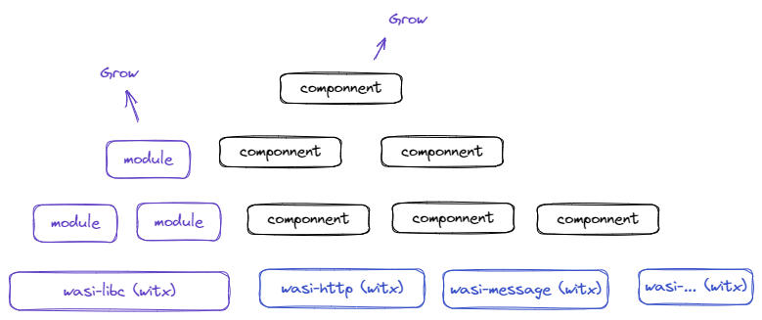
Is Component Model essential for WASI?
A key requirement for WASI on CM is to support a virtualized interface.
However, it seems that we could create a preview2 component based on the preview1 interface, another way to enable the virtualization of WASI?
Any other reason? Streaming or async support? (We don’t have a good understanding for speaking it now)
Is this possible?

Slide 13
WAMR requirements and options
Potential impacts to existing products
It is fine if WASI is not used
If WASI is already used, we can continue to use the WASI-Preview1
Plan to support component model? Yes, in the future
Keep supporting existing core-module-based programming? yes
Ecosystem-wise: working with CM authors on supporting core modules with WASI
Static linking, dynamic linking
Options
Continue to maintain and grow the WASI-Preview1
Evaluate how to dynamically link core modules using WasmGC or mem.ref solving current issues

Slide 14
2023 Aug 29 meeting with Component Model authors (Luke, Pat, Dan, Bailey..)
While supporting the regular CM capability in a rich resource system, we still want to provide such abilities for a small footprint and maximum perf:
A minimal profile of runtime which is built without component model support
Load single core model or single component with single core module
At development time, build a single module/component (using single or multi memories) from multiple components/modules
For WASI, we want such abilities:
Support fast data exchange between Wasm and host by accessing the shared memory.
It seems list <int8> can serve this purpose?
Do static linking of multiple modules from components
Using multiple memories, it is no problem.
Challenge in using single memory. Even the Wasm stack format and memory layout for caller and callee can be standardized (mostly same), but there is a lifecycle problem when they are statically linked in a single memory
For a language like Java, these are temporary data structures constructed from Java objects. It can only serve one one-way copy (caller to callee) and change by callee can’t be reflected back to the Java object after the function call is finished.
If all the components are from C/C++ and Rust, it is just fine as what we are doing today
Can we introduce some tag into the component, like saying “this module can support dynamic linking in LLVM convention? so we can filter the components from the registry service for static linking at development time?
Can we keep the WITX for defining WASI till the component model has market success?
using a tool to generate a witx from wit
It seems okay. Currently the interface is mostly defined with basic value types and little part in pointers.
The need of CM for WASI supporting async and streaming
Rich type of IDL, give type for the stream object
Binding code for reducing complexity in implementing the async and streaming
Can an embedded environment support multiple memories?
Usually no mem.grow. But multiple memories will cause more memory consumption.
If mem.grow is needed, more design challenges due to no virtual memory.
Performance and footprint
The impact is small or an acceptable level (?), Zero for AoT
Some micro bench available

Slide 15
Open

