Slide 1
CSC 480 Artificial Intelligence
Bamshad Mobasher
Constraint Satisfaction Problems

Slide 2

What is Search For?
Assumptions about the world: a single agent, deterministic actions, fully observed state, discrete state space
Planning: sequences of actions
The path to the goal is the important thing
Paths have various costs, depths
Heuristics give problem-specific guidance
Identification: assignments to variables
The goal itself is important, not the path
CSPs: specialized form of search problems for identification problems

Slide 3
Queens puzzle
Place eight queens on a chessboard so that no two attack each other
 |  |  |  | Q
 |  | Q
Q
 |  |  |  |  |  | Q
 | Q
 |  |  |  |  |  |  | Q
 |  |  |  |  | Q
 |  |  | Q

Slide 4
Search formulation of the queens puzzle
Successors: all valid ways of placing additional queen on the board; goal: eight queens placed
 |  |  |  | Q
 |  | Q
Q
 | Q
 |  |  | Q
 |  |  |  | Q
 |  | Q
Q
 |  |  |  |  | Q
 | Q
 |  |  | Q
 |  |  |  | Q
 |  | Q
Q
 | Q
 |  |  |  |  | Q
 |  |  | Q
 |  |  |  | Q
 |  | Q
Q
 |  |  |  |  |  | Q
 | Q
 |  |  | Q
 |  |  |  | Q
 |  | Q
Q
 | Q
 |  |  |  |  |  | Q
 |  |  | Q
 |  |  |  | Q
 |  | Q
Q
 | Q
 |  |  |  |  |  |  | Q
 |  |  | Q

Slide 5


Constraint Satisfaction Problems
Standard search problems:
State is a “black box”: arbitrary data structure
Goal test can be any function over states
Successor function can also be anything
Constraint satisfaction problems (CSPs):
A special subset of search problems
State is defined by variables X_{i} with values from a domain D (sometimes D depends on i)
Goal test is a set of constraints specifying allowable combinations of values for subsets of variables
Allows useful general-purpose algorithms with more power than standard search algorithms
Notes:
Goal test has structure, it ‘s more like a manual describing a set of constraints that have to hold true

Slide 6
Constraint Satisfaction Problems
An assignment is complete when every variable is accounted for
A solution to a CSP is a complete assignment that satisfies all constraints
Some CSPs require a solution that maximizes an objective function
Examples of Applications:
Scheduling the time of observations on the Hubble Space Telescope
Airline schedules
Cryptography
Course planning

Slide 7


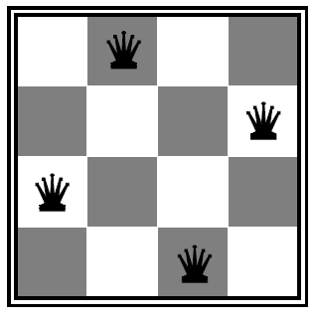
CSP Examples

Slide 8


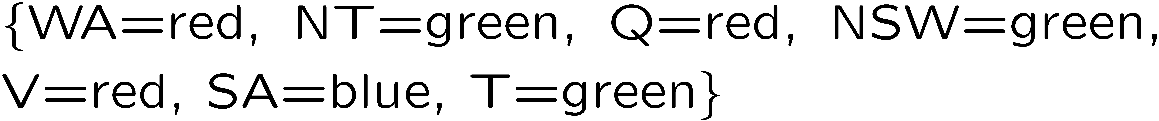
Example: Map Coloring
Variables:
Domains:
Constraints: adjacent regions must have different colors
Solutions are assignments satisfying all constraints, e.g.:
Implicit:
Explicit:

Slide 9

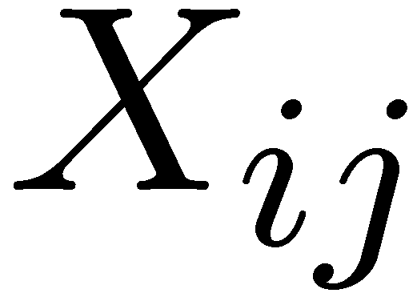

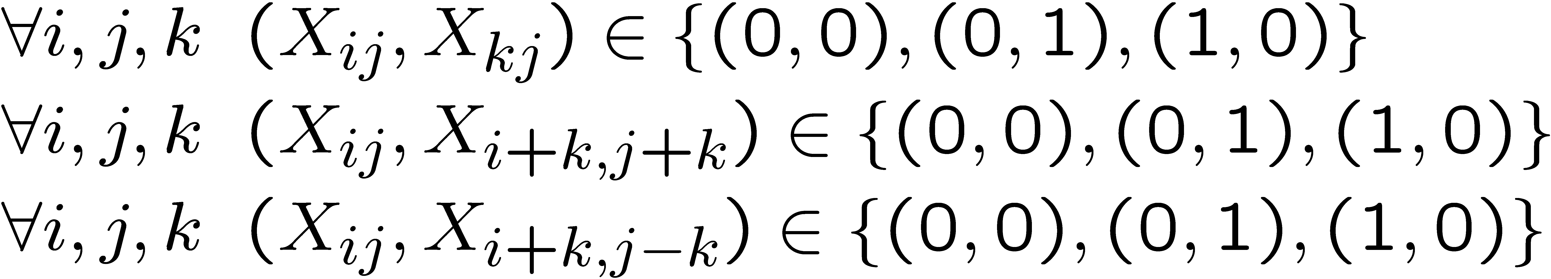
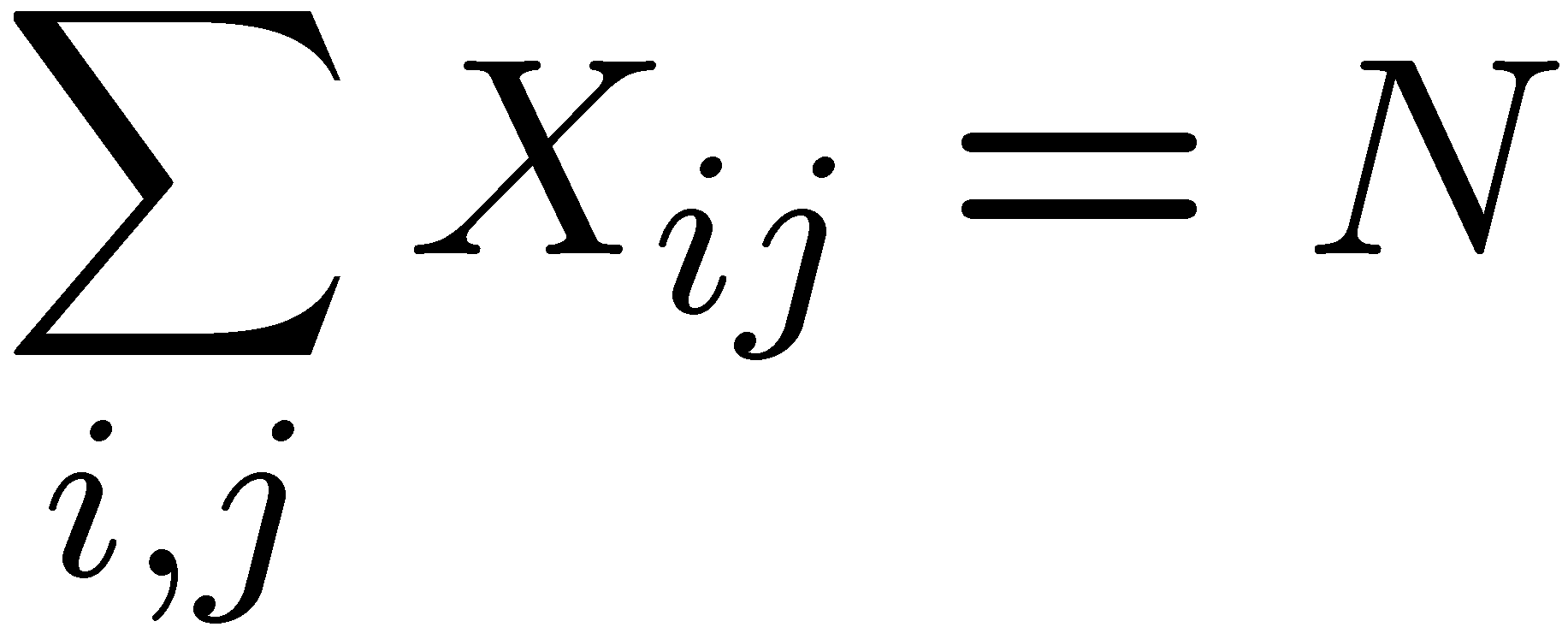
Example: N-Queens
Formulation 1:
Variables: (each square)
Domains:
Constraints

Slide 10







Example: N-Queens
1 2 3 4
Formulation 2:
Variables: (location of queen on row k
Domains:
Constraints:
Implicit:
Explicit:

Slide 11
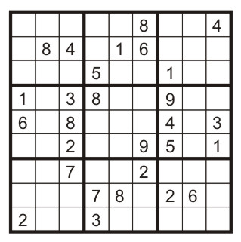
Example: Sudoku
Variables:
Each (open) square
Domains:
{1,2,…,9}
Constraints:
9-way alldiff for each column
9-way alldiff for each row
9-way alldiff for each region
(or can have a bunch of pairwise inequality constraints)

Slide 12
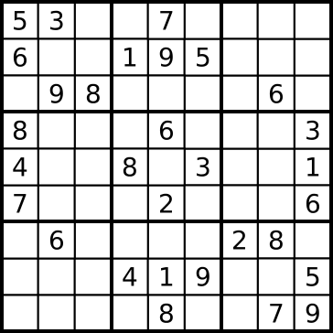
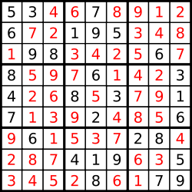
Example: Sudoku

Slide 13
Constraint Graphs
Binary CSP: each constraint relates (at most) two variables
Binary constraint graph: nodes are variables, arcs show constraints
General-purpose CSP algorithms use the graph structure to speed up search. E.g., Tasmania is an independent subproblem!

Slide 14


Example: Cryptarithmetic
Variables:
Domains:
Constraints:
Notes:
O=7, R=4, W=6, U=2, T=8, F=1; 867 + 867 = 1734

Slide 15
Varieties of CSPs
Discrete variables
Finite domains; size d ⇒O(d^{n}) complete assignments.
E.g. Boolean CSPs: Boolean satisfiability (NP-complete).
Infinite domains (integers, strings, etc.)
E.g. job scheduling, variables are start/end days for each job
Need a constraint language e.g StartJob₁ +5 ≤ StartJob₃.
Infinitely many solutions
Linear constraints: solvable
Nonlinear: no general algorithm
Continuous variables
e.g. building an airline schedule or class schedule.
Linear constraints solvable in polynomial time by LP methods.

Slide 16
Varieties of constraints
Unary constraints involve a single variable.
e.g. SA ≠ green
Binary constraints involve pairs of variables.
e.g. SA ≠ WA
Higher-order constraints involve 3 or more variables.
Professors A, B, and C cannot be on a committee together
Can always be represented by multiple binary constraints
Preference (soft constraints)
e.g. red is better than green
often can be represented by a cost for each variable assignment
combination of optimization with CSPs

Slide 17
Standard Search Formulation
CSPs can be expressed as a standard search problem
States defined by the values assigned so far (partial assignments)
Initial state: the empty assignment, {}
Successor function: assign a value to an unassigned variable
Goal test: the current assignment is complete and satisfies all constraints
We’ll start with the straightforward, naïve approach, then improve it

Slide 18
CSP as a standard search problem
Solution is found at depth n (if there are n variables).
Consider using BFS
Branching factor b at the top level is n x d
At next level is (n-1) x d
….
End up with n!d^{n} leaves even though there are only d^{n} complete assignments!

Slide 19
Backtracking Search
The basic uninformed algorithm for solving CSPs
Idea 1: One variable at a time
Variable assignments are commutative, so fix ordering
I.e., [WA = red then NT = green] same as [NT = green then WA = red]
Only need to consider assignments to a single variable at each step
Idea 2: Check constraints as you go
I.e. consider only values which do not conflict previous assignments
Might have to do some computation to check the constraints
“Incremental goal test”
Depth-first search with these two improvements
is called backtracking search (not the best name)
Can solve n-queens for n ≈ 25

Slide 20

Backtracking Example

Slide 21
Backtracking Search
Backtracking = DFS + variable-ordering + fail-on-violation

Slide 22

Improving Backtracking
General-purpose ideas give huge gains in speed
Ordering:
Which variable should be assigned next?
In what order should its values be tried?
Filtering: Can we detect inevitable failure early?
Structure: Can we exploit the problem structure?

Slide 23

Filtering

Slide 24
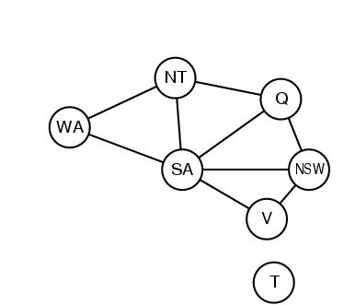
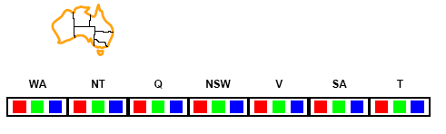
Filtering: Forward checking
Filtering: Keep track of domains for unassigned variables and cross off bad options
Forward checking: Cross off values that violate a constraint when added to the existing assignment

Slide 25
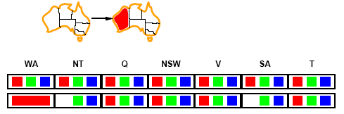
Forward checking
Assign {WA=red}
Effects on other variables connected by constraints to WA
NT can no longer be red
SA can no longer be red

Slide 26
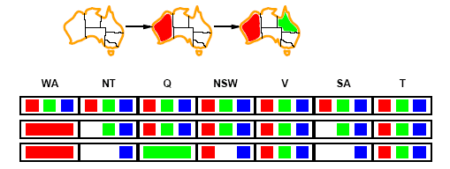
Forward checking
Assign {Q=green}
Effects on other variables connected by constraints with Q
NT can no longer be green
NSW can no longer be green
SA can no longer be green

Slide 27
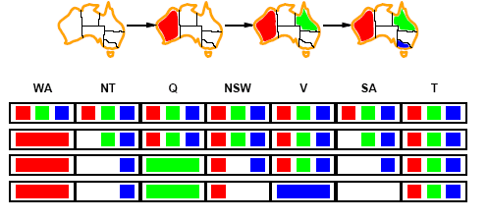
Forward checking
If V is assigned blue
Effects on other variables connected by constraints with V
NSW can no longer be blue
SA is empty
FC has detected that partial assignment is inconsistent with the constraints and backtracking can occur.

Slide 28
Example: 4-Queens Problem
X1
{1,2,3,4}
X2
{1,2,3,4}
1
2
3
4
1
2
3
4
X3
{1,2,3,4}
X4
{1,2,3,4}

Slide 29
Example: 4-Queens Problem
X1
{1,2,3,4}
X2
{1,2,3,4}
1
2
3
4
1
2
3
4
X3
{1,2,3,4}
X4
{1,2,3,4}

Slide 30
Example: 4-Queens Problem
X1
{1,2,3,4}
X2
{ , ,3,4}
1
2
3
4
1
2
3
4
X3
{ ,2, ,4}
X4
{ ,2,3, }

Slide 31
Example: 4-Queens Problem
X1
{1,2,3,4}
X2
{ , ,3,4}
1
2
3
4
1
2
3
4
X3
{ ,2, ,4}
X4
{ ,2,3, }

Slide 32
Example: 4-Queens Problem
X1
{1,2,3,4}
X2
{ , ,3,4}
1
2
3
4
1
2
3
4
X3
{ , , , }
X4
{ , ,3, }

Slide 33
Example: 4-Queens Problem
X1
{1,2,3,4}
X2
{ , , ,4}
1
2
3
4
1
2
3
4
X3
{ ,2, ,4}
X4
{ ,2,3, }

Slide 34
Example: 4-Queens Problem
X1
{1,2,3,4}
X2
{ , , ,4}
1
2
3
4
1
2
3
4
X3
{ ,2, ,4}
X4
{ ,2,3, }

Slide 35
Example: 4-Queens Problem
X1
{1,2,3,4}
X2
{ , , ,4}
1
2
3
4
1
2
3
4
X3
{ ,2, , }
X4
{ , ,3, }

Slide 36
Example: 4-Queens Problem
X1
{1,2,3,4}
X2
{ , , ,4}
1
2
3
4
1
2
3
4
X3
{ ,2, , }
X4
{ , ,3, }

Slide 37
Example: 4-Queens Problem
X1
{1,2,3,4}
X2
{ , ,3,4}
1
2
3
4
1
2
3
4
X3
{ ,2, , }
X4
{ , , , }

Slide 38

Filtering: Constraint propagation
Solving CSPs with combination of heuristics plus forward checking is more efficient than either approach alone
FC does not detect all failures.
E.g., NT and SA cannot be blue
Constraint propagation: reason from constraint to constraint

Slide 39
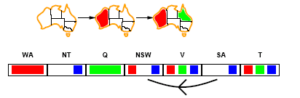
Arc consistency
An Arc X → Y is consistent if
for every value x of X there is some value y consistent with x
(note that this is a directed property)
Consider state of search after WA and Q are assigned:
SA → NSW is consistent if
SA=blue and NSW=red

Slide 40
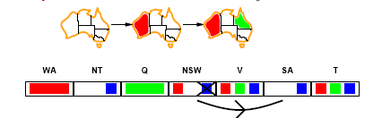
Arc consistency
X → Y is consistent iff
for every value x of X there is some value y consistent with x
NSW → SA is consistent if
NSW=red and SA=blue
NSW=blue and SA=???

Slide 41
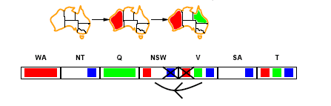
Arc consistency
Can enforce arc-consistency:
NSW → SA can be made consistent by removing blue from NSW
Continue to propagate constraints….
Check V → NSW
Not consistent for V = red
Remove red from V

Slide 42
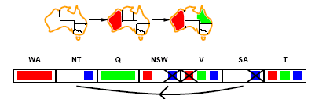
Arc consistency
Continue to propagate constraints….
SA → NT is not consistent
and cannot be made consistent
Arc consistency detects failure earlier than FC

Slide 43
Arc consistency checking
Can be run as a preprocessor or after each assignment
Or as preprocessing before search starts
AC must be run repeatedly until no inconsistency remains
Trade-off
Requires some overhead, but generally more effective than direct search
In effect it can eliminate large (inconsistent) parts of the state space more effectively than search can
Need a systematic method for arc-checking
If X loses a value, neighbors of X need to be rechecked:
i.e. incoming arcs can become inconsistent again
(outgoing arcs will stay consistent).

Slide 44
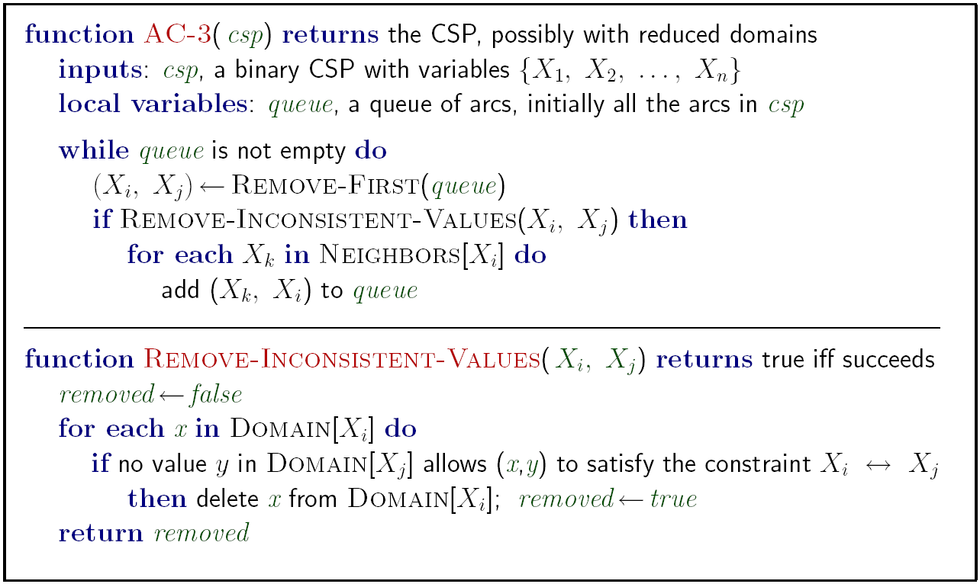
Enforcing Arc Consistency in a CSP

Slide 45
Complexity of AC-3
A binary CSP has at most n² arcs
Each arc can be inserted in the queue d times (worst case)
(X, Y): only d values of X to delete
Consistency of an arc can be checked in O(d²) time
Complexity is O(n² d²)

Slide 46
K-consistency
Arc consistency does not detect all inconsistencies:
Partial assignment {WA=red, NSW=red} is inconsistent.
Stronger forms of propagation can be defined using the notion of k-consistency.
A CSP is k-consistent if for any set of k-1 variables and for any consistent assignment to those variables, a consistent value can always be assigned to any kth variable.
E.g. 1-consistency = node-consistency
E.g. 2-consistency = arc-consistency
E.g. 3-consistency = path-consistency
Strongly k-consistent:
k-consistent for all values {k, k-1, …2, 1}

Slide 47
Trade-offs
Running stronger consistency checks…
Takes more time
But will reduce branching factor and detect more inconsistent partial assignments
No “free lunch”
In worst case n-consistency takes exponential time

Slide 48

Ordering

Slide 49
Backtracking Search
Backtracking = DFS + variable-ordering + fail-on-violation
What are the choice points?

Slide 50
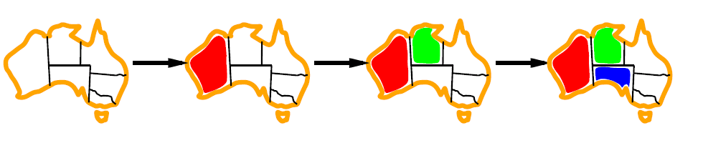
Minimum remaining values (MRV)
Heuristic Rule: choose variable with the fewest legal moves
a.k.a. most constrained variable heuristic
will immediately detect failure if X has no legal values

Slide 51

Degree heuristic for the initial variable
Heuristic Rule: select variable that is involved in the largest number of constraints on other unassigned variables.
Degree heuristic can be useful as a tie breaker.
But, in what order should a variable’s values be tried?

Slide 52
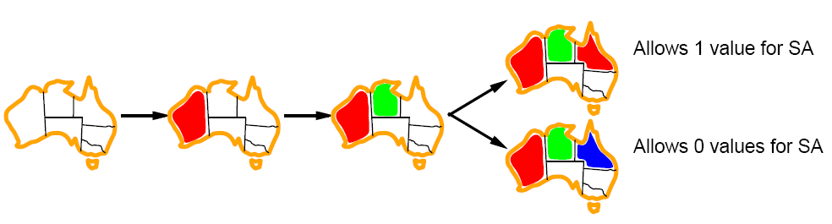
Least constraining value
Value Ordering: Least Constraining Value
Given a choice of variable, choose the least constraining value
I.e., the one that rules out the fewest values in the remaining variables
Note that it may take some computation to determine this! (E.g., rerunning filtering)
Combining these ordering ideas makes1000 queens feasible

Slide 53
Iterative improvements: Local search for CSPs
Tree search keeps unexplored alternatives on the fringe (ensures completeness)
Local search: improve a single option until you can’t make it better (no fringe!)
New successor function: local changes
Generally much faster and more memory efficient (but incomplete and suboptimal)

Slide 54
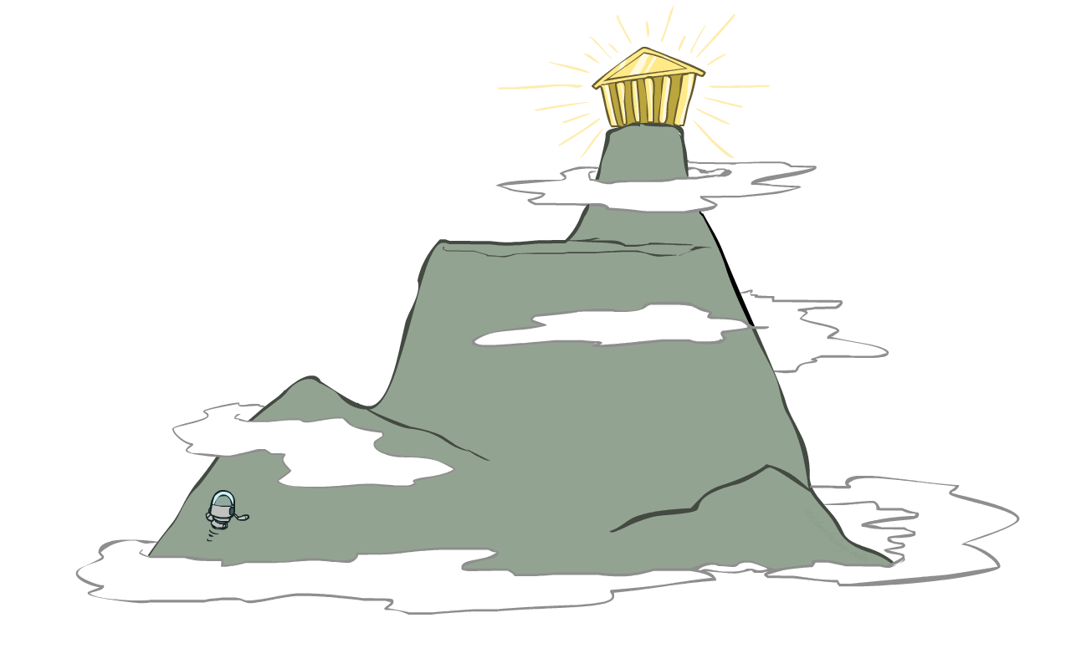
Hill Climbing
Simple, general idea:
Start wherever
Repeat: move to the best neighboring state
If no neighbors better than current, quit
What’s bad about this approach?
Complete?
Optimal?
What’s good about it?

Slide 55
Local search for CSPs
Use complete-state representation
Initial state = all variables assigned values
Successor states = change 1 (or more) values
For CSPs
allow states with unsatisfied constraints
operators reassign variable values
hill-climbing: there is no queue (fringe), so no backtracking
Variable selection: randomly select any conflicted variable
Value selection: min-conflicts heuristic
Select new value that results in a minimum number of conflicts with the other variables
i.e., hill climb with h(n) = total number of violated constraints

Slide 56
Local search for CSP
function MIN-CONFLICTS(csp, max_steps) return solution or failure
inputs: csp, a constraint satisfaction problem
max_steps, the number of steps allowed before giving up
current ← an initial complete assignment for csp
for i = 1 to max_steps do
if current is a solution for csp then return current
var ← a randomly chosen, conflicted variable from VARIABLES[csp]
value ← the value v for var that minimize CONFLICTS(var,v,current,csp)
set var = value in current
return failure

Slide 57
Min-conflicts example: 4-Queens
States: 4 queens in 4 columns (4⁴ = 256 states)
Operators: move queen in column
Goal test: no attacks
Evaluation: c(n) = number of attacks
Notes:
L5D1 – python demos
Coloring – javascript demos

Slide 58
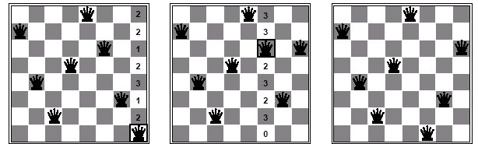
Min-conflicts example 2
A two-step solution for an 8-queens problem using min-conflicts heuristic
At each stage a queen is chosen for reassignment in its column
The algorithm moves the queen to the min-conflict square breaking ties randomly.

Slide 59
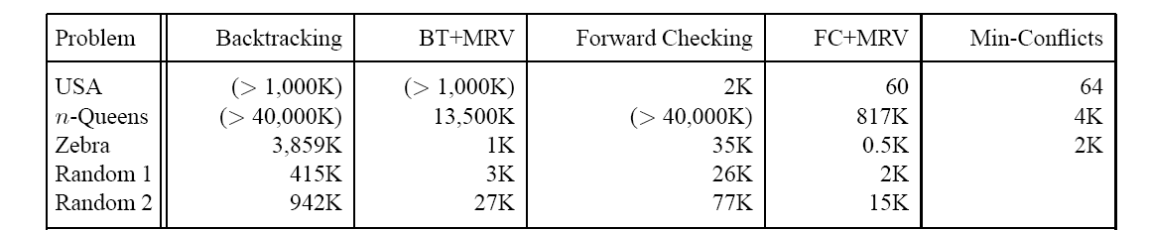
Comparison of CSP algorithms on different problems
Median number of consistency checks over 5 runs to solve problem
Parentheses -> no solution found
USA: 4 coloring
n-queens: n = 2 to 50
Zebra: see exercise 5.13

Slide 60
Advantages of local search
Local search can be particularly useful in an online setting
Airline schedule example
E.g., mechanical problems require that 1 plane is taken out of service
Can locally search for another “close” solution in state-space
Much better (and faster) in practice than finding an entirely new schedule
The runtime of min-conflicts is roughly independent of problem size.
Can solve the millions-queen problem in roughly 50 steps.
Why?
n-queens is easy for local search because of the relatively high density of solutions in state-space

Slide 61
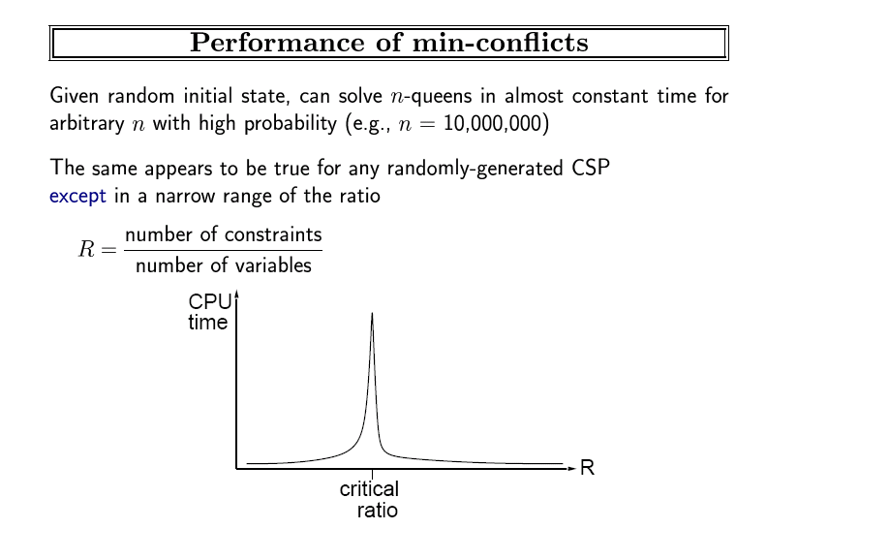

Slide 62
Hill Climbing problems

Slide 63
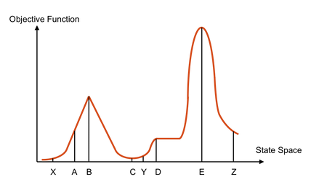
Hill Climbing Quiz
Starting from X, where do you end up ?
Starting from Y, where do you end up ?
Starting from Z, where do you end up ?

Slide 64
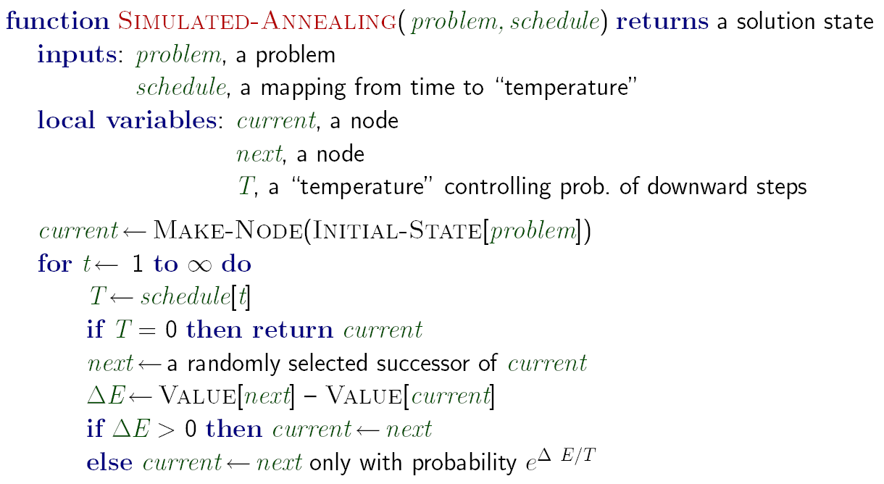

Simulated Annealing
Idea: Escape local maxima by allowing random downhill moves
But make them rarer as time goes on

Slide 65
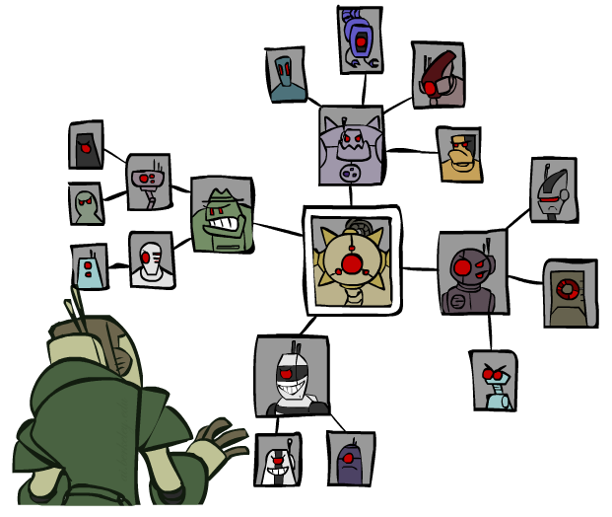
Structure

Slide 66
Problem Structure
Extreme case: independent subproblems
Example: Tasmania and mainland do not interact
Independent subproblems are identifiable as connected components of constraint graph
Suppose a graph of n variables can be broken into subproblems of only c variables:
Worst-case solution cost is O((n/c)(d^{c})), linear in n
E.g., n = 80, d = 2, c =20
2⁸⁰ = 4 billion years at 10 million nodes/sec
(4)(2²⁰) = 0.4 seconds at 10 million nodes/sec

Slide 67
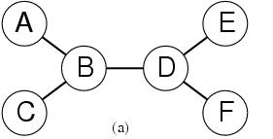
Tree-structured CSPs
Theorem:
if a constraint graph has no loops then the CSP can be solved in O(nd²) time
linear in the number of variables!
Compare difference with general CSP, where worst case is O(d ^{n})
This property also applies to probabilistic reasoning (later): an example of the relation between syntactic restrictions and the complexity of reasoning

Slide 68
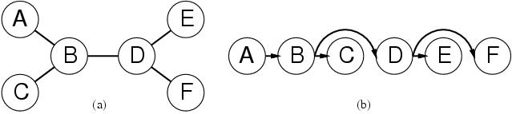
Algorithm for Solving Tree-structured CSPs
Choose some variable as root, order variables from root to leaves such that
every node’s parent precedes it in the ordering.
Label variables from X₁ to X_{n})
Every variable now has 1 parent
Backward Pass
For j from n down to 2, apply arc consistency to arc [Parent(X_{j}), X_{j}) ]
Remove values from Parent(X_{j}) if needed
Forward Pass
For j from 1 to n assign X_{j} consistently with Parent(X_{j} )

Slide 69
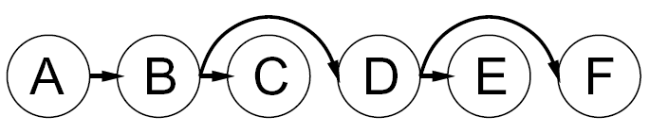
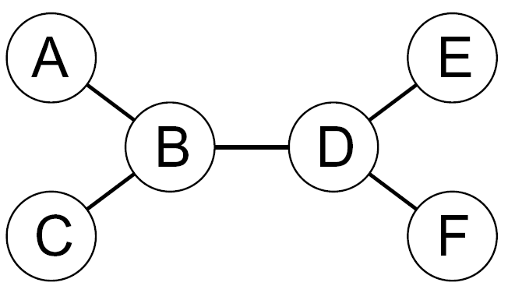
Tree-Structured CSPs
Backward Pass

Slide 70
Tree-Structured CSPs
Backward
Pass
Start from F. Parent is D. Is D→F consistent?
No → we need to remove from D.

Slide 71
Next look at E. Parent is D. Is D→E consistent? Yes → No need to remove a value from D.
Next consider B→D. It is also consistent.
Next: B→C. Not consistent; need to remove from B.

Slide 72
Finally consider A → B. But, now A→B is not arc consistent.
Need to remove from A.
Note that we moved backwards and touched each arc just once to make them consistent.
Now we will move forward from A and make value assignments.

Slide 73
Forward
Pass
A is already red.
There is only one value for B: blue.
B→C: only one value for C: green.
B→D: two possible values. Let’s pick green.
D→E: to stay consistent, must pick blue for E.
D→F: only one value for F: blue.
Note that at each step forward, we were guaranteed to have a consistent value assignment because in the backward direction we ensured arc consistency for each arc. ➔ This allowed us to solve the problem in linear time.

Slide 74
Tree CSP complexity
Backward pass
n arc checks
Each has complexity d² at worst
Forward pass
n variable assignments, O(nd)
Overall complexity is O(nd ²)
Algorithm works because if the backward pass succeeds, then every variable by definition has a legal assignment in the forward pass

Slide 75
What about non-tree CSPs?
General idea is to convert the graph to a tree
Two general approaches
Assign values to specific variables (Cutset method)
Construct a tree-decomposition of the graph

Slide 76
Nearly Tree-Structured CSPs
Conditioning: instantiate a variable, prune its neighbors' domains
Cutset conditioning: instantiate (in all ways) a set of variables such that the remaining constraint graph is a tree
Cutset size c gives runtime O( (d^{c}) (n-c) d² ), very fast for small c

Slide 77
cutset conditioning Algorithm
Choose a subset S of variables from the graph so that graph without S is a tree
S = “cutset”
For each possible consistent assignment for S
Remove any inconsistent values from remaining variables that are inconsistent with S
Use tree-structured CSP to solve the remaining tree-structure
If it has a solution, return it along with S
If not, continue to try other assignments for S

Slide 78
Cutset Conditioning
Choose a cutset
SA
Instantiate the cutset (all possible ways)
SA
SA
SA
Compute residual CSP for each assignment
Solve the residual CSPs (tree structured)

Slide 79
Finding the optimal cutset
If c is small, this technique works very well
However, finding smallest cutset is NP-hard
But there are good approximation algorithms

Slide 80
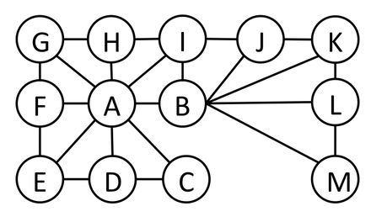
Cutset Quiz
Find the smallest cutset for the graph below.

Slide 81
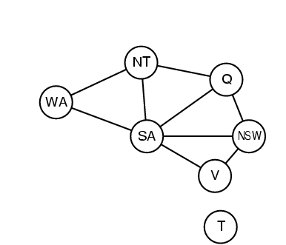
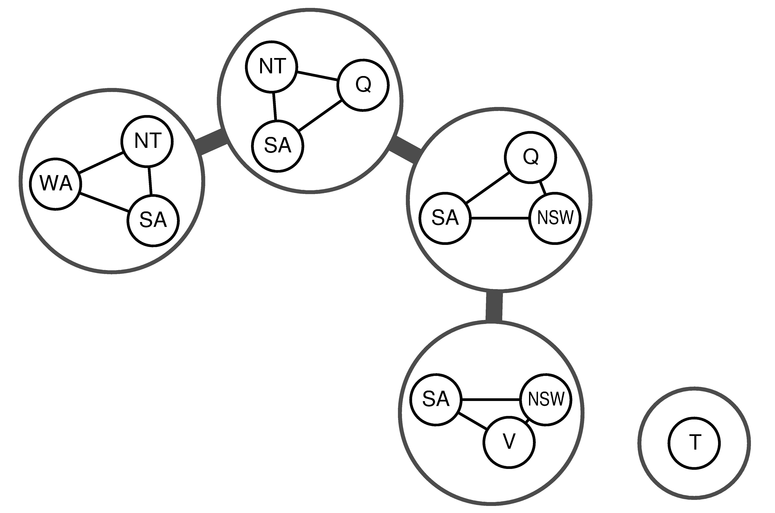
Tree Decompositions

Slide 82
Tree Decomposition
Idea: create a tree-structured graph of mega-variables
Each mega-variable encodes part of the original CSP
Subproblems overlap to ensure consistent solutions
M1
M2
M3
M4
WA
≠
NT
NT
≠
Q
Q
≠
NSW
NSW
≠
V
≠
≠
≠
≠
≠
≠
≠
≠
SA
SA
SA
SA
Agree on shared vars
Agree on shared vars
Agree on shared vars
{(NT=r,SA=g,Q=b),
(NT=b,SA=g,Q=r),
…}
{(WA=r,SA=g,NT=b),
(WA=b,SA=r,NT=g),
…}
Agree: (M1,M2) ∈
{((WA=b,SA=r,NT=g), (NT=g,SA=r,Q=b)), …}

Slide 83
Rules for a Tree Decomposition
Every variable appears in at least one of the subproblems
If two variables are connected in the original problem, they must appear together (with the constraint) in at least one subproblem
If a variable appears in two subproblems, it must appear in each node on the path.

Slide 84
Tree Decomposition Algorithm
View each subproblem as a “super-variable”
Domain = set of solutions for the subproblem
Obtained by running a CSP on each subproblem
E.g., 6 solutions for 3 fully connected variables in map problem
Now use the tree CSP algorithm to solve the constraints connecting the subproblems
Declare a subproblem a root node, create tree
Backward and forward passes
Example of “divide and conquer” strategy

