Slide 1
Log Analysis 1 Demo 3
Red team Nurlan Yagublu
Siyu Chen Nazrin Ibadli Fei Wang Zebai Tian
21/05/2024

Slide 2
Introduction
Project overview
Parsing log files to extract the structured data.
Keywords: PORTEVENT and TIMEROP
Used technologies:
Programming Language: Rust
IDE: RustRover
Version Control: Git, GitHub
CI/CD: GitHub Actions

Slide 3
Content
Completed Tasks
List of User Stories/Tasks
Testing
Show in Demo
Documentation Updates
Conclusion

Slide 4
Last Sprint review
Sprint time: 23 Apr – 21 May
Total Tasks:7 → 6
Done: 5
In progress: 1
Sprint main goal: User Story point 4, Value Type Judgment
UPDATE！

Slide 5
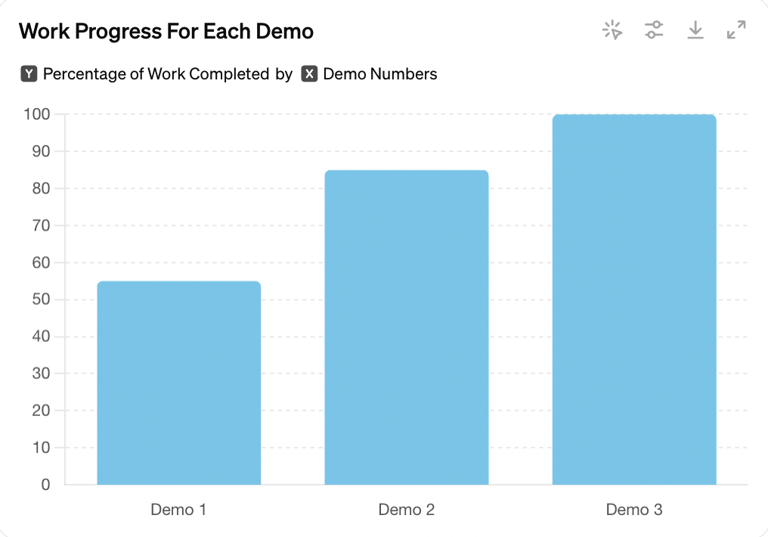
Progress in graph

Slide 6
Sprint summaries
First demo(25.03.2024)
Goal: initial log parsing and extraction focusing on PORTEVENT and TIMEROP
Completed tasks:
Setting up the env.
Initial implementation of log parsing
Simple value extraction
Second demo(23.04.2024)
Goal: Optimization of the structured log extraction
Completed tasks:
Optimization of extraction algorithm
Structuring the extracted data

Slide 7
Data Extraction Techniques
Using delimiters to split the strings into multiple parts.
Data structuring:
Example:
Original Log Entry: 2024-05-20 12:34:56 PORTEVENT some_data more_data
Structured Data: { "timestamp": "2024-05-20 12:34:56", "event": "PORTEVENT", "data": ["some_data", "more_data"] }

Slide 8
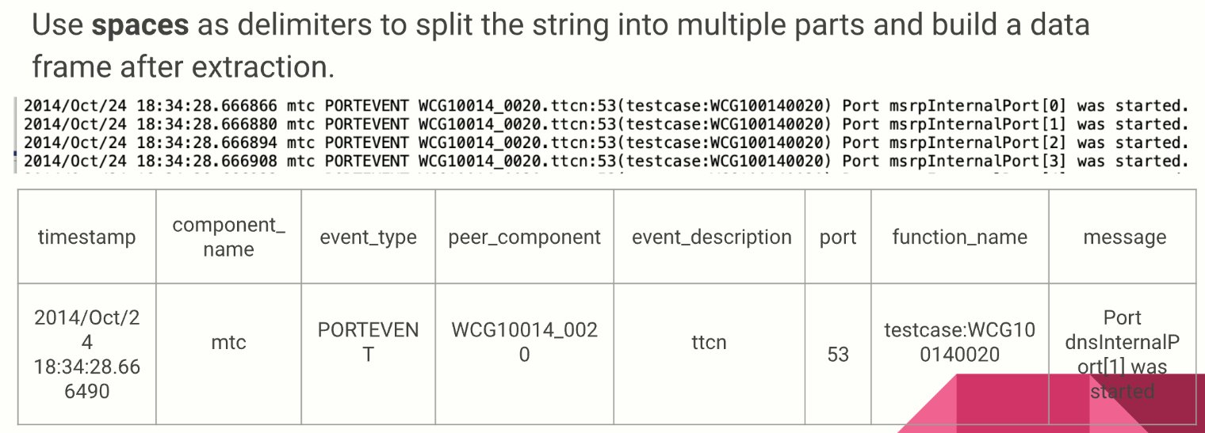
Function summaries-demo1
Simple value extraction for PORTEVENT Example:

Slide 9
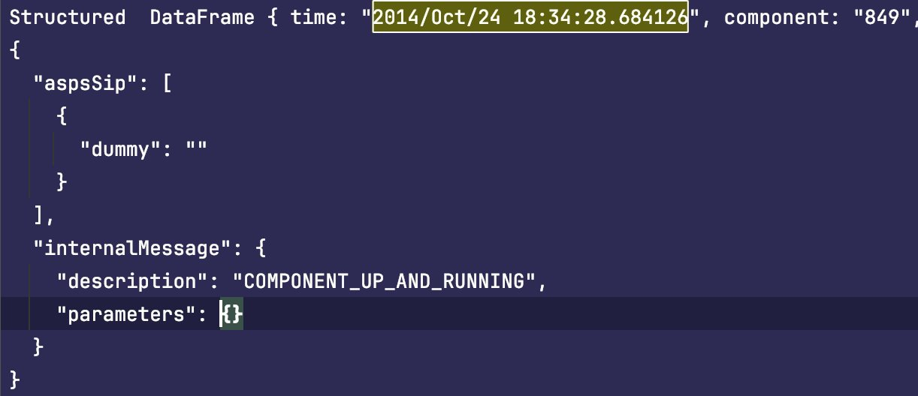
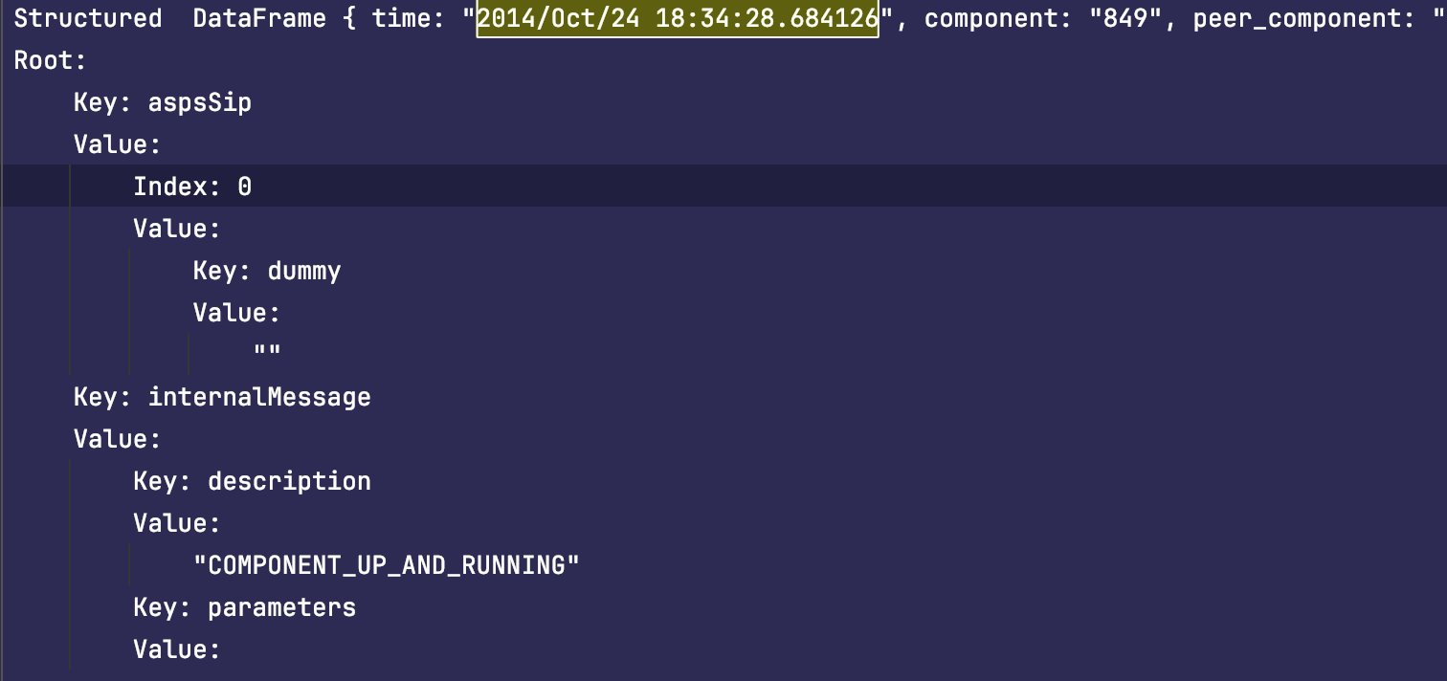
Function summaries-demo2
Structured log extraction Example
JSON ——> Final

Slide 10
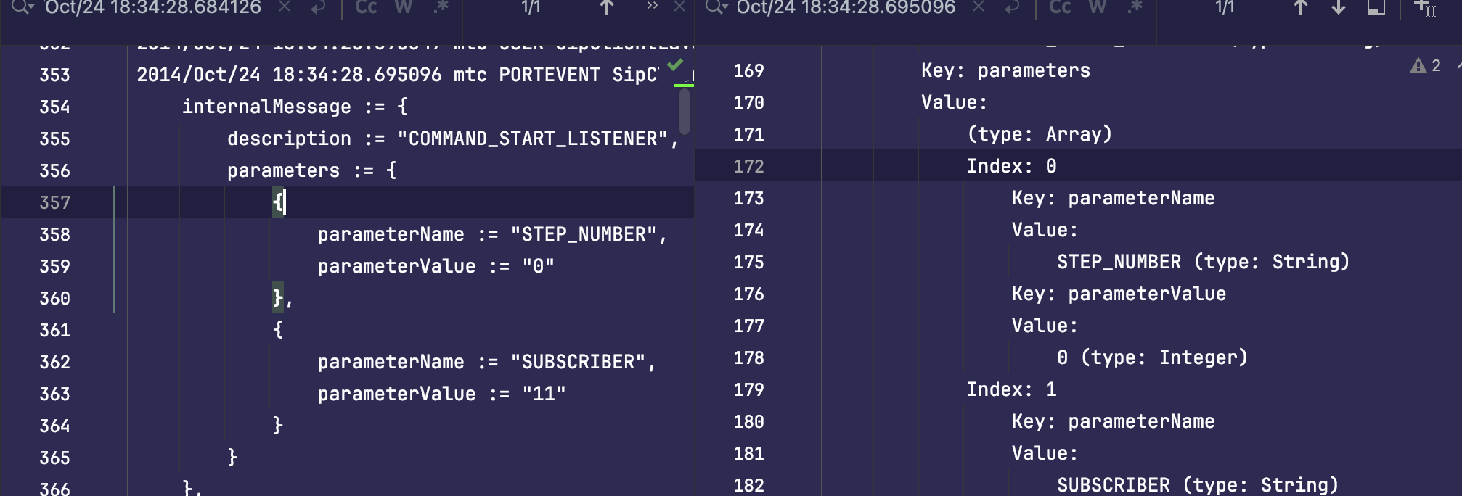
function summaries-demo3
Classify values into data types (e.g. string, integer, …).
Example

Slide 11



User Story
Log parsing and extraction:
Rows for PORTEVENT and TIMEROP, extract relevant information
Structural analysis:
Identify MESSAGE_BODY as the representative structure.
Identify the elements of the structure.
Value storage:
Recognize and store simple values and values of structural elements.
Type inference:
Classify values into data types (e.g. string, integer).
Message generation:
Generates a message containing valid values for each field.
User Interface:
Create a user-friendly interface to configure and launch analysis.
Provides user interaction options.
Documentation:
Document functionality and provide guidance on how to use the tool.

Slide 12
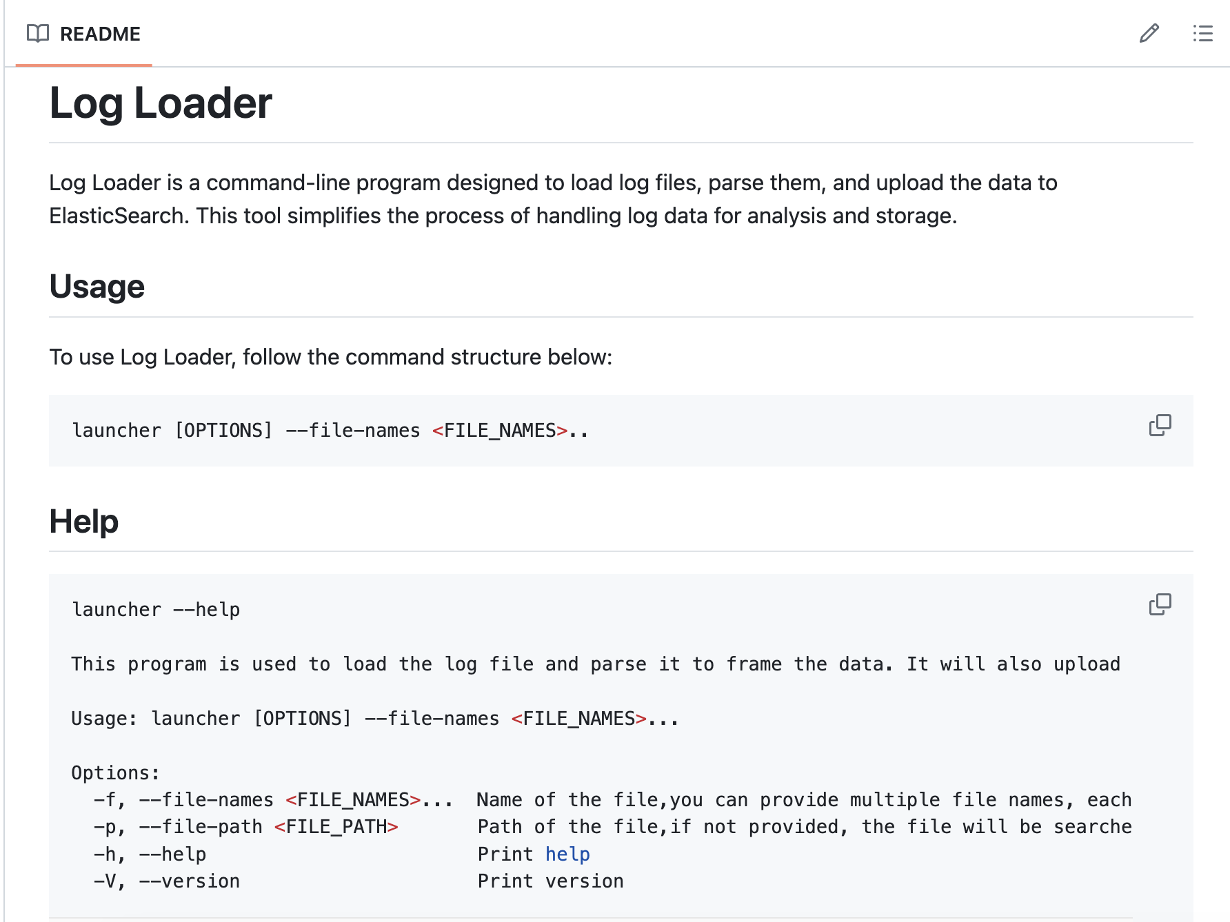

User documentation
https://github.com/bytemaker-io/log-parser.git

Slide 13
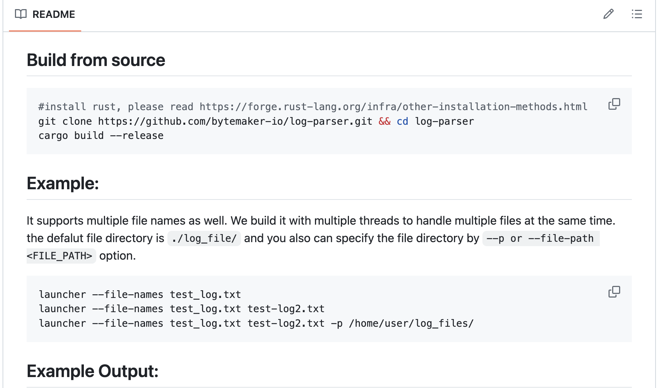
User documentation
README FILE IN GIT
Overview of the project, installation instructions, usage, usage examples, and more.
https://github.com/bytemaker-io/log-parser.git

Slide 14
THANK YOU

