Slide 1
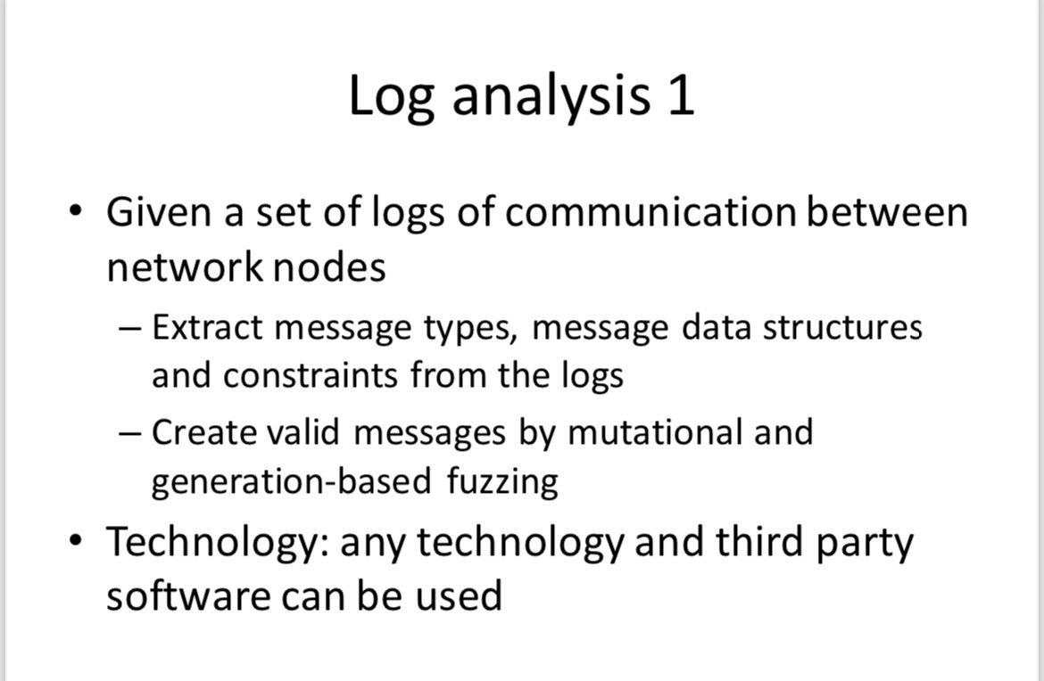
Log Analysis 1
RED TEAM
Demo 1
25.03.2024

Slide 2
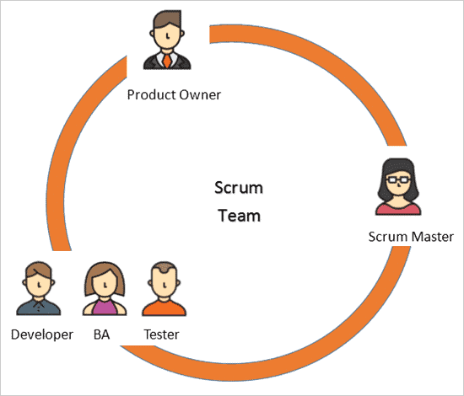
Team members, roles
Nurlan Yagublu - Scrum Master
Siyu Chen - Product Owner
Nazrin Ibadli - Developer
Fei Wang - Developer
Zebai Tian - Tester

Slide 3
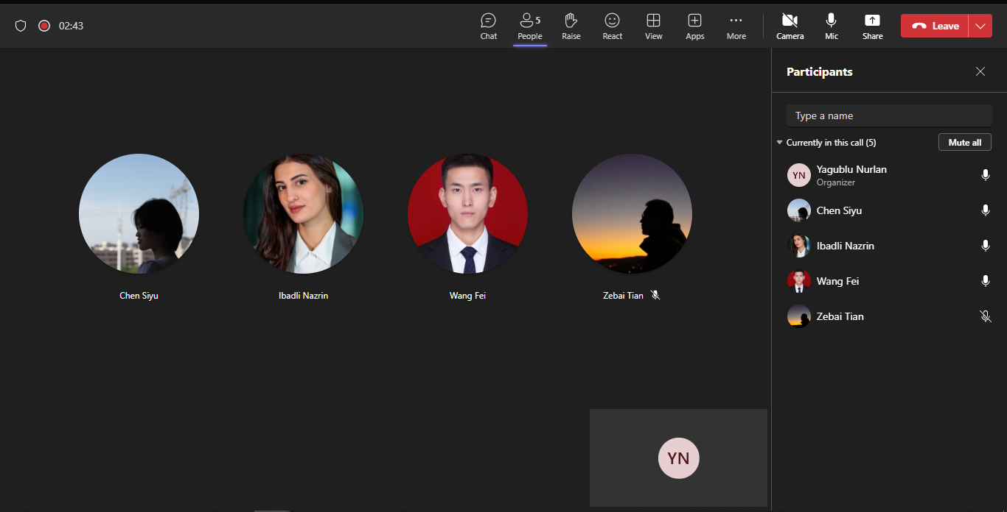
Team Collaboration

Slide 4
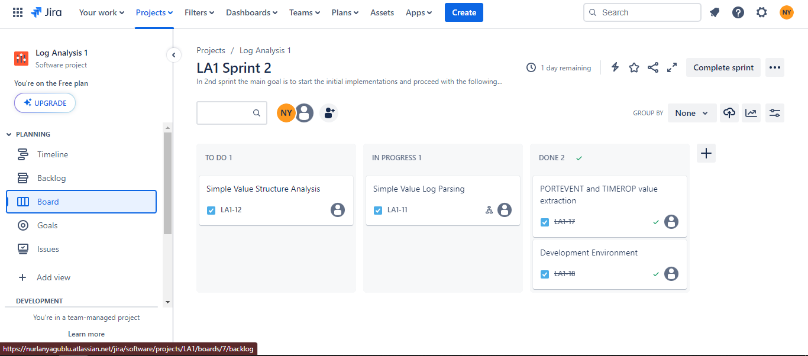
Sprint Plan

Slide 5
Project Overview
Description The Log Analysis 1 project involves parsing log files to extract structured data. The main goal is to analyze log entries with keywords like PORTEVENT and TIMEROP. Key Objective Extract data from log files, focusing on lines containing PORTEVENT and TIMEROP, to understand system communication and behavior. User Story: As a developer, I aim to parse log files containing PORTEVENT and TIMEROP entries to extract structured data. This will enable me to comprehensively analyze system communication and behavior.

Slide 6
Backlog & Communication & Sprint Planning
Product Owner's Overview Managing the Project Backlog Facilitating Sprint Planning and Review Driving Collaboration and Communication

Slide 7
Simple value case
PORTEVENT and TIMEROP value extraction

Slide 8
Development Environment
IDE: RustRover (https://www.jetbrains.com/rust/)
Platform: Macos 13.0
Programming Language: Rust
Version Control: Git
Remote Version Control Rep: Github
CI／CD: Github Action

Slide 9
CI/CD
We use Github Action as the CI/CD tool for this project. When a developer pushes a new commit, the pipeline will be triggered to complete the automated build.
pipeline:https://github.com/bytemaker-io/log-parser/blob/main/.github/workflows/rust-build.yml
When the developer is ready to release a new version, it will perform the entire release process, such as compilation, testing, packaging, compression, and uploading.
pipeline:https://github.com/bytemaker-io/log-parser/blob/main/.github/workflows/release.yml

Slide 10
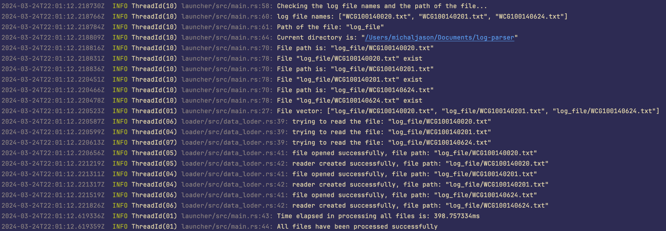
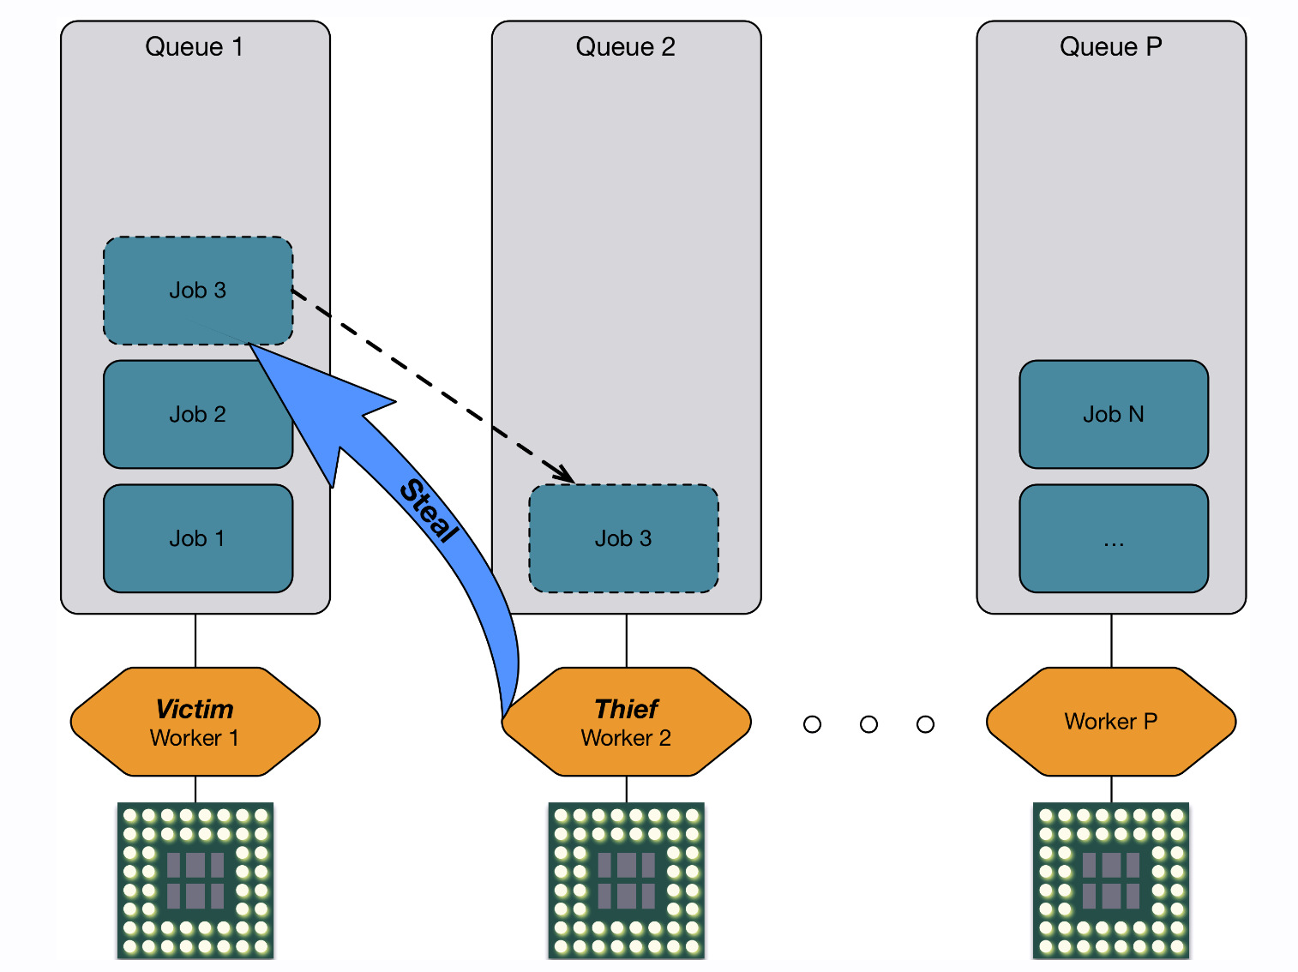
Log Parser
We use an asynchronous multi-threading model to process multiple files at the same time. We only need about 300-400 ms to complete the parsing of 200,000 lines of log data.
Notes:
Imagine you and your friends are helping to clean up toys.

Slide 11
PORTEVENT and TIMEROP Extraction
Use spaces as delimiters to split the string into multiple parts and build a data frame after extraction.
timestamp | component_name | event_type | peer_component | event_description | port | function_name | message
2014/Oct/24 18:34:28.666490 | mtc | PORTEVENT | WCG10014_0020 | ttcn | 53 | testcase:WCG100140020 | Port dnsInternalPort[1] was started

Slide 12
Next Sprint Plan
Refinement of Extraction Algorithm Structured Log Extraction

Slide 13
THANKS

