Slide 1


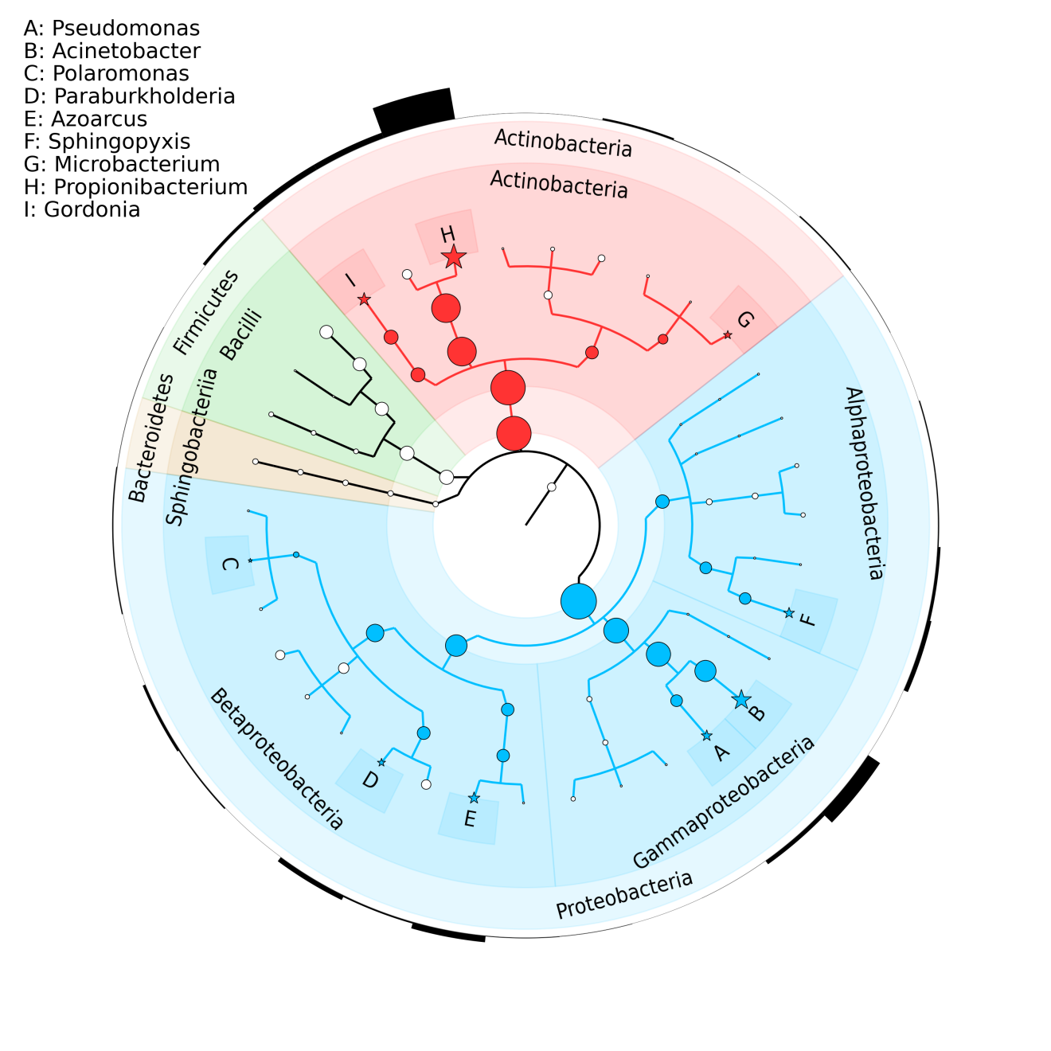
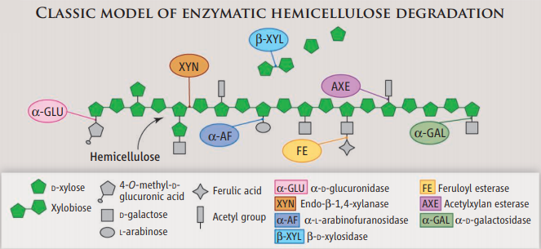
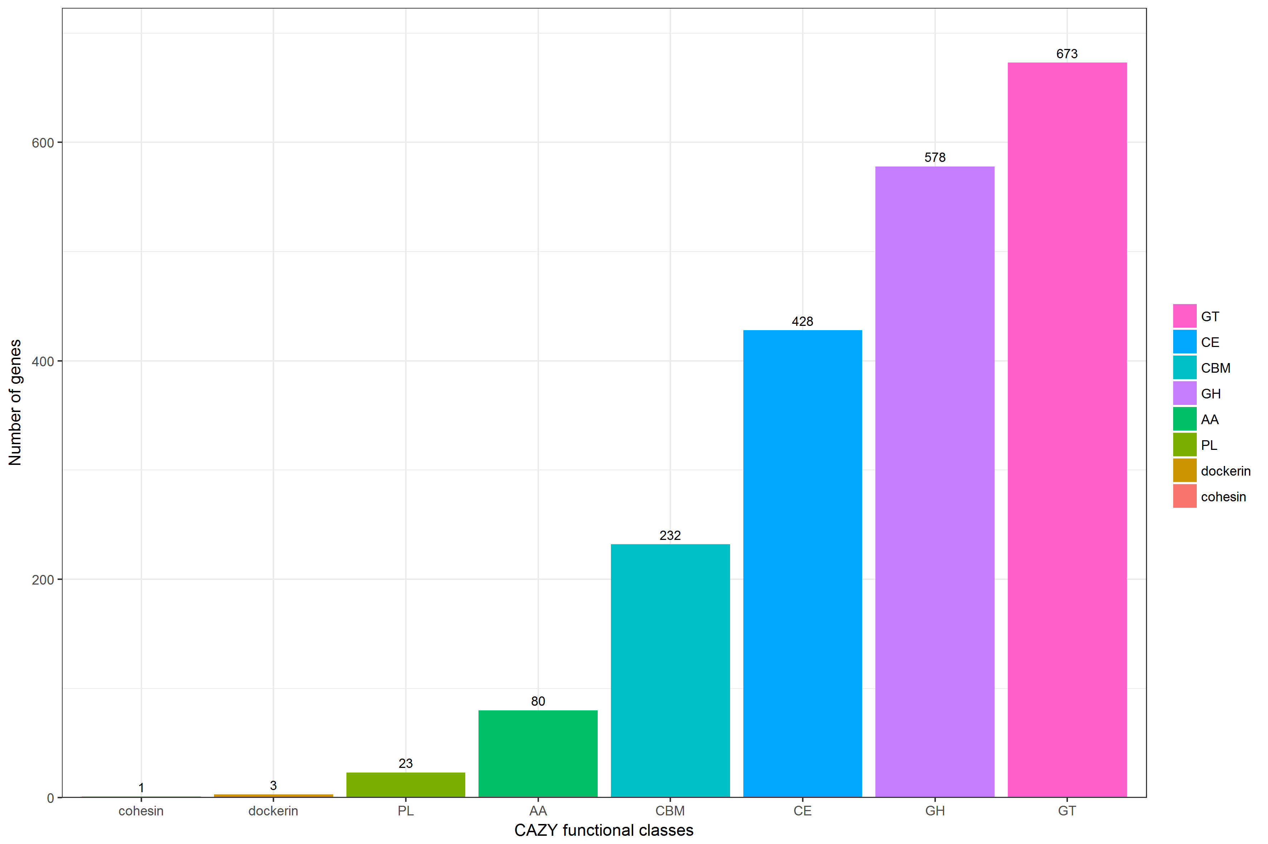
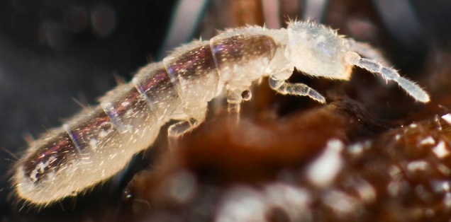
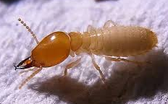
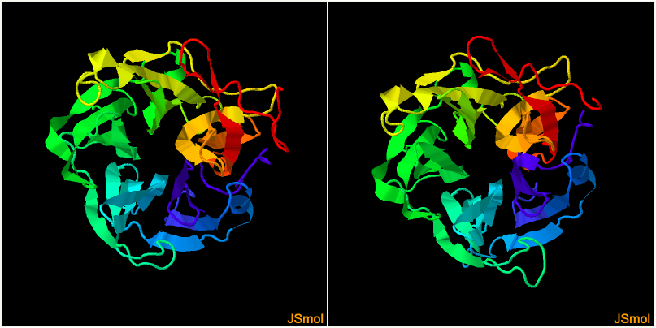
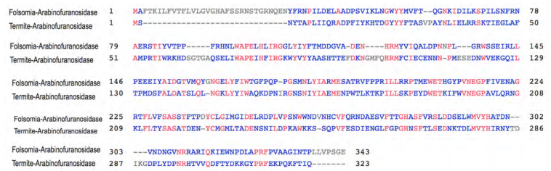




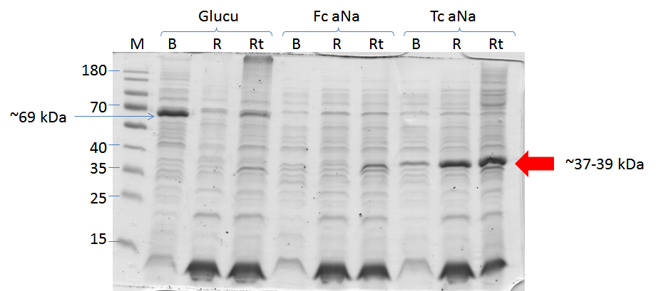


Isolation and functional characterization of hemi-cellulose breakdown enzymes from animal gut microbiome
Giang Le^{1,2}, Valeria Agamennone¹, Nico M. Van Straalen¹, Truong Nam Hai², and Dick Roelofs¹
^{1,} Vrije Universiteit Amsterdam, Molecular Cell Physiology, De Boelelaan 1085, 1081HV Amsterdam, the Netherlands;
^{2,} Vietnam Academy of Science and Technology (VAST), Institute of Biotechnology , 18 Hoang Quoc Viet, Cau Giay, Hanoi, Vietnam
Introduction
Results
Agricultural wastes lead to pollution and health problems.
Biomass is a great bio-renewable carbon source for food, feed and biofuels. Hemi-cellulose is the second most abundance after cellulose.
A
B
613
667
420
Figure 1: Hemi-cellulose degrading enzymes. (Reviewed by Berlin A, 2013)
218
Investigate hemi-cellulose degredation in animals feeding on woods.
Metagenomic tools have proven to be instrumental in identifying and isolating hemi-cellulose degrading genes from animal gut microbiomes
Aim: Isolation and functional characterisation of arabinofuranosidase gene from gut microbiomes
1
2
33
81
C
Figure 3: A: Annotated 147,851 genes: Majority map back to bacteria (90%)
B: Carbohydrate activity enzymes found in the metagenomes.
C: Taxonomic distribution of genus with CAZymes
Material and methods
Folsomia candida
Coptotermes gestroi
DNA extraction
Sequencing
SPAdes
Fc
Tc
Assembly
Figure 4: A: Blastp result of arabinofuranosidase gene.
A: 3D structure of the arabinofuranosidase enzymes from springtail (Fc) and termite (Tc).
B: The alignments of the two sequences with the conserved domains (boxes in alignment)
Proteins sequences
Candidate genes
CAZy
Expression
Figure 5: Expression of soluble arabinofuranosidase (aNa) gene in BL21-DE3 and Rosetta E. coli.
B: BL21, R: Rosetta2 : Soluble fraction Rt: Rosetta total fraction
Fc: Folsomia clone. Tc: Termite clone
Activity
Conclusion
Two genetically divergent full length alpha N arabinofunosidase genes were isolated from termite and Folsomia metagenomic DNA
Successful expression of proteins in soluble fraction.
Future work: protein purification and activity assay (Megazyme kit)
Figure 2: Pipeline for annotating, identifying and expressing genes with carbohydrate-related activity
Metagenome sequences of springtail, termite and goat were generated.
Screen gene annotations for potential hemicellulose degrading functions.
Candidates are being cloned and expressed.
Cloning performed in pET16 Expression vector. Protein is expressed in E.coli expression strain BL21-DE3 and Rosetta2.
Reference:
Berlin A No Barriers to Cellulose Breakdown Science 342, 1454 (2013); DOI: 10.1126/science.1247697
Do, T.H., Nguyen, T.T., Nguyen, T.N., Le, Q.G., Nguyen, C., Kimura, K., and Truong, N.H. (2014). Mining biomass-degrading genes through Illumina-based de novo sequencing and metagenomic analysis of free-living bacteria in the gut of the lower termite Coptotermes gestroi harvested in Vietnam. J. Biosci. Bioeng. 118, 665–671.
Acknowledgements
This work is supported by a BE-Basic Foundation-FES grant (F07.003.07) from the Dutch Ministry of Economic Affairs, and by a grant from Institute of Biotechnology (IBT)

