Slide 1




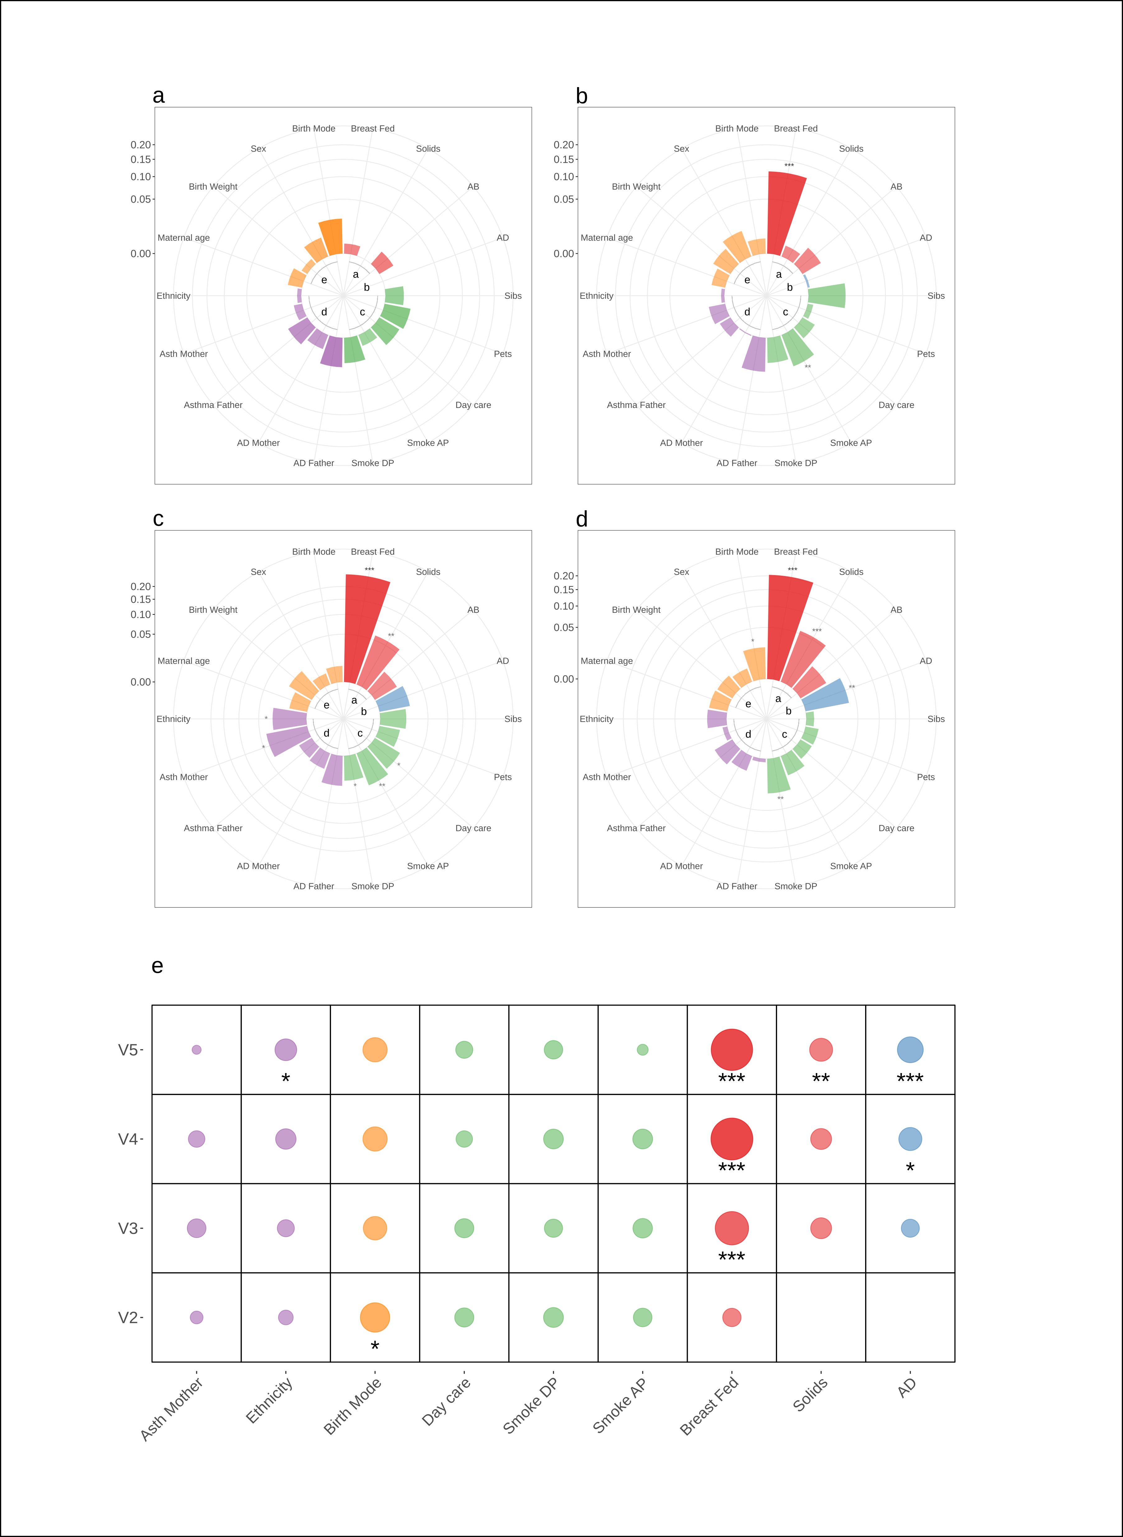



Infant gut microbial community assembly and maturation is linked to subsequent atopy development during childhood
Gianluca Galazzo^{A,B}, Niels van Best^{A,C,D}, Liene Bervoets^{A,D}, Isaan Oteng Dapaah^{A}, Paul H. Savelkoul^{A,B,E}, Mathias W. Hornef^{C}, the GI-MDH consortium, Susanne Lau^{F}, Eckard Hamelmann^{G}, John Penders^{A,B,D}
^{A} School of Nutrition and Translational Research in Metabolism (NUTRIM), Department of Medical Microbiology, Maastricht University Medical Center, Maastricht, the Netherlands
^{B} School for Public Health and Primary Care (Caphri), Department of Medical Microbiology, Maastricht University Medical Center, Maastricht, the Netherlands.
^{C} Institute of Medical Microbiology, RWTH University Hospital Aachen, RWTH University, Aachen, Germany
^{D} in Vivo Planetary Health: an affiliate of the World Universities Network (WUN), West New York,New Jersey
^{E} Department of Medical Microbiology and Infection Control, Amsterdam UMC, location VUmc, Amsterdam, The Netherlands
^{F} Department of Pediatric Pulmonology, Immunology and Intensive Care Medicine, Charité Universitätsmedizin Berlin, Germany
^{G} Children's Center Bethel, Protestant Hospital Bethel, University of Bielefeld, Germany
Introduction
The establishment of the enteric microbiota during infancy critically influences immune maturation. Microbial perturbations during infancy may promote the development of immune-mediated diseases. Although numerous epidemiological studies suggest that the infant intestinal microbiota plays an important role in the manifestation of allergic diseases and asthma, results on the involved bacterial taxa vary considerably between studies which might be related to heterogeneity in study designs. In particular timing of fecal sampling varies considerably between studies.
Given the highly dynamic and complex process of microbial assembly, succession and maturation, repeated sampling is important to allow analysis of the overall development of the indigenous infant microbial ecology
Methods
1,453 stool samples from 440 children were profiled using 16S rRNA gene amplicon sequencing to characterize microbiota composition during infancy and childhood and to identify associations with allergic disease manifestations. Various longitudinal models such as Joint Modeling (JM) and Generalized Linear Models (GLM) have been used to investigate the how the establishment and maturation of the gut microbiota affects the chances to develop allergic manifestation later in life.
Results
At the age of 5 weeks, birth mode explained the greatest variance in bacterial community profiles, whereas at the ages of 13, 21 and 31 weeks by far the greatest variance in bacterial community profiles was explained by breastfeeding followed by introduction of solid food. More precisely, we found that some taxa such as Streptococci, Staphylococci and Bifidobacteria were significantly decreased after cessation of breast feeding.
The temporal pattern of microbial diversity was independently and inversely associated with AD (Hazard rate (HR)= 0.21; p=1.15*10-4), indicating that a lower microbial diversity throughout infancy is associated with an increased risk of AD. Our results show also that Faecalibacterium and Lachnobacterium were significantly decreased in children that developed AD.
Finally, our investigation showed that higher diversity is also associated with lower risk of allergic sensitization at school age (Shannon index at 31 weeks OR_{adjusted} = 0.19, p = 7.33*10⁻³)
Objective
The aim of this study was to investigate the association between microbiota maturation during infancy and allergic disease manifestation later in life.
a
b
c
d
e
Figure2: Microbiota composition, diversity and maturity is linked to the subsequent development of atopic dermatitis. A, Volcano plot depicting the coefficients from the joint model on the association between the Shannon index and the development of atopic dermatitis (AD). The dashed line depicts the threshold for statistical significance at p<0.05. B, Development of microbial diversity (Shannon index) throughout infancy among children that did (red line) or did not (green line) develop AD. Grey areas represent the 95% confidence intervals. C-E, Time intervals of differential abundance in Lachnobacteriumn (C), Prevotella (D), and Faecalibacterium (E) between infants that did or did not develop AD. Significantly different time-intervals (FDR-adjusted p<0.05) are depicted by gray shading.
Figure 1: Microbiota community structure is most strongly influenced by breastfeeding. A, Polar plots visualizing the amount of variance of microbial communities at each infant time point that could be explained. The height of the bars reflects the amount of variance (R²) explained by each covariate. B, Permutational Multivariate Analysis of Variance (PERMANOVA) combining all covariates that were significantly associated with microbial community variation at any given time point in the EnvFit analyses. The size of the dots reflects the R². Asterisks indicate statistical significance with *p<0.05, **p<0.01, ***p<0.001.
Conclusion
Our results demonstrate the importance of birth mode and diet on the early maturation of the infant microbiota and demonstrate that, upon careful adjustment of important confounding factors, alterations in the microbial colonization process of the infant intestinal tract precede the development of AD and allergic sensitization.
Correspondence to:
Gianluca Galazzo
g.galazzo@maastrichtuniversity.nl
T +31627207006
Dept of Medical Microbiology
Maastricht University
P.O. Box 616
6200 MD Maastricht, The Netherlands
@Penderslab
DIGITAL POSTER
www.penderslab.com
Notes:
ALIGN THE WIDTH OF THE FIGURES WITH THE Width of the tekst boxes

