Slide 1
Dissemination of a mosaic transposon carrying fourteen different antimicrobial resistance genes driven by a polyclonal outbreak in two hospitals.
Casper Jamin
PhD Student
Maastricht UMC

Slide 2



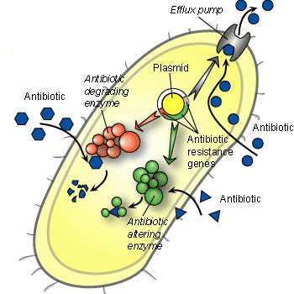
Outbreak of multidrug resistant bacteria
Typing request from regional hospital
Multidrug resistant klebsiella and Enterobacter
all resistant to antibiotics of first choice:
Ciproflocaxin Fluoroquinolone
Gentamicin aminoglycoside
Cotrimoxazol trimethoprim + sulfonamide
Ceftriaxon beta-lactam (3th gen cephalosporin)
Augmentin ampicillin + clavulanate
Clonal dissemination & plasmid outbreak?
Regional hospital

Slide 3
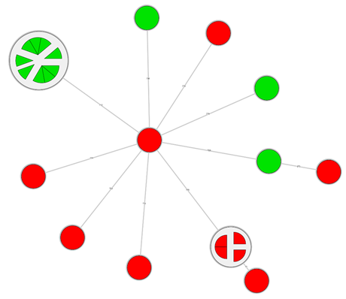
Inter hospital outbreak?
Regional hospital
MUMC+
Various different strains

Slide 4
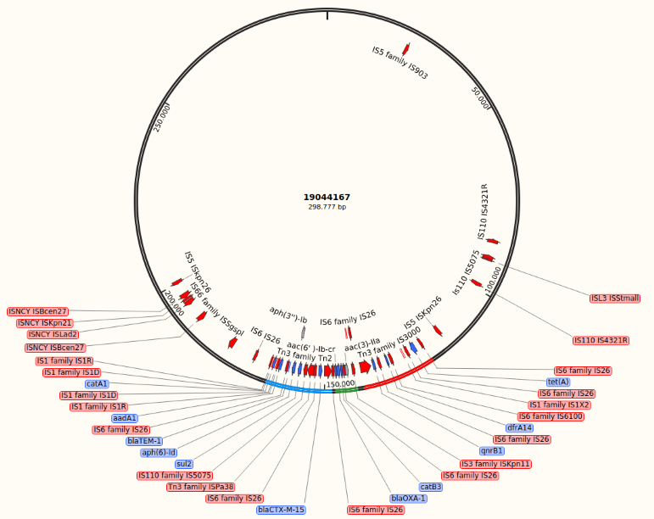
Multidrug resistance plasmids found
MinION sequencing
4 different plasmids found
All with dense resistance region

Slide 5
Same multi-drug resistance region?
Screen all local datasets by mapping whole genome sequencing reads to reference
Compared to representative dataset of 1800 multidrug resistant strains in the Netherlands
Based on Tetyper (https://github.com/aesheppard/TETyper)

Slide 6
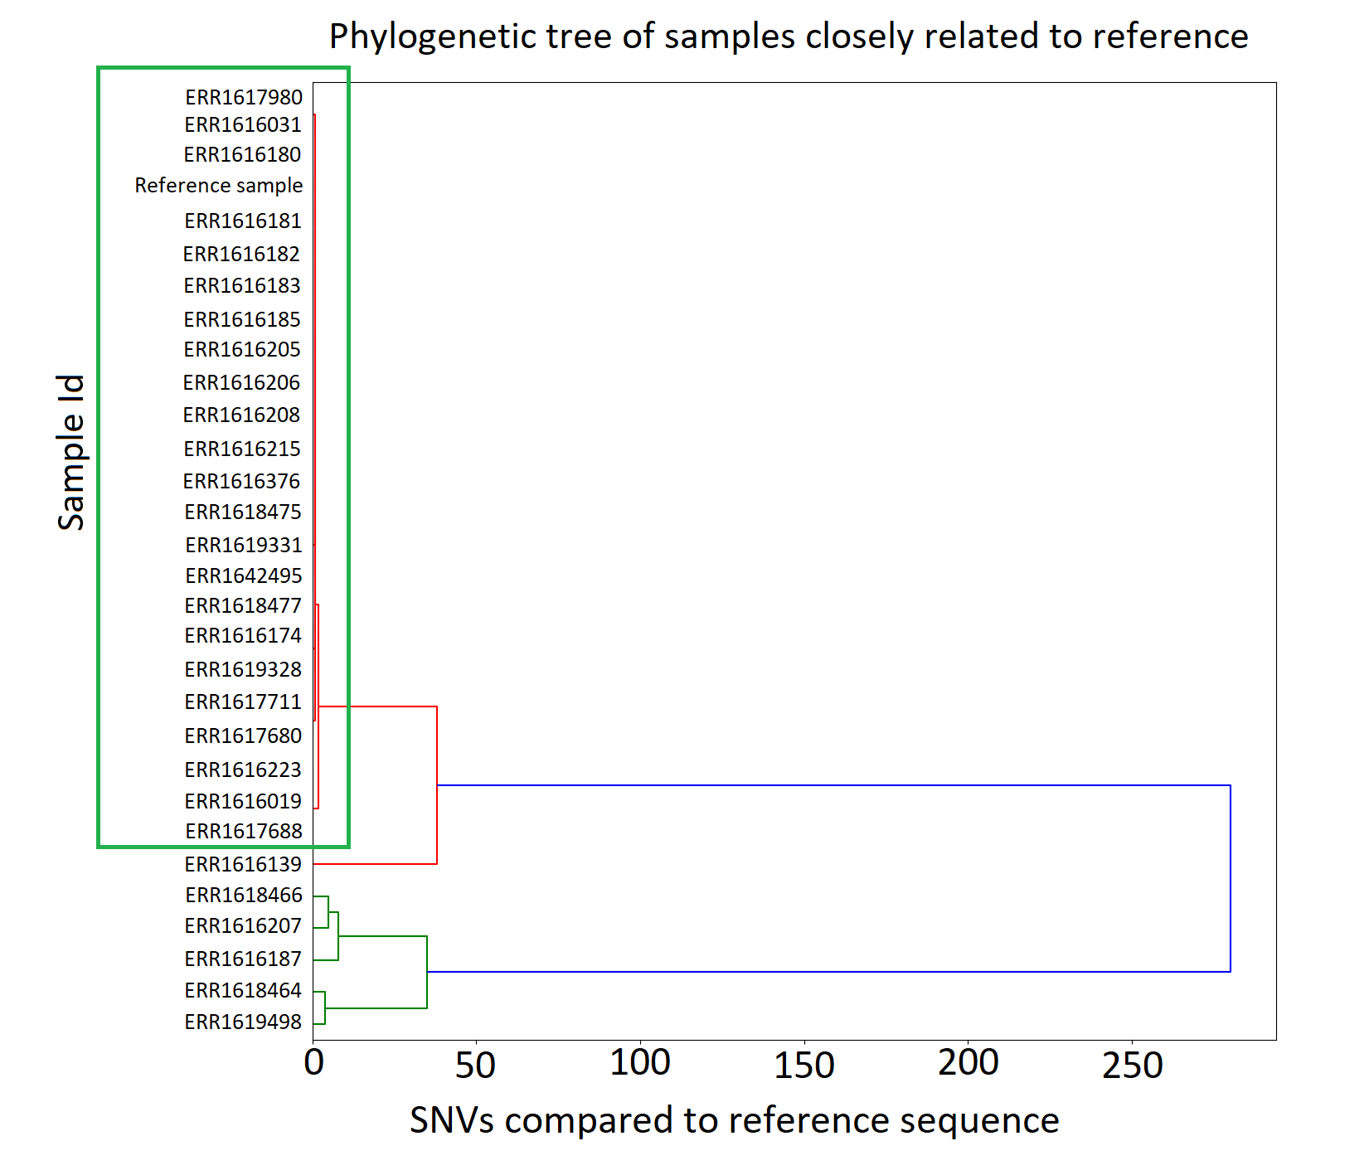
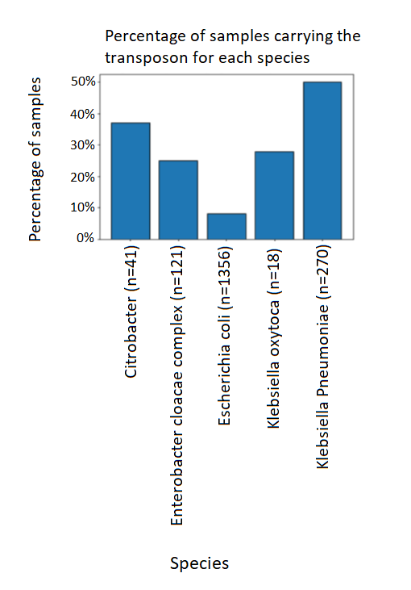
Reference mapping
23 / 1800 cluster very with our reference

Slide 7
Wrapping up
Spread of antimicrobial resistance in our hospitals are on different levels:
1. spread of bacteria
2. spread of plasmids
3. spread of transposon

Slide 8
Thank you!
Questions?

