Slide 1
Akka Java Cluster

Slide 2
Why use a cluster?
Cost-effective computer power for applications that need greater performance than the one provided by a vertical scale architecture.
Main Reasons to adopt a cluster architecture:
Real time constraints;
Throughput;
Memory;
Parallel Programming;
Fault Tolerance;
Zero downtime upgrades.

Slide 3
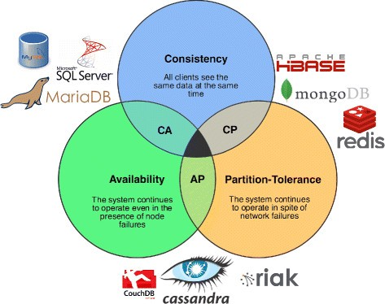
Distributed Systems – CAP Theorem
Consistency | Every read receives the most recent writes or an error.
Availability | Every request received by a non-failing node in the system must result in a response.
Partition-Tolerance | The system continues to operate despite an arbitrary number of messages being (dropped/delayed) by the network between nodes.

Slide 4
Distributed Systems
Challenges of Distributed Computing
Replication is slow;
Servers fail;
The network is not reliable;
Latency >> 0;
Limited Bandwidth.
Fallacies of Traditional Data Models
Total Global Ordering is not possible;
Data is not a single opaque value;
ACID Transactions are not possible.

Slide 5
Distributed Systems - Eventual Consistency
Eventual consistency is a characteristic of distributed computing systems such that the value for a specific data item will, given enough time without updates, be consistent across all nodes.
Is designed to:
Embracing failure in distributed systems;
Reconciling different operation orders.
You have two types of Eventual Consistency:
EC with Probabilist Guarantees (The order of the merge of the events does not matter);
EC with Strong Guarantees (Order matters).

Slide 6
Eventual Consistency vs Strong Consistency
Eventual Consistency
I watch the weather report and learn that it’s going to rain tomorrow;
I tell you that it’s going to rain tomorrow;
Your neighbour tells his wife that’s it’s going to be sunny tomorrow;
You tell your neighbour that is going to rain tomorrow.
Strong Consistency
Your bank balance is $50;
You deposit $100;
Your bank balance, queried from any ATM anywhere, is $150;
Your daughter withdraws $40 with your ATM card;
Your bank balance, queried from any ATM anywhere, is $110.

Slide 7
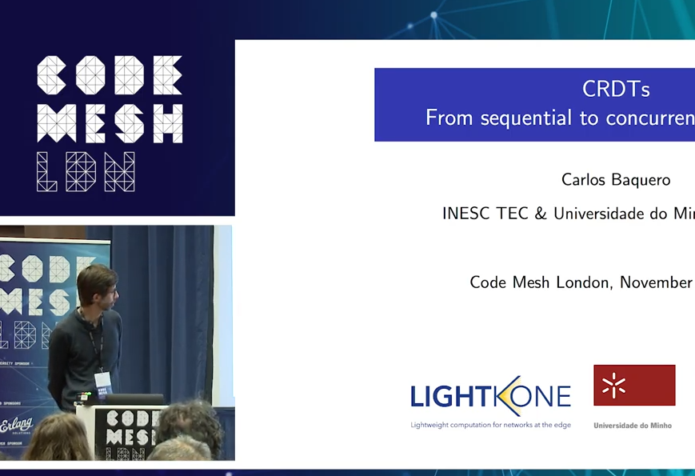
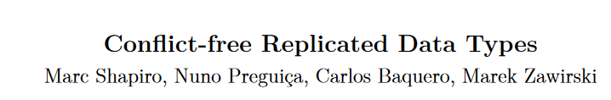
Distributed Data Conflict Free Replicated Data Types (CRDT)
CRDTs – Data types that guarantee convergence to the same value in spite of network delays, partitions and message reordering.
https://hal.inria.fr/inria-00609399v1/document
https://www.youtube.com/watch?v=hw4agjz4240

Slide 8
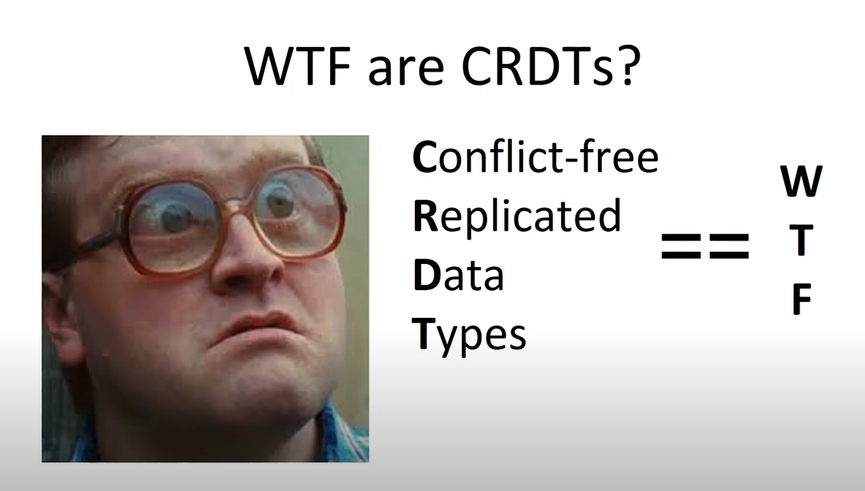
Distributed Data CRDT
https://www.youtube.com/watch?v=vBU70EjwGfw&feature=youtu.be&t=201

Slide 9
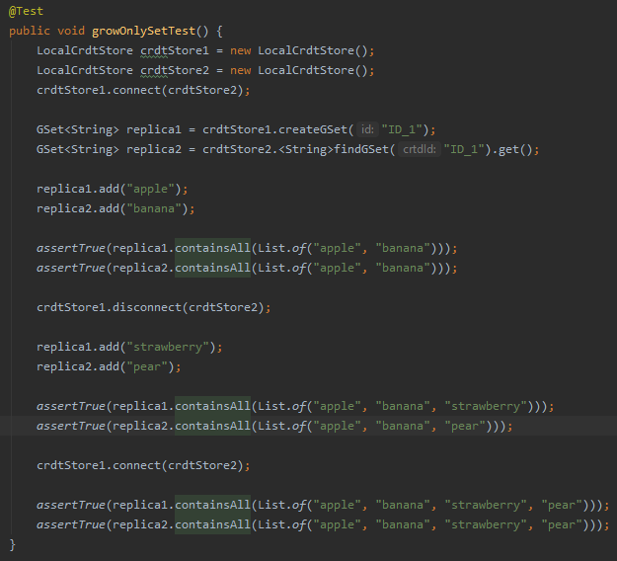
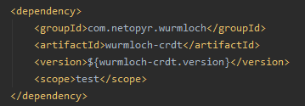
Distributed Data CRDT – Grow Only Set Operation
https://www.baeldung.com/java-conflict-free-replicated-data-types
A: {Apple}
A: {Apple, Banana}
B: {Banana}
B: {Apple, Banana}

Slide 10
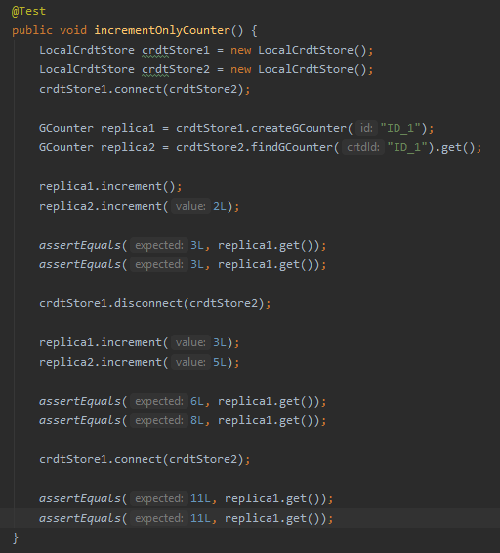
Distributed Data CRDT – Increment Only Counter

Slide 11
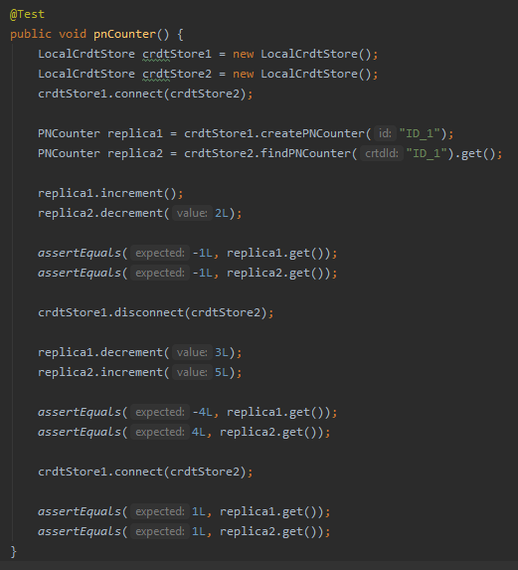
Distributed Data CRDT – PN Counter

Slide 12
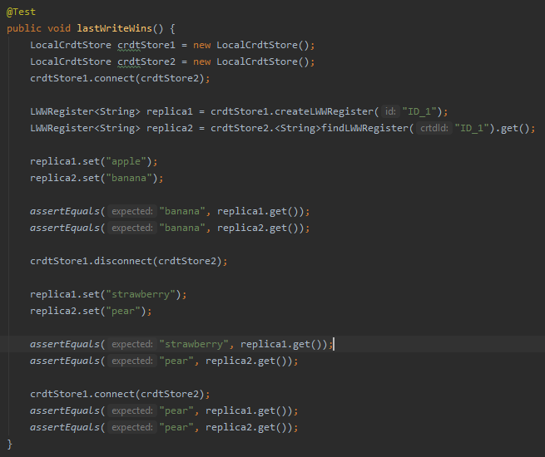
Distributed Data CRDT – Last Write Wins (LWW)

Slide 13
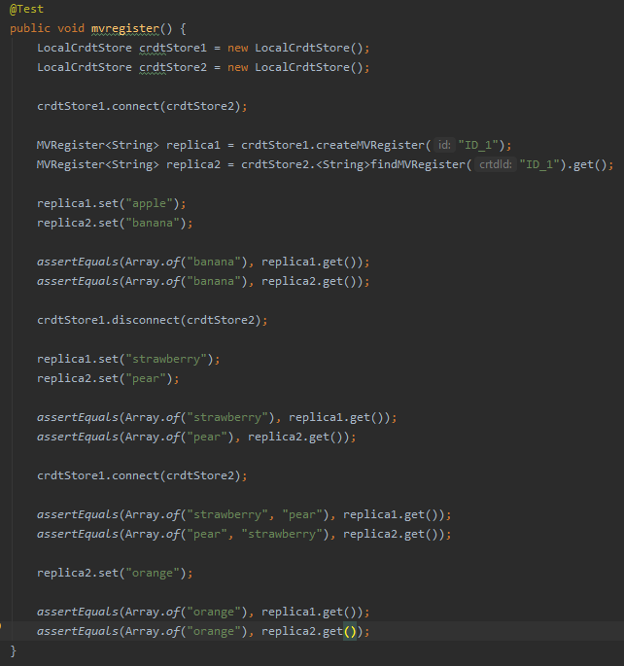
Distributed Data CRDT – Multi Value (MV) Register
An specialization of Last Write Wins but with the extension:
If the value of a value MV-Register is changed concurrently, it keeps all values.

Slide 14
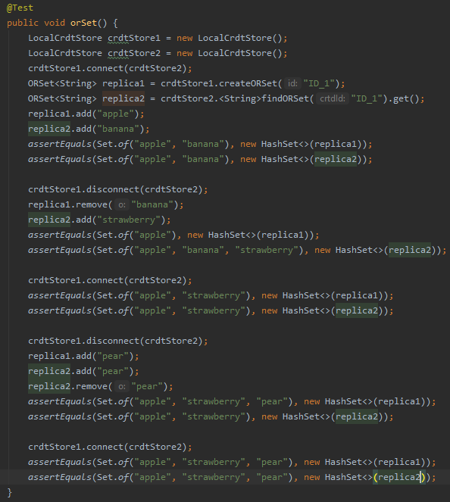
Distributed Data CRDT – OR-Set
Only elements which add-operation is visible to a replica can be removed from that replica.

Slide 15
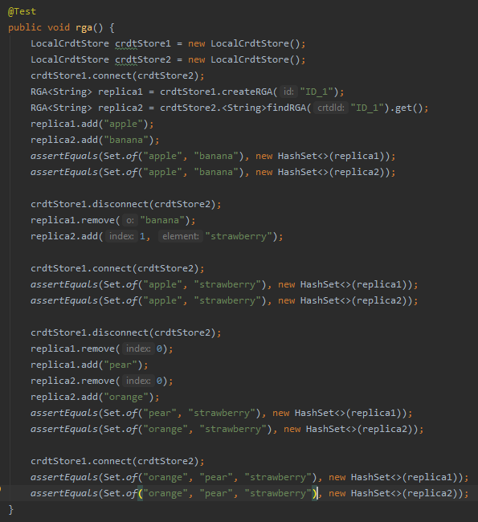
Distributed Data CRDT – Replicated Growable Array (RGA)
Can add and remove in a specific order.

Slide 16
Distributed Data CRDT – Consequences
Rethinking how we view the data
Not just a place to dump values;
Abstraction of the data type;
Data Structure that tells how to build the value.
Why CRDT
Replicate data across the network without any synchronization mechanism;
Avoid distributed locks, two-phase commit, etc...
Consistency without consensus.
Value of CRDTs
Sacrifice linearisability (guaranteed ordering) while renaming correct;
Used to build High Available and Partition Tolerant (AP) architectures.

Slide 17
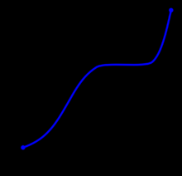
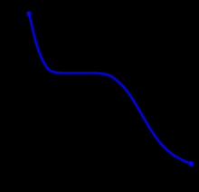
Monotonic Sequence – Data Types For CRDTs
Sequences that always increases or always decreases;
Are eventually consistent without any need for coordination protocols.
https://en.wikipedia.org/wiki/Monotone_convergence_theorem
https://en.wikipedia.org/wiki/Monotonic_function

Slide 18
Convergent Operations – Data Types For CRDTs
Associative (a + (b + c));
Commutative (a + b = b + a);
Idempotent (a + a = a).

Slide 19
Akka
Akka
Actor based Toolkit;
Simple Concurrency & Distribution;
Error Handling and Self-Healing;
Elastic and Decentralized;
Adaptative Load Balancing.
Actors
Isolated lightweight processes;
Message based / Event driven;
Run Asynchronously;
Process one message at time;
Sane concurrency;
Isolated Failure Handling.

Slide 20
Akka
Actor Systems
Actor System is the hierarchic of collaborating actors;
Parent actors delegate work to child actors;
Child actors are supervised by parent actors;
Failure can be propagated back up Actor Hierarchy.
Akka Clustering
Peer-to-peer based cluster membership;
Communicates state via gossip protocols;
No single point of failure or single point of bottleneck;
Automatic node failure detector.

Slide 21
Gossip Protocol
Sharing state by gossiping with neighbours;
Each node holds state and picks a random node to share information with;
Reliable communication is not assumed.

Slide 22
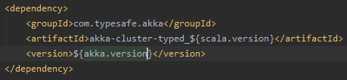
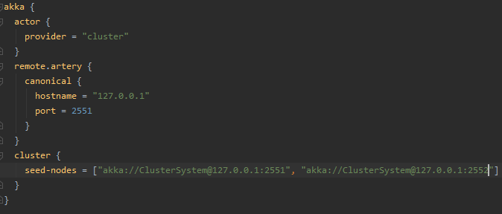

Cluster Usage – Minimum Configuration
Accessing the Cluster extension in each node

Slide 23
Cluster Usage – Programmatically Configuration
Leave other member
Can be used to receive when cluster state changes. (E.g. 1 node leaves).
Get Current State

Slide 24

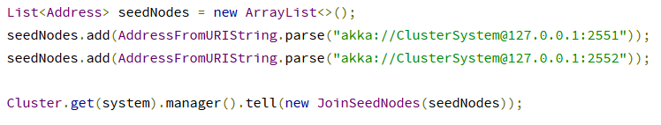
Cluster Usage – Seed Configuration
When a new node is started it sends a message to all seed nodes and then sends join command to the one that answers first. If no one of the seed nodes replied it retries this procedure until successful or shutdown.
If you don’t configure. The application will retry sent the gossip protocol message. In case of failure it will add then to the deadletter message inbox until get OutOfMemoryException!

Slide 25
Cluster Usage – Leaving Cluster
Leaving Cluster:
Graceful exit, informing the cluster that a node shall leave. (Performed by default by the Coordinated Shutdown);
Graceful exit using HTTP or JMX;
Abrupt termination, the node will be detected as unreachable by other nodes and removed after Downing.
Tell programmatically that one node leaves.

Slide 26

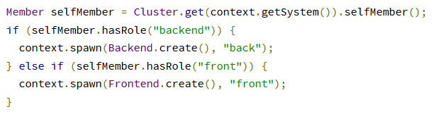
Cluster Usage – Roles
Not all nodes of a cluster need to perform the same function. So we set roles for each node to define their functions. (Useful in cluster-aware routers architectures).

Slide 27

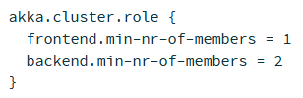

Cluster Usage – Configuration
Minimum number of nodes to form a cluster.
You must define the minimum number of nodes as:
Number of total fix nodes/2 + 1 to avoid split brain scenarios.
To use a separate dispatcher for cluster.
Check if the new joiners are compatible.
akka.cluster.configuration-compatibility-check.enforce-on-join = off
Disable compatibility verification.

Slide 28
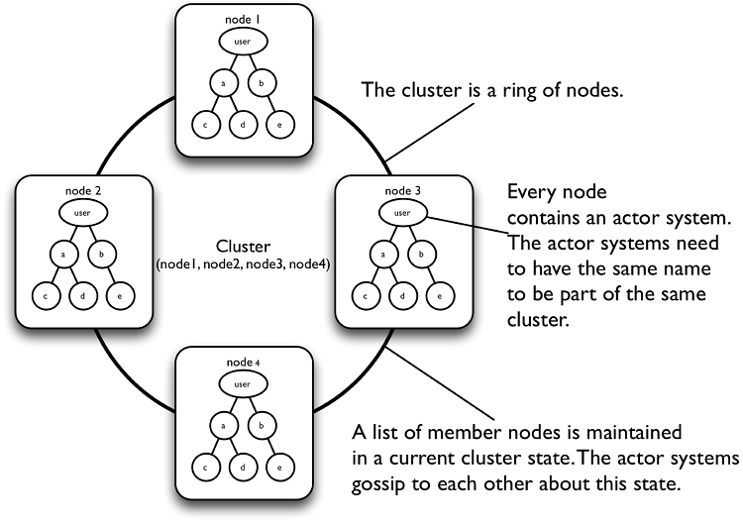
Cluster Membership Service
Akka Cluster has two objectives.
Keep track of what nodes are part of the cluster and their health.
Cluster membership is communicated using gossip and failure detection.

Slide 29
Cluster Terms
Node | A logical member of a cluster. Identified by hostname:port:uid
Cluster | A set of joined nodes
Leader | A single node in the cluster that manages the convergence and membership state transitions.

Slide 30
Akka Cluster – Member States
joining | Transient when joining a cluster
weakly up | Transient state while network split (only if akka.cluster.allow-weakly-up-members=on)
up | Normal operating state
leaving | States during graceful removal
down | Marked as down (Still member but no longer part of cluster decisions).
removed | Tombstone state (no longer a member).

Slide 31
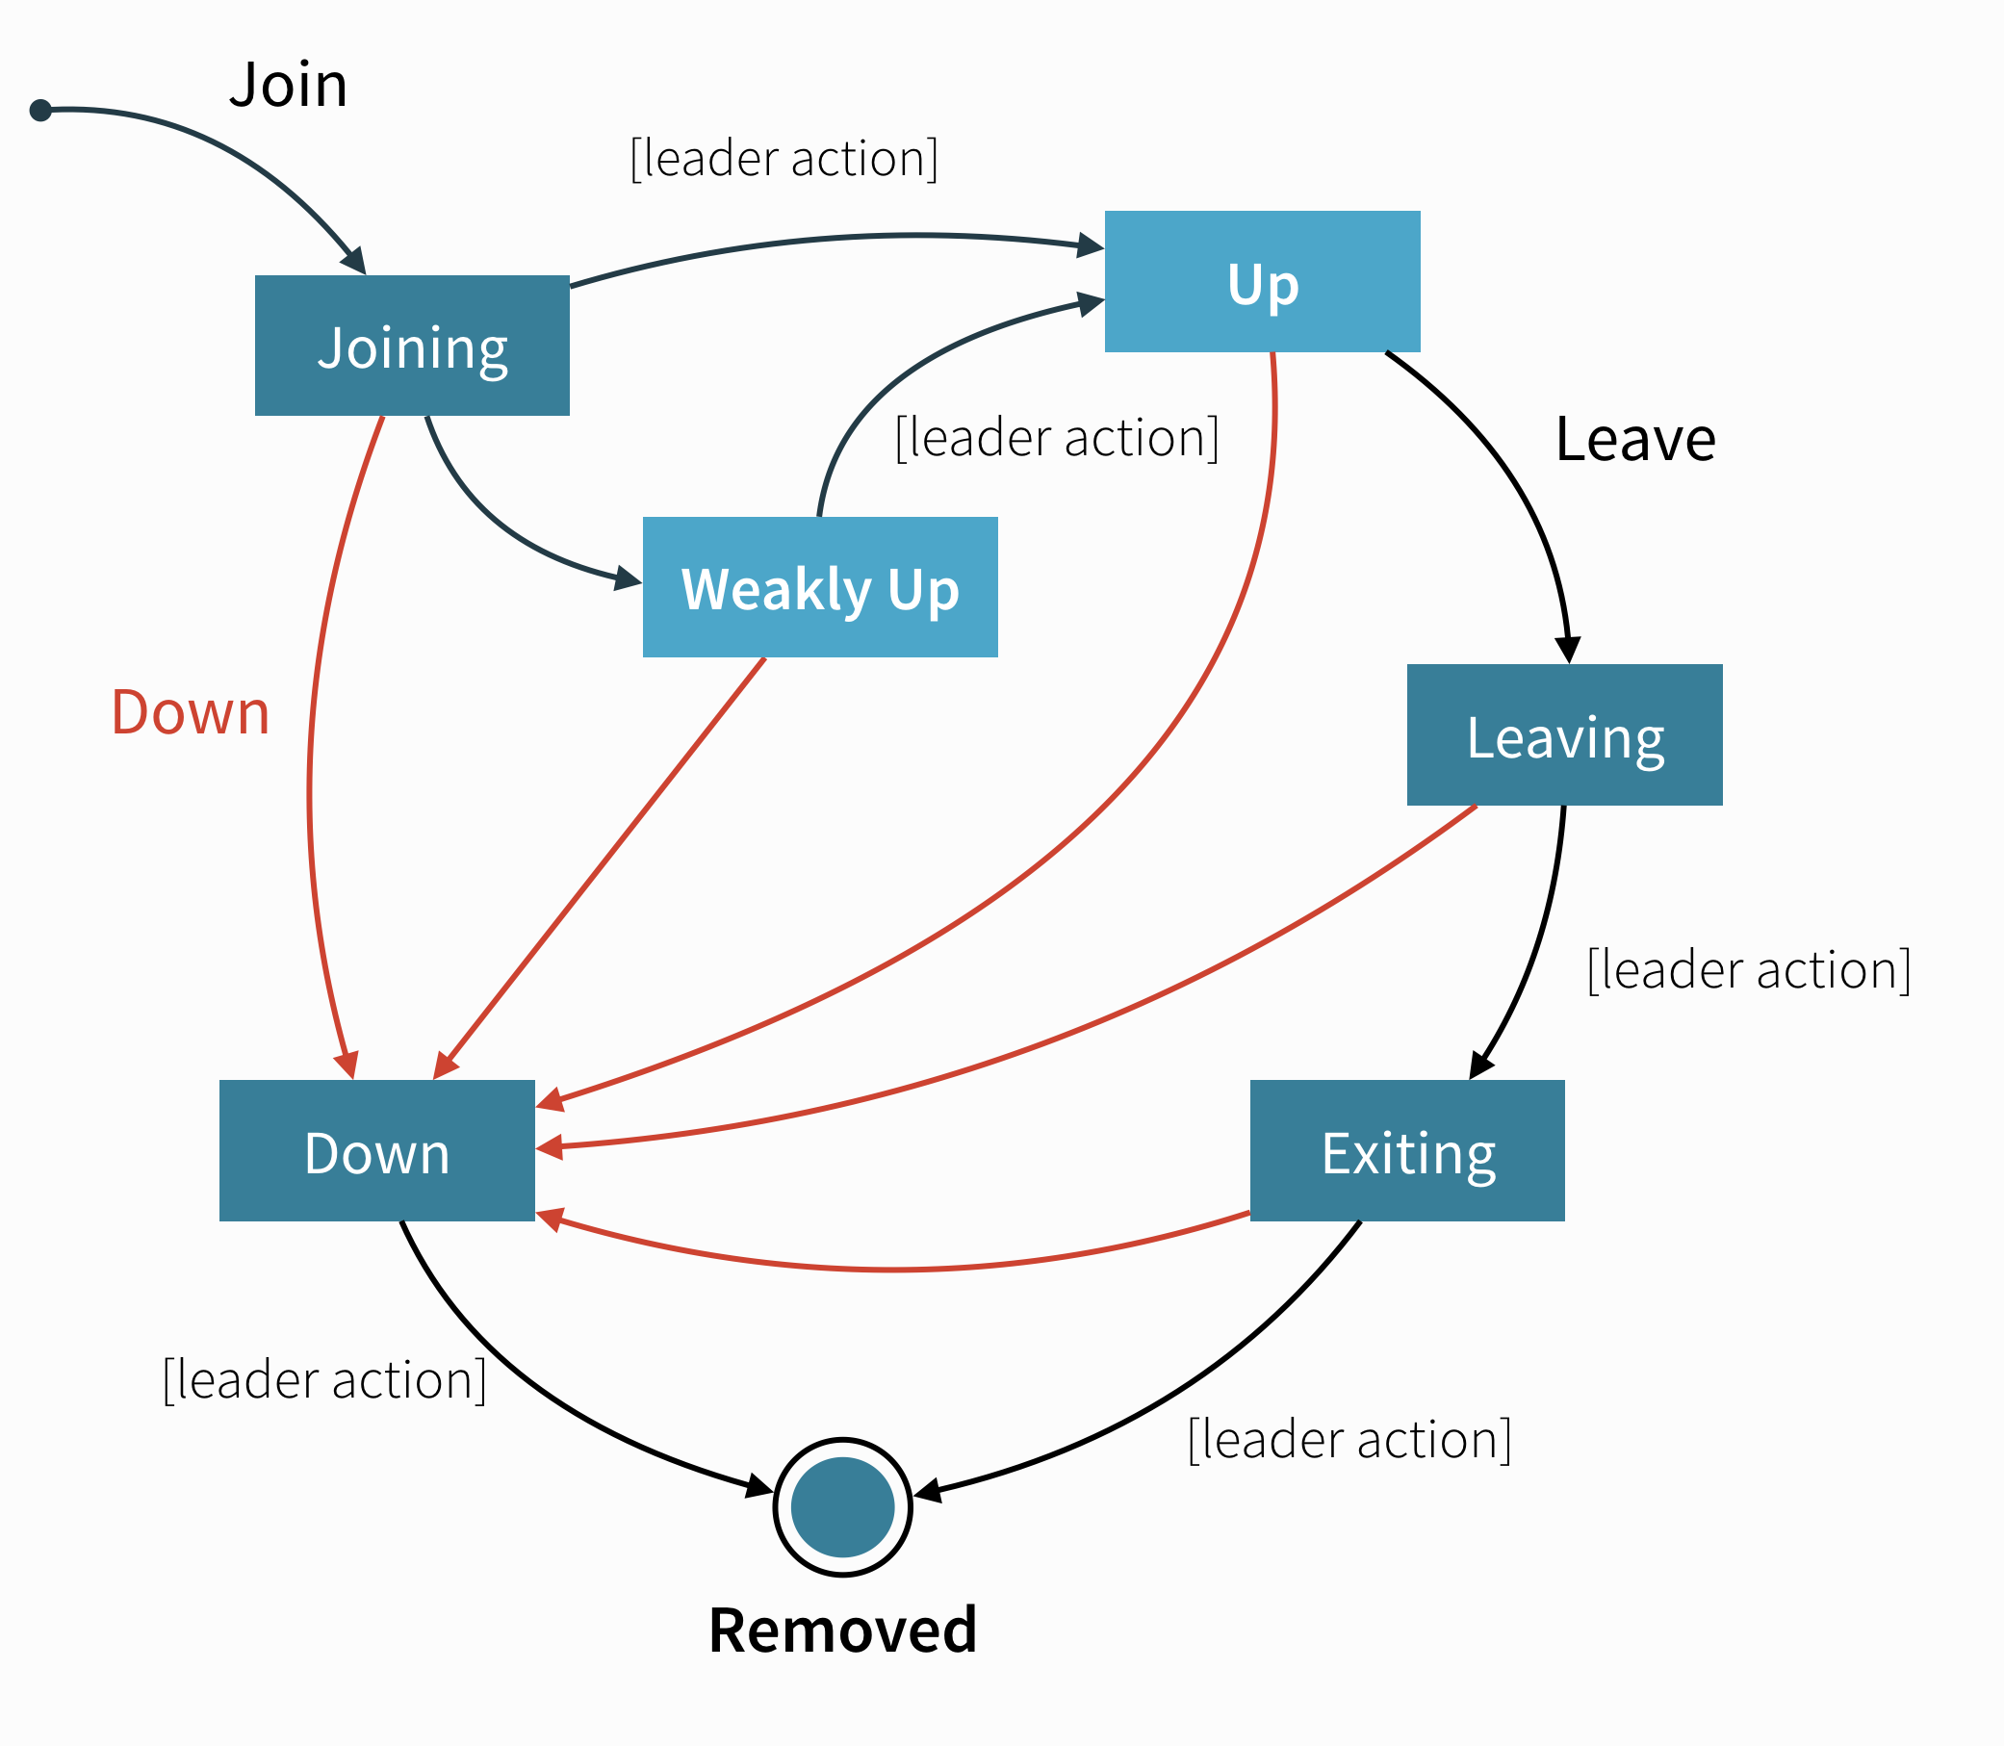
Member States – Lifecycle (Monotonit Sequence!)
User Actions
join | Join a single node to a Cluster
leave | Tell a node to leave the cluster gracefully
down | Mark a node as down
Leader Actions
joining -> up
Joining -> weakly up
weakly up
leaving -> exiting
exiting -> removed
down -> removed

Slide 32
Phi Accrual Failure Detector
Heartbeats are sent every second (configurable). They are performed in a request/reply handshake and the replies into the failure detector.
Desirable properties for a Distributed failure detector
Property | Description | Real World / Benefit
Completeness | Each failure is detected | Guaranteed
Accuracy | There is no mistaken detection | Partial / Probabilistic Guaranteed
Speed | Time to first detection of a failure | Time until some process detects failure.
Scale | Equal load in each member / Network Message Load | No Bottlenecks single failure point.

Slide 33
Phi Accrual Failure Detector
Each node has a failure detector it uses to determine if it’s neighbors are reachable (heartbeats).
heartbeat
heartbeat
heartbeat

Slide 34
Phi Accrual Failure Detector
Each node has a failure detector it uses to determine if it’s neighbors are reachable (heartbeats).
No answer!

Slide 35
Phi Accrual Failure Detector
Each node has a failure detector it uses to determine if it’s neighbors are reachable (heartbeats).
! Unreachable

Slide 36
Phi Accrual Failure Detector
Each node has a failure detector it uses to determine if it’s neighbors are reachable (heartbeats).
heartbeat
heartbeat
heartbeat
Retry!
! Unreachable

Slide 37
Phi Accrual Failure Detector
Each node has a failure detector it uses to determine if it’s neighbors are reachable (heartbeats).
After Retry
Success

Slide 38
Phi Accrual Failure Detector
Each node has a failure detector it uses to determine if it’s neighbors are reachable (heartbeats).
After Retry
Failure
!
Quarantined (Marked to be removed).

Slide 39


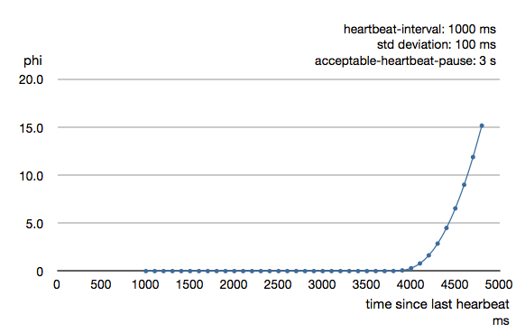


Phi Accrual Failure Detector - Logging
If the log is bouncing between REACHABLE/UNREACHABLE you can
increase the acceptable-heartbeat-pause.
When the heartbeat arrival interval exceeds 2/3 of
Requires investigation of the root cause.

Slide 40

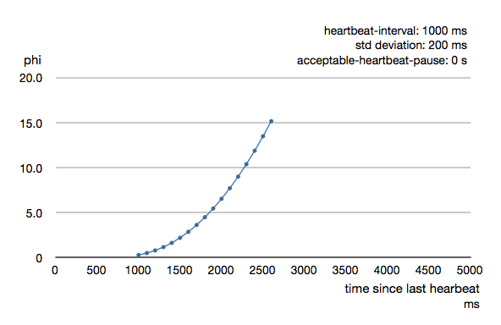
Phi Accrual Failure Detector - Threshold
Default threshold is 8 and is appropriate for most situations. However in cloud environments,
Such as Amazon EC2, the value could be increased to 12 in order to account for network issues.
Threshold

Slide 41
Gossip Protocol
Let each node hold the state of the cluster, and tell the neighbors about it!
7
7
7
Select two nodes to spread the information.
7

Slide 42
Gossip Protocol
Let each node hold the state of the cluster, and tell the neighbors about it!
7
7
7
7
7
And the process continues until all nodes get the latest state!
7
7

Slide 43
Seed - Leader - Node
joining
f
g
a
c
b
Leader
Seed
d
e

Slide 44
Seed - Leader - Node
joining
f
g
a
c
b
Leader
Seed
d
e

Slide 45
Seed - Leader - Node
joining
f
g
a
c
b
Leader
Seed
d
e

Slide 46
Seed - Leader - Node
up
f
g
a
c
b
Leader
Seed
d
e

Slide 47
Split Brain
f
g
c
b
Leader
Seed
d
e

Slide 48
Split Brain
Min Nodes Cluster = Total Nodes / 2 + 1
Quorum size
f
g
c
b
Leader
Seed
d
e

Slide 49
Akka Cluster
Distributed Data;
Cluster Singleton;
Cluster Sharding;
Distributed Publish – Subscriber.

Slide 50
Akka Distributed Data
Replicated in-memory data store;
Share Data between Akka Cluster Nodes;
Low latency and high-availability;
Key-Value store like API;
The values to be shared are CRDTs.

Slide 51
Akka Distributed Data
Akka uses the following CRDTs Data Types
Type | Implementation
Counters | GCounter, PNCounter
Sets | GSet, ORSet
Maps | ORMap, ORMultiMap, LWWMap, PNCounterMap
Registers | LWWRegister, Flag
You can also implement your custom data type!

Slide 52
Distributed Data – The Replicator Actor
Performs all Replication;
Started on all cluster nodes participating in Distributed Data;
The replicator is similar to a key-value store. Keys are strings, values are ReplicatedData;
Data is replicated directly and via gossiping.

Slide 53
Distributed Data - Local Replicator
All communication is done via the local Replicator;
Accessed via the DataReplication extension;
Supported operations are:
  Get;
  Subscribe;
  Update;
  Delete.

Slide 54
Distributed Data – The Replicator Actor Consistency
Consistency level that is supplied in the Update and Get and specifies how many replicas that must respond successfully to a write an read request.
Read Consistency | Write Consistency | Nodes Affected
ReadLocal | WriteLocal | Local node only
ReadFrom(n) | WriteTo(n) | N nodes (local included)
ReadMajority | WriteMajority | 2N + 1 Nodes
ReadAll | WriteAll | All
To guarantee the cluster consistency we need to have at least (writes + reads) > Number of nodes.

Slide 55
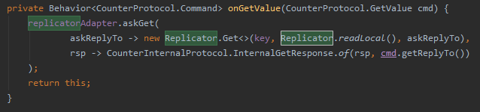
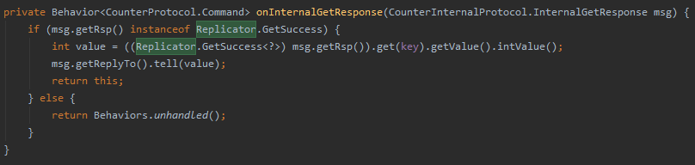
Distributed Data – Replicator Operations GET

Slide 56
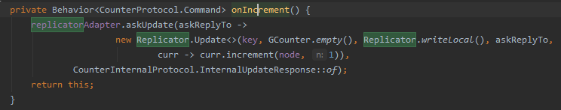
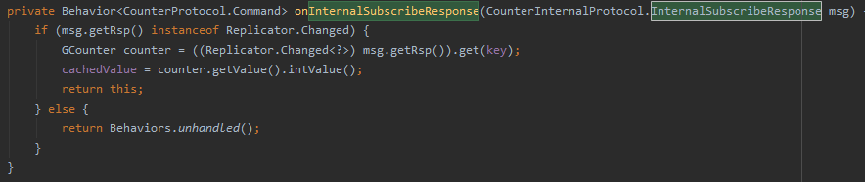
Distributed Data – Replicator Operations UPDATE, SUBSCRIBE

Slide 57
Distributed Data – Replicator Operations UNSUBSCRIBE, DELETE
A data entry can be delete sending a Replicator.Delete. A delete key cannot be reused again.
A deleted key continue to be included in the stored data on each node as well in gossip messages.
If you need a data type that needs removals try to use ORMap or ORSet data type.

Slide 58
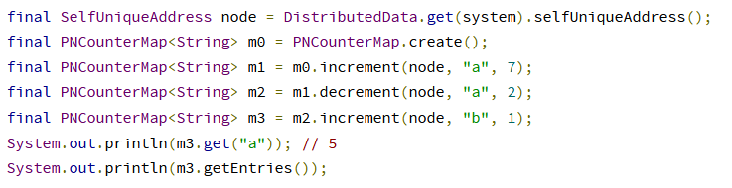
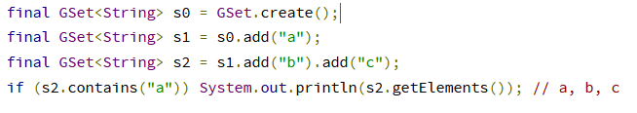
Distributed Data CRDT – Other types

Slide 59
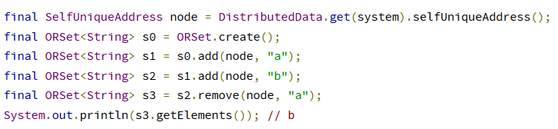
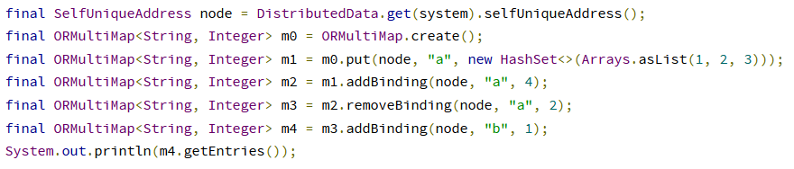
Distributed Data CRDT – Other types

Slide 60

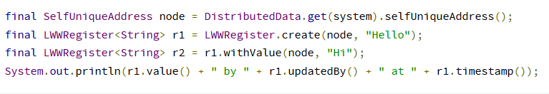
Distributed Data CRDT – Other types
If you want a First writ wins you can use LWWRegister#reverseClock.
The clock used is Max (System.currentTimeMillis(), currentTimestamp + 1)

Slide 61
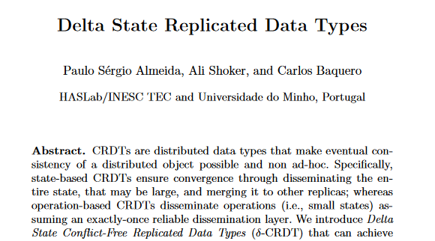
Distributed Data – Delta CRDT
A delta data type is a way to reduce the need for sending the full state for updates.
You can disable it using the following the configuration property.
https://arxiv.org/pdf/1603.01529.pdf

Slide 62
Distributed Data CRDT – Custom Data Type
Do a custom CRDT Data type:
1 – Create a Immutable class T that extends AbstractReplicatedData<TwoPhaseSet>;
2 – Create the protobuf message representation;
3 – Create the Serializer extending AbstractSerializationSupport (you can use compression);
4 – Register the Serializer in the configuration.

Slide 63
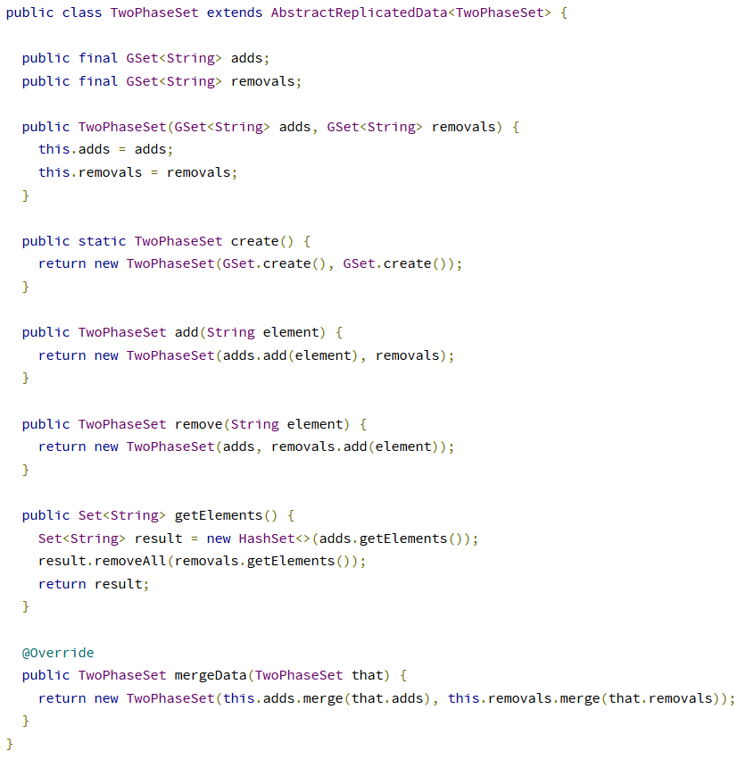
Distributed Data CRDT – Custom Data Type 1- Create a custom CRDT Data Type

Slide 64
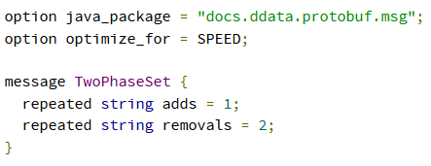
Distributed Data CRDT – Custom Data Type 2 - Create the Protobuf schema

Slide 65
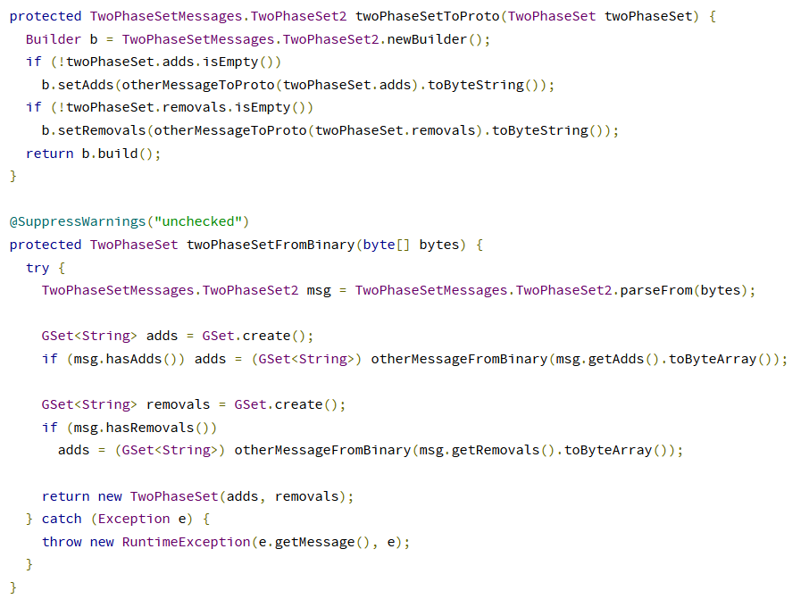
Distributed Data CRDT – Custom Data Type 3 - Create Serializer
Provided by
SerializationSupport
To serialize and deserialize
Gset instances

Slide 66
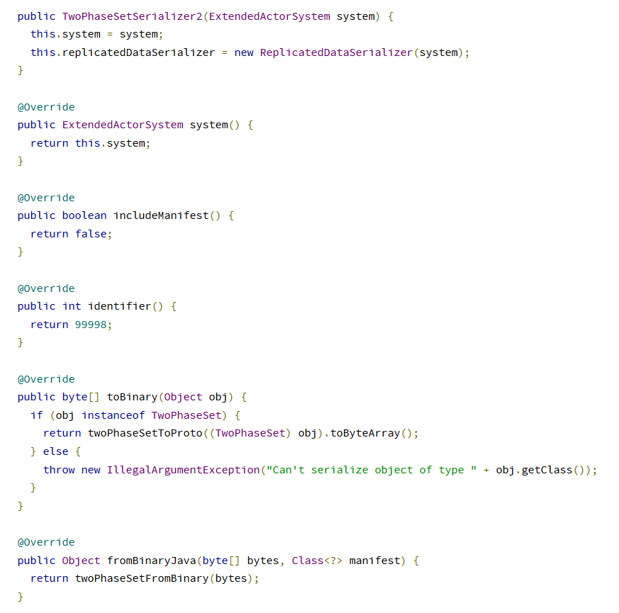
Distributed Data CRDT – Custom Data Type 3 - Create Serializer

Slide 67
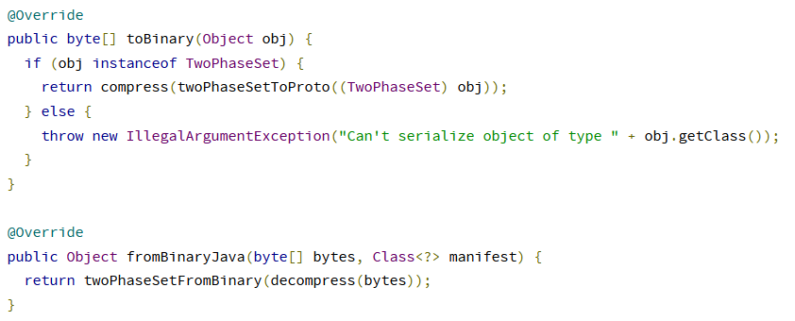
Distributed Data CRDT – Custom Data Type 3 - Create Serializer With compression
Compress and Decompress
Are provided by the
AbstractSerializationSupport

Slide 68
Distributed Data CRDT – Durable Storage
By default data is only kept in memory. It is redundant since it is replicated to other nodes in the
Cluster.
If you stop all nodes the data is LOST.
Entries can be configured be durable (stored on local disk on each node, LMDB implementation).
Where to save the files
The data is flushed to disk before the UpdateSuccess and has performance impact.
When enabling write-behind-interval will log possible errors that happen after the UpdateSuccess
Like WriteFailure.

Slide 69
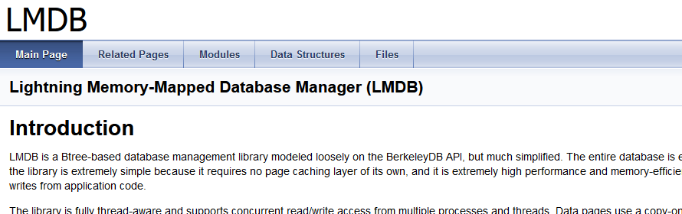
Distributed Data CRDT – Durable Storage
LMDB information
http://www.lmdb.tech/doc/index.html

Slide 70
Distributed Data CRDT - Limitations
Not use CRDT in Strong consistency context;
Not use in Big Data environments.
Max number of entries recommended are 100k.
Use delta-CRDT.
Use CRDT Types that Implement the RemovedNodePruning trait. Otherwise the type will keep the full history.

Slide 71
Cluster Singleton
When you want to run exactly one actor of a certain type running somewhere in the cluster.
Use cases:
Single point of responsibility for certain cluster-wide consistent decisions, or coordination of actions across the cluster system;
Single entry point to an external system;
Single master, many workers;
Centralized naming service, or routing logic.

Slide 72
Cluster Singleton - Drawbacks
Cluster Singleton may be a bottleneck;
Cluster Singleton cannot be available all the time.

Slide 73
Cluster Singleton
CLUSTER
Node
Node
SA
CSM
CSM
Singleton Actor
Node
Node
CSM
CSM
Cluster Singleton Manager

Slide 74
Cluster Singleton - Recovery
CLUSTER
Node
Node
SA
SA
CSM
CSM
Singleton Actor
Started in the oldest node.
Node
Node
CSM
CSM
Cluster Singleton Manager

Slide 75
Cluster Singleton - Access
World
Cluster Singleton
Proxy
Singleton Actor
If the actor becomes unreachable
The proxy stash all the messages
Until a new Singleton actor
becomes available.

Slide 76
Cluster Singleton - Lease
A lease can be used as an additional safety measure to ensure two singletons don’t run at same time. Reasons for how this can happen:
Network partitions without an appropriate downing provider;
Mistakes in the deployment process leading to two separate Akka Clusters;
Timing issues between removing members from the Cluster on one side of a network partition and shutting them down on the other side.
akka.cluster.singleton.use-lease =
<actor_system_name>-singleton-<singleton_actor_path>

Slide 77
Cluster Singleton – Get Properties
ClusterSingletonSettings
ClusterSingleProxySettings

Slide 78
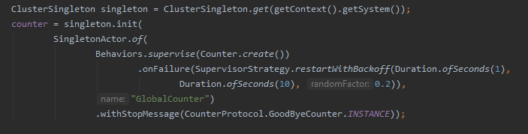
Cluster Singleton – Example
Supervision
Graceful Shutdown
Normal Actor decorated to be singleton
Cluster Singleton Manager

Slide 79
Cluster Sharding - Concepts
ShardingRegion Actor is started on each node in the cluster, or group of nodes tagged with a specific roles. It has the following responsibilities:
Extract the entity identifier from the incoming messages;
Extract the shard identifier from the incoming messages.
A shard is a group of entities that will be managed together.
ShardCoordinator decides which ShardRegion shall own the Shard and informs that ShardRegion. The state of is persistent with Distributed Data to survive failures.
Each time that a new member is removed or added to the cluster the coordinator facilitates the rebalancind of shards (migrate entities from one node to another). The ShardRegion sends a PoisonPill to all the entities and after they are created in the new node. So its recommended to use persistence with sharding.

Slide 80
Cluster Sharding - Concepts
ShardCoordinator.LeastShardAllocationStrategy is the default strategy for rebalancing.
There’s also a parameter to control the threshold there control how many shards can be rebalance at the same time (1 is recommended). The property is rebalance-threshold.
As long as a sender uses the same ShardRegion the order is preserved, with a at-most once semantics.
We need to be aware of the additional latency by the cluster shard management. Send messages to other nodes, rebalancing, call the coordinator to get the shard etc.

Slide 81
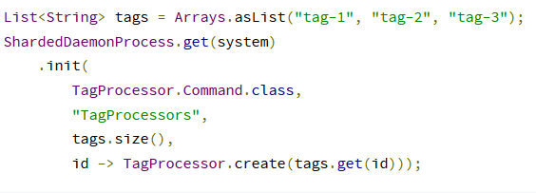
Cluster Sharding - Daemon Process
This module is currently marked as may change
Sharded Daemon Process provides a way to run N actors, each given a numeric id starting from 0 that are then kept alive and balanced across the cluster.
The intended use case is for splitting data processing workloads across a set number of workers that each get to work on a subset of the data that needs to be processed.
Example of usage: CQRS.

Slide 82
Cluster Sharding
Node
Shard Region
Shard
Coordinator
M1
Shard
A
A
A
A
A
A
A
A

Slide 83
Cluster Sharding Message sent to the wrong region.
Node
Shard Region1
Shard
Coordinator
M1
Shard Region2
Shard
A
A
A
A
A
A
A
A

Slide 84
Distributed Data CRDT
A set of merge friendly data types to maintain state across a cluster.
CRDT – Conflict-free replicated data type.

Slide 85
Distributed Data CRDT
A set of merge friendly data types to maintain state across a cluster.
CRDT – Conflict-free replicated data type.

Slide 86
Distributed Data CRDT
A set of merge friendly data types to maintain state across a cluster.
CRDT – Conflict-free replicated data type.

Slide 87
Distributed Data CRDT
A set of merge friendly data types to maintain state across a cluster.
CRDT – Conflict-free replicated data type.

Slide 88
Distributed Data CRDT
A set of merge friendly data types to maintain state across a cluster.
CRDT – Conflict-free replicated data type.

