Slide 1
Reactive Arch Academy
Architecture Design Basics

Slide 2


Intro - Plan for the academy
2021 – Plan
Mar – Architecture Basics threw code;
May – Concurrency / Parallel Basics;
Jul – Reactive Patterns;
Sep – Scalability;
Nov – Observability.
* This is only a suggestion. The plan may change based on the audience feedback.

Slide 3

Intro - Warnings
This is not a Java Academy | We strongly believe that the language is the weakest link in development. So we will pick the right language for the right concept. You can use Haskell, Rust, Scala, .Net or Java. We also don’t care where app is hosted. Our applications must run in a mobile environment, must be scalable and resilient. We will probably use Kubernetes or even AWS but as a tool but not as our main goal.
This is not a RxJava, Rx.NET, or Akka Academy | There is a huge difference between Reactive/Functional Reactive Programming and Reactive Architecture.
This is not a DDD Academy | Unless it is requested by the audience, we will focus on the implementation of some DDD concepts and Microservices.
We are not right all the time | Things evolve and we probably won’t pick the best tools / stacks or even decisions. We will focus on sharing our experiences here in the tribe. It worked for us until now but does not mean that will work for you.

Slide 4

Intro - Schedule
Sessions – Twice per Week
1h Theory – Antonio antonio.silva@ppb.com Tuesdays
2h Practice
1h Damien Wednesdays?
1h Tom Thursdays?
Repository:
https://github.com/bytemania/buckpal

Slide 5
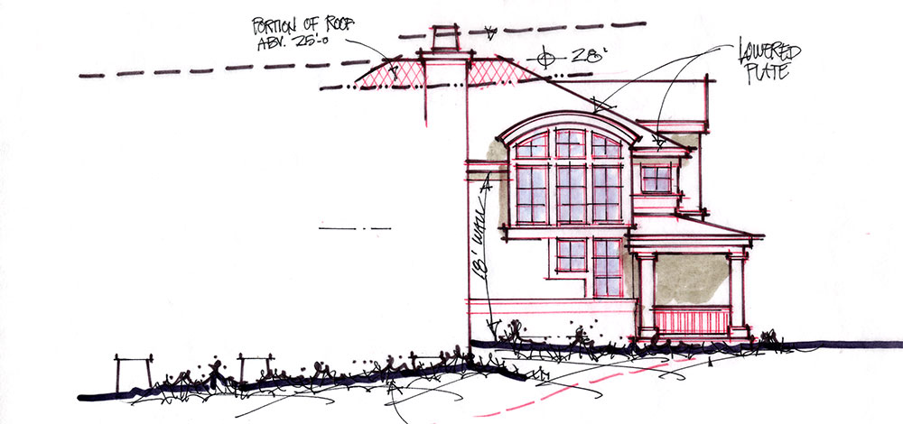
Architecture Basics
Intro

Slide 6
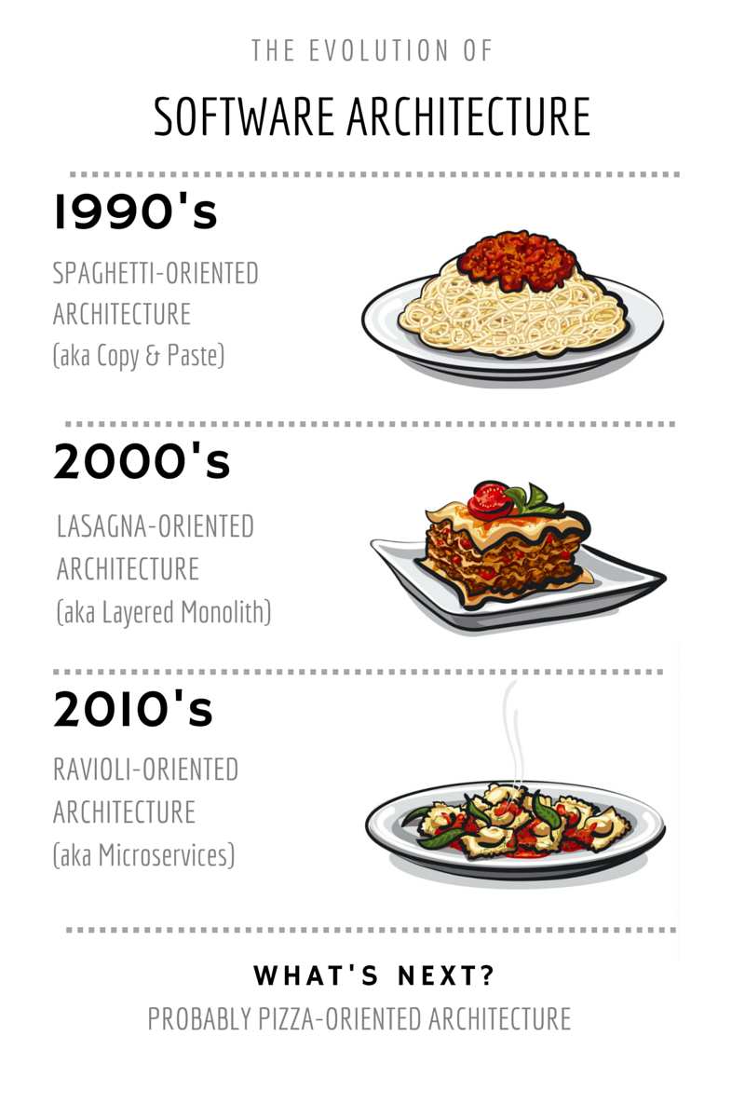

Architecture Basics – Types of Arch
2015 - Serverless

Slide 7
Architecture Basics – Arch Good an Bads
ARCH | GOOD Because | BAD Because | Use Cases
Mainframe | Fast development; Easy deploy; Generally uses modules/plugin can be replace without redeploy the entire app; Easier debug and test. | Decide what belongs to a module to the app is often an art; Modifying is difficult ball of mud. | Gamedev; Desktop app.
Layered | Maintainable; Testable; Easy to assign separate roles; Easy to update and enhance layers | Big ball of mud; Sinkhole anti-pattern (code passing date through layers without using any logic); Layer isolation is difficult; Small change requires a complete redeployment. | Easy to build apps quickly; The abstraction in levels describe better the OOP paradigm; Simple patterns that can be understood even for unexperience developers.
Microservices | Modularity easy to understand; Scalability; Integration. | Hard to test E2E; Transaction management / consistency is hard to achieve; Higher cost (development, deployment, system resources, network) compared with monilith | Websites with small components; Business with well defined boundaries; Develop teams spread across the globe.
Serverless | Pay as you go; Elasticity; Event-driven functions (stateless, easy to scale, not interface/http handlers). | Latency; Resource Limits (aws offers you 1000 threads per account, need to be careful how you allocate these threads across the functions); Vendor lock-in. | Iot; Stream processing; Multimedia processing; Batch jobs; Mobile backend. Apps that require autoscale.

Slide 8
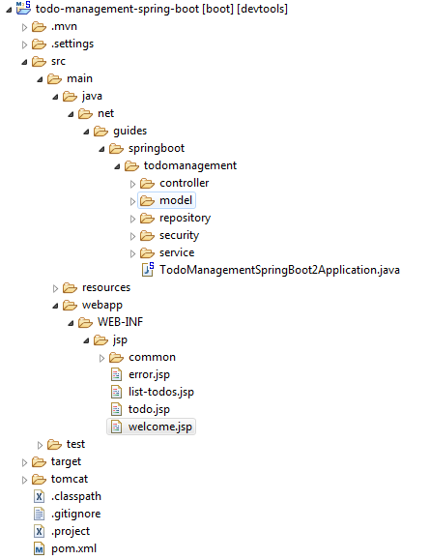
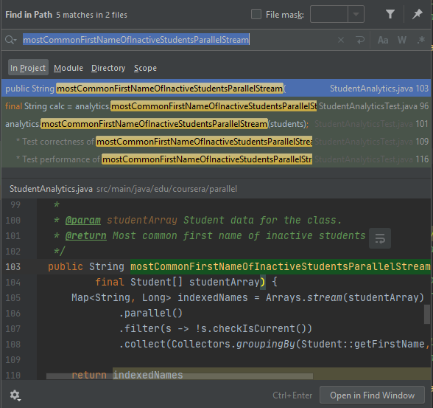


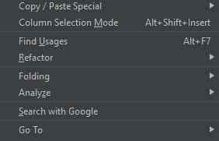
Architecture Basics – Layered Architecture
Find me?
Where am I?
We are living in a “GPS driven development” world!
Who uses me?

Slide 9

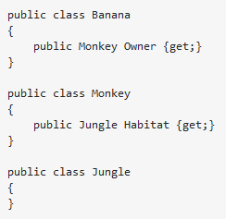
Architecture Basics – Layered Architecture

Slide 10
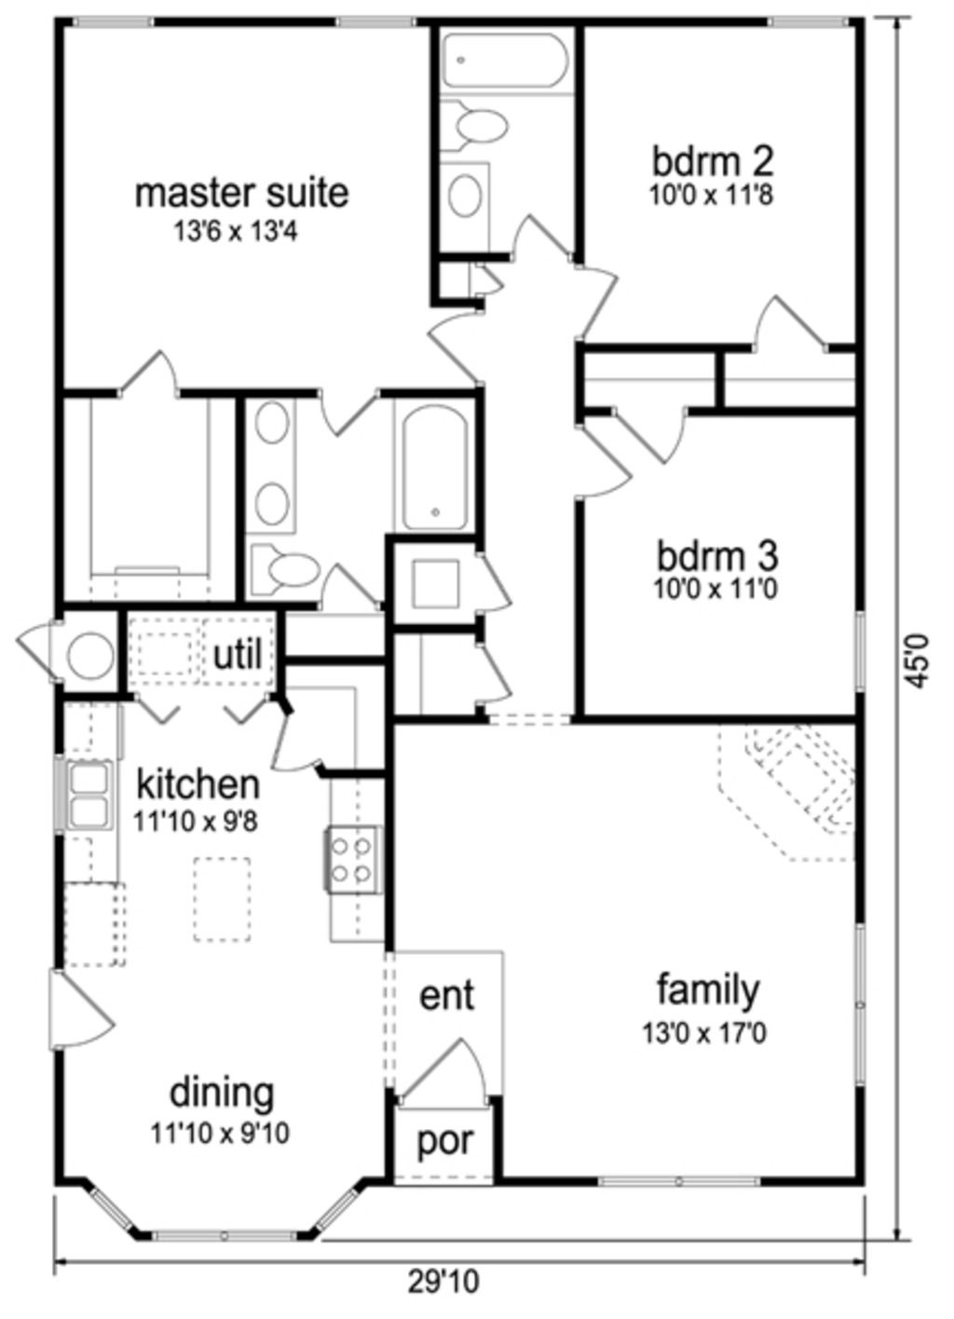
Architecture Basics – Layered Architecture

Slide 11
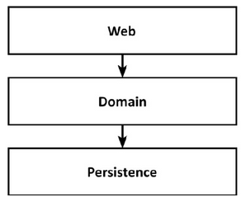
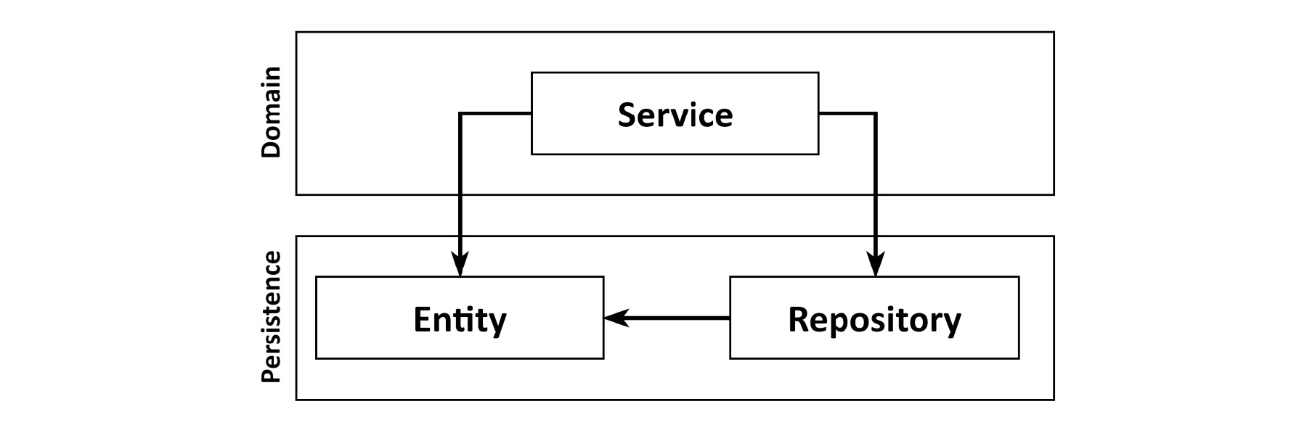
Architecture Basics – Layered Architecture
Promotes the Database-Driven-Design.
Everything builds on top of the persistence layer.
Entities are part of persistence layer promoting strong coupling between them. So the entities are responsible for architectural decisions like eager vs lazy loading, flushing caches, transactions, ...
We should primarily model the behaviour and then the state!
Notes:
DATA-DRIVEN DESIGN
We're primarily trying to model behavior, and not state. Yes, state is an important part of any application, but the behavior is what changes the state and thus drives the business.
Think back to the last use cases you have implemented in any application. Did you start by implementing the domain logic or the persistence layer? Most likely, you thought about what the database structure would look like and only then moved on to implementing the domain logic on top of it.

Slide 12
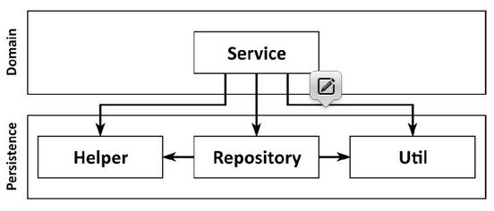

Architecture Basics – Layered Architecture
It’s Prone to Shortcuts
Since we may access everything in the persistence layer, it tends to grow fat over time.

Slide 13
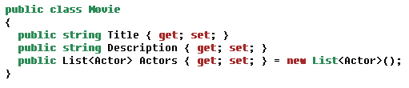
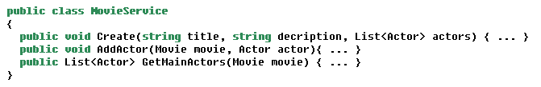
Architecture Basics – Layered Architecture
Promotes an Anaemic Model

Slide 14
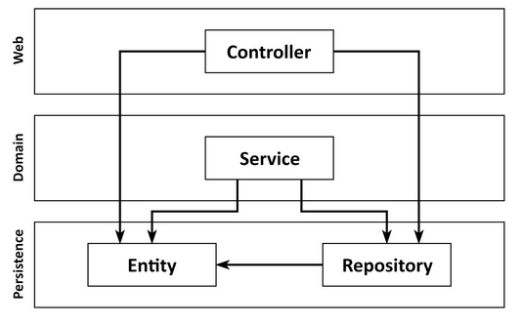
Architecture Basics – Layered Architecture
It Grows hard to Test
Layers tend to be skipped
We’re most likely going to add more domain logic to the web layer, mixing responsibilities and spreading essential domain logic all over the application.
If we need to change this entity we need to change:
the service and repository layer;
rewrite the tests increasing the complexity.

Slide 15
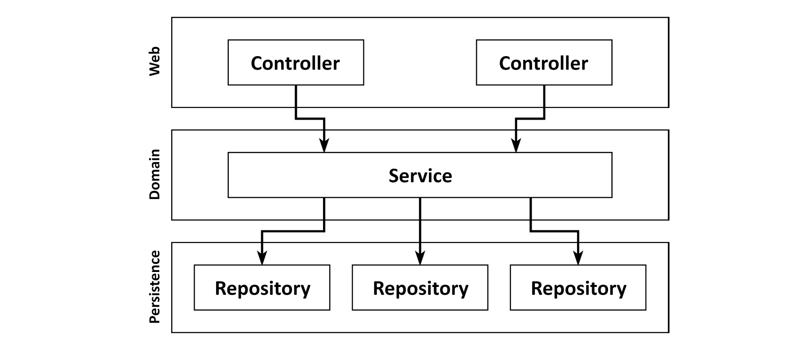
Architecture Basics – Layered Architecture
It hides uses cases
“As developers, we like to create new code that implements shiny new use cases. But we usually spend much more time changing existing code than we do creating new code.
Since we're so often searching for the right place to add or change functionality, our architecture should help us to quickly navigate the code base.”
Broad services make it hard to find a certain use case within the code base.
“How much easier would it be if we had highly specialized narrow domain services that each serve a single use case? Instead of searching for the user registration use case in the UserService, we would just open up the RegisterUserService and start working.”

Slide 16

Architecture Basics – Layered Architecture
It makes parallel work difficult
“Adding manpower to a late software project makes it later”
If two developers start two features in parallel probably they will start for the persistence layer and break each others code.
If we have broad services in our codebase maybe will cause conflicts if this service is edited in parallel.

Slide 17

Architecture Basics – Layered Architecture
“If done correctly, and if some additional rules are imposed on it, a layered architecture can be very maintainable and make changing or adding to the codebase a breeze.
However, the discussion shows that a layered architecture allows many things to go wrong. Without very strict self-discipline, it's prone to degrade and become less maintainable over time. And this self-discipline usually becomes a little less strict each time a manager draws a new deadline around the development team.”

Slide 18
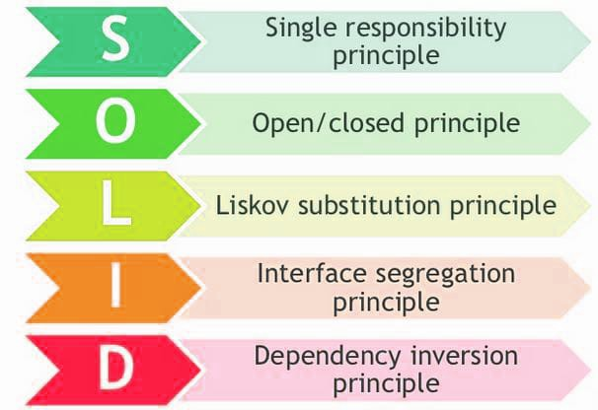
Architecture Basics – SOLID Principles

Slide 19
Architecture Basics – SOLID
Single Responsibility Principle
There should never be more than one reason for a class to change.
A class must be:
Focused;
Single functionality;
Address a specific concern.

Slide 20
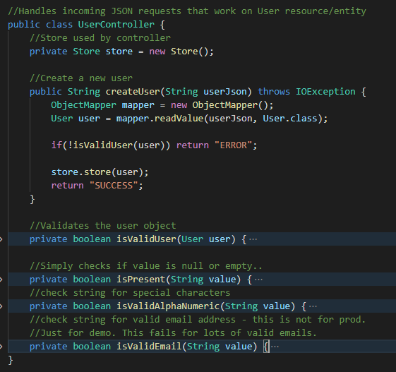
Architecture Basics – SOLID
Single Responsibility Principle

Slide 21
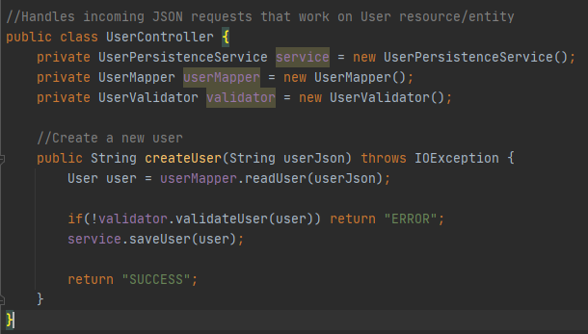
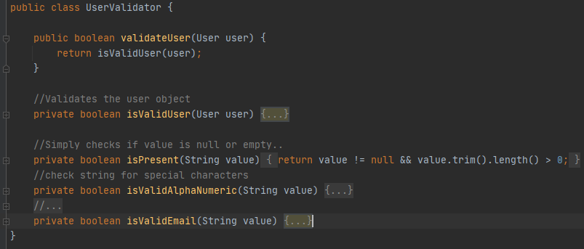
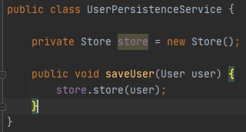
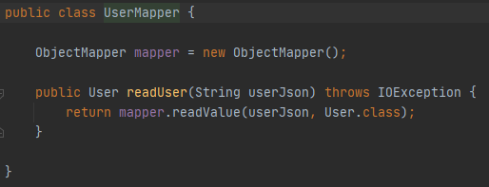
Architecture Basics – SOLID
Single Responsibility Principle

Slide 22
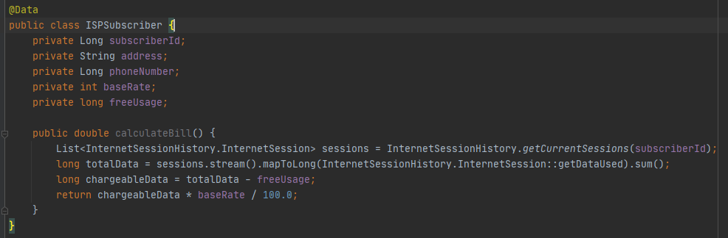
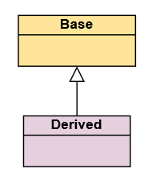

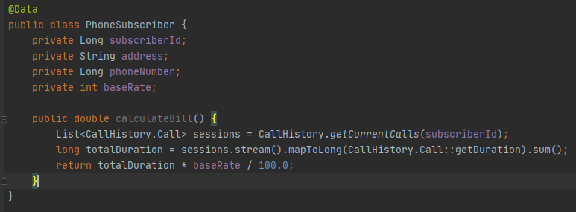
Architecture Basics – SOLID
Open-Closed Principle
Open for extension;
Closed for modification
Open for extension
Can derive from base & override methods

Slide 23
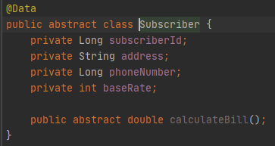
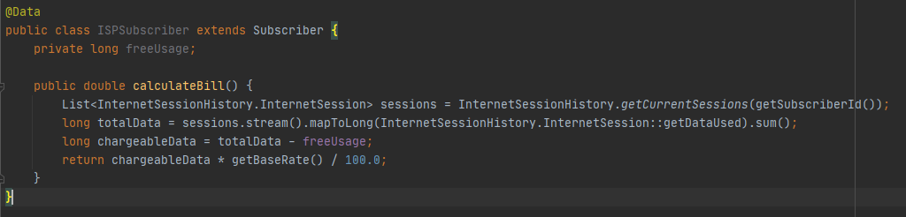
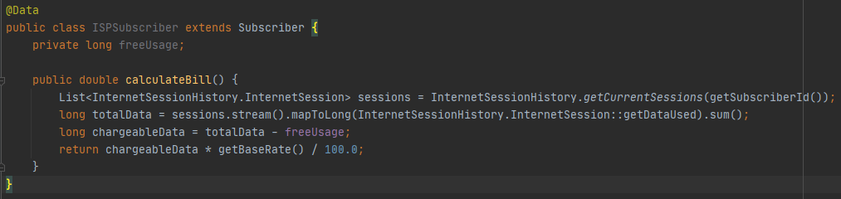
Architecture Basics – SOLID
Open-Closed Principle

Slide 24
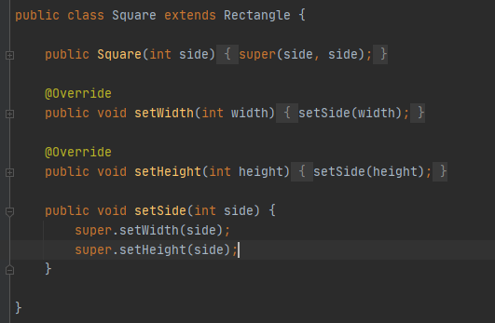
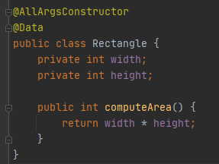
Architecture Basics – SOLID
Liskov Substitution Principle
We should be able to substitute base class object with child class objects and this should
not alter the behaviour/characteristics of program.

Slide 25

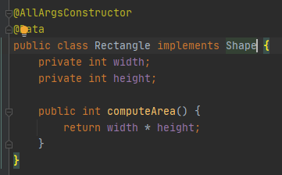
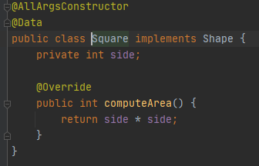
Architecture Basics – SOLID
Liskov Substitution Principle

Slide 26
Architecture Basics – SOLID
Interface Segregation Principle
Write Highly Cohesive Interfaces
Signs of interface pollution:
Class have empty method implementations;
Method implementation throw UnsupportedOperationException;
Method implementation return null/default/dummy values.

Slide 27
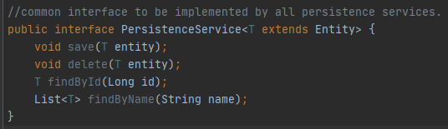
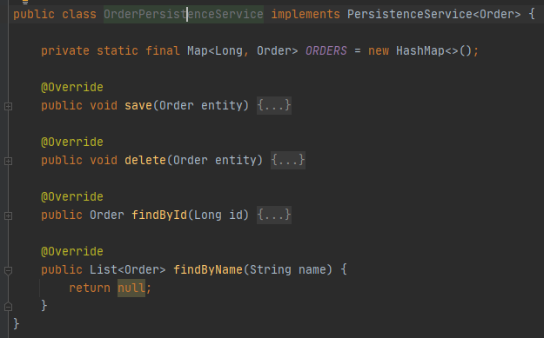
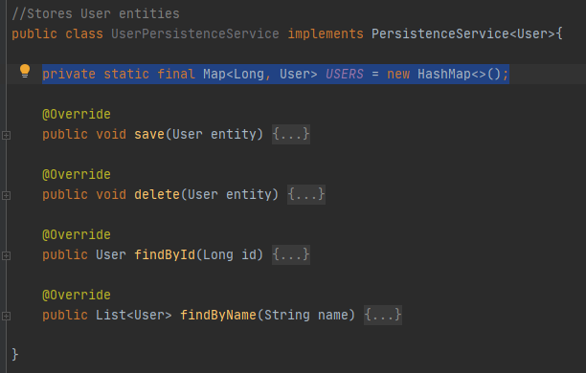
Architecture Basics – SOLID
Interface Segregation Principle

Slide 28
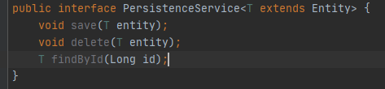
Architecture Basics – Lasagna Architecture
Interface Segregation Principle

Slide 29
Architecture Basics – SOLID
Dependency Inversion Principle
High level modules should not depend upon low level modules.
Both should depend upon abstractions.
Abstractions should not depend upon details.
Details should depend upon abstractions.

Slide 30
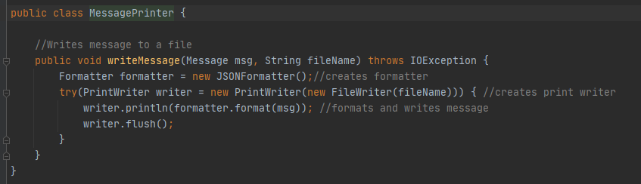
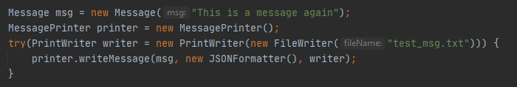
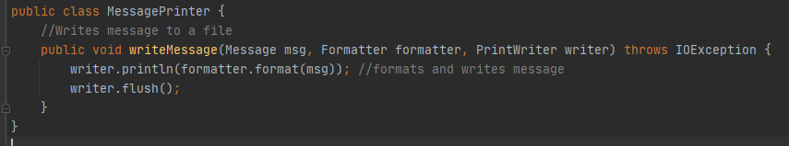
Architecture Basics – SOLID
Dependency Inversion Principle

Slide 31
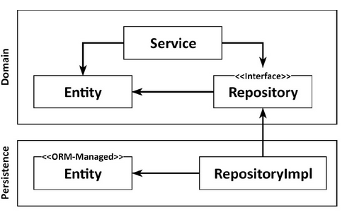
Architecture Basics – SOLID
Dependency Inversion Principle
We can turn around (invert) the direction of any dependency within our codebase.

Slide 32
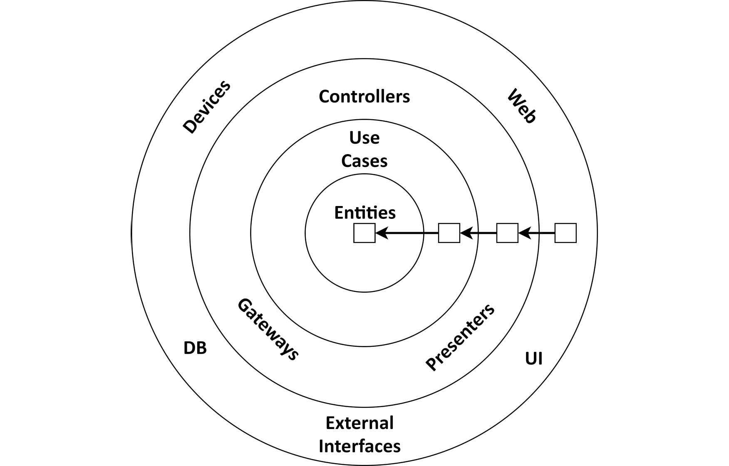
Architecture Basics – Clean Architecture
Clean Architecture
In clean architecture, the business rules are testable by design and independent of frameworks, databases, UI technologies, and other external applications or interfaces.
The core of the architecture contains the domain entities, which are accessed by the surrounding use cases. The use cases are what we have called services earlier but are more fine-grained to have a single responsibility (that is, a single reason to change), thus avoiding the problem of broad services that we discussed earlier.
This decoupling is exactly what we wanted to achieve to free the domain code from framework-specific problems. The Java Persistence API (the standard ORM-API in the Java world), for instance, requires ORM-managed entities to have a default constructor without arguments that we might want to avoid in our domain model.

Slide 33
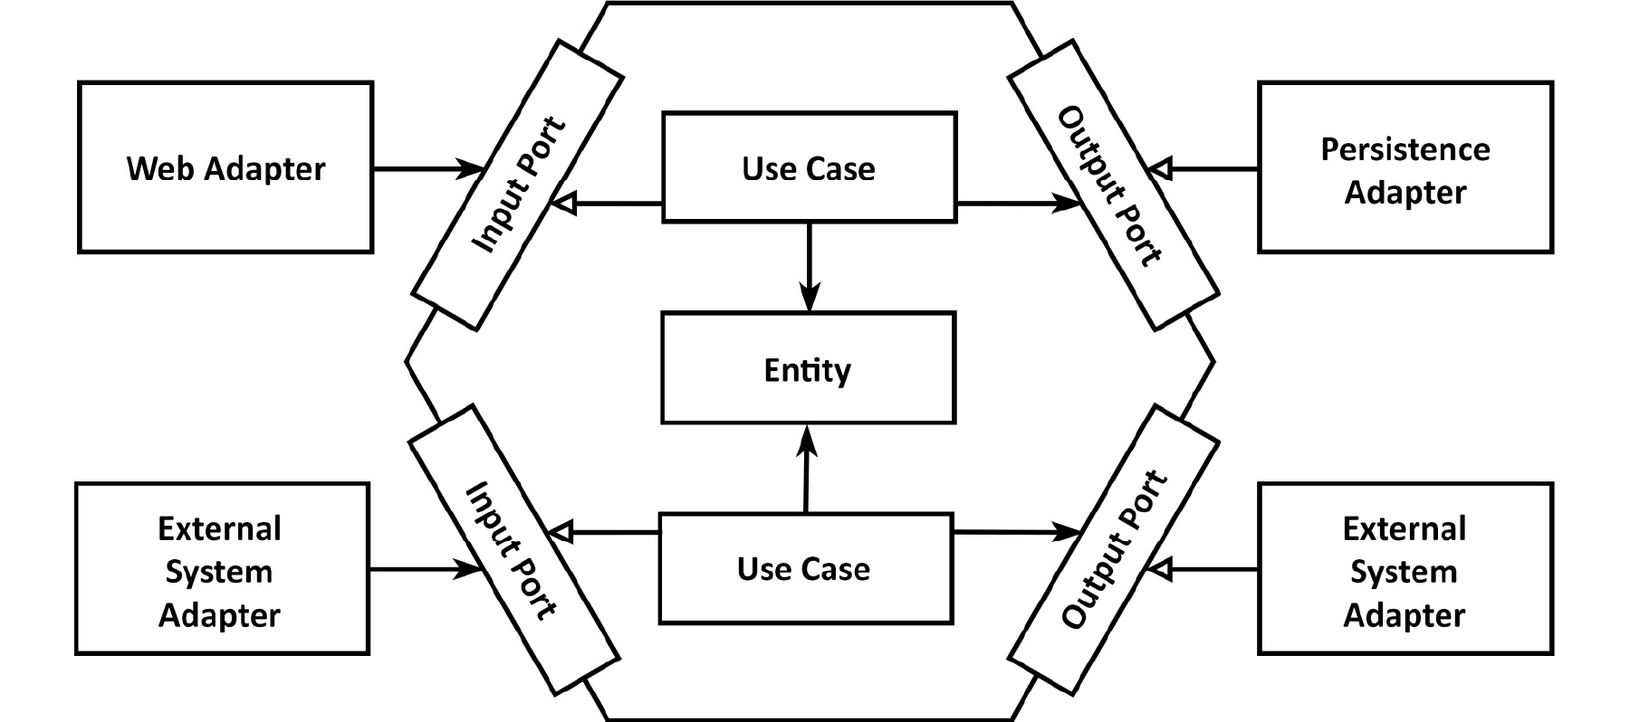
Architecture Basics – Hexagonal Architecture
Hexagonal Architecture
The hexagonal architecture divides a system into several loosely-coupled interchangeable components, such as the application core, the database, the user interface, test scripts and interfaces with other systems.
Each component is connected to the others through a number of exposed ports. (Method invocation in OOP, RPC, Rest and others).
Adapters are the glue between components and the outside world.

Slide 34
Architecture Basics – Clean Architecture
Benefits
Decouple the domain code from the interfaces/UI/ and so on. No more Mockito!
The domain code is free to be modelled in the way that’s most suitable for the business. We are not constrained by the limitations that are often imposed by
frameworks.

Slide 35
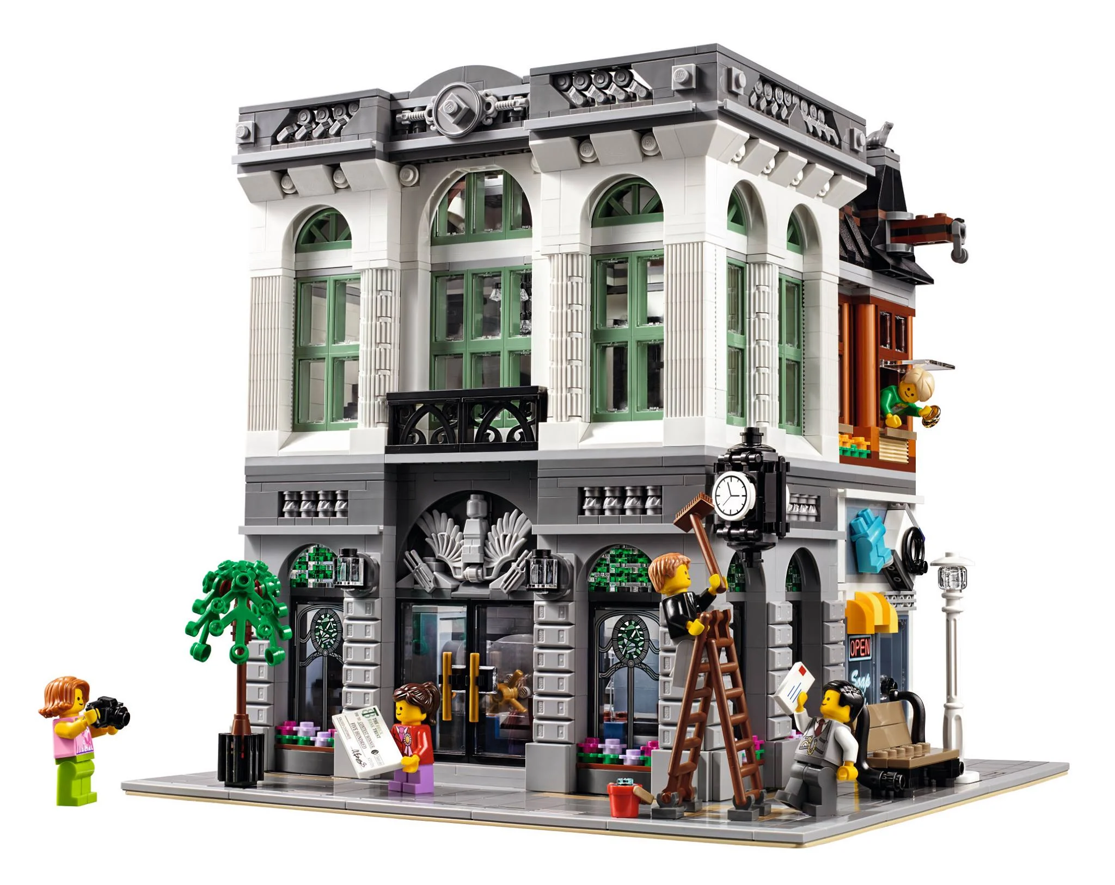
Architecture Basics
Architecture Basics
Architecture Basics
Architecture Basics
Example of Implementation

Slide 36
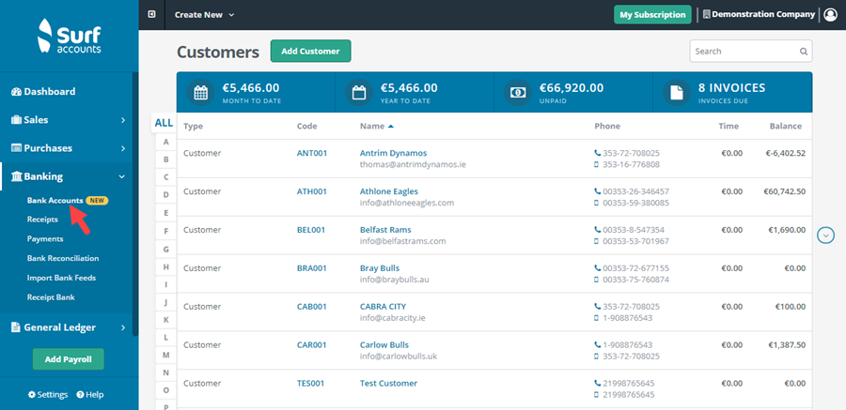
Architecture Basics – BuckPal Example
Architecture Basics
Architecture Basics
Architecture Basics
To show the basics of this architecture lets follow the example of the bank account, and implement a send money use case.
An account has a owner and a base balance.
And a set of movements. These movements can be a withdraw or deposit.
We want to implement a use case: send money from one account to another.

Slide 37

Architecture Basics
Architecture Basics
Architecture Basics
Architecture Basics
Organizing the code

Slide 38
Architecture Basics – Organizing the Code
In greenfield software projects, the first thing we try to get right is the package structure.
We set up a nice-looking structure that we intend to use for the rest of the project. Then, during the project, things become hectic and we realize that in many places the package structure is just a nice-looking facade for an unstructured mess of code.
Classes in one package import classes from other packages that should not be imported.

Slide 39
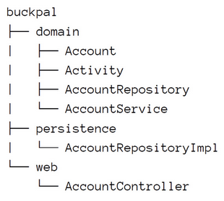
Architecture Basics – Organizing the Code by Layer
Functional aspects tend to be mixed;
No package boundaries between functional slices or features. If we add a feature for managing users, we will add a Controller, Service and Repository, RepositoryImpl;
We can’t see what AccountRepository/Service Implements. They hide the use cases;
What we receive in the controller and persist in the database is hidden in the code.

Slide 40
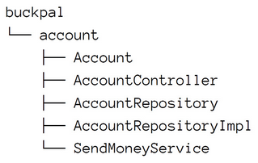
Architecture Basics – Organizing the Code by Feature
Difficult to grasp the underlining architecture;
In essence we have put all the code layers in the same package;
No package names to identify our adapters;
Can’t easily identify the incoming and outgoing ports;
We cannot use package-private visibility to protect the domain code from accidental dependencies connecting to the persistence code.

Slide 41
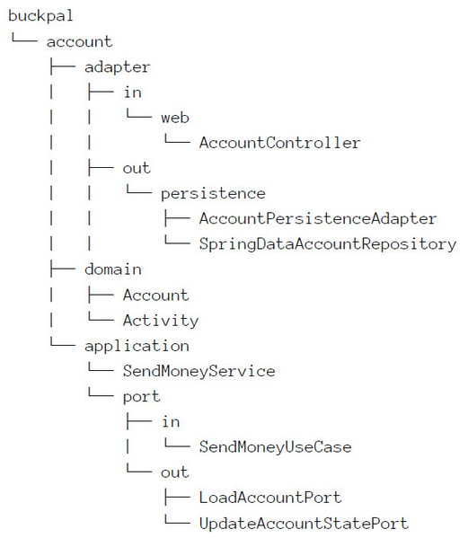
Architecture Basics – Expressive Package Structure
Each architecture element has its place;
account base package, implementing use-cases related with account;
domain package contain our domain module;
adapter web in and out;
application package: classes not called by the outside world except the port ones.

Slide 42
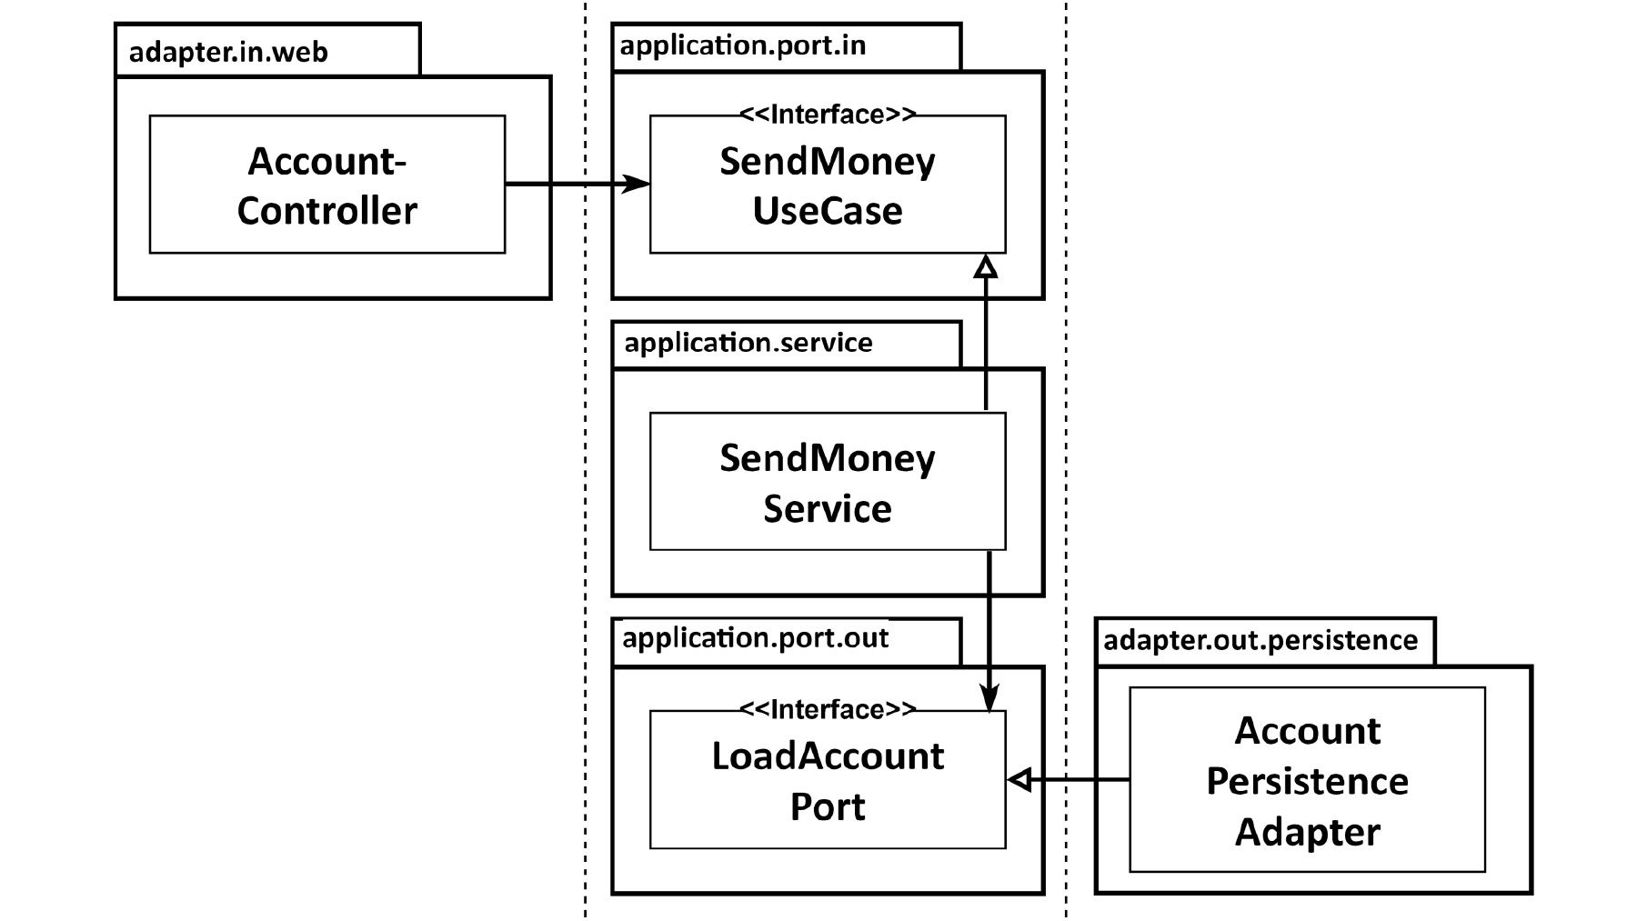
Architecture Basics – Role of Dependency Injection
The web controller calls an incoming port, which is implemented by a service. The service calls an outgoing port, which is implemented by an adapter.

Slide 43

Architecture Basics – Mapping Between Boundaries
Architecture Basics
Architecture Basics
Architecture Basics
Mapping Between Boundaries

Slide 44

Architecture Basics – Mapping Between Boundaries
Architecture Basics
Architecture Basics
Architecture Basics
Contra Mapping Developer
Pro Mapping Developer
If we don't map between layers, we have to use the same model in both layers, which means that the layers will be tightly coupled.
If we do map between layers, we produce a lot of boilerplate code, which is overkill for many use cases, since they're only doing CRUD and have the same model across layers anyway.

Slide 45
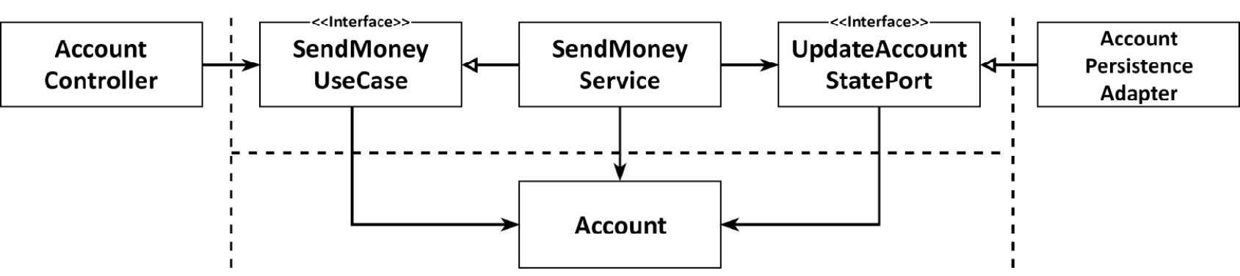
Architecture Basics – Mapping Between Boundaries
Architecture Basics
Architecture Basics
Architecture Basics
No Mapping Strategy
The web and persistence layers may have special requirements for their models. If our web layer exposes its model via REST, for instance, the model classes might need some annotations that define how to serialize certain fields into JSON. The same is true for the persistence layer if we are using an ORM framework, which might require some annotations that define the database mapping.
Suitable for simple CRUD services
This violates the Single Responsibility Principle;
If you change the rest controller you don’t have a Anti-Corruption Layer so will end up leaking logic in your domain.

Slide 46
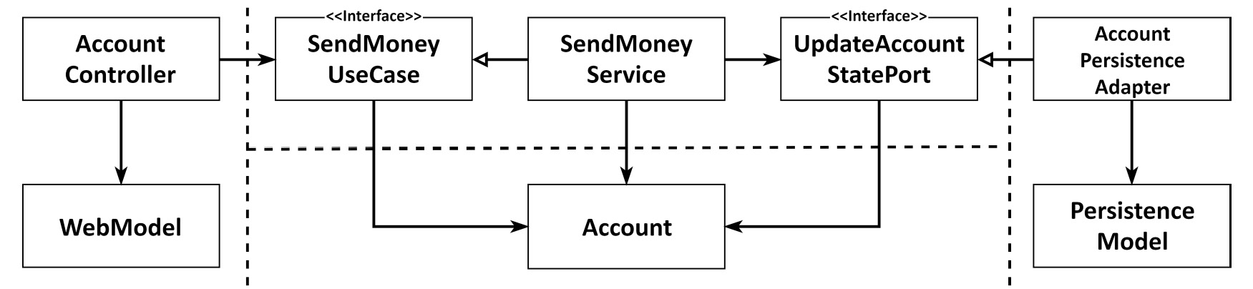
Architecture Basics – Mapping Between Boundaries
Architecture Basics
Architecture Basics
Architecture Basics
Two Mapping Strategy
The web layer maps the web model into the domain model that is expected by the incoming ports;
The persistence layer is responsible for a similar mapping between the domain model, which is used by the outgoing ports, and the persistence model.
A lot of boilerplate code;
Another drawback is that the domain model is used to communicate across layer boundaries.

Slide 47
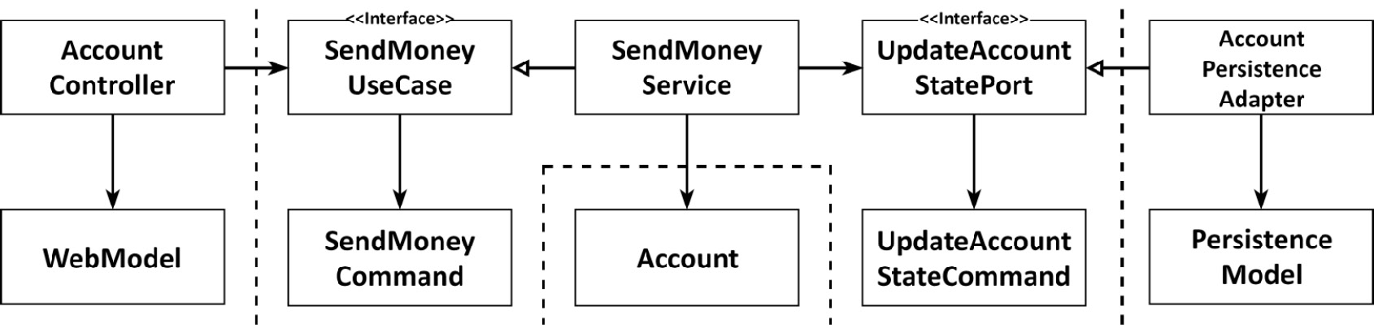
Architecture Basics – Mapping Between Boundaries
Architecture Basics
Architecture Basics
Architecture Basics
Full Mapping Strategy
Each operation require its own model, for the adapters layers we expect to have commands describing the action that they perform.
A lot of boilerplate code.

Slide 48
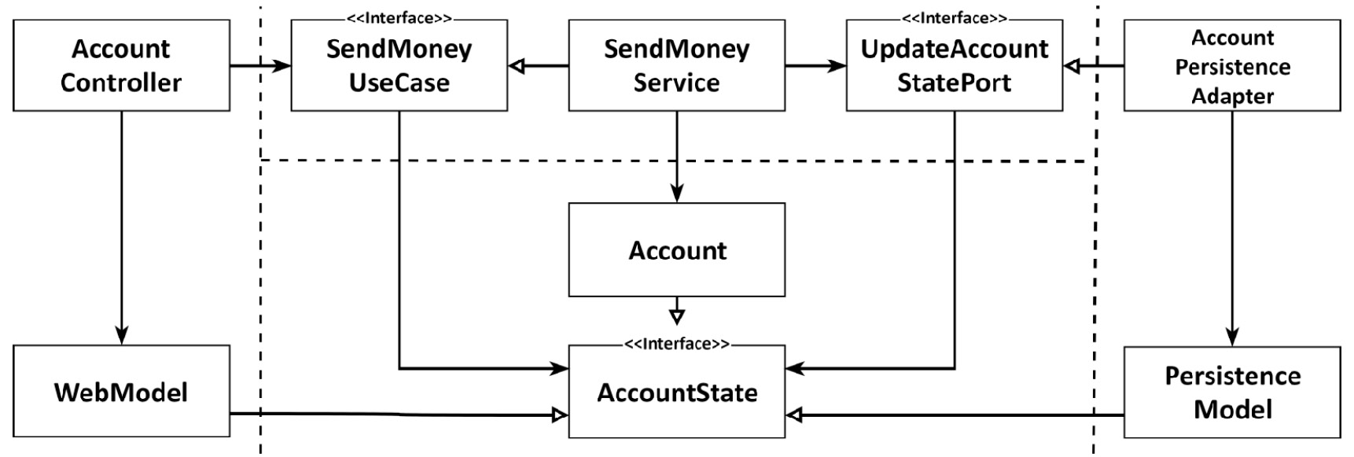
Architecture Basics – Mapping Between Boundaries
Architecture Basics
Architecture Basics
Architecture Basics
One-Way Mapping Strategy
The domain model and the adapter implement the same state, each layer only needs to map objects it receives from other layers – one way;
This strategy plays well with the DDD concept of a factory. A factory in terms of DDD is responsible for reconstituting a domain object from a certain state, which is exactly what we are doing.
The account state is hard to implement.

Slide 49

Architecture Basics – Mapping Between Boundaries
Architecture Basics
Architecture Basics
Architecture Basics
When use each strategy?
Guidelines
If we are working on modifying a use case, the "full mapping" strategy is the first choice between the web and application layers, in order to decouple the use cases from one another. This gives us clear per-use-case validation rules and we won't have to deal with fields we don't need in a certain use case.
If we are working on modifying a use case, the "no mapping" strategy is the first choice between the application and persistence layers in order to be able to quickly evolve the code without mapping overhead. As soon as we have to deal with persistence issues in the application layer, however, we move to a "two-way" mapping strategy to keep persistence issues in the persistence layer. The same applies for the front-end.

Slide 50

Architecture Basics
Architecture Basics
Architecture Basics
Architecture Basics
Enforcing Boundaries

Slide 51

Architecture Basics – Enforcing Boundaries
Architecture Basics
Architecture Basics
Architecture Basics
Single Package Structure
Public
Package Private

Slide 52


Architecture Basics – Enforcing Boundaries
Architecture Basics
Architecture Basics
Architecture Basics
Arch Unit
ArchUnit is a free, simple and extensible library for checking the architecture of your Java code. That is, ArchUnit can check dependencies between packages and classes, layers and slices, check for cyclic dependencies and more.

Slide 53

Architecture Basics – Enforcing Boundaries
Architecture Basics
Architecture Basics
Architecture Basics
Multiple artifacts
It helps to enforce the boundaries

Slide 54

Architecture Basics - Testing
Architecture Basics
Architecture Basics
Architecture Basics
Testing

Slide 55

Architecture Basics – Testing
Architecture Basics
Architecture Basics
Architecture Basics
The Test Pyramid
Unit tests are the base of the pyramid. A unit test usually instantiates a single class and tests its functionality through its interface. If the class under test has dependencies to other classes, those other classes are not instantiated, but replaced with mocks, simulating the behaviour of the real classes as needed during the test.
Integration tests form the next layer of the pyramid. These tests instantiate a network of multiple units and verify whether this network works as expected by sending some data into it through the interface of an entry class. In our interpretation, integration tests will cross the boundary between two layers, so the network of objects is not complete or must work against mocks at some point.
System tests spin up the whole network of objects that makes up our application and verify whether a certain use case works as expected through all the layers of the application.
Above the system tests, there might be a layer of end-to-end tests that include the UI of the application.

Slide 56

Architecture Basics – Testing
Architecture Basics
Architecture Basics
Architecture Basics
The Test Pyramid
Acceptance
Arch
E2E
System
Performance
Integration Tests
Unit Tests with mocks
Unit Tests without mocks

Slide 57

Architecture Basics - Implementing the domain
Architecture Basics
Architecture Basics
Architecture Basics
Implementing the domain

Slide 58
Architecture Basics - Implementing the domain
Architecture Basics
Architecture Basics
Architecture Basics
Implementing the domain
Since the application, web, and persistence layers are so loosely coupled in our architecture, we are totally free to model our domain code as we see fit.
We can use any strategy that we want but DDD is preferred;
The classes must be POJOs with validation and simple business rules;
Immutability is preferred;
No need to Mock in the tests.

Slide 59


Architecture Basics - Implementing the domain
Architecture Basics
Architecture Basics
Architecture Basics
Domain

Slide 60


Architecture Basics – Implementing the domain
Domain – Code Example

Slide 61

Architecture Basics
Architecture Basics
Architecture Basics
Architecture Basics
Implementation Details

Slide 62


Architecture Basics – Implementing a Use Case
Implementation Details
We prefer Value Objects
Thread safe;
Easier to test;
No side effects.

Slide 63
Architecture Basics – Implementing a Use Case
Implementation Details
We prefer Value Objects
Thread safe;
Easier to test;
No side effects.

Slide 64

Architecture Basics – Implementing a Use Case
Implementation Details
Mutable Class
Thread safe getters
Simple Business Rules
Inside the POJO

Slide 65


Architecture Basics – Implementing a Use Case
Implementation Details
Inject Dependencies via constructor:
Easier to change during the tests;
Cannot be changed after creation.

Slide 66

Architecture Basics – Implementing a Use Case
Implementation Details
Try to validate at the port-in.
You are using a fail-fast strategy.

Slide 67



Architecture Basics – Implementation Details
Implementation Details
We are validating in the Command using
Bean Validation. This does not follow the Single
Responsibility from SOLID.
Sometimes we need to balance our approach to make it easier to implement.

Slide 68

Architecture Basics – Implementation Details
Implementation Details
Use Builders to help you with the tests.

Slide 69

Architecture Basics – Implementation Details
Implementation Details
Use assertj and mockito bdd.
They are more fluent and easier to read.
Use displayname to
Explain the test

Slide 70

Architecture Basics – Implementation Details
Implementation Details
Use a BDD test framework (Cucumber, jBehave, Spock) to write your
acceptance tests

Slide 71
Architecture Basics
Architecture Basics
Architecture Basics
Architecture Basics
Implementing a Use Case

Slide 72



Architecture Basics – Use Case
How do you see a Use Case / User Story?
PO / BA / PM
In a B2B Event Sourcing/data stream platform do we have roles?
In gamestate horse racing project...
As a Horse when I ________?
I want to notify the gamestate.
So that the information is processed and sent to the exchange.
Start Running?
Fall?

Slide 73

Architecture Basics – Use case
How do you see a Use Case / User Story?
DEV / ARCH
1
2
3
4
INPUT
OUTPUT
VALIDATE
BUSINESS
RULES
MANIPULATES
THE MODEL
STATE

Slide 74

Architecture Basics – Use Case Implementation
Use Case Implementation
SendMoneyUseCase
An user must be capable to transfer money from one account to another if has sufficient money.

Slide 75


Architecture Basics – Use Case Implementation

Slide 76

Architecture Basics
Architecture Basics
Architecture Basics
Architecture Basics
Implementing a Web Adapter

Slide 77



Architecture Basics – Implementing a Web Adapter
Implementing a Web-Adapter
Why do we add another layer of indirection between the adapter and the use cases? The reason is that the ports are a specification of the places where the outside world can interact with our application core.

Slide 78
Architecture Basics – Implementing a Web Adapter
Responsibilities of a Web-Adapter
Make HTTP requests to Java Objects;
Performs authorization checks;
Validates input;
Maps input to the input model of the use case;
Calls the use case;
Maps the output of the use case back to HTTP;
Returns HTTP response.

Slide 79



Architecture Basics – Implementing a Web Adapter
How many Controllers?
We should make sure that each controller implements a slice of the web adapter that is as narrow as possible and that shares as little as possible with other controllers.
port.in
Validate at Port Level
Controller

Slide 80

Architecture Basics
Architecture Basics
Architecture Basics
Architecture Basics
Implementing a Persistence Adapter

Slide 81

Architecture Basics – Implementing a Persistence Adapter
Implementing a Persistence Adapter

Slide 82

Architecture Basics – Implementing a Persistence Adapter
How many Port Interfaces
Breaks the Interface Segregation Principle
Centralizing all database operations into a single outgoing port interface makes all services depend on methods they don't need.

Slide 83

Architecture Basics – Implementing a Persistence Adapter
How many Port Interfaces
We should create multiple persistence adapters, one for each aggregate.

Slide 84

Architecture Basics – Implementing a Persistence Adapter
How many Port Interfaces
Hard boundaries must have different adapters.

Slide 85



Architecture Basics – Implementing a Persistence Adapter
Implementing a Persistence Adapter
Mapper
You can use a BeanMapper to help you with the translation. Mapstructs is a good one.
Dao
Entity

Slide 86

Architecture Basics – Implementing a Persistence Adapter
Implementing a Persistence Adapter
port.out

Slide 87

Architecture Basics – Implementing a Persistence Adapter
Implementing a Persistence Adapter
Transaction Management is done at Service Level because the service can call many persistence adapters!

Slide 88

Architecture Basics
Architecture Basics
Architecture Basics
Architecture Basics
Shortcuts

Slide 89

Architecture Basics – Shortcuts
Shortcuts are Like Broken Windows
Applying architectural shortcuts consequences:
The broken windows theory is a criminological theory that states that visible signs of crime, anti-social behaviour, and civil disorder create an urban environment that encourages further crime and disorder, including serious crimes. The theory suggests that policing methods that target minor crimes, such as vandalism, loitering, public drinking, jaywalking and fare evasion, help to create an atmosphere of order and lawfulness, thereby preventing more serious crimes.

Slide 90

Architecture Basics – Shortcuts
Sharing model between use cases
Sharing the input or output model between use cases leads to coupling between the use cases. This break the Single Responsibility Principle.
Sharing input and output models between use cases is valid if the use cases are functionally bound – that is, if they share a certain requirement. In this case, we actually want both use cases to be affected if we change a certain detail.

Slide 91

Architecture Basics – Shortcuts
Using Domain Entities as Input or Output Models
Using a domain entity as the input or output model of a use case couples the domain entity to the use case.
What makes this shortcut dangerous is the fact that many use cases start their lives as a simple create or update use case only to become beasts of complex domain logic over time.

Slide 92

Architecture Basics – Shortcuts
Skipping Incoming Ports
Without incoming ports, we lose clearly marked entry points to the domain logic.
If an application is small enough or only has a single incoming adapter so that we can grasp the whole control flow without the help of incoming ports, we might want to do without incoming ports. However, how often can we say that we know that an application will stay small or will only ever have a single incoming adapter over its whole lifetime?

Slide 93

Architecture Basics – Shortcuts
Skipping Services
Tempting for CRUD services but if we need to call two persistence adapters where do we manage the transaction?
Without application services, we don't have a specified location for domain logic.

Slide 94

Architecture Basics
Architecture Basics
Architecture Basics
Architecture Basics
Architectural Style

Slide 95
Architecture Basics – Architecture Style
Domain is King
Evolving the domain code free from external influence is the single most important argument for the Hexagonal and Domain Driven Design practices. To accomplish this goal the most important thing is invert the dependencies towards the domain code.

Slide 96

Architecture Basics – Architecture Style
Experience is Queen
If we build a new web application, we use the layered architecture style. We have done it so often in the past that it has become a habit.
So, the only way to make an educated decision about an architecture style is by having experience in different architecture styles.

Slide 97
Architecture Basics – Architecture Style
Which style to use? It Depends...
Choose an architecture style for your application depends on:
Type of software to be built;
Role of the domain code;
Experience of the team;
Being comfortable with a decision.

Slide 98





Architecture Basics - Bibliography
https://alistair.cockburn.us/hexagonal-architecture/

