Slide 1
Review Some Concepts of RedBook
Futures example

Slide 2
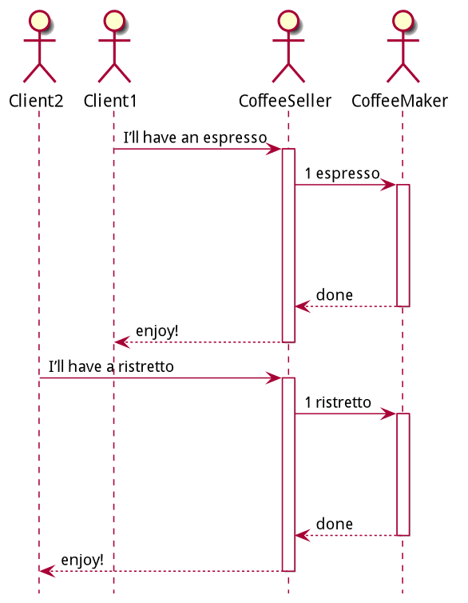
Sync Calls - StarBlocks

Slide 3
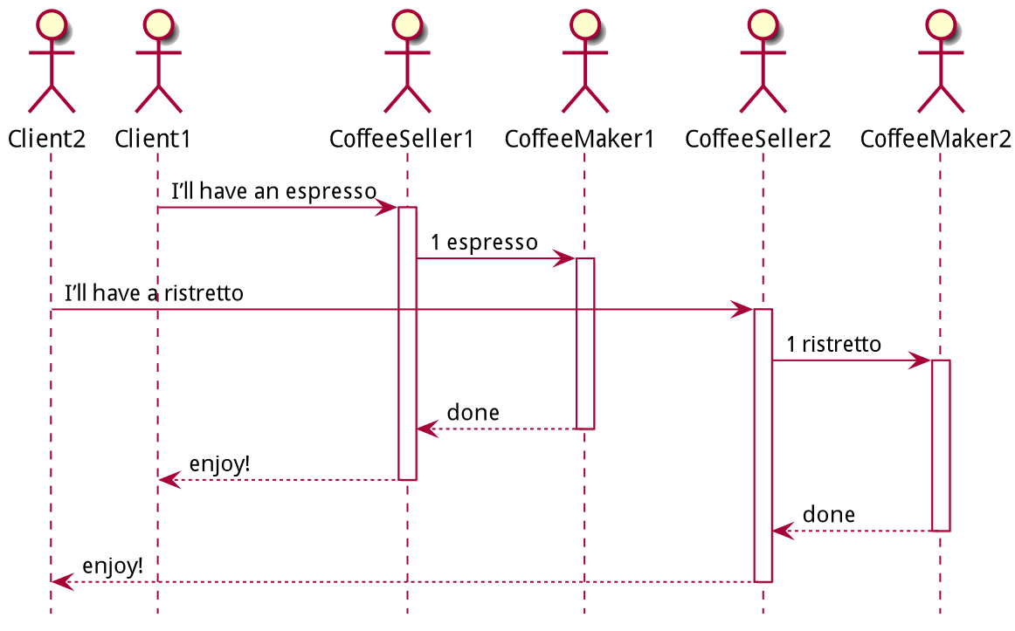
Parallel Calls - ParallelCosta

Slide 4
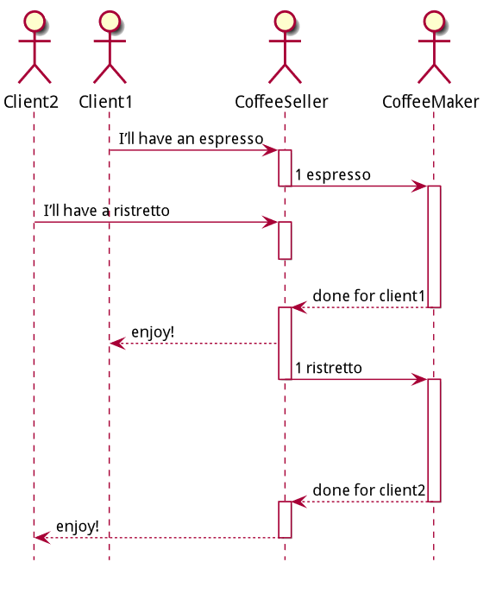
Async Calls – Future Cafe

Slide 5
Async Calls – Advantages
Execution of a computation on another computing unit, without waiting for its termination;
Better Resource Efficiency

Slide 6
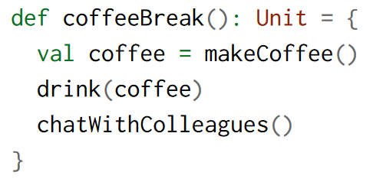
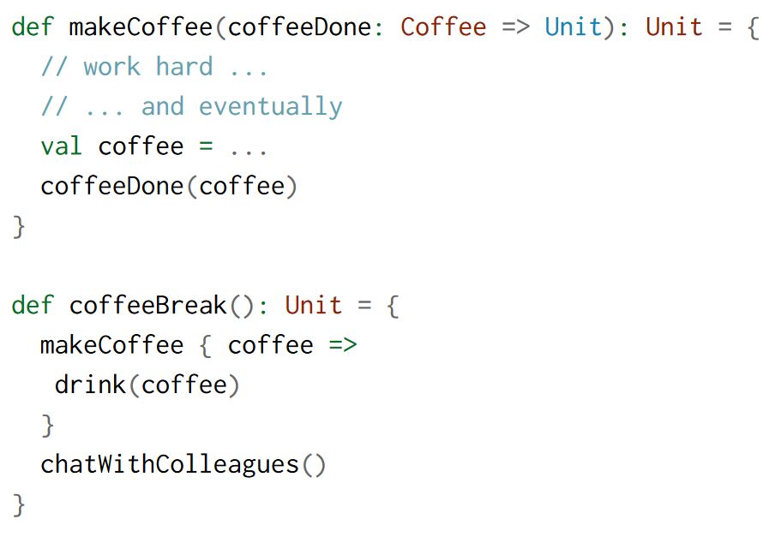
Coffee Sync to Async Code
Callback
When its ready

Slide 7
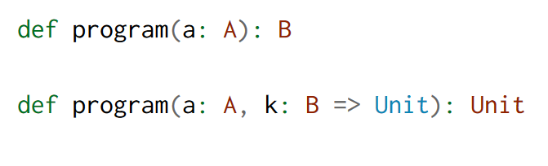
Sync to Async With Callback

Slide 8
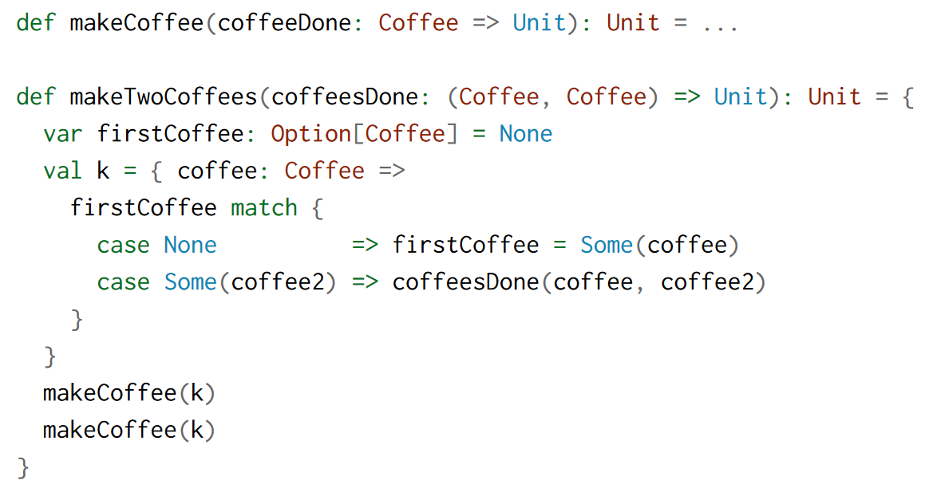
Combining Asynchronous

Slide 9
Handling Failures

Slide 10
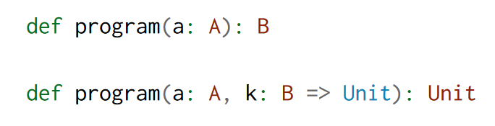


Whats Wrong with callbacks?
BLACK HOLES & REVELATIONS!

Slide 11



Futures a better Approach
Effect encapsulated

Slide 12
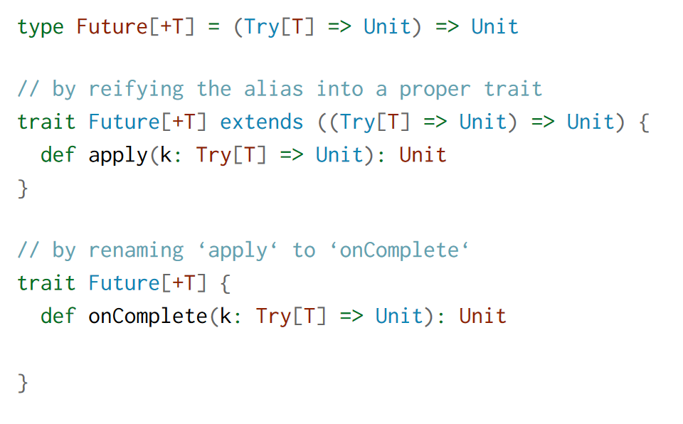
Future definition

Slide 13
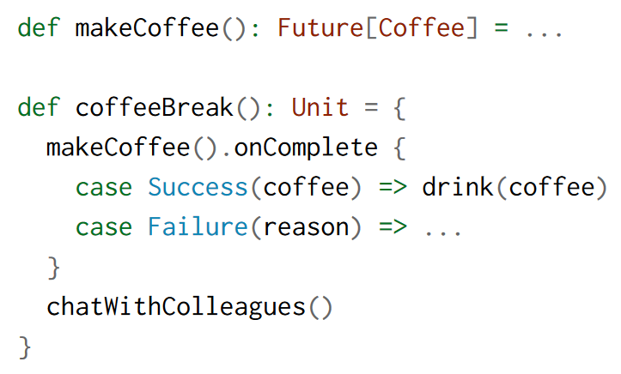
Make Coffee with Futures

Slide 14
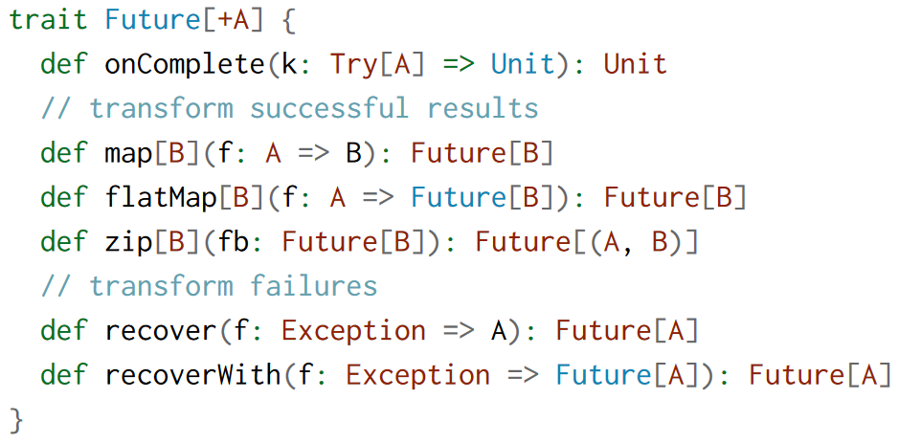
Functor/Monad Future
Sequencing Futures. Runs f/fb after the
future runs
Runs in parallel

Slide 15
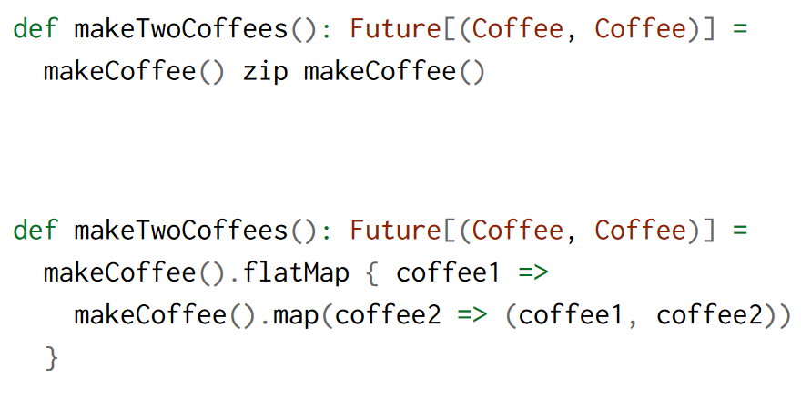
Zip vs Flatmap

Slide 16
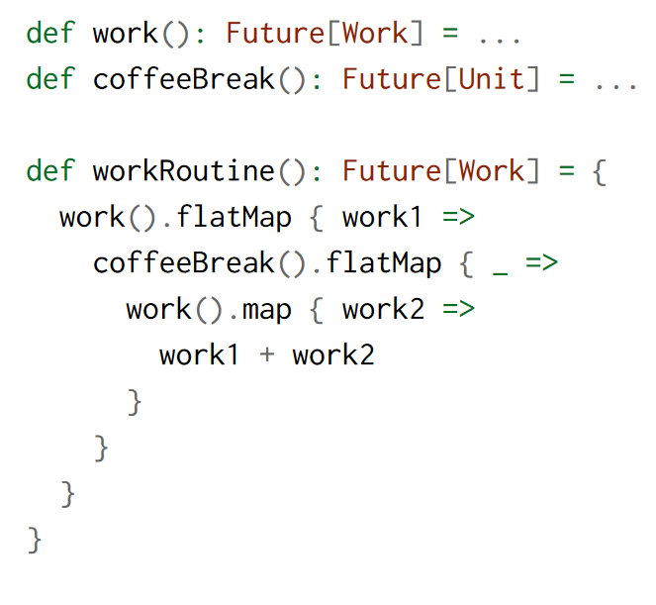
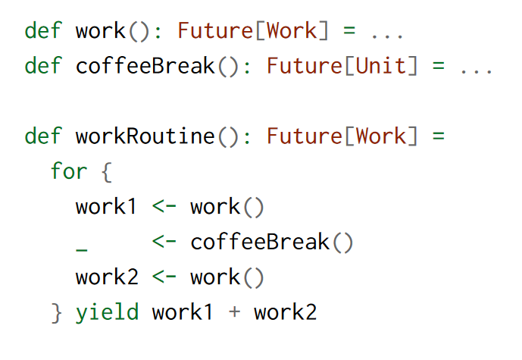

For Comprehension

Slide 17
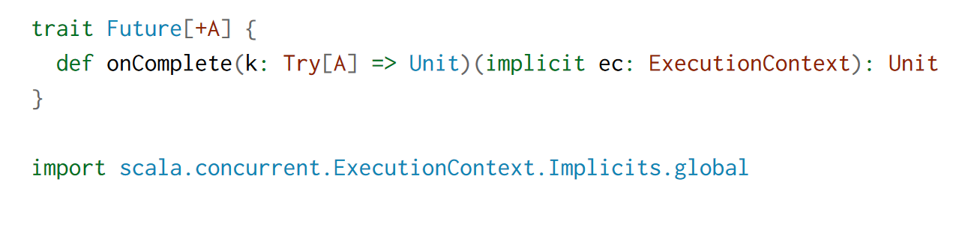
ExecutionContext
Dispatcher: FixedThreadPool/Single
Thread etc...

Slide 18
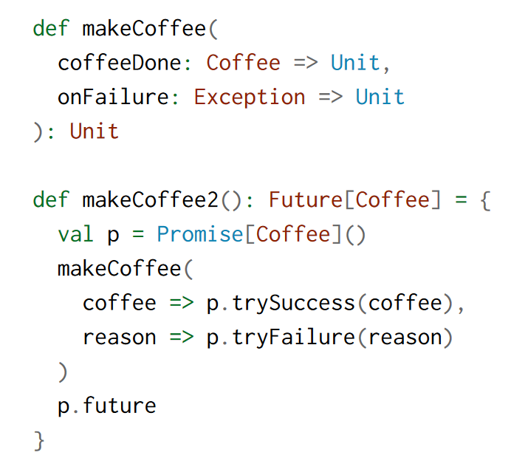
Lift a CallBack to Future

Slide 19

Questions

