Slide 1

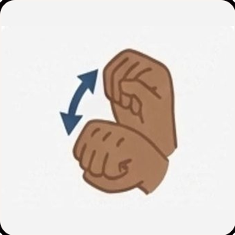
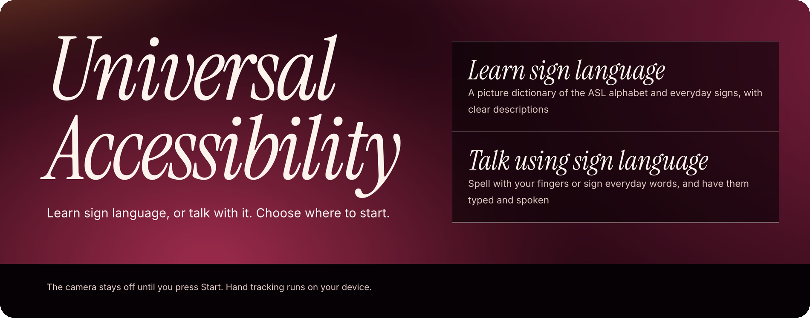
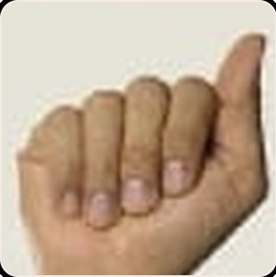
Universal Accessibility Platform
BYTE4ME · MINDS IN ENGINEERING
Learn signs. Express yourself.
Works on laptop and phone
American Sign Language (ASL) first
Notes:
Title slide. Universal Accessibility Platform: learn sign language, or talk with it. Works on laptop and phone; ASL first.

Slide 2
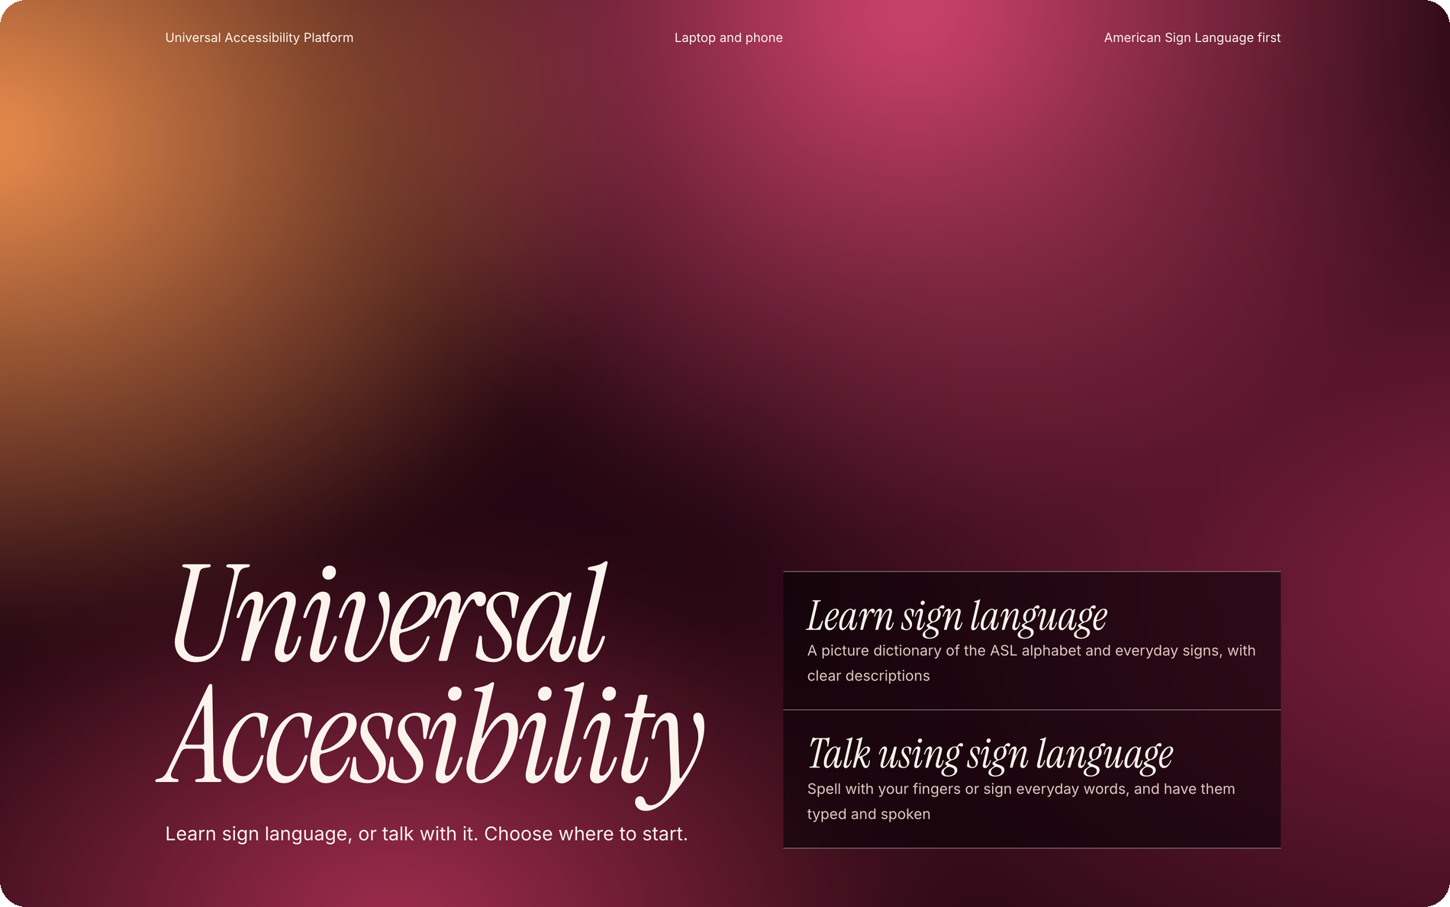



What it is
OVERVIEW
A web app that helps people learn ASL and turn signs and gestures into text and speech.
1
No installation
Open it in your browser and get started.
Private by design
2
Hand tracking runs on your device. The camera only starts when you press Start.
Two main paths
1
Learn
Explore the ASL picture dictionary.
2
Talk
Turn supported signs into text and speech.
Choose Learn to explore signs, or Talk to try them out with the camera.
Notes:
A single-page web app. Runs in the browser, no installation. Hand tracking runs on the device; camera stays off until Start. Two paths from Home: 1 = Learn (click opens the picture dictionary), 2 = Talk (click opens the four talking modes).

Slide 3
App map
STRUCTURE
Home
Learn ASL
Sign to communicate
Alphabet A–Z
26 letters
Everyday signs
20 signs
Fingerspelling
Basic signs
Draw a letter
Draw in the air
Practise with the camera to jump from Learn into Talk.
Create your own gestures
Available throughout the app: message bar · text size (A, A+, A++) · voice on / off
Notes:
Home leads to two paths. Learn: picture dictionary with Alphabet A–Z and Everyday signs tabs. Talk: Fingerspelling, Basic signs, Draw a letter, Draw in the air, plus the optional My own gestures. A shared message bar and accessibility controls appear across pages. Practise with the camera in Learn jumps to the matching Talk camera screen.

Slide 4
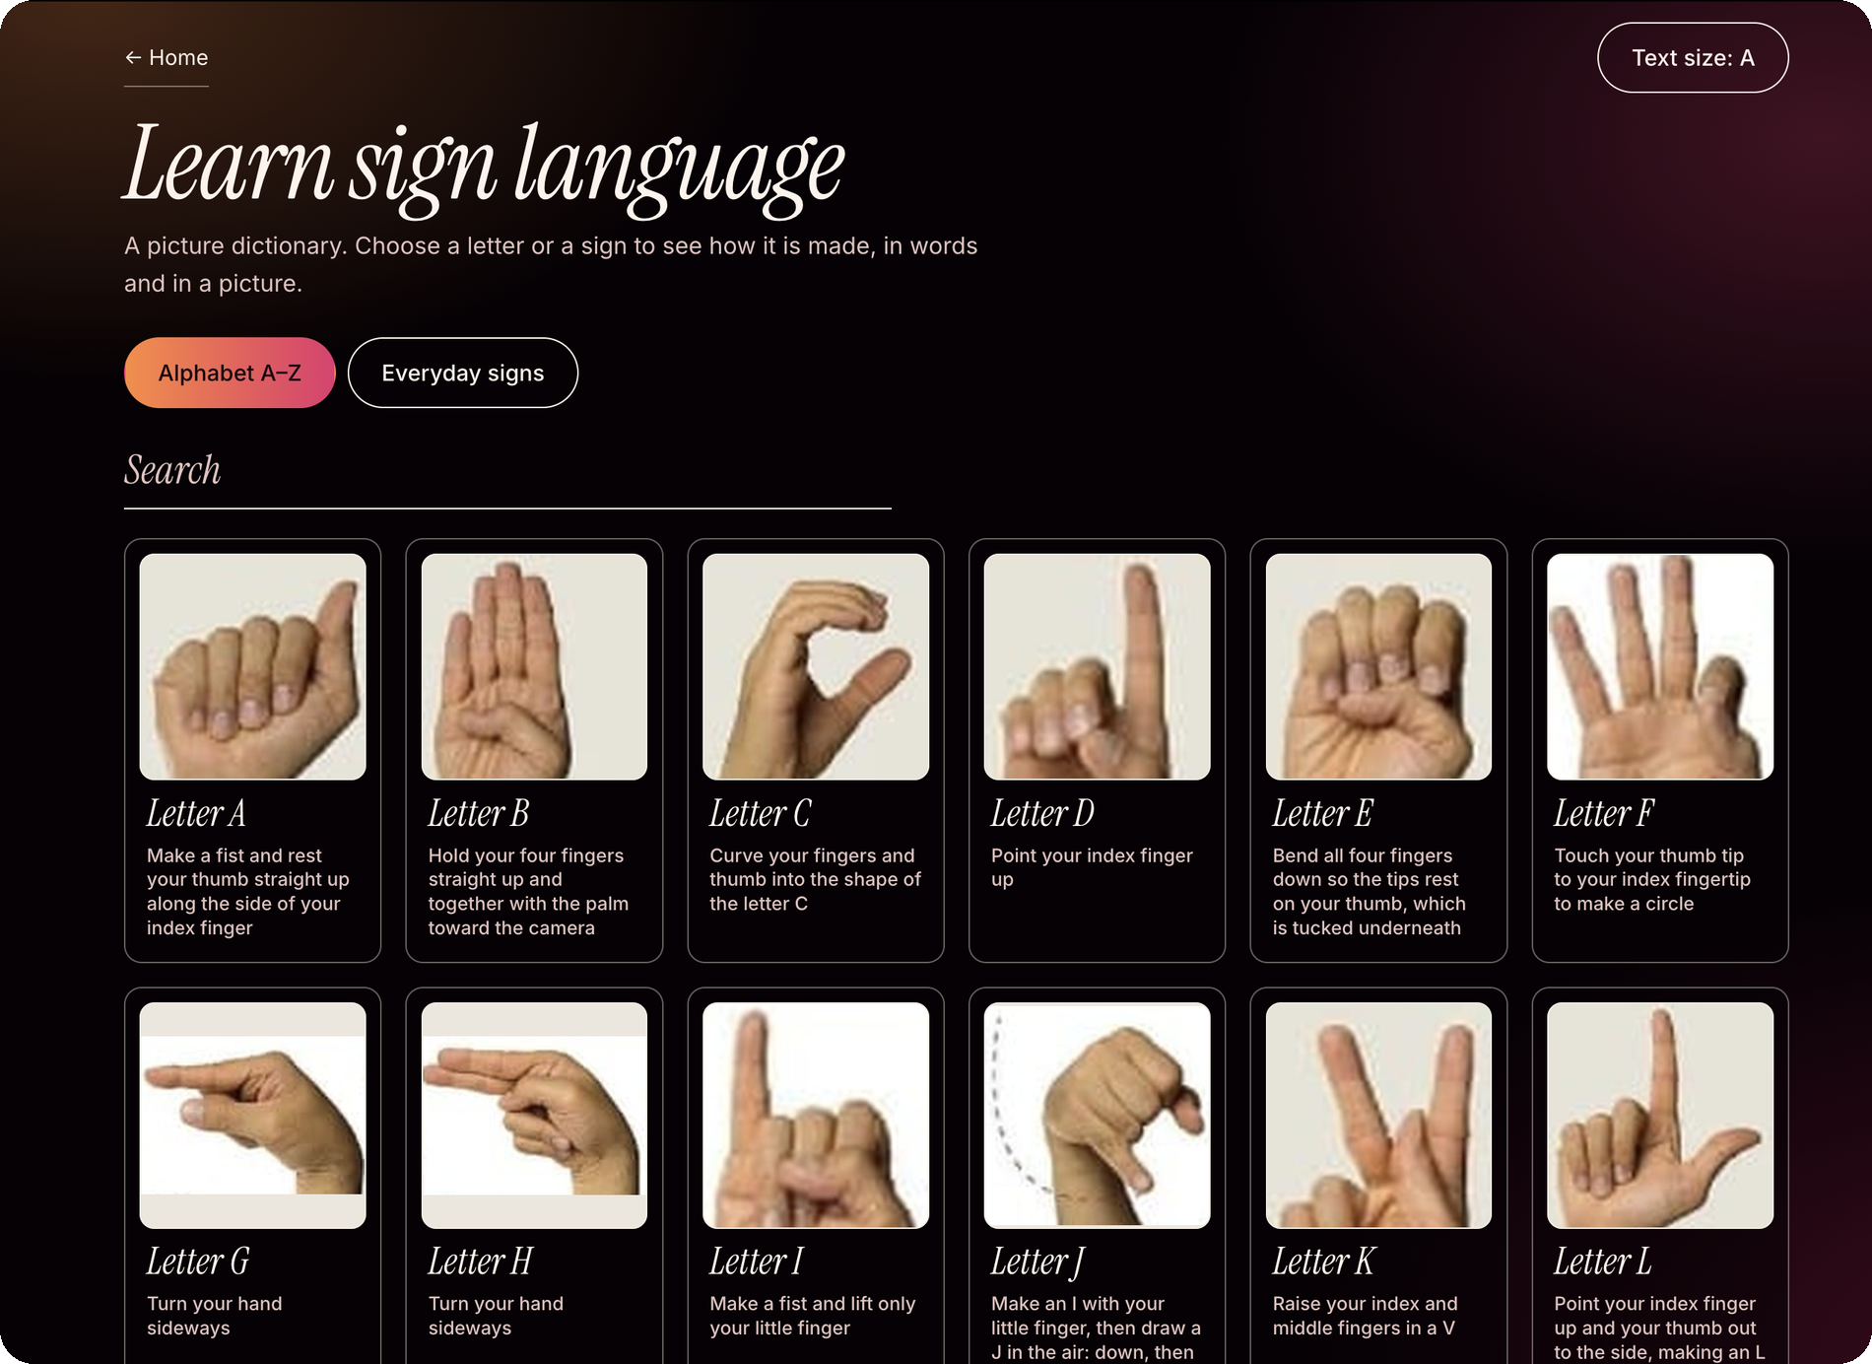
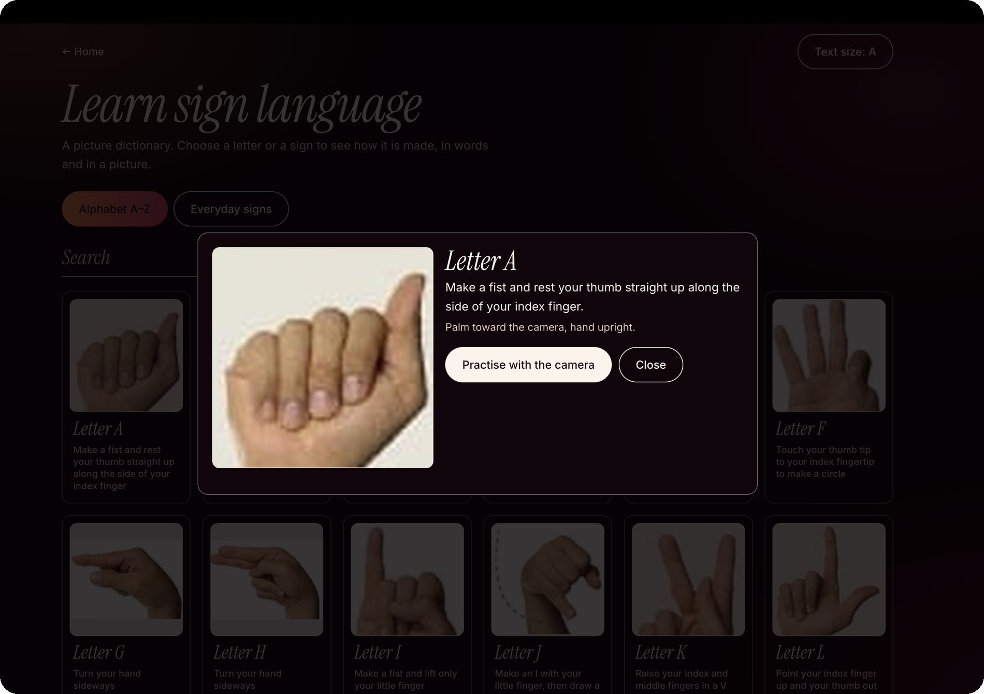
Learn sign language
PATH 1 · LEARN
4
1
2
3
tap a card
5
1
Pick a tab
2
Search
3
Tap a card
4
Read and see
5
Practise / Close
Browse all 26 letters or explore 20 everyday signs.
Find a letter or sign by typing its name.
Select a card to see the sign and its name.
View a larger picture, follow the written steps, and check the camera tips.
Open the camera to practise, or close the pop-up to return to the dictionary.
Notes:
Learn is a picture dictionary. 1 Tabs: Alphabet A–Z (26 letters) and Everyday signs (20 signs); clicking switches the list. 2 Search box filters the dictionary; empty results show “Nothing matches that search”. 3 Each entry is a card with picture and name; tapping opens a pop-up. 4 The pop-up shows a large picture, step-by-step instructions and a camera tip where relevant, e.g. turn your hand sideways for G and H. 5 Practise with the camera jumps to the Fingerspelling camera screen (Talk); Close dismisses the pop-up.

Slide 5
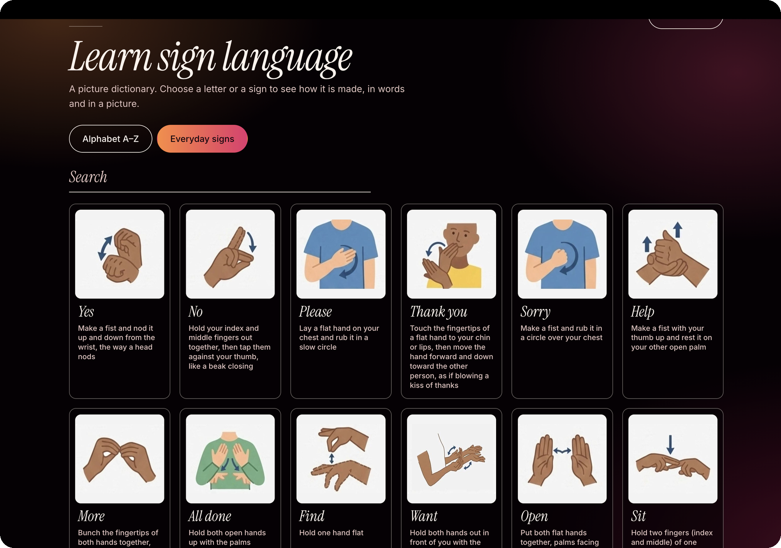
The 20 everyday signs
LEARN · EVERYDAY SIGNS TAB
Each card shows how to make the sign, with written steps and a note on whether it uses one or both hands.
Yes
No
Please
Thank you
1
Sorry
Help
More
All done
2
Find
Want
Open
Sit
Sleep
Play
Eat
Drink
Hurt
Restroom
Stop
Go
3
EXAMPLES
Please: Rub a Flat hand in a slow circle on the chest.
Sorry: The same circle, but with a fist.
Thank you: Move a flat hand from the chin forward and down.
1 Everyday signs tab 2 Picture 3 Written steps, with the one- or two-hand note
Notes:
The 20 everyday signs: Yes, No, Please, Thank you, Sorry, Help, More, All done, Find, Want, Open, Sit, Sleep, Play, Eat, Drink, Hurt, Restroom, Stop, Go. 1 Clicking the Everyday signs tab swaps the alphabet for these cards. 2 Each card has a picture. 3 Each has a written description plus a note on one or two hands. Examples: Please = flat hand circles on chest; Sorry = same circle with a fist; Thank you = flat hand from chin forward and down.

Slide 6
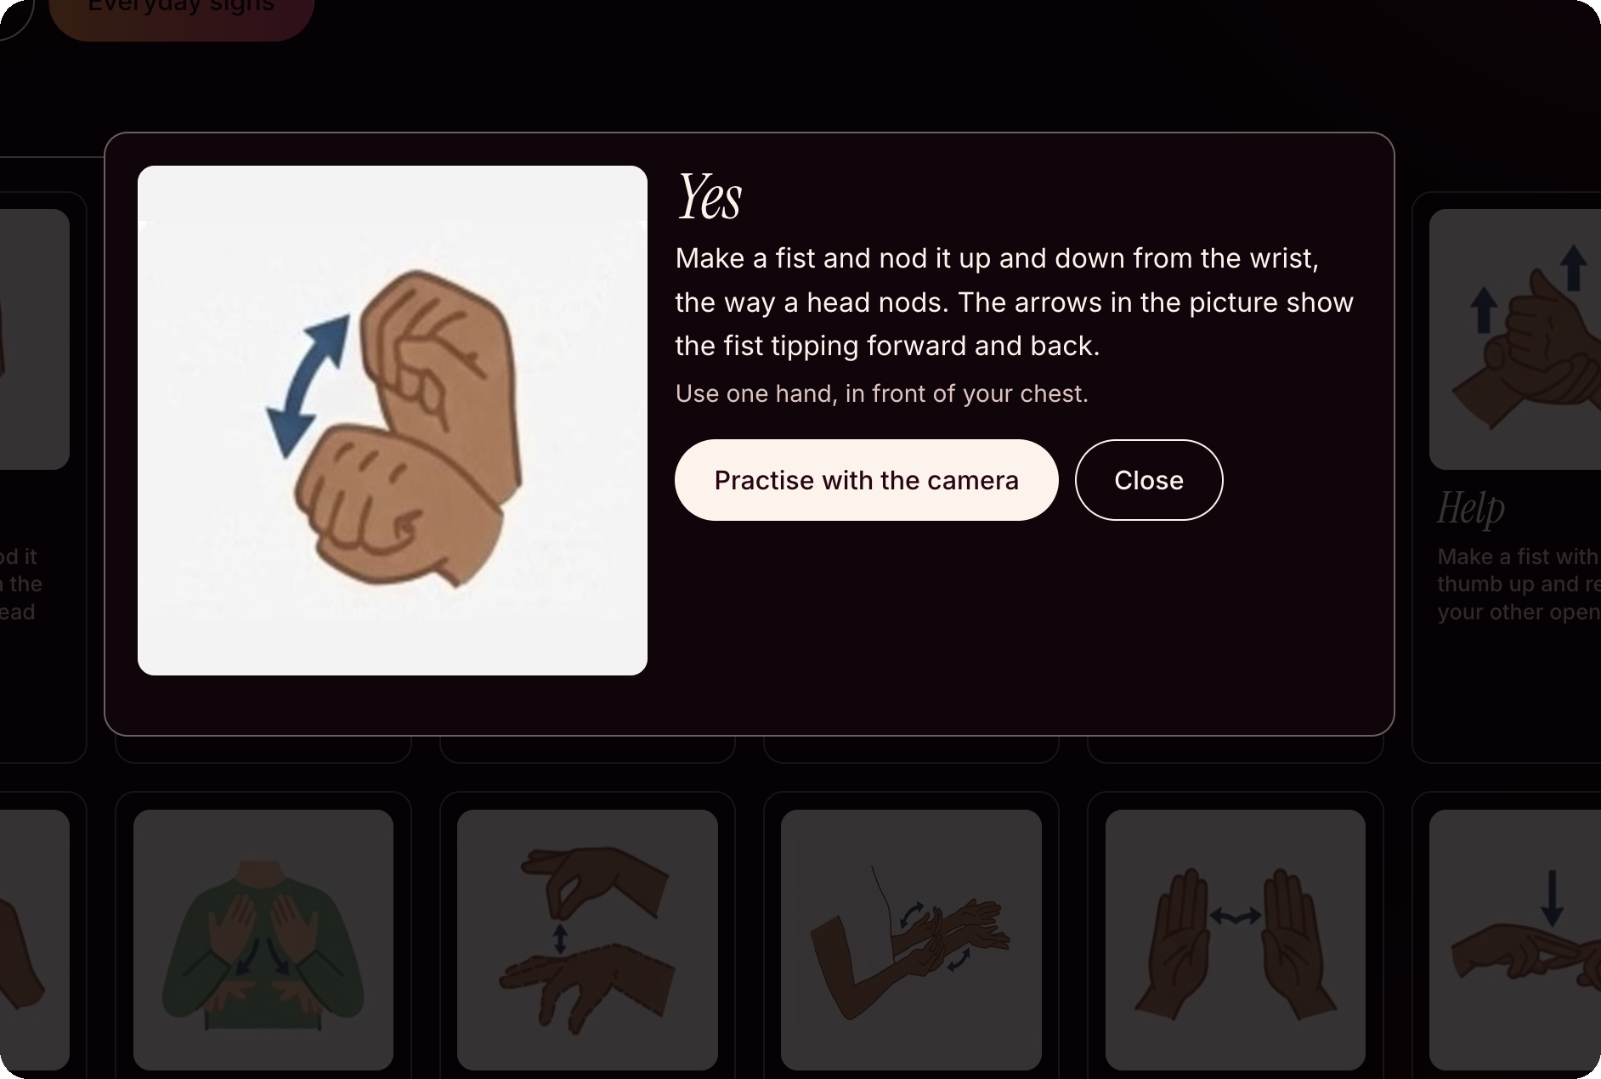
Tap a sign to see how it is made
LEARN · EVERYDAY SIGNS POP-UP
2
1
Picture with arrows
Arrows show which way the hand moves.
2
Written steps
Follow the instructions, written in plain language.
3
5
3
One or two hands
See whether the sign uses one hand or both, and where to place them.
4
4
Practise with the camera
Opens Talk > Basic signs so you can try it with the camera.
1
5
Close
Return to the sign grid.
Notes:
Pop-up for an everyday sign (here: Yes). 1 Picture with arrows showing movement. 2 Written step-by-step description. 3 Note on one or two hands and placement. 4 Practise with the camera jumps to the camera screen of Talk > Basic signs. 5 Close dismisses the pop-up.

Slide 7
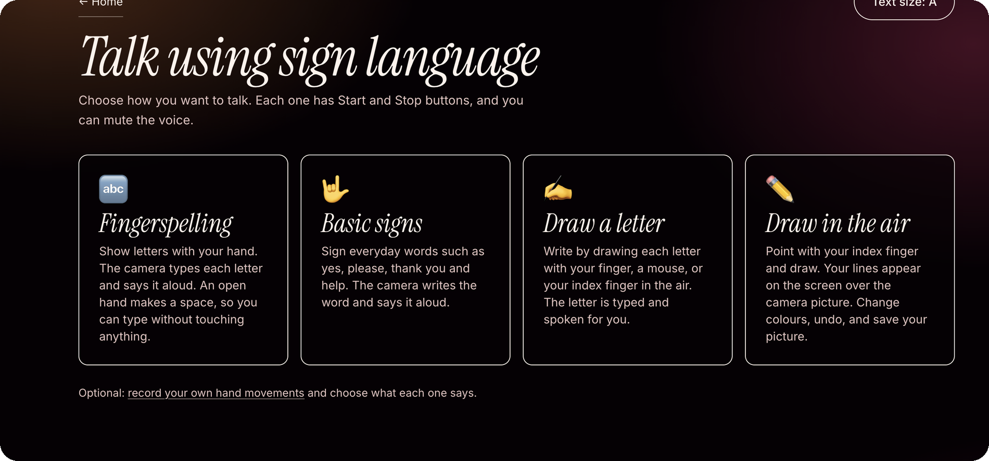
Talk using sign language
PATH 2 · TALK
Every mode
has Start and Stop buttons, plus a voice mute option.
Choose a mode
Click a card to open it.
5
1
2
3
4
1
Fingerspelling
2
Basic signs
3
Draw a letter
4
Draw in the air
5
My own gestures
Form ASL letters with your hand to build words.
Try everyday signs like Yes, Please, Thank you and Help.
Draw letters on the board or use your finger to draw them in the air.
Use hand movements to draw directly over the camera view.
Create custom gestures and assign a word or phrase to each one.
Notes:
Four modes, each with Start and Stop buttons and a voice mute option: 1 Fingerspelling, 2 Basic signs, 3 Draw a letter, 4 Draw in the air. Clicking a card opens that mode. 5 Optional link: record your own hand movements and choose what each one says (opens My own gestures).

Slide 8
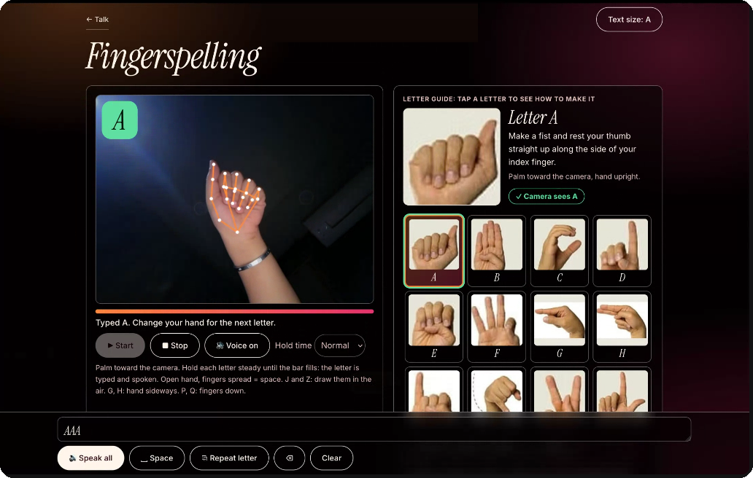
Turn hand signs into written words
MODE 1 · FINGERSPELLING
1
Start, Stop, Voice
Camera stays off until Start. Stop turns it off; Voice mutes speech.
2
Hold the letter
Keep it steady until the progress bar fills.
3
Choose hold time
Slow 1.25 s, Normal 0.85 s or Fast 0.55 s.
4
2
4
Match indicator
“Camera sees A” appears when the camera matches your hand to the selected letter.
1
3
5
Open hand = space
Spread your fingers to add a space without touching the screen. The app reads the completed word aloud.
5
Tips: J and Z are moving letters, so draw them in the air · G and H: hand sideways · P and Q: fingers pointing down
Notes:
Fingerspelling. 1 Start turns the camera on, Stop turns it off, Voice toggles speech. 2 Hold an ASL letter steady until the progress bar fills; the letter is typed into the message box and spoken aloud. 3 Hold time dropdown: Slow (~1.25 s), Normal (~0.85 s), Fast (~0.55 s). 4 The match indicator shows when the camera sees the selected letter. 5 Typed letters collect in the message box; an open hand with fingers spread types a space and the app says the word just finished. J and Z are drawn in the air; G and H with hand sideways; P and Q with fingers pointing down.

Slide 9
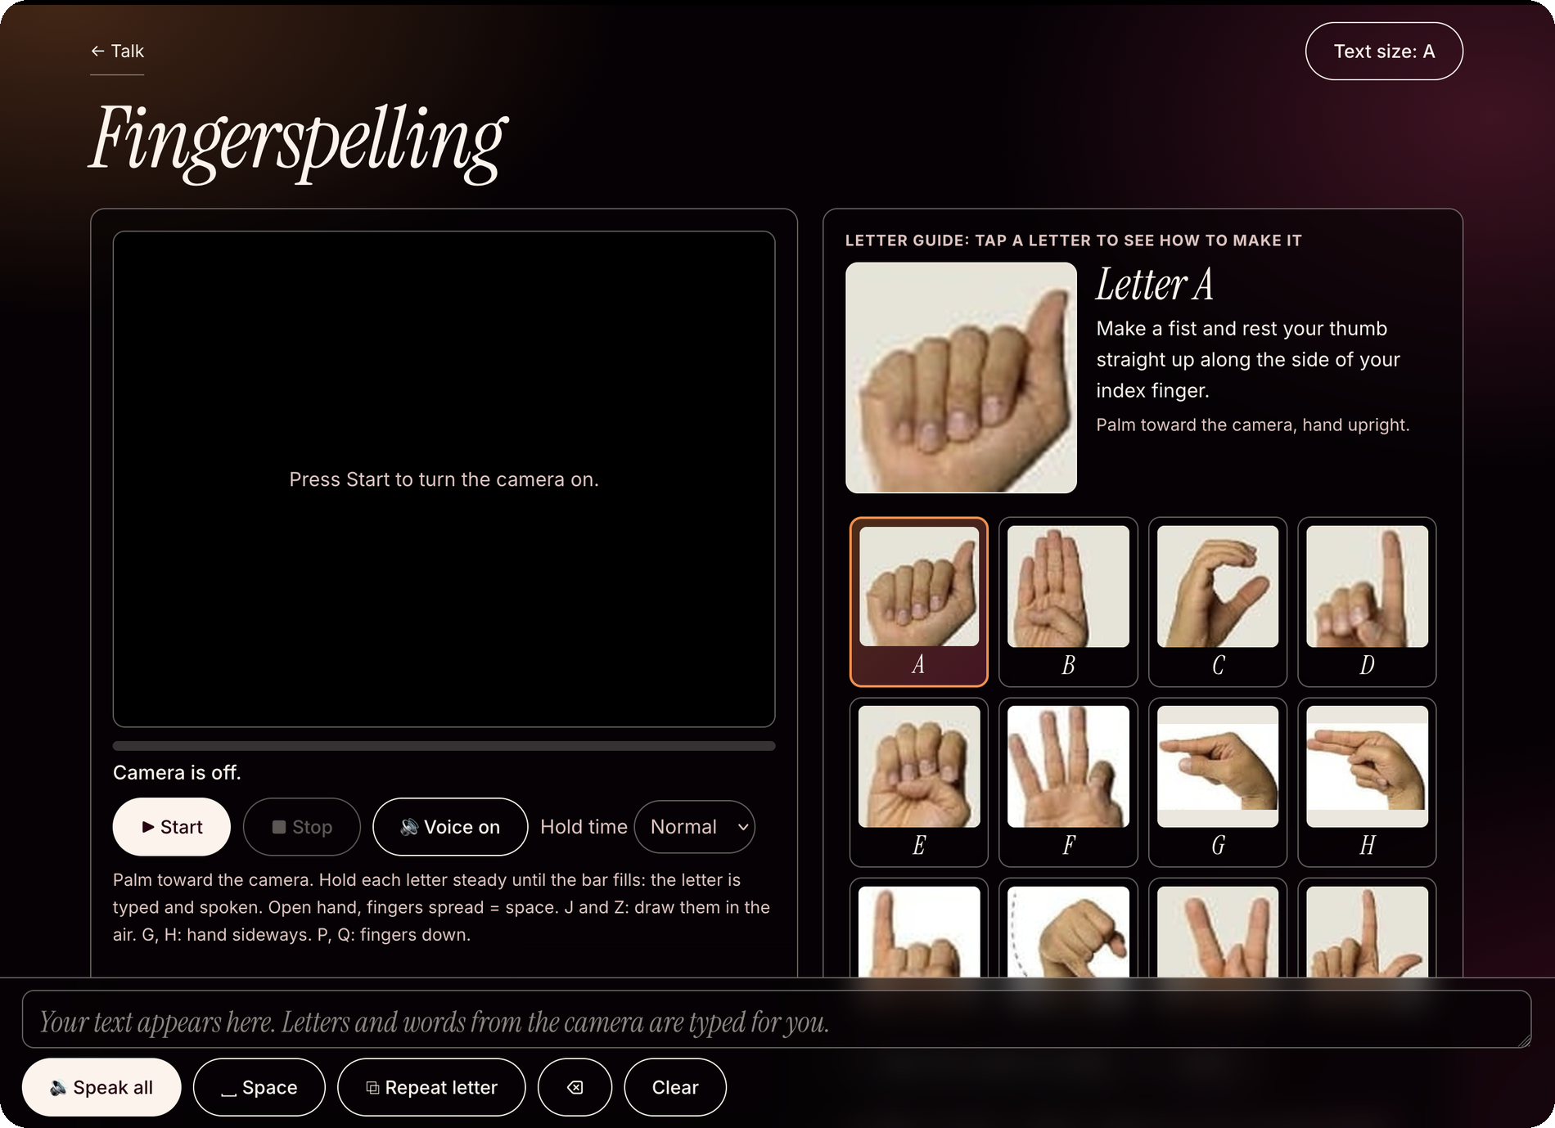
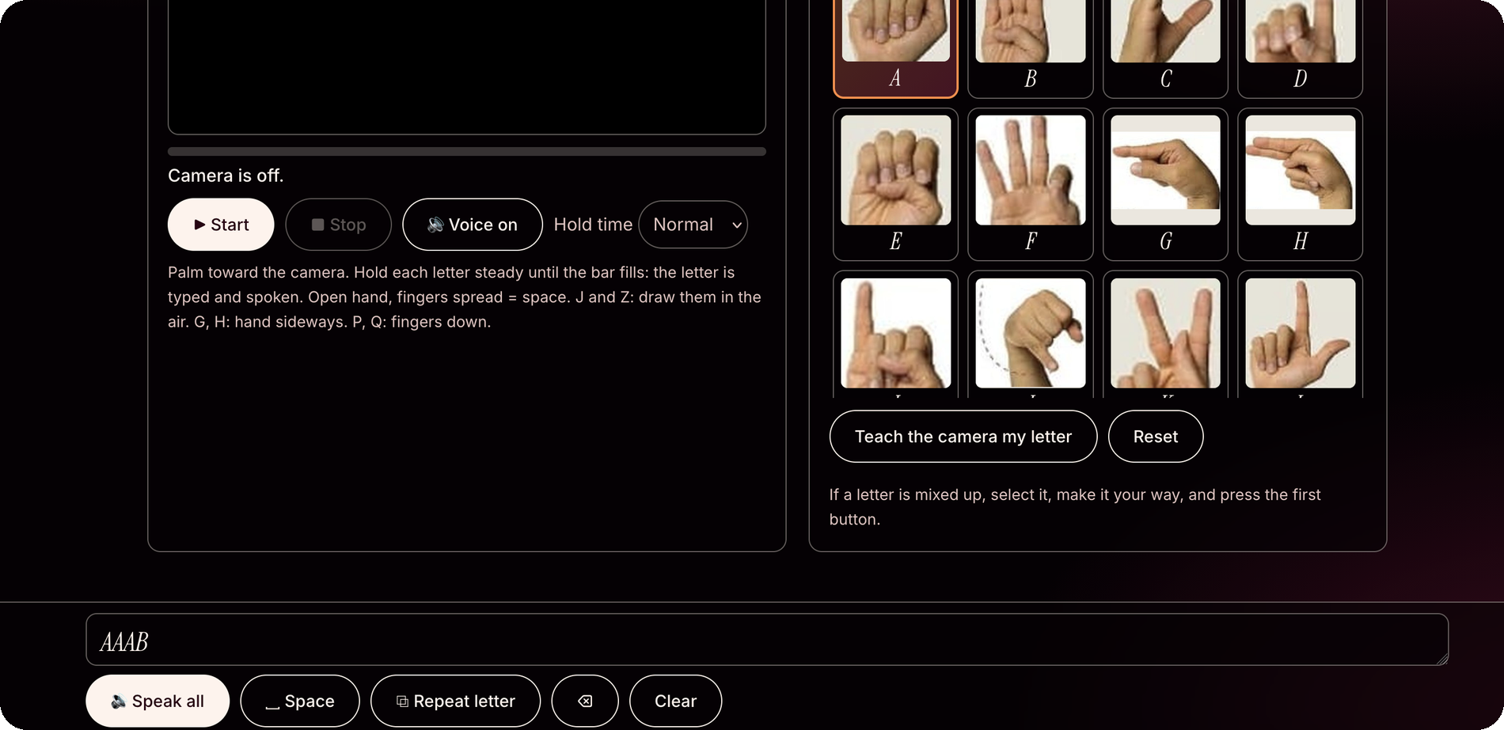
Letter guide and customising recognition
MODE 1 · FINGERSPELLING
1
3
4
2
5
1
Big picture + steps
2
Tiles A–Z + Space
3
Teach my letter
4
Reset
5
Space + Repeat
Tap a tile to see how to make the letter, with a camera tip.
Select a tile; the match indicator checks your hand against it.
Choose a letter the camera often misreads, make your version and hold it for 2 seconds to save it.
Clears your taught version of that letter.
Use Repeat letter to enter double letters, such as LL.
Notes:
1 Tapping a tile shows a big picture, written steps and a camera tip. 2 Tiles cover A–Z plus Space. 3 Teach the camera my letter: select the letter, make it your way and hold for two seconds; it is saved on the device. 4 Reset clears the taught version. 5 Message-bar buttons: Space adds a space, Repeat letter repeats the last letter for double letters such as LL.

Slide 10
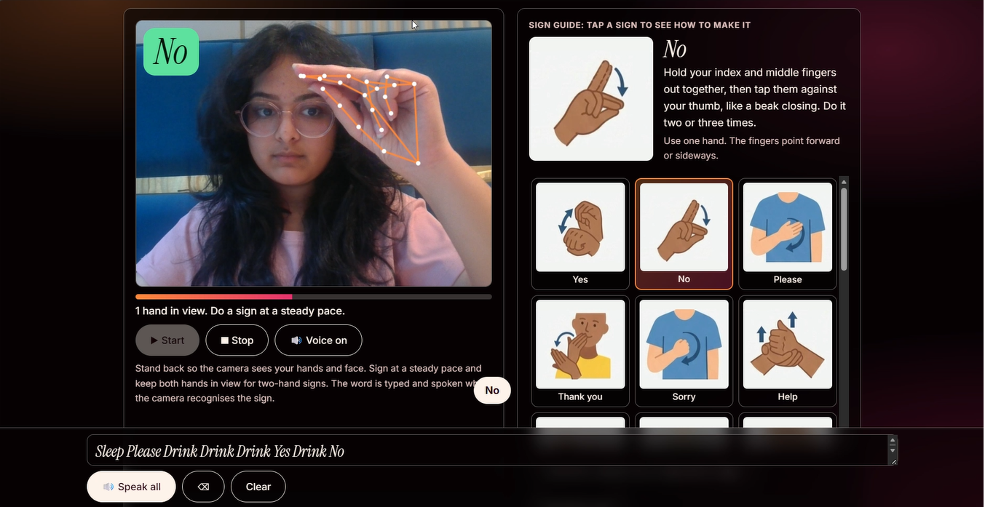
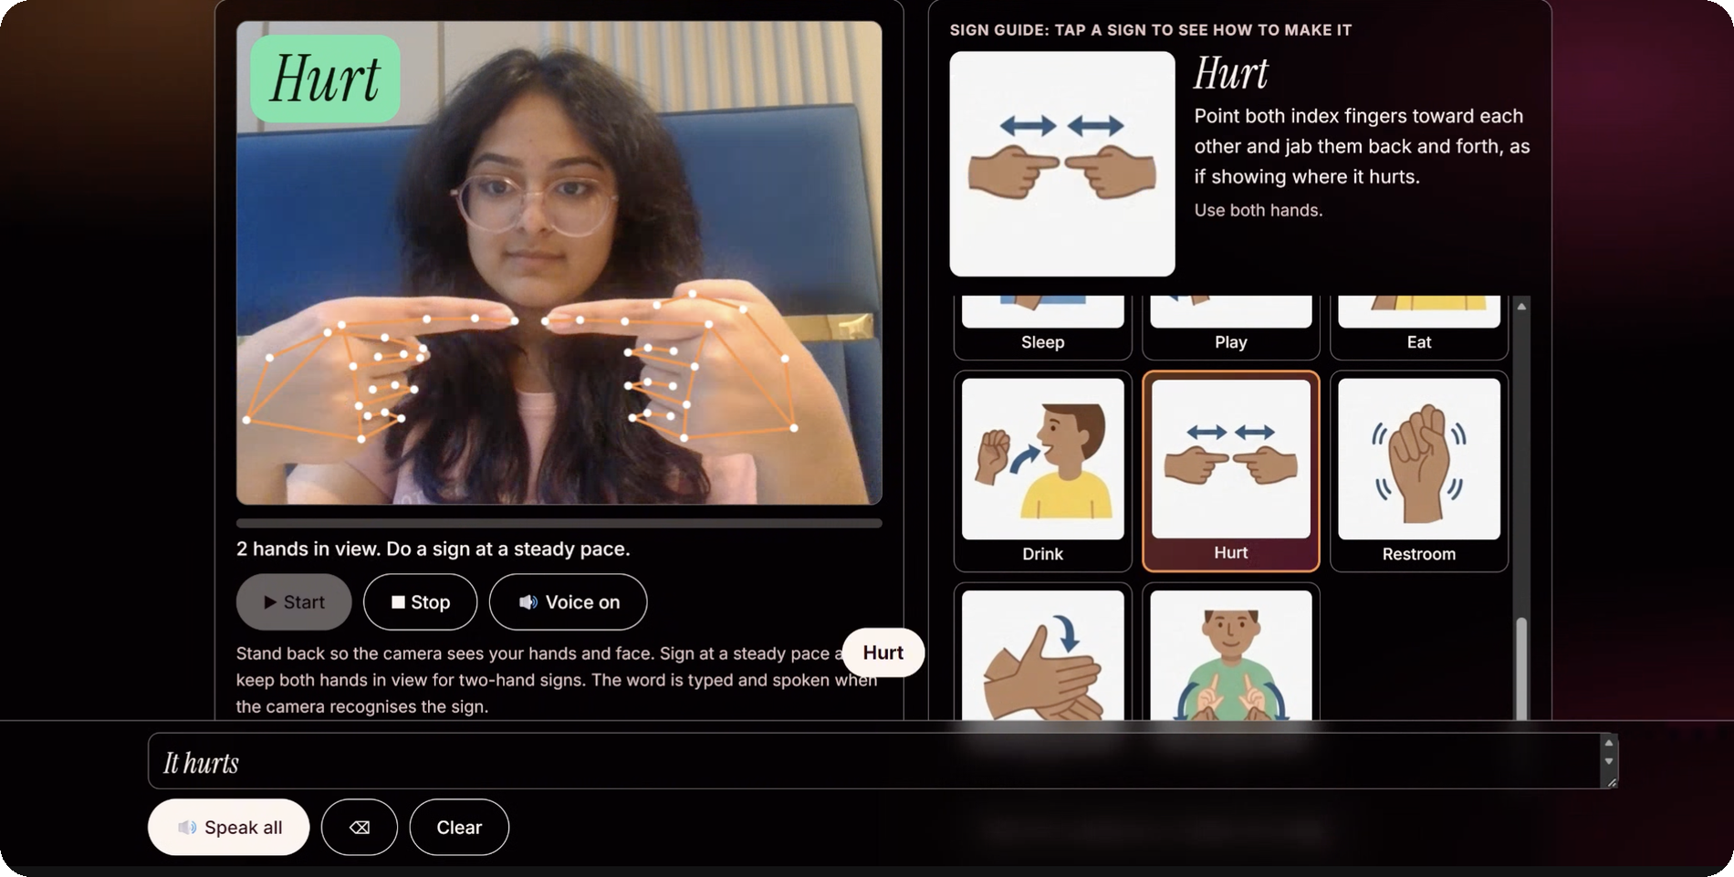
Recognising everyday signs
MODE 2 · BASIC SIGNS
2
4
1
5
3
1
Keep your face and hands in view.
2
Word appears
3
Typed + spoken
4
Brief pause
5
Sign guide
Make sure your face and hands are visible. The status line shows how many hands are in view.
The app checks hand shape, movement and position relative to your face.
The recognised word appears in the message bar and is spoken aloud.
A brief pause helps prevent the same sign from being added twice.
Browse the signs and check the instructions for using one or both hands.
Notes:
Basic signs. 1 Stand back so hands and face are visible; the status line reports 1 hand or 2 hands in view. 2 The recognised word appears in the green tag (rule-based on hand shape, movement and position relative to the face, using both hands and the face). 3 The word is typed and spoken aloud. 4 After a sign fires the system pauses briefly so the same sign is not added twice. 5 The sign guide shows pictures and instructions; tapping a tile selects it.

Slide 11
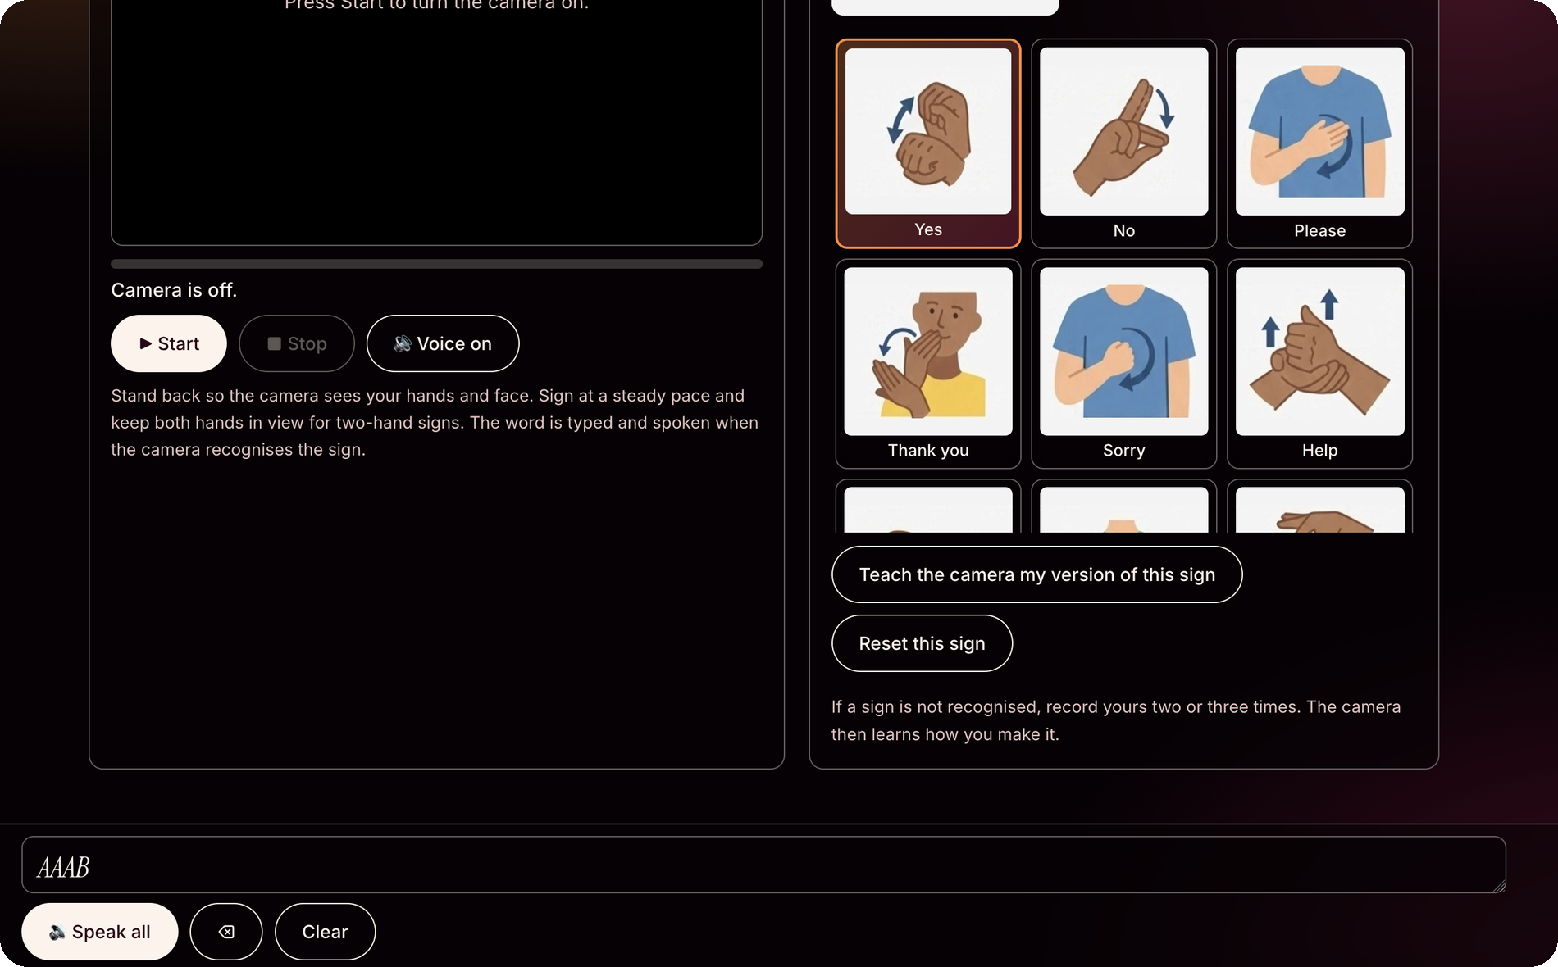
Teach the camera your version of a sign
MODE 2 · BASIC SIGNS
1
Select a sign
Tap a tile in the sign guide. The chosen sign is outlined.
1
2
Teach my version
Press the button and use the 3-second countdown to get ready.
2
4
3
Record 2–3 times
Perform the sign two or three times so the app can save examples of your version.
3
4
Reset this sign
Removes your custom version of this sign only.
Your custom sign examples are saved on this device for your next visit.
Notes:
Teach the camera my version of this sign. 1 Select the sign tile in the guide. 2 Press Teach the camera my version of this sign: a 3-second countdown starts. 3 Record the sign two or three times; the camera learns how you make it. 4 Reset this sign clears your version for that sign only. Taught data is saved on the device.

Slide 12
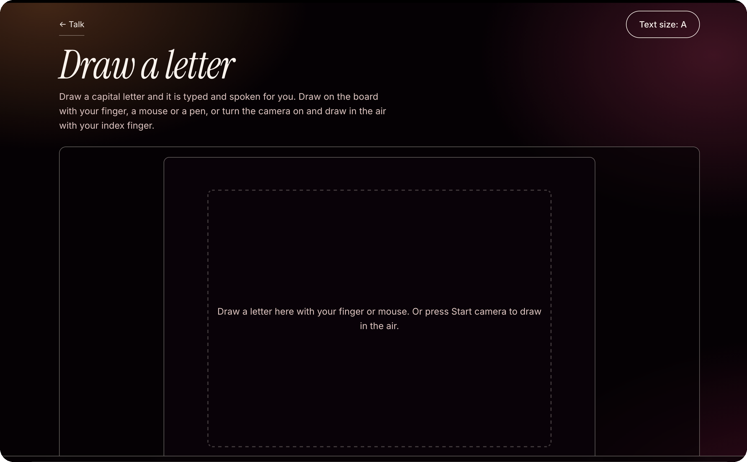
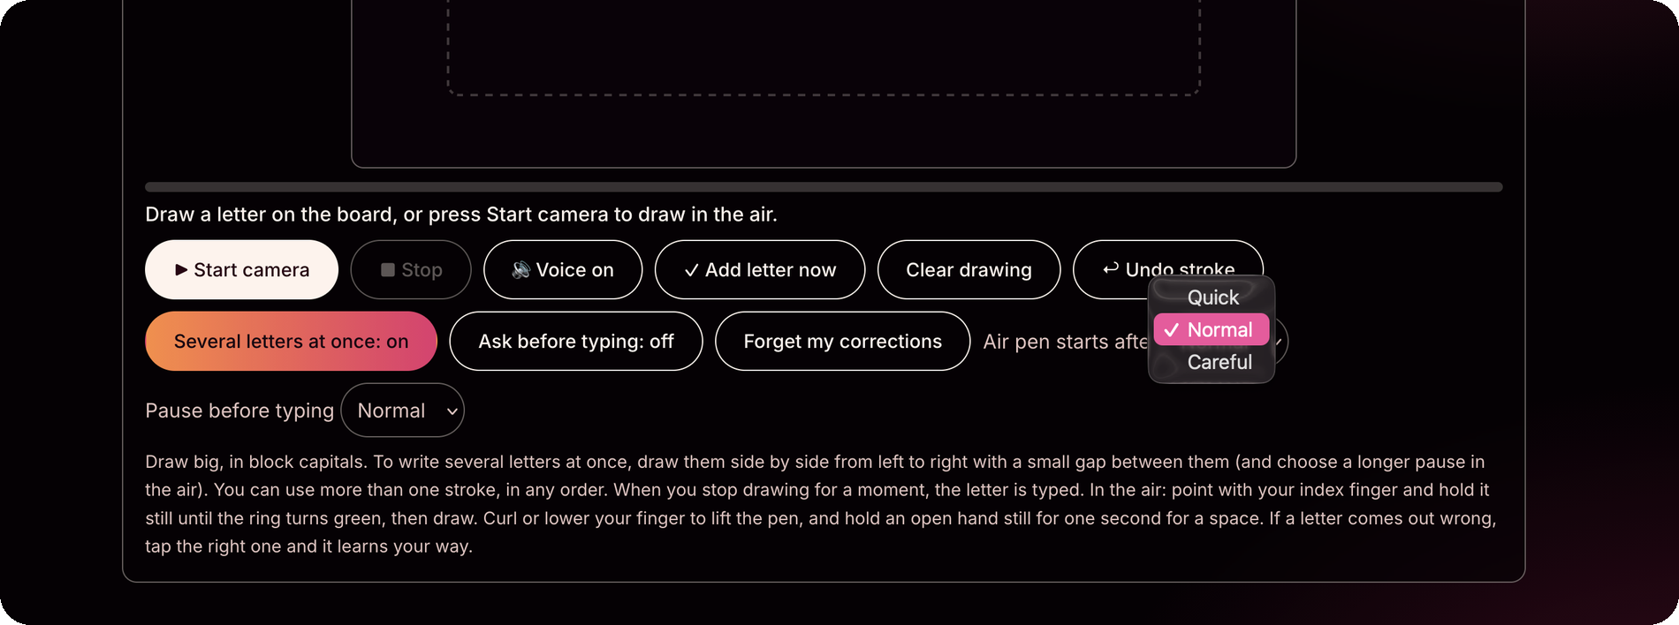
Draw a letter. The app recognises it and reads it aloud.
MODE 3 · DRAW A LETTER
1
2
4
5
3
1
Draw on the board
2
Buttons
3
Smart toggles
4
Air pen delay
5
Pause to type
Draw with your finger, mouse or pen, or start the camera to draw in the air. Pause briefly and the letter is entered.
Add letter now enters it immediately; Clear drawing removes the drawing, and Undo stroke removes the last stroke.
Draw multiple letters at once, review alternatives before typing, or clear the app’s learned corrections.
Choose Quick, Normal or Careful to set how soon the air pen starts.
Choose how long to pause before the app enters a letter.
Notes:
Draw a letter. 1 Draw a capital letter on the board with a finger, mouse or pen, or press Start camera and draw in the air with the index finger; when you stop for a moment the letter is recognised, typed and spoken. 2 Add letter now types immediately, Clear drawing wipes the board, Undo stroke removes the last stroke. 3 Several letters at once: draw them side by side with small gaps; multiple strokes in any order work. Ask before typing shows alternative candidates to choose from. The app learns from corrections; Forget my corrections resets them. 4 Air-pen start delay: Quick, Normal or Careful. 5 Pause before typing: Short, Normal or Long.

Slide 13
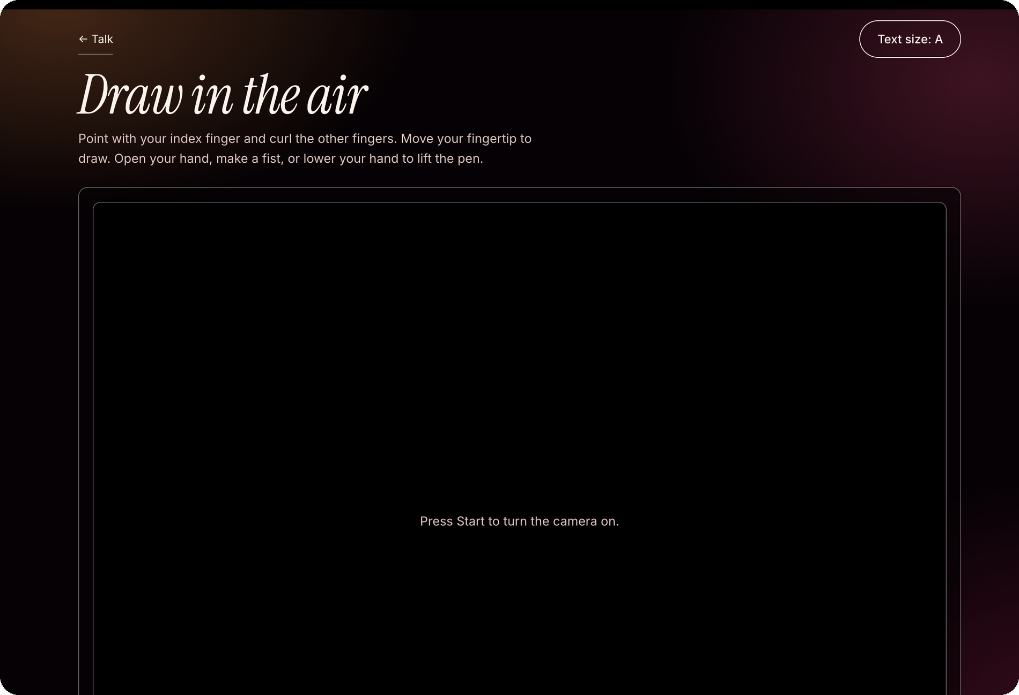
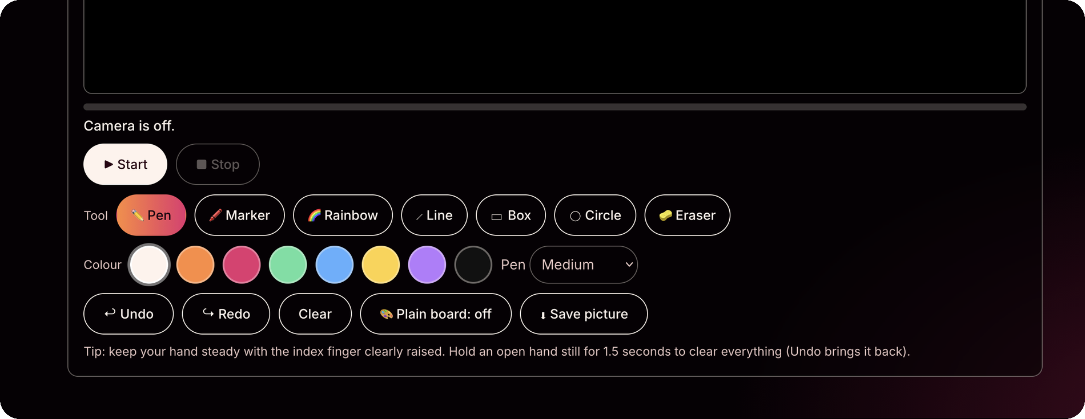
Draw directly in the camera view
MODE 4 · DRAW IN THE AIR
1
2
3
4
5
1
Point and draw
2
7 tools
3
Colour and size
4
Actions
5
Lift your hand to stop drawing
Raise your index finger and curl the others, then move your fingertip to draw.
Pen, Marker, Rainbow, Line, Box, Circle and Eraser.
Choose from eight colours and four pen widths: Thin, Medium, Thick or Extra thick.
Undo or redo a stroke, clear the drawing, save the picture, or hide the camera view with Plain board.
Open your hand, make a fist or lower your hand to stop drawing. Hold an open hand still for 1.5 seconds to clear the board.
Notes:
Draw in the air. 1 Point with the index finger and curl the others; move the fingertip to draw over the live camera picture. Open the hand, make a fist or lower the hand to lift the pen. 2 Tools: Pen, Marker, Rainbow, Line, Box, Circle, Eraser. 3 Eight colour swatches (white, orange, pink, green, blue, yellow, purple, black) and pen sizes Thin, Medium, Thick, Extra thick. 4 Undo, Redo, Clear, Save picture (downloads the drawing) and Plain board (hides the camera picture). 5 Holding an open hand still for 1.5 seconds clears everything; Undo brings it back.

Slide 14
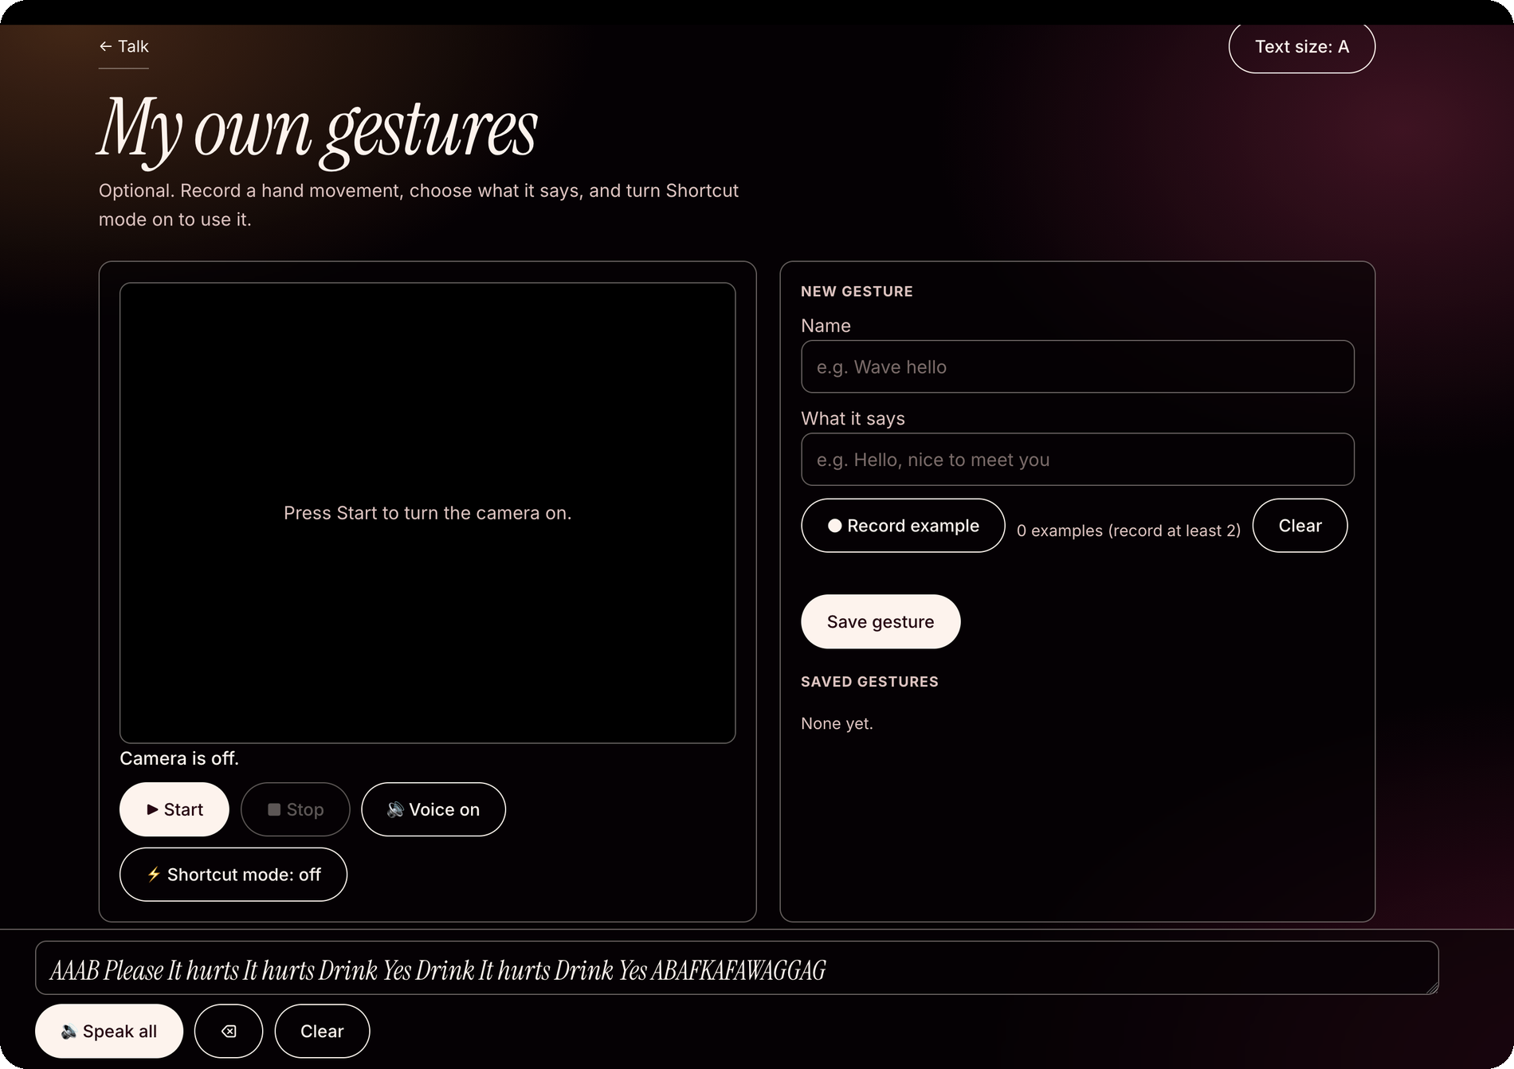
Make gestures your own
OPTIONAL · MY OWN GESTURES
1
Choose a gesture
Name it and enter what it should say, e.g. “Wave hello” → “Hello, nice to meet you”.
2
Record example
Record at least two examples; the counter shows how many you have added.
1
2
3
Save gesture
Saves the gesture to your list, whether it is a still hand shape or a movement.
3
4
4
Saved gestures
View and manage your saved gestures here.
5
5
Shortcut mode
Turn this on to recognise your saved gestures and speak their assigned phrases.
Notes:
My own gestures. 1 Give the gesture a name and type what it says, e.g. Wave hello > Hello, nice to meet you. 2 Record example: record at least two examples. 3 Save gesture stores it. 4 The saved-gestures list lets you manage them. 5 Shortcut mode turns saved gestures on so they are recognised and spoken. Works with still shapes and movements.

Slide 15
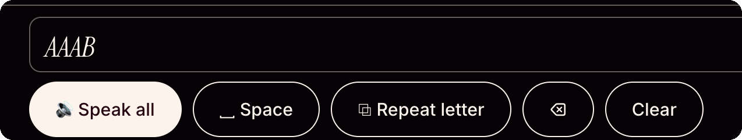
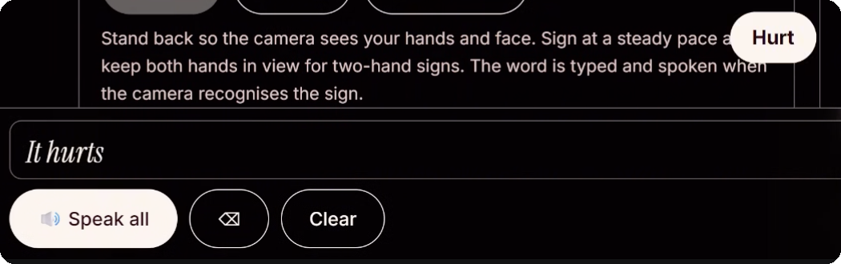
The message bar
SHARED · CAMERA AND GESTURE PAGES
1
6
2
3
4
5
1
Message box
2
Speak all
3
Space
Letters and words from your signs and drawings appear here, ready to edit or read aloud.
Reads the full message aloud.
Adds a space between words.
4
Repeat letter
5
Delete ⌫ and Clear
6
Toast + live region
Repeats the last letter, for double letters such as LL.
Delete removes the last item; Clear removes everything in the message box.
Each action triggers a brief on-screen notice and an announcement for screen readers.
Notes:
The message bar appears on the camera and gesture pages. 1 Text box where letters and words collect. 2 Speak all reads the whole message aloud. 3 Space. 4 Repeat letter. 5 Delete (⌫) and Clear. 6 Every action also shows a toast notification and a spoken live-region announcement for screen readers.

Slide 16






How it works
TECHNOLOGY
Camera
640×480
Landmark models
hand + face, GPU with CPU fallback
Normalised hand frame
Same reference for every Hand
Recognisers
Letters, Signs, Gestures, Drawings
Typed + spoken
message bar and speech
Normalised hand frame
Letter classifier
Moving letters and signs
Hand positions are normalised using the wrist as a reference and palm length for scale, making comparisons less dependent on hand size or orientation.
ASL letters are matched against hand-shape templates, with extra rules for commonly confused letters. Recent frames are compared to make recognition more stable.
J and Z are detected from fingertip movement. Basic signs are recognised through hand shape, movement and position relative to the face.
Personal gestures
Drawn letters
Speech
Custom gestures are matched by comparing their shapes and movement patterns using dynamic time warping.
Drawn letters are recognised by comparing the points in a drawing, even when strokes are made in a different order.
Recognised letters and words appear in the message bar and can be read aloud using the browser’s built-in text-to-speech.
Notes:
Hand and face landmark models (MediaPipe-style) load on first use; camera runs at 640x480; GPU with CPU fallback. Normalised hand frame: wrist origin, scaled by palm length, left hands mirrored. Letter classifier: template comparison with weighted distances plus orientation, a rule layer for commonly confused letters (E, X, G, Q, P) and a majority vote over the last few frames. J and Z from fingertip paths. Basic signs: rule-based. Personal gestures: DTW. Drawn letters: point-cloud matcher. Speech: browser text-to-speech.

Slide 17







Accessibility and usability features
USABILITY
Adjust the text size
Voice on / off
Designed for easier navigation
Less unnecessary motion
Choose A, A+ or A++ using the button at the top of each page.
Remembered between visits.
Large touch targets, visible focus indicators, screen-reader labels and live announcements help make the interface easier to use.
Respects your device’s reduced-motion setting.
Vibration feedback
Use gestures instead of typing
Works across screen sizes
Your settings stay saved
The phone vibrates when a letter is typed.
Spaces, holds and gestures let you interact without touching the screen.
Responsive layout with a mirrored camera view for more natural movement.
Settings and personal teaching data are saved on your device.
Notes:
Three text sizes (A, A+, A++). Voice on/off remembered. Large touch targets (48 px+), focus outline, screen-reader labels with live announcements. Reduced-motion respected. Phone vibration when a letter is typed. Hands-free typing through spaces, holds and gestures. Responsive for laptop and phone with mirrored camera. Settings and teaching saved on device.

Slide 18





Privacy and safety
TRUST
Camera control
The camera stays off until you press Start. Press Stop when you’re finished.
On-device processing
Hand tracking runs locally on your device.
Local storage
Custom teaching data is saved in your browser.
1
Your camera, your control.
Clear error messages
The camera starts only when you choose to use it, and hand tracking runs on your device.
The app explains when camera access is blocked or a model fails to load.
Notes:
The camera is off until the user presses Start; Stop turns it off. Hand tracking runs on the device and the footer says so (1). Personal teaching data is stored locally in the browser. Clear error messages cover a blocked camera or a model that fails to load.

Slide 19




Who it’s for
IMPACT
People learning ASL
Deaf and hard-of-hearing users
Teachers, families and children
Explore signs at your own pace and practise them with the camera.
Use recognised signs to produce text and speech when communicating with non-signers.
Explore everyday signs together through visual examples and interactive practice.
No special equipment
Get started with a compatible laptop or phone, a camera and a modern browser.
Notes:
Audiences: people learning ASL; Deaf and hard-of-hearing users who want to communicate with people who don’t sign; teachers, families and children. It works without special hardware, just a camera.

Slide 20
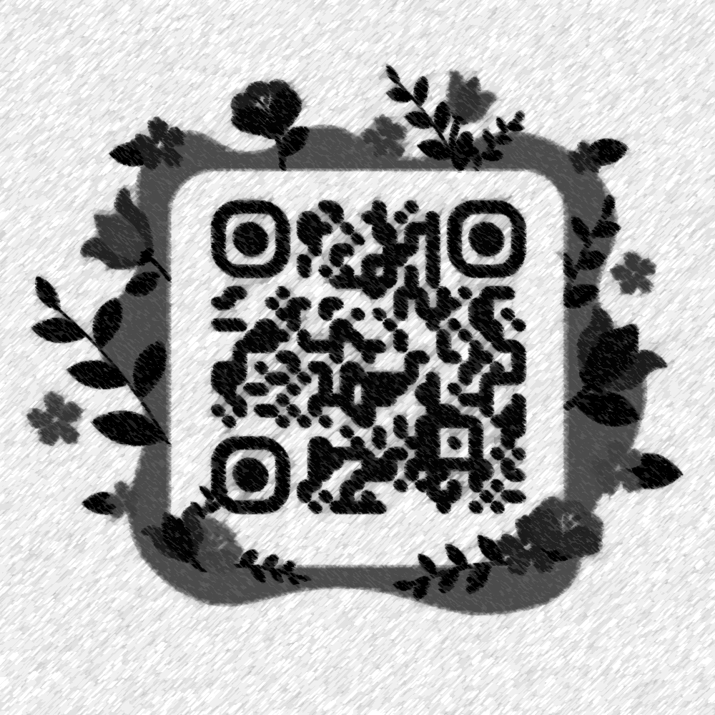
Communication should have fewer barriers.
BYTE4ME · MINDS IN ENGINEERING
Visit our Repository and
Explore The Project
Scan to try it
https://github.com/byteme-code/Sign-Speech/
Works in a modern browser on laptop or phone.
Notes:
Closing: Universal Accessibility: learn it, sign it, say it. Replace the QR placeholder with your app QR code and add the app link under it.

