Slide 1

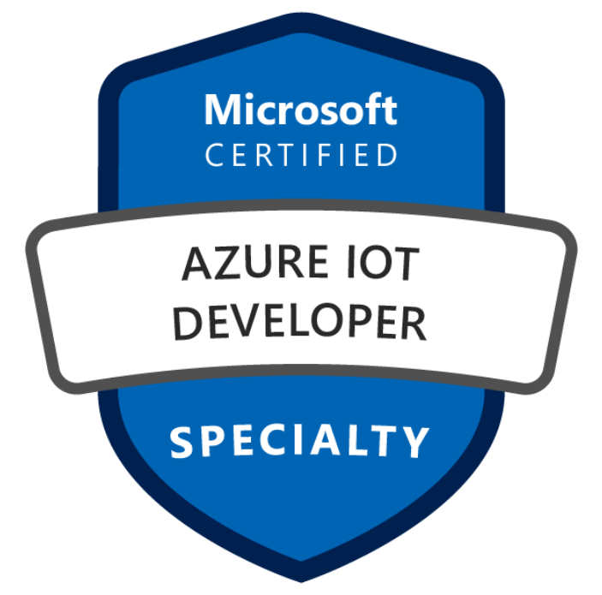
Azure Study Group
AZ-220: Microsoft Azure IoT Developer
Session 1: AZ-220: Kickoff + Implement the IoT solution infrastructure (15-20%)
Diana Phillips Senior Cloud Solution Architect, US OCP Technical Team

Slide 2
Agenda
Series Schedule
Speaker Introduction
Feedback Loop
Expectations
Open Mic
Implement the IoT solution infrastructure (15-20%)

Slide 3
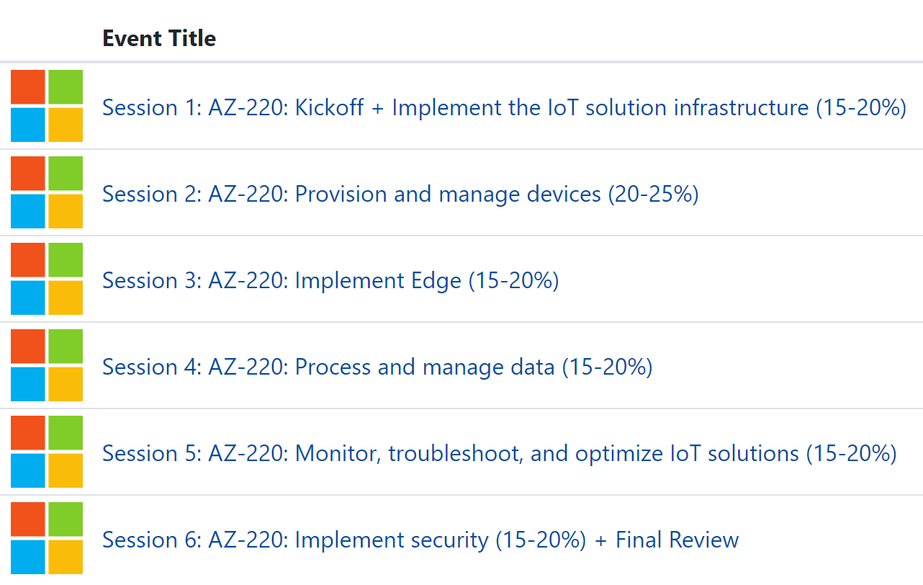
Study Group Series Schedule
Registration: https://msuspartners.eventbuilder.com/AZ220StudyGroup
Microsoft Tech Community: Learn IoT conversation space: https://aka.ms/IoTTechCommunity/LearnIoT

Slide 4
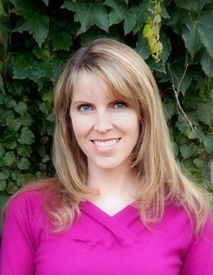
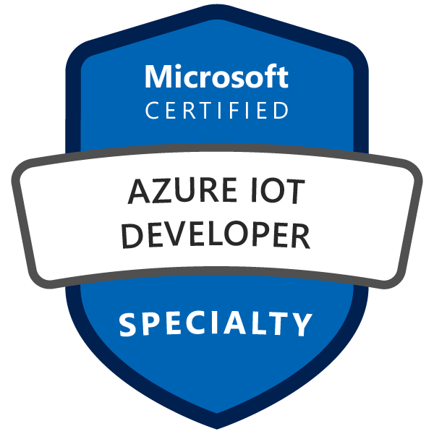


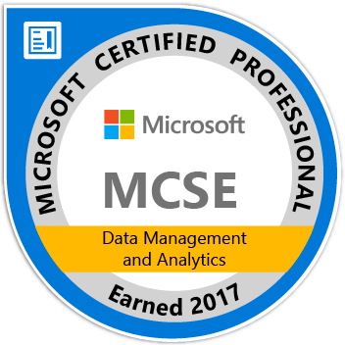
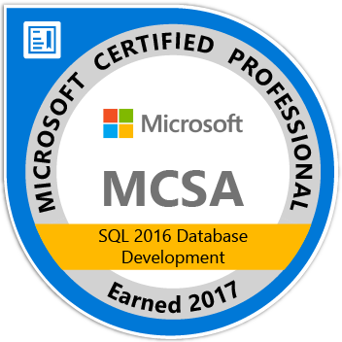
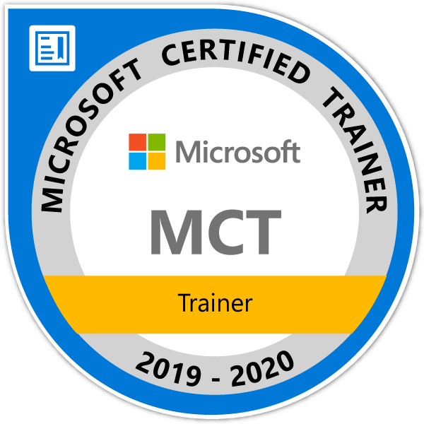
Speaker Introduction – Diana Phillips
Senior Cloud Solution Architecture based in St. George, UT
4 years at Microsoft, 27 years in the industry
Microsoft Certified Professional since 1996
Microsoft Certified Trainer
Conference speaker, Community call presenter, STEM volunteer
http://linkedin.com/in/UtahITPro

Slide 5
Poll: Help us understand the audience…
Where are you calling in from?
What is your role today?
What is your experience level with Azure IoT?
1 – Beginner, I’m new to this
2 – Intermediate, I have used Azure IoT services, but not on a production project
3 – Experienced with Azure IoT, I use the services often
4 – Expert, I am exam ready
Previously recorded

Slide 6
How does this study group work?
Each week, we will cover a different exam objective
You’ll be assigned homework aligned to an exam objective for you to do on your own via self-study
We’ll meet once a week to review and discuss content with Q&A
During the week, post any questions you may have to the Microsoft Tech Community "Learn IoT" Conversation Space (https://aka.ms/iottechcommunity/learniot) Include AZ-220 with your question if it is specifically related to this study group
Weekly sessions will be recorded for on-demand viewing

Slide 7
About this study group…
What this study group is…
A review of areas covered on the exam
Resources to help you prepare
Learning Paths
Hands-on Labs
Strategies for managing your time during the exam
A supportive group to help answer your prep questions
What it is NOT…
A guarantee that you will pass your first time, especially if you don’t have IoT experience
Exam answers

Slide 8
Prerequisites
Software Development Experience
No specific software language required
Does not need to be at a professional level
Data Processing Experience
General understanding of data storage and data processing (recommended but not required)
Cloud Solution Awareness
Have a basic understanding of PaaS, SaaS, and IaaS implementations
Microsoft Azure Fundamentals (AZ-900) or equivalent skills, is recommended

Slide 9
What you need to be successful
Microsoft Azure subscription – Visual Studio or Internal Use Rights from partner organization (Free trial may be restrictive)
Complete the study group homework – Labs and Online Workshop Series
Use the Microsoft Tech Community "Learn IoT" Conversation Space (https://aka.ms/iottechcommunity/learniot) for help
A growth mindset!
Embrace the challenge
Put in the effort to understand key concepts and use cases
Learn by doing - Get hands on!
Find lessons and inspiration in the success of others

Slide 10
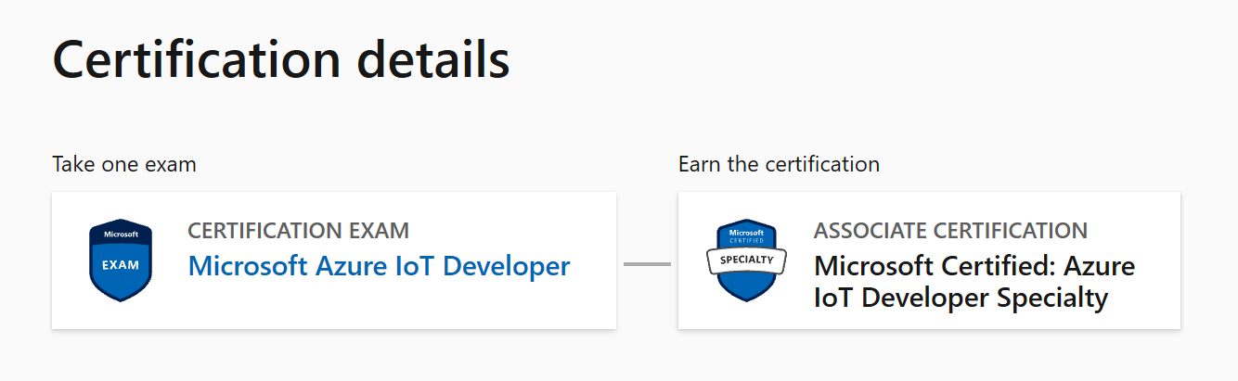
About AZ-220: Microsoft Azure Developer
Exam: https://docs.microsoft.com/en-us/learn/certifications/exams/az-220
Requirement for: Microsoft Certified: Azure IoT Developer Specialty
Notes:
The Azure IoT Developer is responsible for the implementation and the coding required to create and maintain the cloud and edge portion of an IoT solution. In addition to configuring and maintaining the devices by using cloud services, the IoT Developer also sets up the physical devices. The IoT Developer is responsible for maintaining the devices throughout the life cycle.
The IoT Developer implements designs for IoT solutions, including device topology, connectivity, debugging and security. The IoT Developer deploys compute/containers and configures device networking. The IoT Developer implements designs for solutions to manage data pipelines, including monitoring and data transformation as it relates to IoT. The IoT Developer works with data engineers and other stakeholders to ensure successful business integration.
IoT Developers should have a good understanding of how to implement the Azure services that form an IoT solution, including data storage options, data analysis, data processing, and platform-as-a-service options. IoT Developers must be able to recognize Azure IoT service configuration settings within the code portion of an IoT solution and perform specific IoT coding tasks in at least one Azure-supported language, including C#, Node, C, or Python.

Slide 11
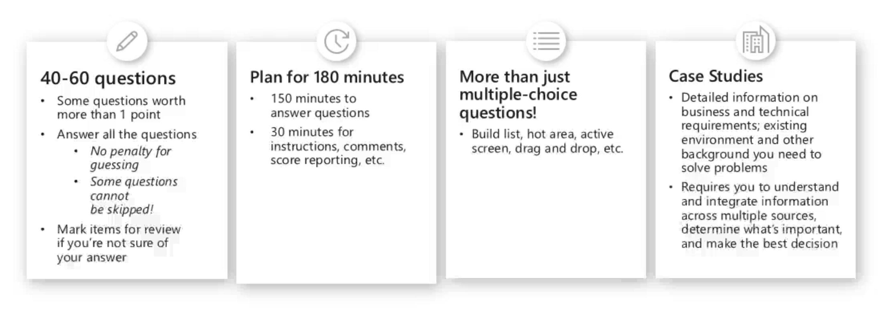
Exam Basics

Slide 12
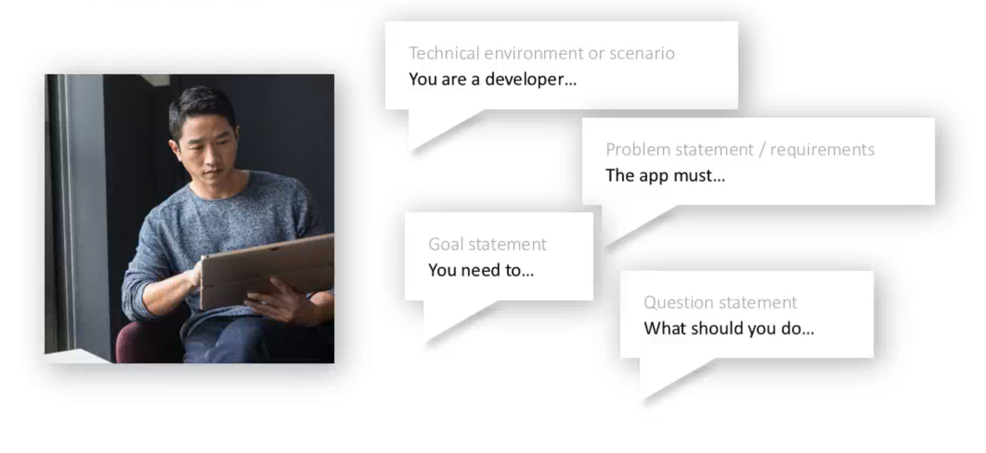
Exam Question Structure

Slide 13
Skills Measured
Implement the IoT solution infrastructure (15-20%)
Provision and manage devices (20-25%)
Implement Edge (15-20%)
Process and manage data (15-20%)
Monitor, troubleshoot, and optimize IoT solutions (15-20%)
Implement security (15-20%)
Note: In most cases, exams do NOT cover preview features, and some features will only be added to an exam when they are GA (General Availability)

Slide 14
Schedule
April 22: Implement the IoT solution infrastructure (15-20%)
April 29: Provision and manage devices (20-25%)
May 6: Implement Edge (15-20%)
May 13: Process and manage data (15-20%)
May 20: Monitor, troubleshoot, and optimize IoT solutions (15-20%)
May 27: Implement security (15-20%)

Slide 15
Study Group Links
AZ-220 Resources and Homework: https://aka.ms/OCPStudyGroup-IoT
Study Group On-Demand Video Registration: https://msuspartners.eventbuilder.com/AZ220StudyGroup
“Learn IoT” conversation space on Microsoft Tech Community: (Note “AZ-220” in posts for study group discussion) https://aka.ms/iottechcommunity/learniot
AZ-220 Labs (from official curriculum): https://microsoftlearning.github.io/AZ-220-Microsoft-Azure-IoT-Developer/
AZ-220 Microsoft Azure IoT Developer Exam Information: https://docs.microsoft.com/en-us/learn/certifications/exams/az-220

Slide 16
Azure Study Group
AZ-220: Microsoft Azure IoT Developer
Questions?

