Slide 1
Chord DHT
Distributed Hash Table Simulation
Ziad Mohamed · Artem Ulianov · Egor Maiorov
Mikhail Tikhonov · Kamil Khusnutdinov
Distributed Network Systems · April 2026

Slide 2
The Problem
You have 5 computers and 1,000 files to store — with no central server. How does computer A find a file on computer D?
Naive approach
Central server
Chord DHT
Ask every node one-by-one
O(N) hops — too slow
Single point of failure
Doesn't scale
Distributed ring structure
O(log N) hops ✓

Slide 3
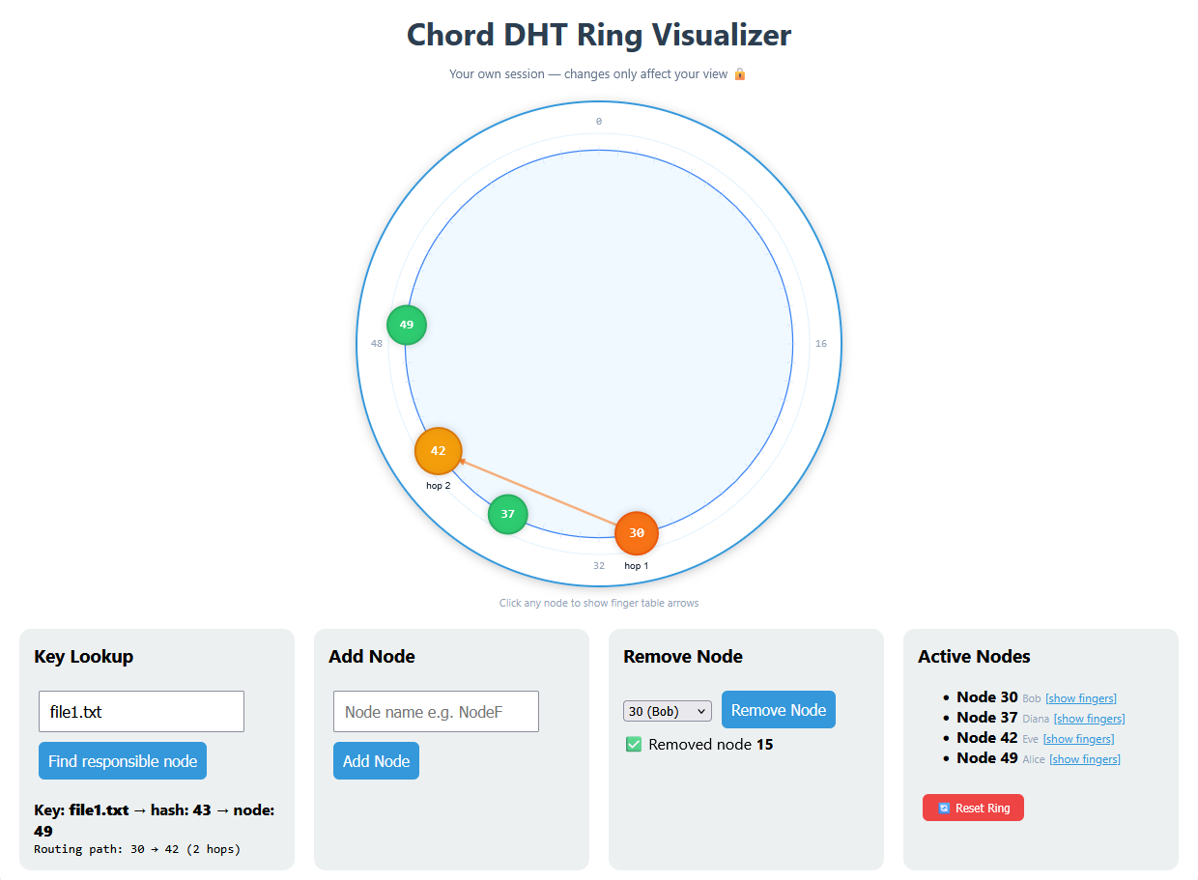
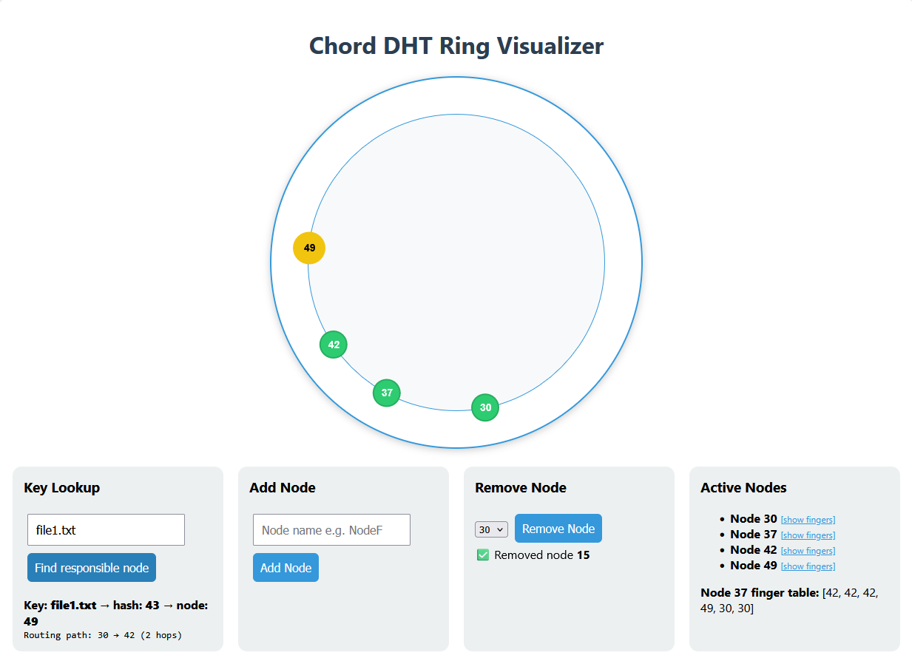
How Chord Works — The Ring
Consistent Hashing
Both nodes and keys are hashed to a position 0–63 using SHA-1
15
Ring Structure
49
hash=43
→ node 49
Nodes sit on an imaginary circle. Keys belong to the first node clockwise from their hash
64-slot ring (0–63)
30
Example
"file1.txt" hashes to 43 → stored on node 49 (next clockwise)
42
37

Slide 4
Finger Tables — O(log N) Routing
Without shortcuts:
Node 15 — Finger Table
Ask every node → O(N) hops
i | Target (15+2ⁱ) mod 64 | Points to
0 | 15 + 1 = 16 | node 30
1 | 15 + 2 = 17 | node 30
2 | 15 + 4 = 19 | node 30
3 | 15 + 8 = 23 | node 30
4 | 15 + 16 = 31 | node 37
5 | 15 + 32 = 47 | node 49
With finger tables:
Each node has 6 shortcuts
pointing +1, +2, +4, +8, +16, +32 ahead
→ O(log N) hops
Formula: finger[i] = (node.id + 2ⁱ) mod 64

Slide 5
Lookup in Action
Looking up "file1.txt" (hash = 43) starting from node 15
15
37
42
49
→
→
→
Start
Hop 2
Hop 3
Found! ✓
finger[4]=37
finger[1]=42
successor=49
Result: "file1.txt" is stored on node 49 | 3 hops | O(log 5) ≈ 2.3

Slide 6
Churn — Nodes Joining & Leaving
BEFORE (5 nodes)
Routing Efficiency
15
30
37
42
49
Node 15 (Charlie) leaves the ring
Finger tables rebuild automatically
AFTER (4 nodes)
30
37
42
49
Node 30 inherits keys that belonged to node 15

Slide 7
Implementation
node.py
Ziad
Ring structure, consistent hashing (SHA-1), node init, add/remove
finger_table.py
Egor
Builds 6-entry finger table per node using binary search (bisect_left)
routing.py
Mikhail
Chord lookup — greedy hop traversal, predecessor check, wrap-around
logger.py
Kamil
Logs INSERT, LOOKUP, JOIN, LEAVE events — memory + file output
visualizer.py
Artem
ASCII ring display + Flask web interface with live add/remove/lookup

Slide 8
Results & Evaluation
1.80
1.30
10
Avg hops
before churn
Avg hops
after churn
Keys
lookup tested
Sample Lookup Results
Key | Hash | Before churn | After churn
file1.txt | 43 | [15,37,42] 3 hops | [30,42] 2 hops
photo.jpg | 25 | [15] 1 hop | [30] 1 hop
data.csv | 12 | [15] 1 hop | [30] 1 hop
video.mp4 | 44 | [15,37,42] 3 hops | [30,42] 2 hops

Slide 9
Web Interface
Built with Flask + HTML Canvas. Run: python server.py → http://127.0.0.1:8010
🔍
Key Lookup
➕
Add Node
Type any string (e.g. hello.txt)
See hash, responsible node, full hop path
Type a name, node appears on
the ring instantly. Finger tables rebuild.
➖
Remove Node
📋
Finger Table
Pick a node from dropdown.
Ring rebalances, keys transferred.
Click any node to inspect
its 6 routing shortcuts.
🔒
Private Sessions
🧭
Path Highlighting
Isolated ring for every user.
Arrows highlighting hop path between nodes.

Slide 10

Live Demo
Link

Slide 11
Conclusion
✓ Full Chord DHT simulation — ring, finger tables, routing, churn
✓ O(log N) routing verified — avg 1.80 hops before, 1.30 after churn
✓ Correctness confirmed — edge cases, single-node ring, key inheritance
✓ Web interface — live add/remove nodes, key lookup, finger inspection
✓ Logging — full event trail for every insert, lookup, join, leave
github.com/bytepharaoh/chord-dht · python server.py → http://127.0.0.1:8010

