Slide 1
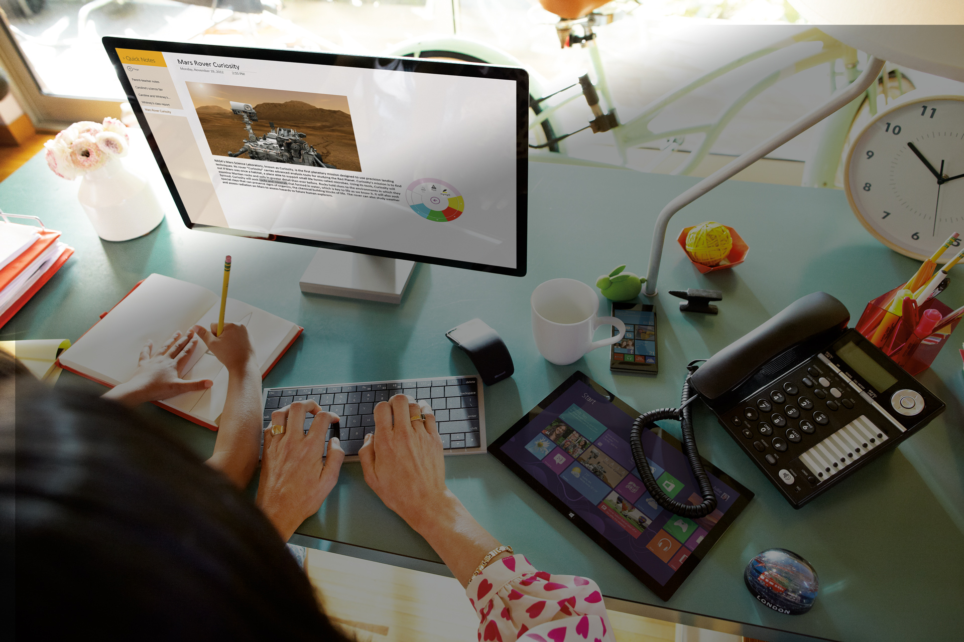
IDC Foundry Hyderabad
Bootcamp

Slide 2
Introduction

Slide 3
Introduction
Bootcamp to get your started on Tools and Technology
Three day hands on lab – Some slides, Some demos and a lot of coding
Use your desktop, devices and Subscriptions
Build along with us, Ask questions, Tell us what you know.
Speakers – Vinayak,Trilok, Netaji, Lakshmi, Shubham

Slide 4
Foundry Projects Edit this slide
Real time Candidate BG Verification
Blockchain, Hyperledger
Securing IoT devices in an Enterprise
Azure, IoT, Machine Learning
PEAS
Azure, IaaS
Visio IoT Dashboards
Azure, Visio, IoT Hub
Kaizala
Social, Enterprise, Azure
IoT for Agriculture
IoT, Azure Cosmos, Machine Learning
Virtual Pet with AR and Cortana
AR Core, Bot Framework, Cortana
Data Studio
Unity, Cortana, Mixed Reality, LUIS
Edge
Microsoft Edge, Web
RuBot
Cognitive Services, Bot Framework, Azure

Slide 5
Foundry Projects
How do we do this?

Slide 6
Agenda
Day 1 – Start 09:30
Introduction to a lot of things
Agile Methodology and Tools
Introduction to .net and C#
Lunch (12:30 – 13:30)
Python
Javascript
Browser extensions
Snacks (16:00 - 16:30)
Introduction to Azure
Exercises of the day
Day end (18:00)
Day 2 – Start 09:30
Introduction to NodeJS and Angular
Introduction to ReactJS
Cognitive services
Lunch (12:30 – 13:30)
Azure SQL
Web services
Snacks (16:00 - 16:30)
Bot Framework
CosmosDB
Day end (18:00)
Day 3 – Start 09:30
Machine Learning
Deep Learning
Scikit learning
LUIS
Lunch (12:30 – 13:30)
Android Development
iOS development
Snacks (16:00 - 16:30)
Exercises of the day
Day end (18:00)

Slide 7
Foundry Projects
Lets get you started…

