Slide 1
By Satish Kumar Tamada
Basic Introduction to React Native

Slide 2
Introduction to React Native
Released in 2015
Built using react
Build cross platform applications using Javascripts
Targets not only iOS & Android, but also Apple TV, VR, AR, Windows and Desktop
React Native Users:
Facebook
Adidas
Airbnb
Bloomberg
Tesla
Baidu
Walmart
Wix
Instagram
Discord
Skype
JD.com

Slide 3
Software Requirements
Development OS: macOS
Common Softwares needed for iOS & Android:
Node
Watchman
The React Native Command Line Interface
Target OS: iOS
Xcode
Target OS: Android
JDK and
Android Studio.

Slide 4
Software Requirements (2)
Development OS: Windows
Common Software needed for iOS & Android:
The React Native Command Line Interface
Target OS: Android
Node
Python2
JDK
Android Studio.

Slide 5
Software Requirements (3)
Development OS: Linux
Common Software needed for iOS & Android:
The React Native Command Line Interface
Target OS: Android
Node
JDK
Android Studio.

Slide 6
Creating your first React Native project
$ npx react-native init ReactExamples
$ cd ReactExamples
$ react-native start
$ react-native run-android
$ react-native run-iOS

Slide 7
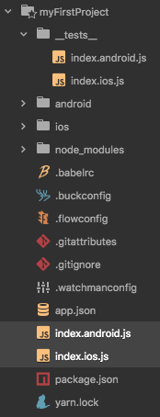
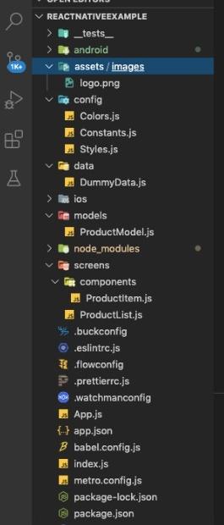
Basic Project Structure
Basic Structure
Customized Structure

Slide 8
Sample Project

Slide 9
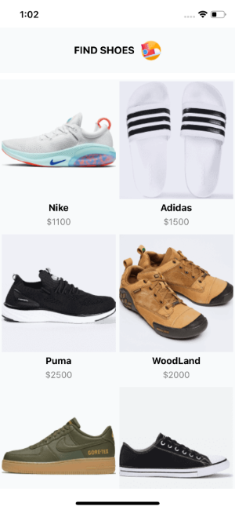
Layout Structure
Header Container
Title
Logo
Product Image
Product Title
Product Price
Body Container
Created demo screen to show the project’s output.

Slide 10
Components used in the Sample Project
View
Text
Image
Style Sheet
Flat List

Slide 11
Components used in the Sample Project (2)
1. View Component
View is a container that supports layout with flexbox, Style, some touch handling, and accessibility controls.
View Function Component Example
import React from "react";
import { View} from "react-native";
const ViewExample= () => {
return (
<View
style={{
flexDirection: "row",
height: 100,
padding: 20
}}
>
<View style={{ backgroundColor: "blue", flex: 0.3 }} />
<View style={{ backgroundColor: "red", flex: 0.5 }} />
</View>
);
};
export default ViewExample;

Slide 12
Components used in the Sample Project (3)
2. Text Component
A React component for displaying text. Text supports nesting, styling, and touch handling.
Basic syntax:
<Text >Hello world</Text>
3. Image Component
A React component for displaying different types of images, including network images, static resources, temporary local images, and images from local disk, such as the camera roll.
Loading static Image
<Image source={require('../assets/images/logo.png')} />
Loading Network Image
<Image source={{ uri: 'https://reactnative.dev/img/tiny_logo.png', }} />

Slide 13
Components used in the Sample Project (4)
4. Flat list
A performant interface for rendering basic, flat lists, supporting the most handy features like:
Fully cross-platform.
Optional horizontal mode.
Configurable viewability callbacks.
Header support.
Footer support.
6. Separator support.
7. Pull to Refresh.
8. Scroll loading.
9. ScrollToIndex support.
10. Multiple column support
Example:
<FlatList keyExtractor={(item, index) => item.id} data={PRODUCTS} numColumns={2} renderItem={renderGridItem} style={{ backgroundColor: Colors.headerColor }} />

Slide 14
Components used in the Sample Project (5)
5. Style Sheets: A StyleSheet is an abstraction similar to CSS StyleSheets
import React from "react";
import { StyleSheet, Text, View } from "react-native";
export default App = () => (
<View style={styles.container}>
<Text style={styles.title}>React Native</Text>
</View>
);
const styles = StyleSheet.create({
container: {
flex: 1,
padding: 24,
backgroundColor: "#eaeaea"
},
title: {
marginTop: 16,
paddingVertical: 8,
borderWidth: 4,
borderColor: "#20232a",
borderRadius: 6,
backgroundColor: "#61dafb",
color: "#20232a",
textAlign: "center",
fontSize: 30,
fontWeight: "bold"
}
});

Slide 15
Thank you

