Slide 1
Node.js + Express + MongoDB
Introduction and HOL
by Sravani Lekkala

Slide 2
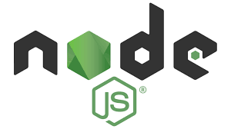
JavaScript runtime environment that executes JavaScript code outside of a web browser

Slide 3
Why Node.js ?
Asynchronous and event driven
Very fast
Single threaded but highly scalable
No buffering

Slide 4

Fast, unopinionated, minimalist web framework for node.
Built on top of the node. js framework and helps in fast-tracking development of server-based applications

Slide 5

MongoDB is a document database, which means it stores data in JSON-like documents

Slide 6
Why MongoDB ?
Rich JSON documents
Powerful query language
All the power of relational data base and more..

Slide 7
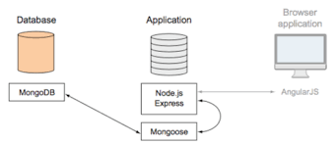
Node.js + Express + MongoDB

Slide 8
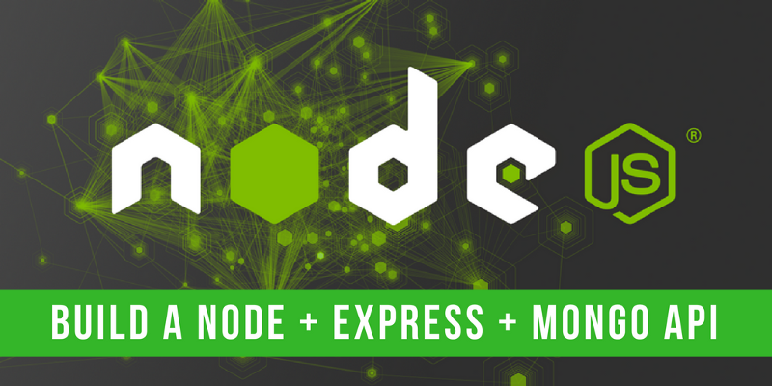
Lets build our first application

Slide 9
Install Nods.js from
https://nodejs.org/en/download/
2. Install mongo DB from
https://www.mongodb.com/download-center
3. Your favorite IDE

Slide 10
npm install -g express-generator
The quickest way to get started with express is to utilize the executable express to generate an application
express first-app
Will generate the required folders and files to start with the node application
npm install
Will install all the dependencies saved in package.json

Slide 11
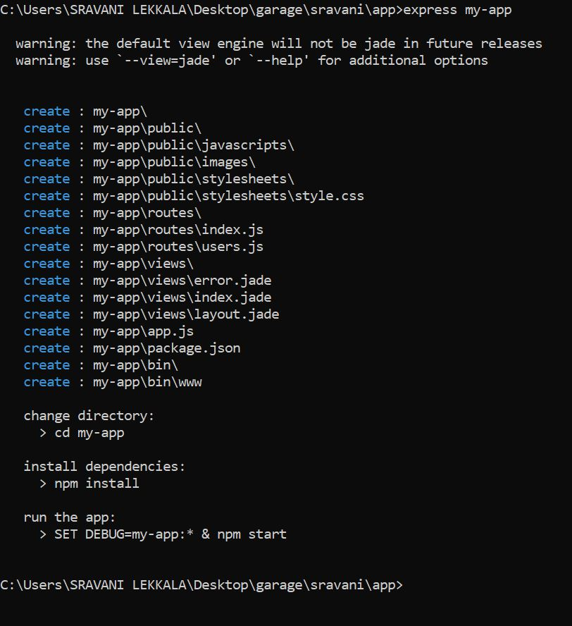
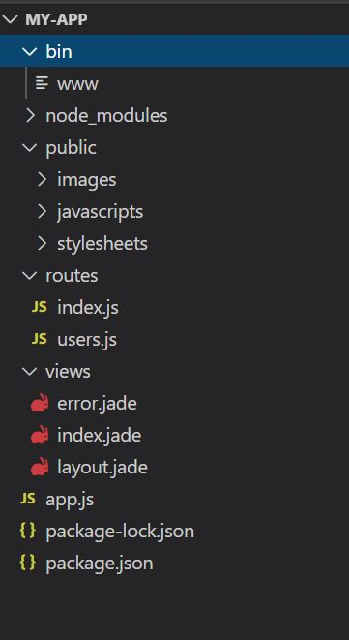

Slide 12
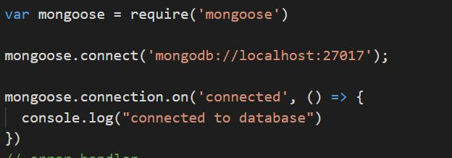
npm install mongoose
Mongoose is a MongoDB object modeling tool designed to work in an asynchronous environment. Mongoose supports both promises and callbacks.
Connect to mongoDB

Slide 13
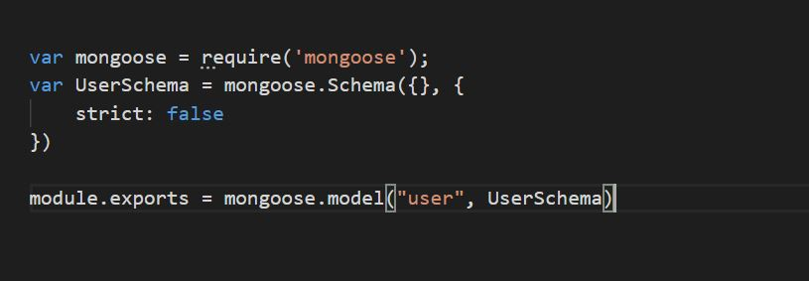
Lets create a basic schema for user

Slide 14
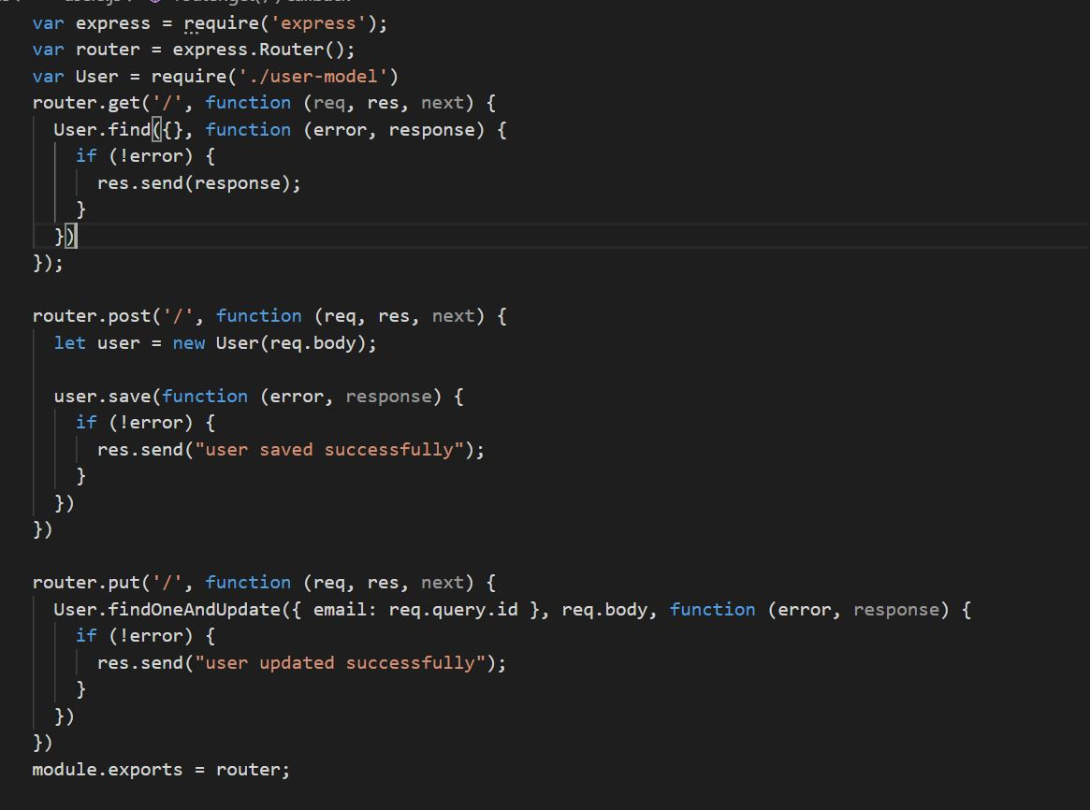

Slide 15


Slide 16


