Slide 1
Node.js + Express + MongoDB
Introduction and HOL
by Sravani Lekkala

Slide 2
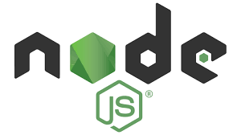
JavaScript runtime environment that executes JavaScript code outside of a web browser

Slide 3
Why Node.js ?
Asynchronous and event driven
Very fast
Single threaded but highly scalable
No buffering

Slide 4

Fast, unopinionated, minimalist web framework for node.
Built on top of the node. js framework and helps in fast-tracking development of server-based applications

Slide 5

MongoDB is a document database, which means it stores data in JSON-like documents

Slide 6
Why MongoDB ?
Rich JSON documents
Powerful query language
All the power of relational data base and more..

Slide 7
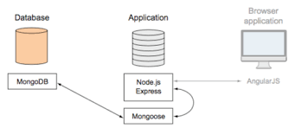
Node.js + Express + MongoDB

Slide 8
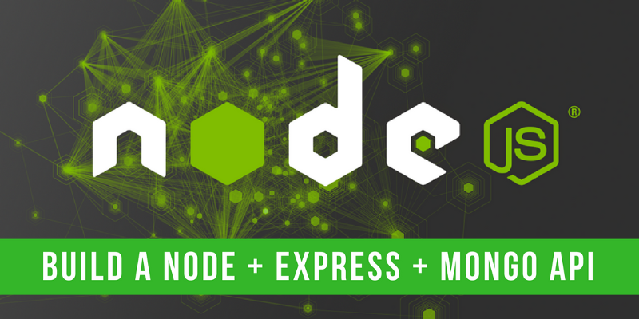
Lets build our first application

Slide 9
Install Nods.js from
https://nodejs.org/en/download/
2. Install mongo DB from
https://www.mongodb.com/download-center
3. Your favaroute IDE

Slide 10
npm install -g express-generator
The quickest way to get started with express is to utilize the executable express to generate an application
express first-app
Will generate the required folders and files to start with the node application
npm install

Slide 11
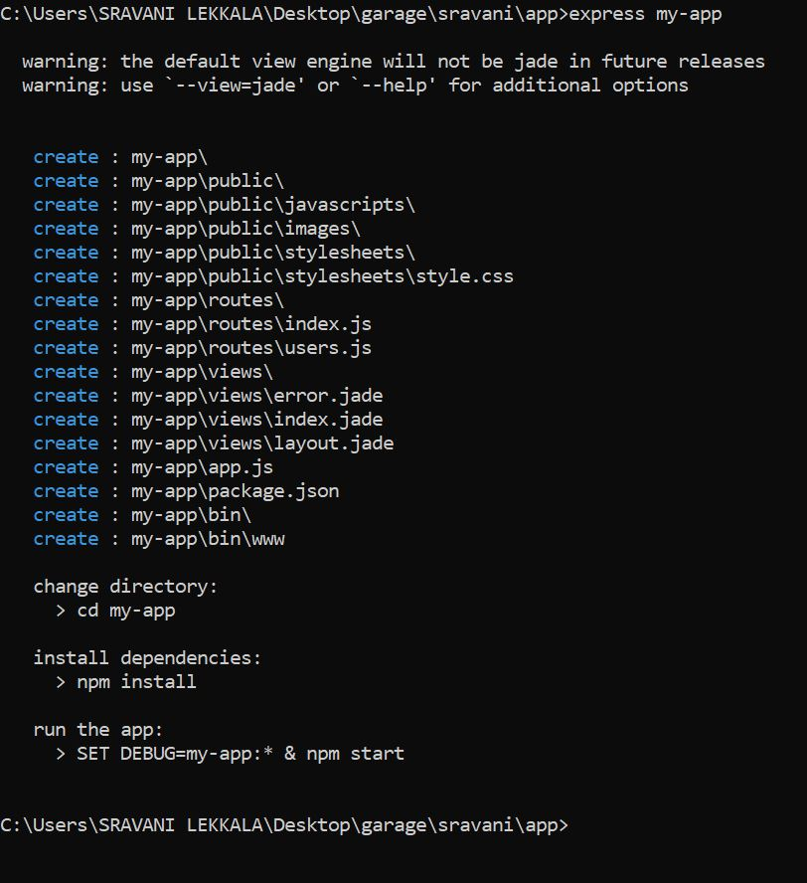
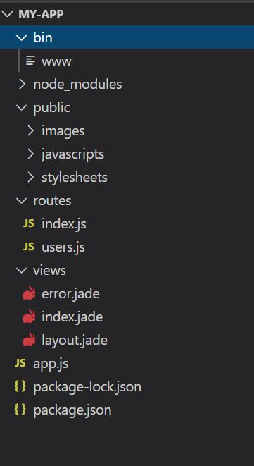

Slide 12
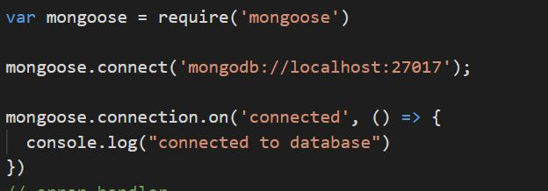
npm install mongoose
Mongoose is a MongoDB object modeling tool designed to work in an asynchronous environment. Mongoose supports both promises and callbacks.
Connect to mongoDB

Slide 13
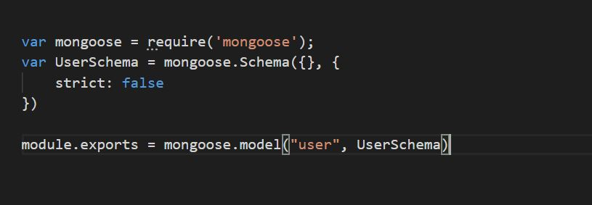
Lets create a basic schema for user

Slide 14
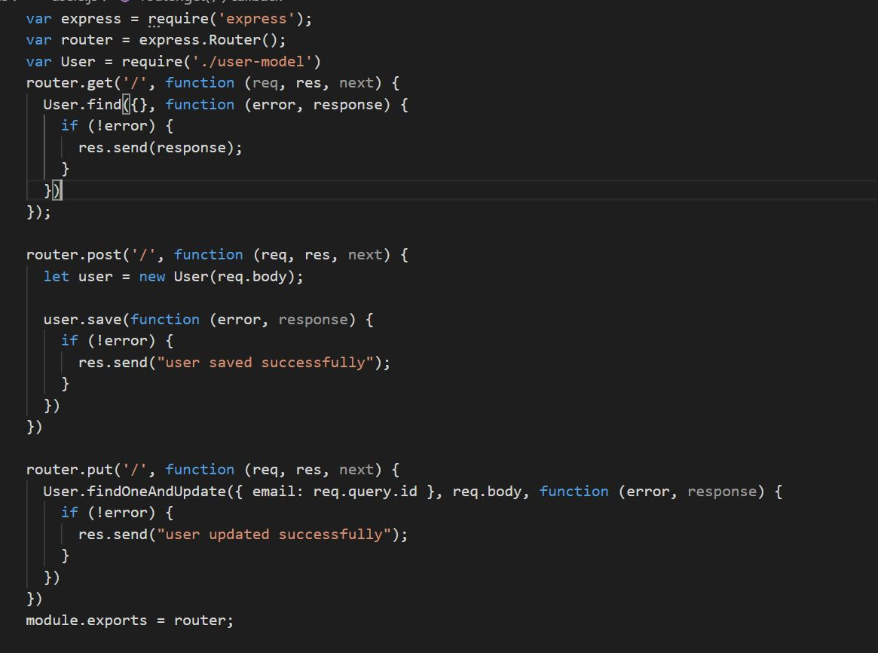

Slide 15


Slide 16


