Slide 1

Welcome to
Internship, 2020

Slide 2

Garage India Internship 2020
Bootcamp

Slide 3
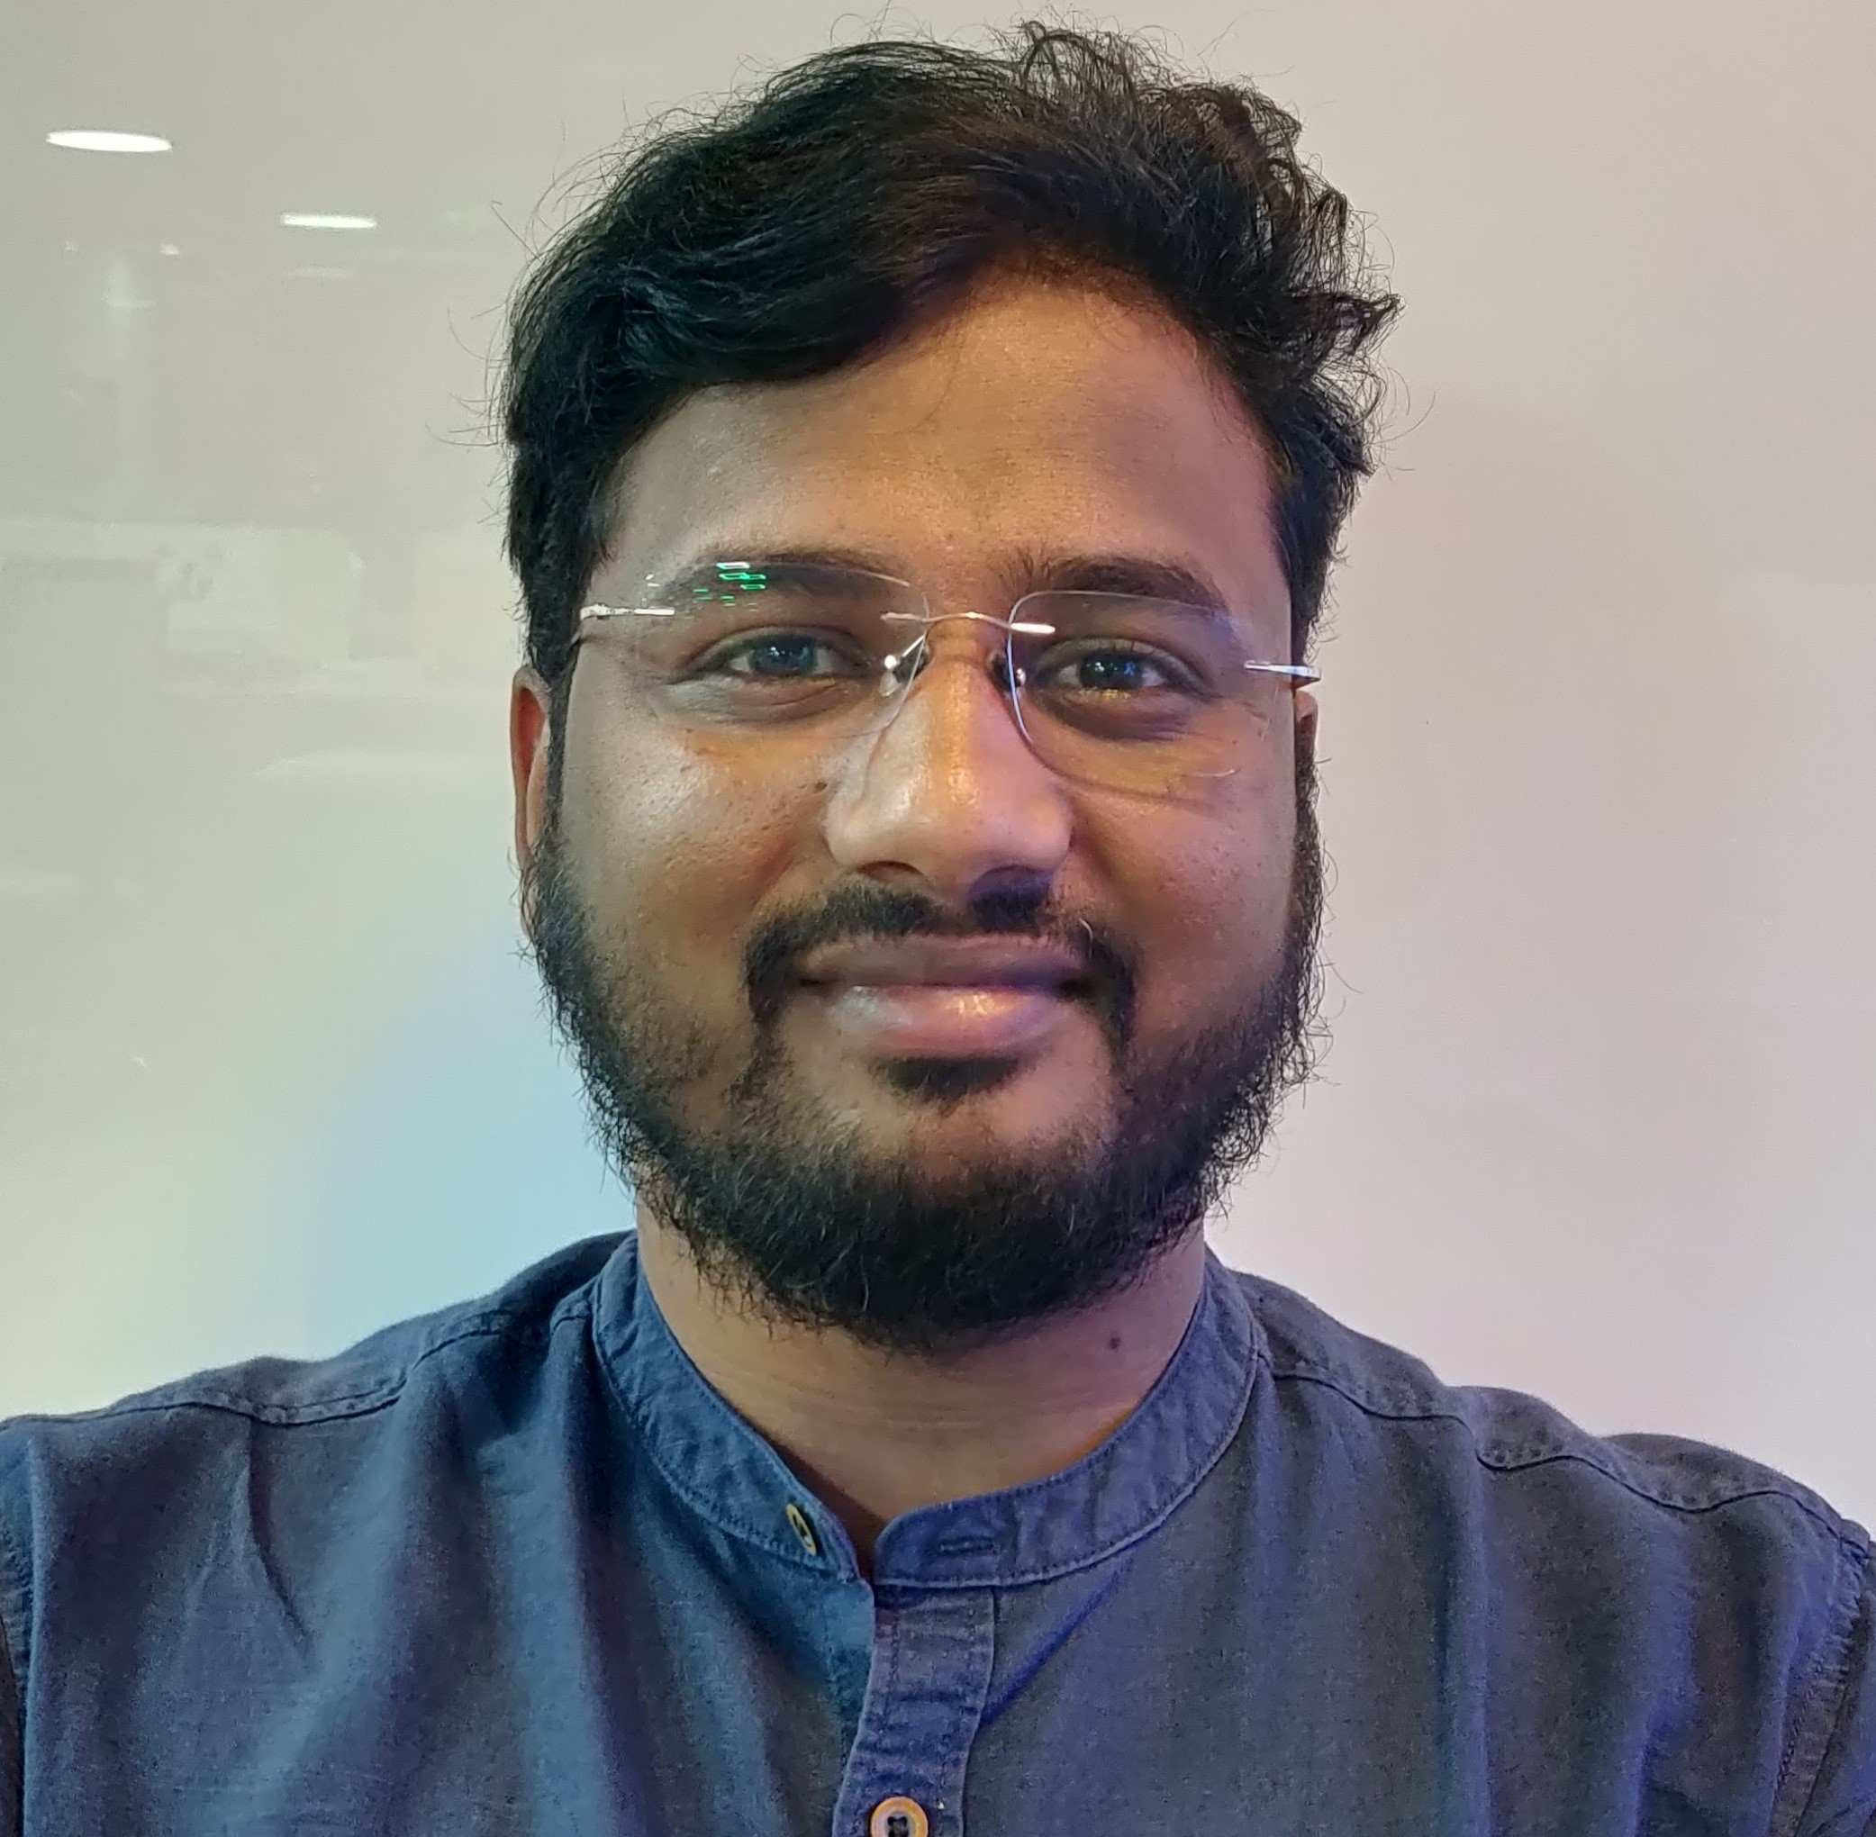
Trilok Chowdary
Technical Program Manager
Garage India Internship
Technical Program Lead
Byteridge Software PVT LTD
ML Spokes person at Byteridge,
Working with Microsoft for 5 years for now on various
Aka.ms/Garagebot

Slide 4
Introduction
Bootcamp to get your started on Tools and Technology
Three day hands on lab – Some slides, Some demos and a lot of coding
Use your desktop, devices and Subscriptions
Build along with us, Ask questions, Tell us what you know.
Speakers – Vinayak, Trilok, Prakash, Sravani, Santhan, Mrinal, Saiteja, Surya, Satish, Manjunath, Jeetendra Pandey and Sanjeev’s Team

Slide 5
The Garage India Internship Projects
Carbon Dashboard
Operational Evolution and Sustainability Based on Megatrends
Media sharing in Microsoft Teams mobile app: Best-in class video and image sharing platform for modern users.
Organization News in Teams
PDF Reflow
Teams for EDU - differentiated experience
Excel powered platform for making customized Cashflow Management Apps for mobile first Small Business customers
Skill based LU
Multi-Platform User Interface for Mixed and Virtual Reality App to Visualize and Simulate Quantum Computing
Outlook on Jio Phone

Slide 6
The Garage India Internship Projects Projects
How do we do this?

Slide 7
Agenda
Day 1 – Start 10:00
Agile/Git
.Net /C# Sample hands on
Lunch (13:00 – 14:00)
Web API, Sample
Azure Fundamentals
Node, Express, Mongo
Day end (17:00)
Day 2 – Start 10:00
Android Programming
React JS
Quantum Basics
Lunch (13:00 – 14:00)
Microsoft SQL Server
Azure Data factory
Azure Data Lake
Azure Databricks
Day end (17:30)
Day 3 – Start 10:00
React Native
Power BI
Basic ML and DL
Lunch (12:30 – 14:00)
Time series, LSTM, ARIMA
Quantum - Advanced
Day end (16:00)

Slide 8
The Garage India Internship Projects Projects
Lets get you started…

