Slide 1

Welcome to
Internship, 2021

Slide 2

Garage India Internship 2021
Bootcamp

Slide 3
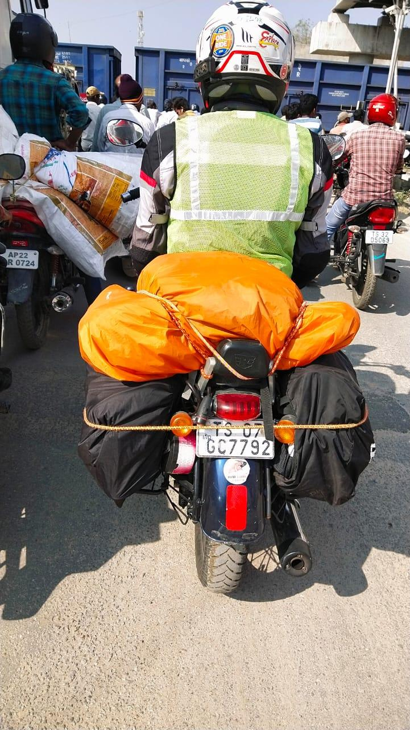
Trilok Chowdary
Technical Program Manager
Garage India Internship
ML Spokes person at Byteridge,
Working with Microsoft for 6 years for now on various
A Data Science Engineer and Mentor. Extensive experience of working in Artificial Intelligence and cloud frameworks.
Spoke at various premium intuitions of India like IITs, NITs, .. etc on behalf of Microsoft
My research work involves in Text summarization and summarization for multiple documents and research papers

Slide 4
Introduction
Bootcamp to get your started on Tools and Technology
Three day hands on lab – Some slides, Some demos and a lot of coding
Use your desktop, devices and Subscriptions
Build along with us, Ask questions, Tell us what you know.
Speakers – Vinayak, Trilok, Sandeep, Babji, Dhruv

Slide 5
The Garage India Internship Projects
Task Management Systems
Fraud Linkage Analyzer

Slide 6
The Garage India Internship Projects Projects
How do we do this?

Slide 7
Agenda
Day 1 – Start 10:00
Agile/Git
Lunch (13:00 – 14:00)
.Net /C# Sample hands on
Web development
Azure Fundamentals
Day end (18:00)
Day 2 – Start 10:00
React JS
QnA
Lunch (13:00 – 14:00)
Microsoft SQL Server
AAD
Azure Cosmos DB
Day end (18:00)
Day 3 – Start 10:00
Browser Extension Development
Intro to ML
Intro to Azure ML
Lunch (13:00 – 14:00)
Fraud Detection Case study(2:30pm)
QnA & Socilize
Day end (16:00)

Slide 8
The Garage India Internship Projects
Lets get you started…

