Slide 1

Android Development:
Introduction & Basics
Mrinal Das
Software Developer, Byteridge.

Slide 2
Android Development
Course of contents
Create & Configure Your First Project.
Setup Emulated Device.
Run on real device.
Project structure overview
Activity & Layout
Hands On
Build.Gradle
Android Compatibility
Vector Drawables
Android Activity Lifecycle
Useful Reference Link’s

Slide 3
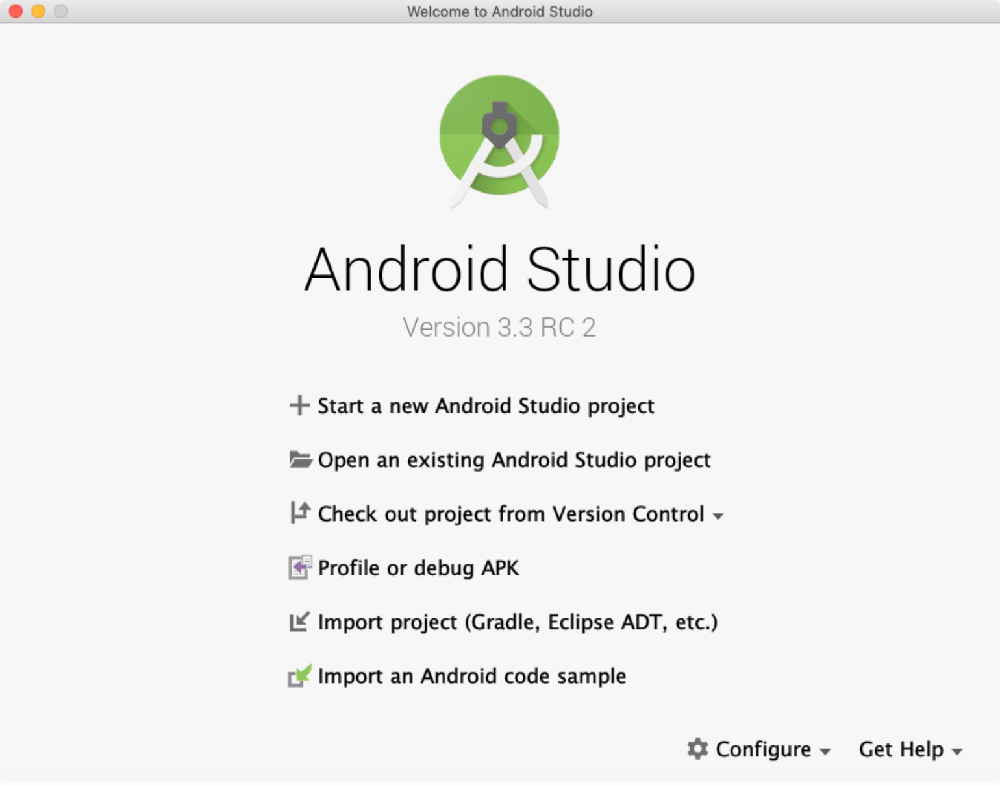
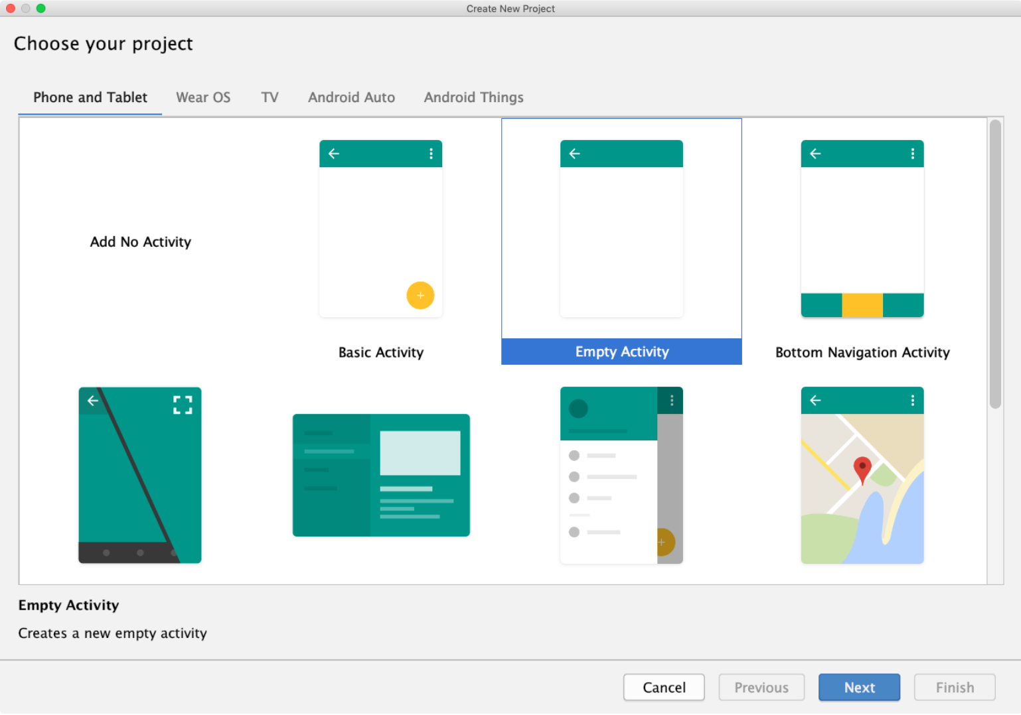
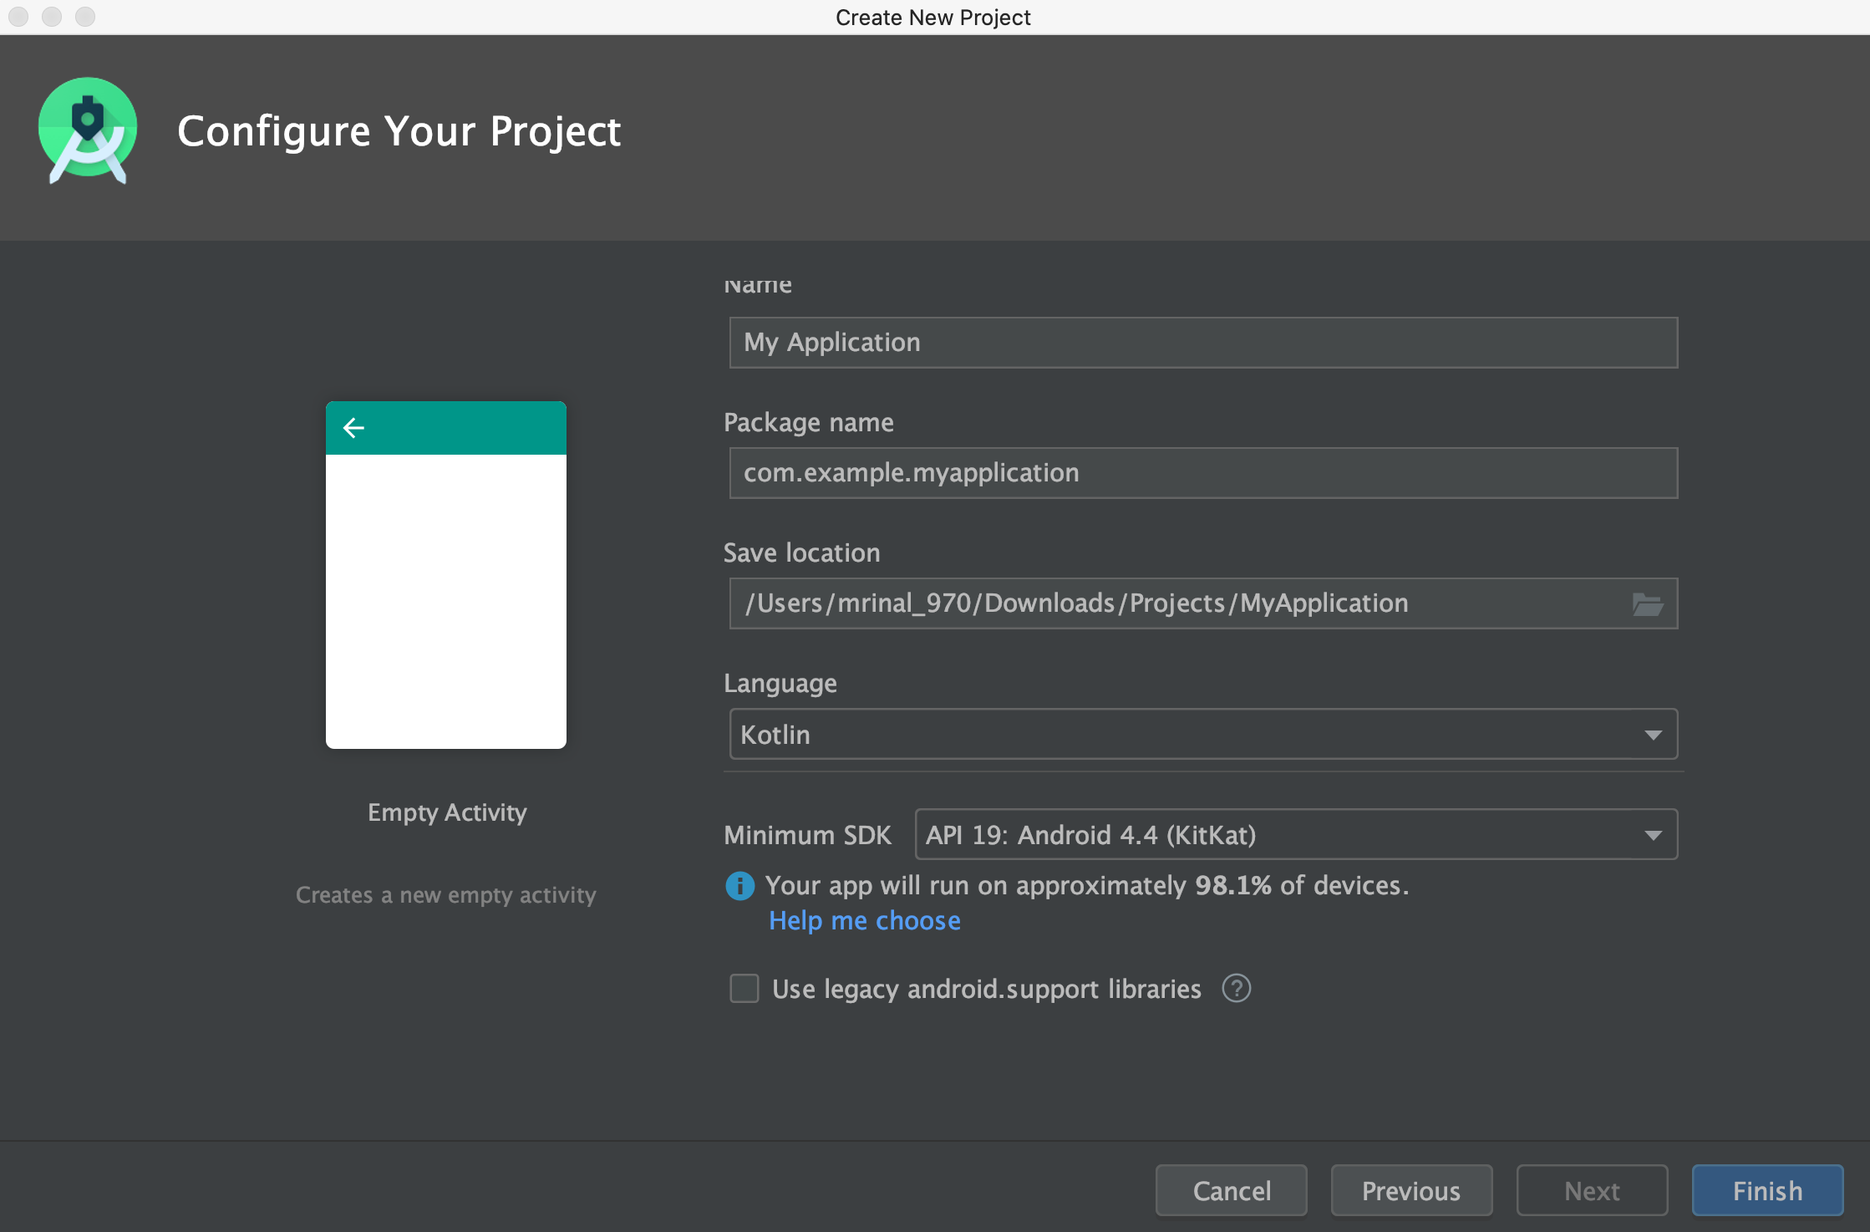
Create & Configure
Making Your First App
Click “Start A New Android Studio Project”.
Choose your project, From the “Phone & Tablet” tab choose “Empty Activity” & click “Next".
Configure Android Project.
Name: Project Name.
Package: com.example.android.app.
Project location: Your Desired Path.
Language: Leave the default value.
Minimum API: leave the default values.
I’ve decided to build this project for "Phone and Tablet" with Minimum SDK of API 19. As of the time 95.3% coverage of devices and allowed us to have support for many modern features.
Finally, click "Finish" to create your first project.

Slide 4
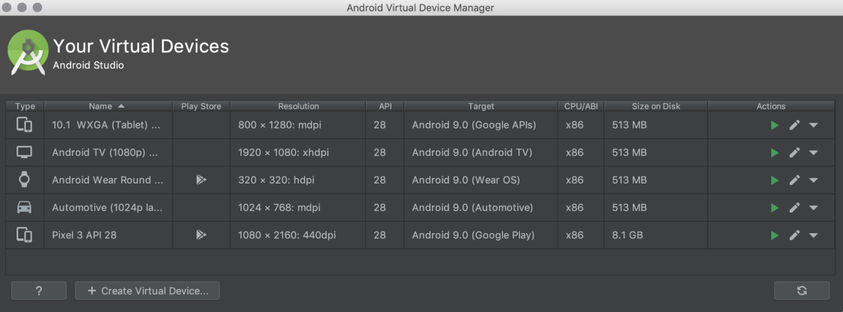
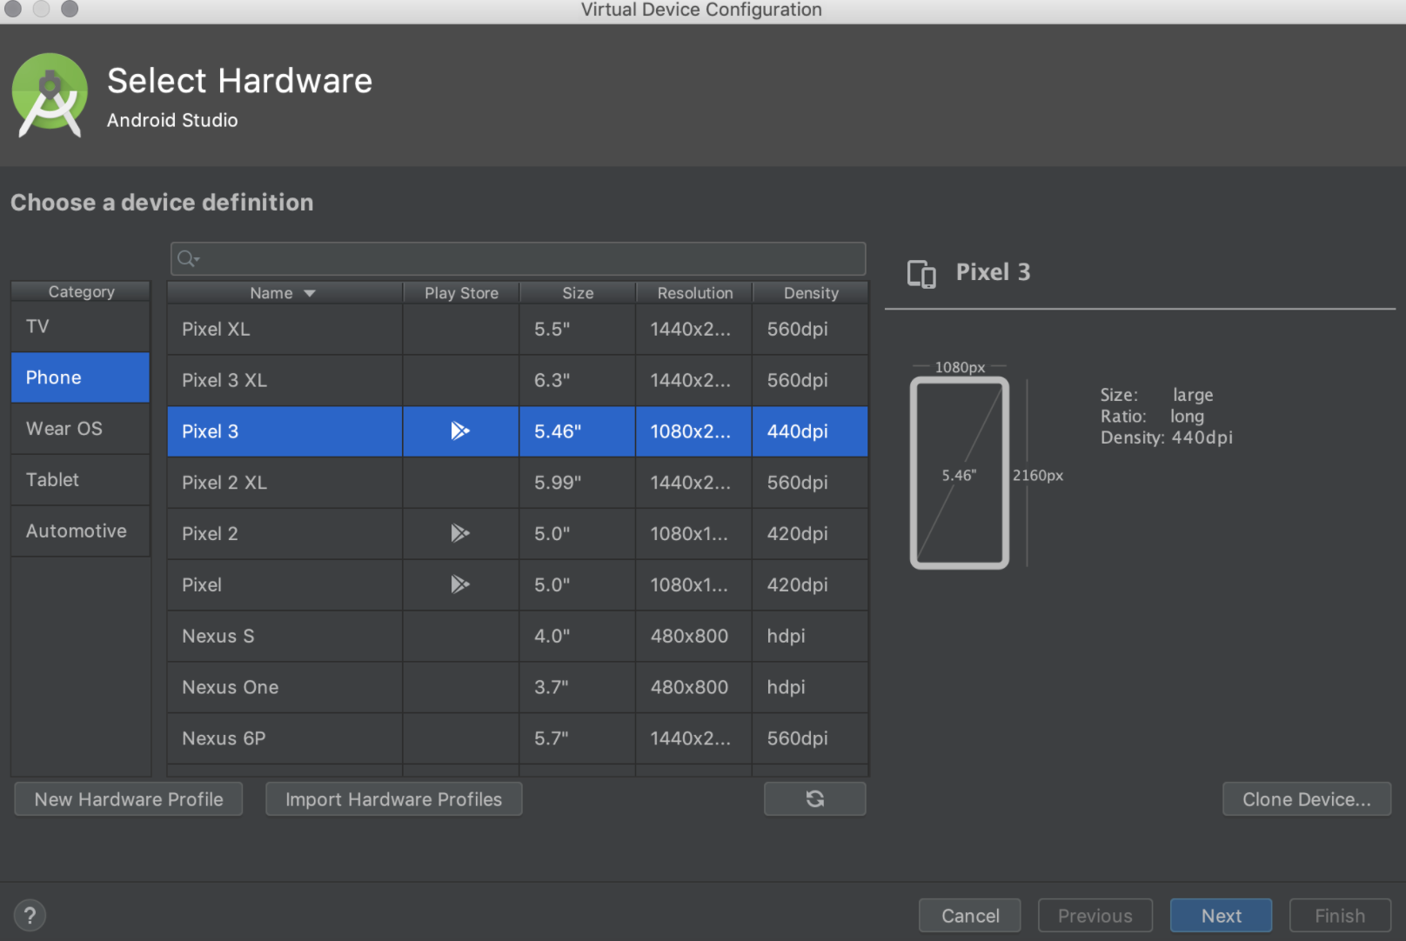
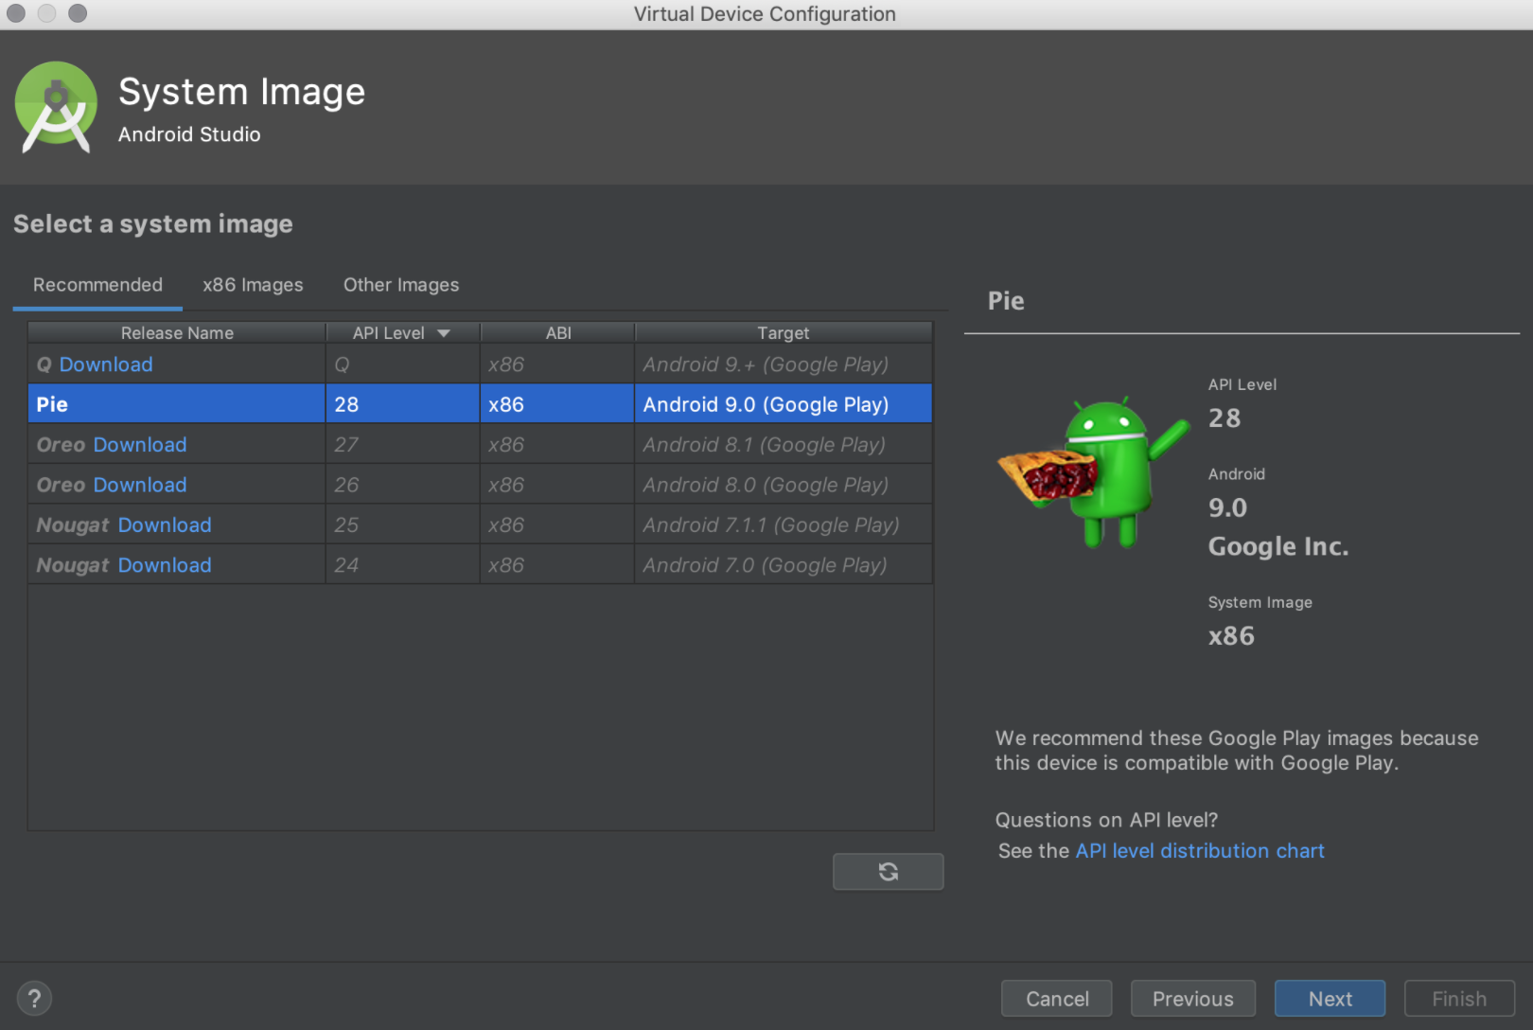
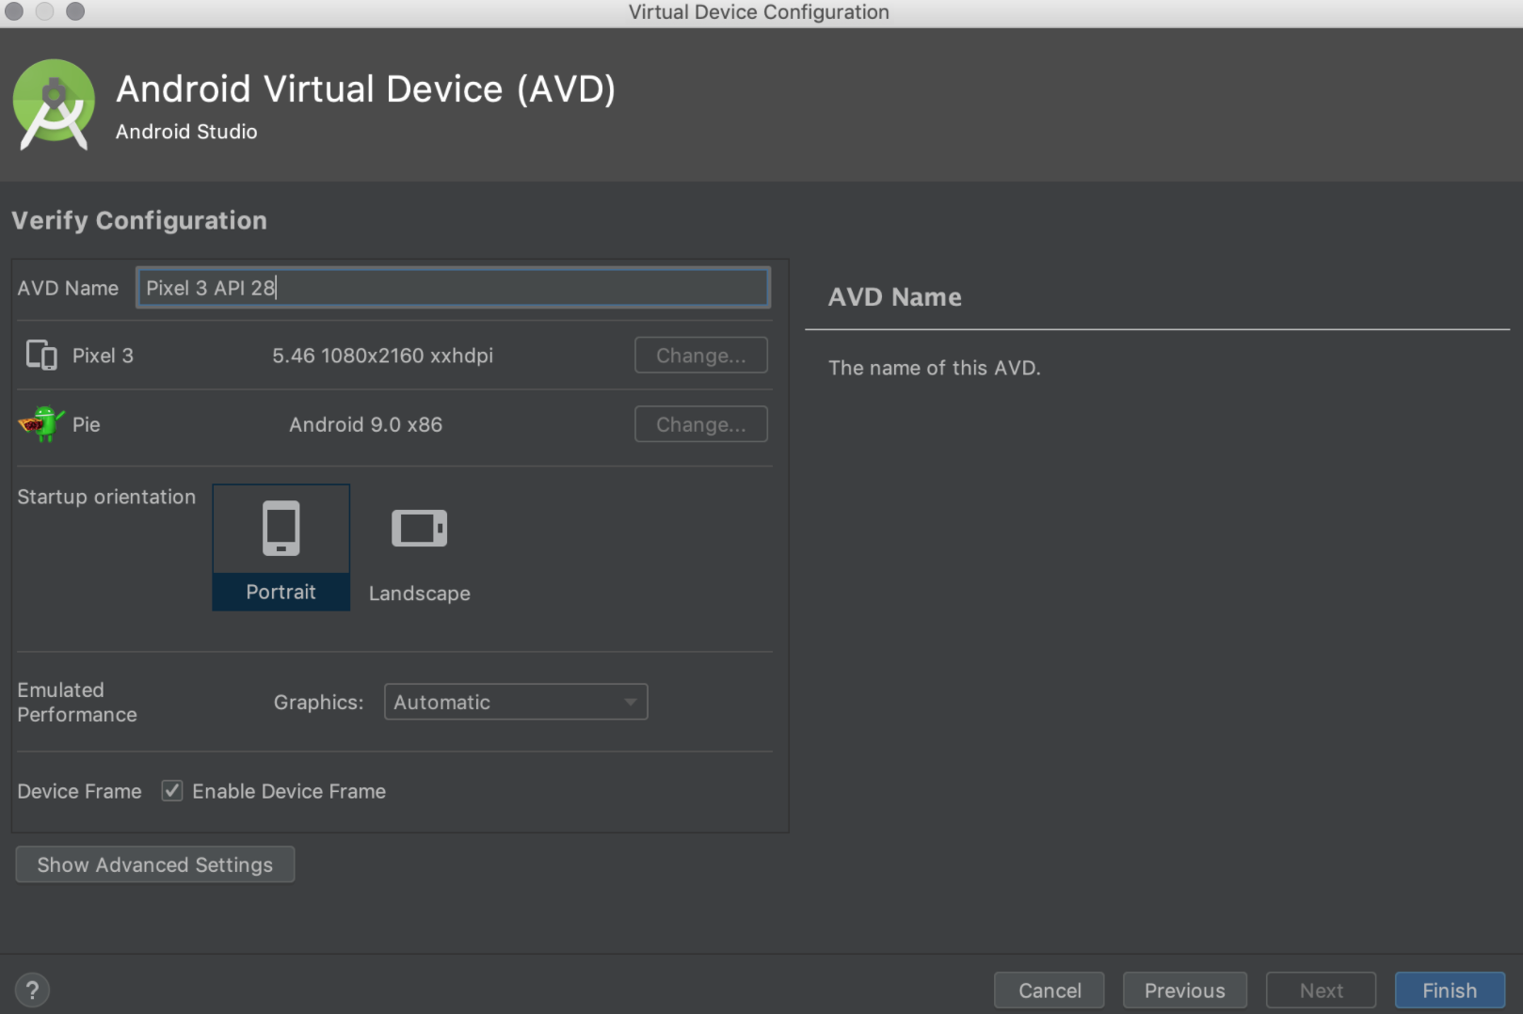
Run on emulated device
Set up your device as follows:
Open the AVD Manager by clicking Tools > AVD Manager.
Click Create Virtual Device, at the bottom of the AVD Manager dialog.
The Select Hardware page appears.
Select a hardware profile, and then click Next.
Select the system image for a particular API level, and then click Next.
Change AVD properties as needed, and then click Finish.

Slide 5
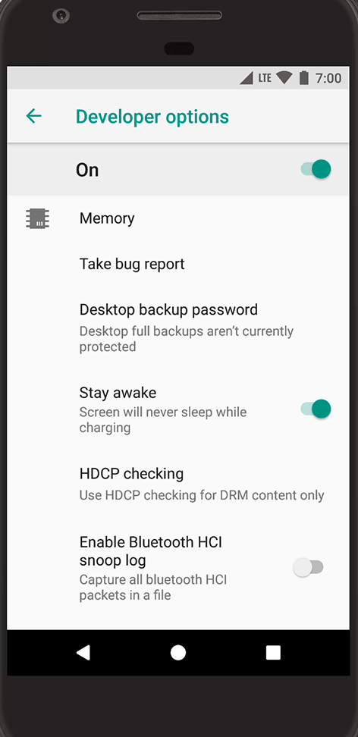
Run on real device
Configure on-device developer options &
Enable developer options and USB debugging
To enable developer options, tap the Build Number option 7 times. You can find this option in one of the following locations, depending on your Android version:
Android 9 (API level 28) and higher: Settings > About Phone > Build Number.
Android 8.0.0 (API level 26) and Android 8.1.0 (API level 26): Settings > System > About Phone > Build Number.
Android 7.1 (API level 25) and lower: Settings > About Phone > Build Number.
Fig.1 Developer Options

Slide 6
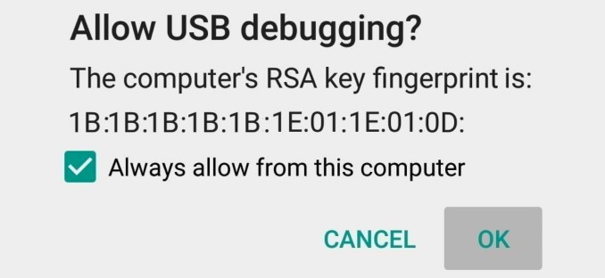
Run on real device
Configure on-device developer options &
Enable developer options and USB debugging.
At the top of the Developer options screen, you can toggle the options on and off .
Enable USB debugging, which allows Android Studio and other SDK tools to recognize your device when connected via USB.
You can find this option in one of the following locations, depending on your Android version:
Android 9 (API level 28) and higher: Settings > System > Advanced > Developer Options > USB debugging.
Android 8.0.0 (API level 26) and Android 8.1.0 (API level 26): Settings > System > Developer Options > USB debugging.
Android 7.1 (API level 25) and lower: Settings > Developer Options > USB debugging.
When you connect your device, you should see a pop-up on the phone asking to allow USB debugging. You can tick the "Always allow" option as shown in the image to remember this computer. Click “OK".
Fig 2. Allow Debugging Prompt.

Slide 7
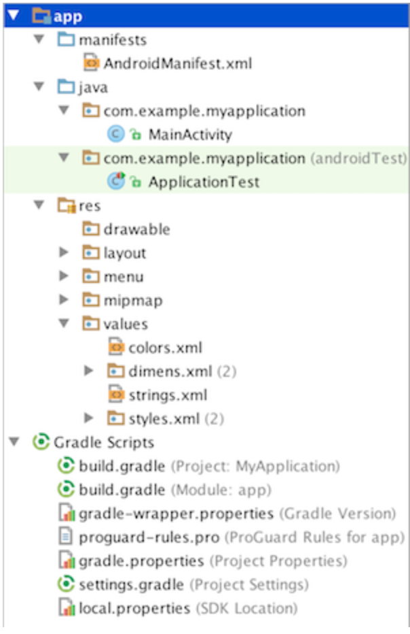
Projects overview
Android Project Structure
manifests :
Contains the AndroidManifest.xml file.
java :
Contains the Java source code files, separated by package names, including JUnit test code.
res/drawable :
Contains bitmap files (eg. png, jpeg), 9-Patch images (stretchable and repeatable images), and drawable shapes (xml).
res/layout :
Contains XML screen layout files that can be linked to Activities or other components of your application. The layout files are referenced by its filename, while the each component inside the layout can be referenced by their respective ids.
res/menu :
Contains XML files for menu application.
res/mipmap :
Contains your app-launcher icons (icon displayed on the home screen) for various screen resolutions.
res/values :
Contains XML value files for specifying colors, dimensions, strings, styles, etc. Besides for neat organization, classifying values under this directory is useful for reusability if many components of the application need to use the same value.
build.gradle (Module: app) :
Allows us to customise properties for build system, specific to the module app. It will override default build settings used by the manifest. You will usually add dependency libraries specific to your application here as well.
Application-level view of the project

Slide 8
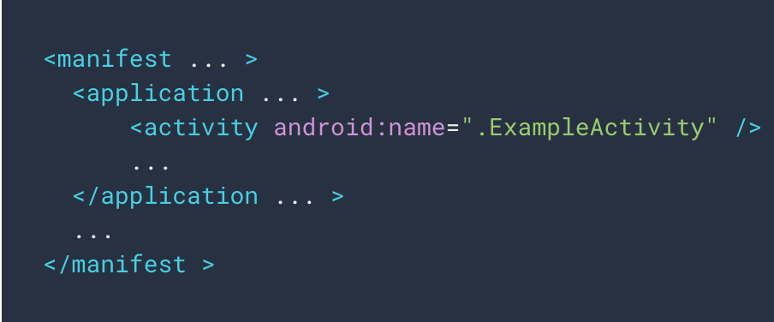
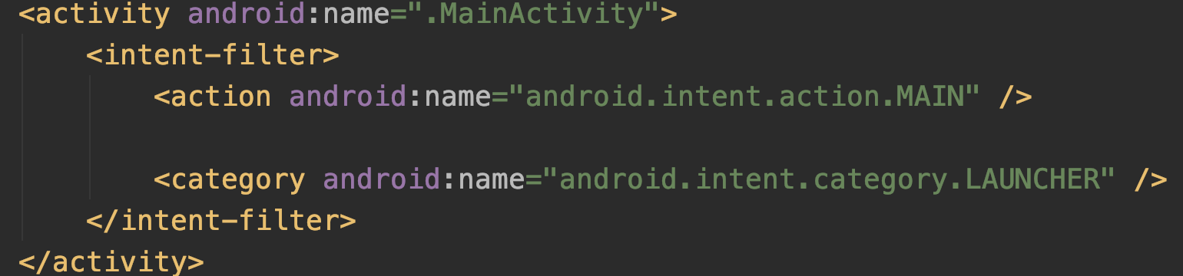
Activity & Layout
Activity class is a crucial component of an Android app.
The mobile-app experience differs from its desktop counterpart.
User journey often begins non-deterministically
An activity provides the window in which the app draws its UI.
Activities work together to form a cohesive user experience in an app.
Each activity is only loosely bound to the other activities.
You must register information about them in the app’s manifest, and you must manage activity lifecycles appropriately.
Fig1. Declaring Activity In Manifest.
Fig2. Declaring Activity As Launcher

Slide 9

Enough Theory Let’s Code

Slide 10
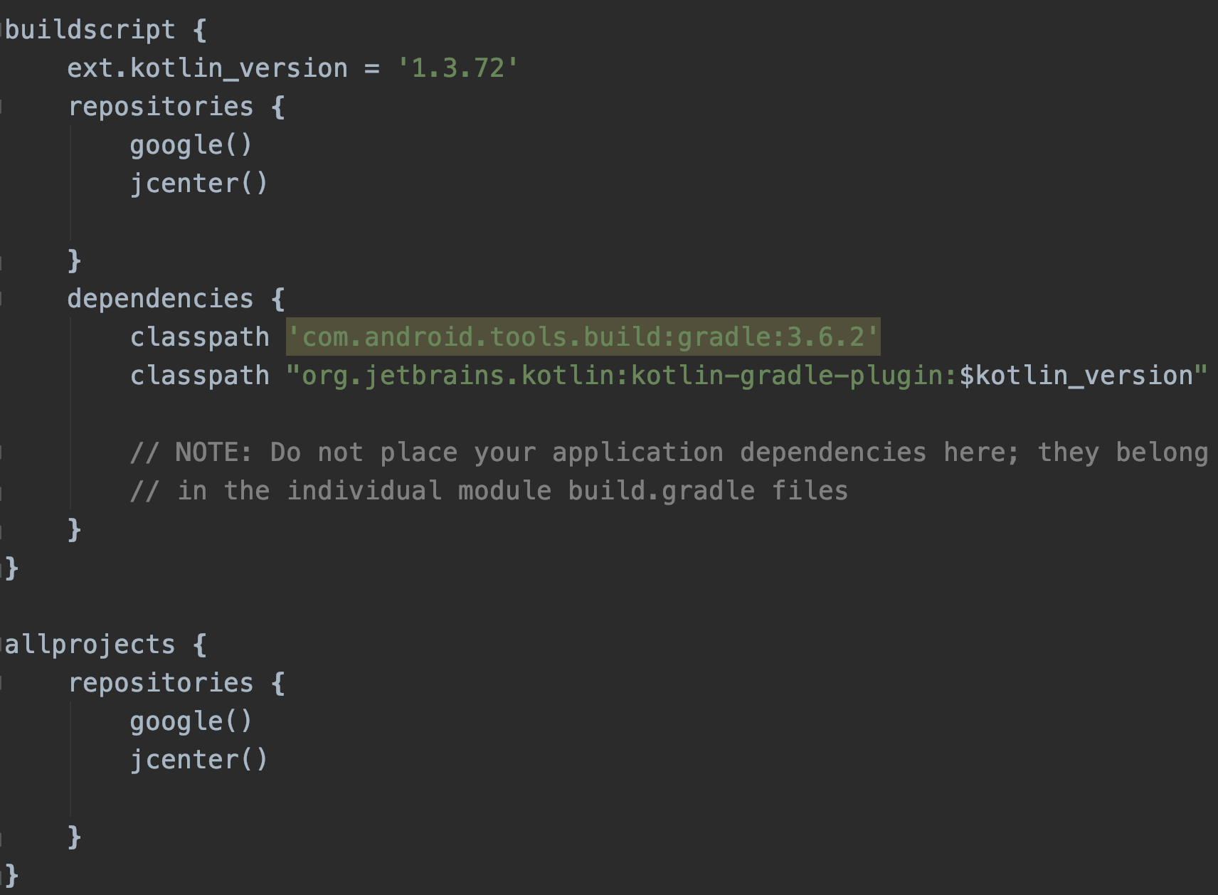
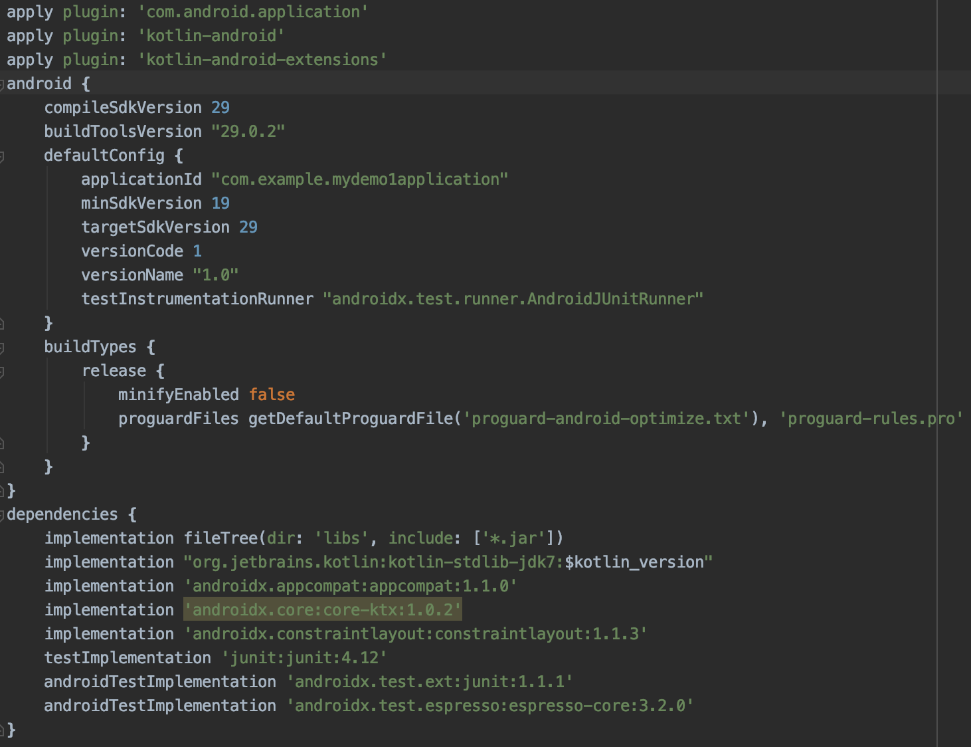
Gradle
Android Build Tool
What Devices Run Your App.
Compile To Executable
Dependency Mangement
App signing for Google Play
Automated Tests
Project Level Gradle
Module Level Gradle

Slide 11
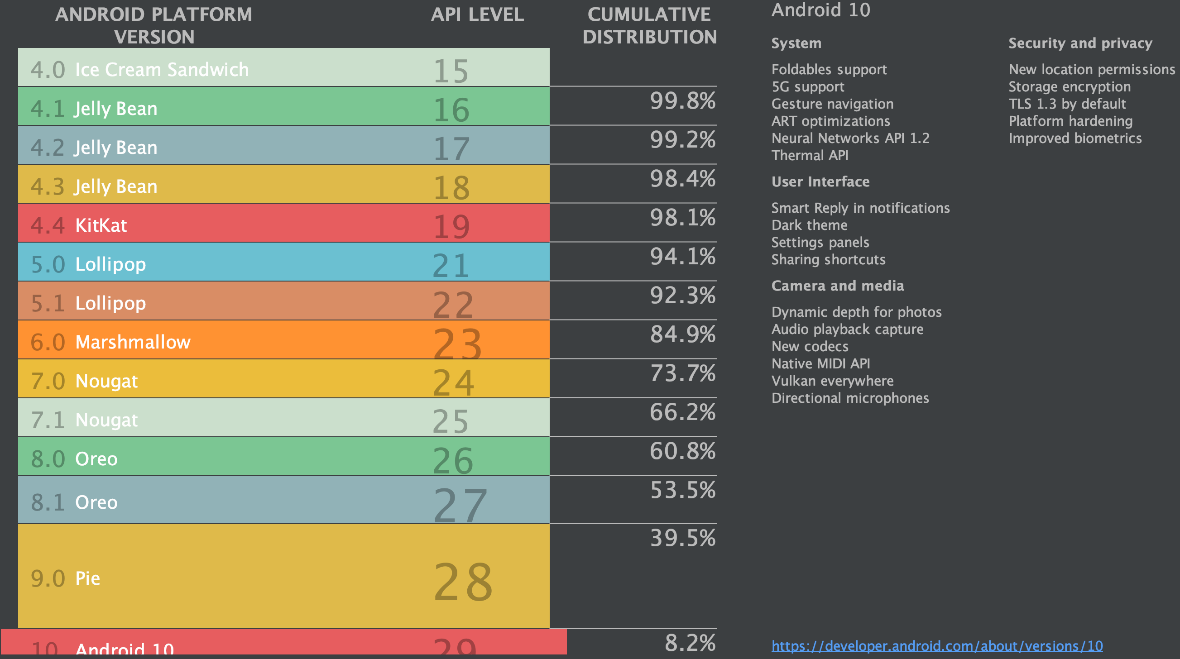
Android Compatibility
Supporting Different Devices
Android is designed to run on many different types of devices, from phones, AutoMobiles, tablets, watches, PixelBook and televisions.
Release of new Android Version each year.
New Functionality in each new Android Version.
Setting Minimum SDK.
Version Checks to execute piece of code.
Issue with multiple version checks.
Backward Compatibility support.
2011 First Support Library Released. Google owned library for backwards compatibility.
2018 Android Jetpack Released.
AndroidX is the Namespace for Android Jetpack.

Slide 12
Vector Drawables
Support Library For Vector Drawables
Vector Drawables scale without loosing quality.
Vector Drawables are supported form Api Level 21(Lollipop) & upwards.
While “.png” files were supported in Api Level 19(Kitkat) & backwards.
AndroidX Compatibility libraries for “Vector Drawables” to support all the way unto Api Level 7.
Vector Drawable Adding Support.
Add to build.gradle.
Use Correct Layout Namespace.
Change src to srcCompat.

Slide 13
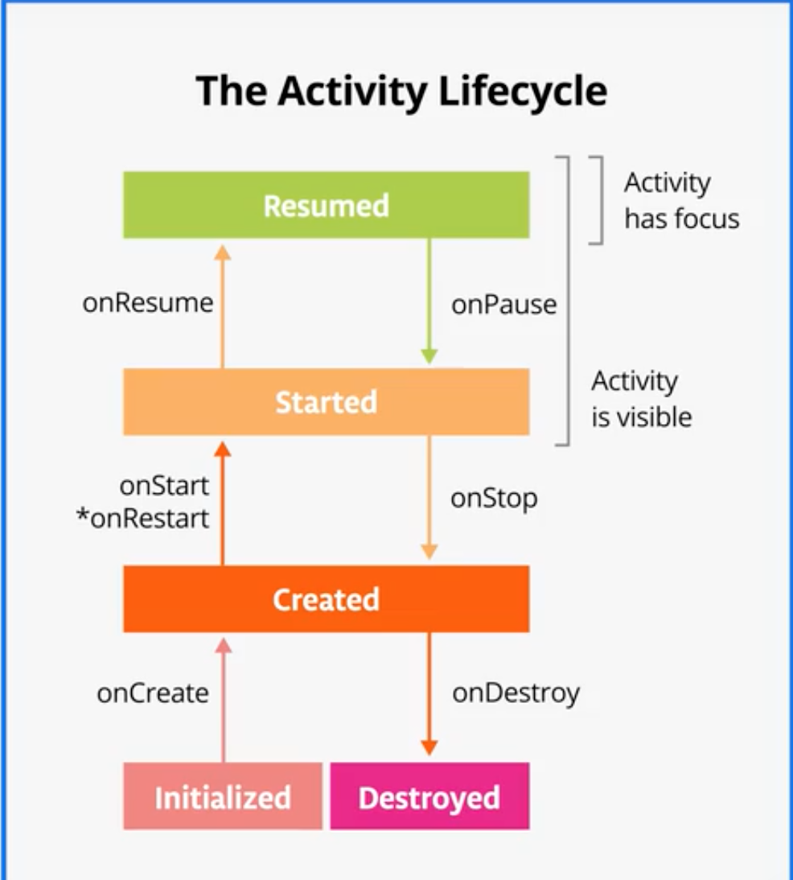
Android Activity Lifecycle
Track Lifecycle State
Each and every entity in this universe has a Lifecycle.
Lifecycle are helpful to track app state.
Good implementation of the lifecycle callbacks can help ensure that your app avoids Crashing, Avoid consuming valuable system resources, Handling data loss during configuration changes.
Activity class provides a core set of six callbacks: onCreate(), onStart(), onResume(), onPause(), onStop(), and onDestroy(). The system invokes each of these callbacks as an activity enters a new state.

Slide 14
Reference Links
LevelUp Your Android Skills
Kotlin Documentation - “https://kotlinlang.org/docs/tutorials/kotlin-for-py/documentation.html”
Android Documentation - “https://developer.android.com/docs”
Kotlin For Android - “https://developer.android.com/kotlin/campaign/learn”

