Slide 1

Angular 6
Introduction to

Slide 2
Angular 6
Angular 2 is a framework for building client applications (SPA) in HTML and either JavaScript or languages like TypeScript or Dart that compile to JavaScript.
Angular 2 is not a version upgrade, but a complete rewrite.
Angular 2 is written in TypeScript.
Angular 1.X will not end life until the majority of traffic has moved to 2.0

Slide 3








Why Angular 6?
Components & components interaction
Modularity - much core functionality has moved to modules, producing a lighter, faster core.
AOT compilation.
Simple routing.
Incredible performances.
Typescript
Mobile Development
Modern browsers only
Reactive Programming
Lazy Loading Support
Improved DI HDI
RIP Parts
Documentation

Slide 4
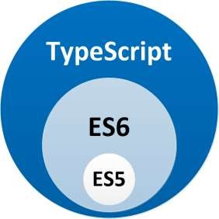
Typescript
Developed and maintained by Microsoft.
Superset of JavaScript that compiles to clean JavaScript output.
Adds optional types, classes, and modules to JavaScript.
Compiles to readable, standards-based JavaScript.

Slide 5

Why Typescript?
Type safety.
Compile time error check.
Annotations offer a powerful and very expressive way to describe elements.
Ease of refactoring.
IntelliSense auto suggest in code editors.
Easy to adopt for backend developers (like java & C#).
Angular2 Dependency Injection system is based on type reflection.

Slide 6
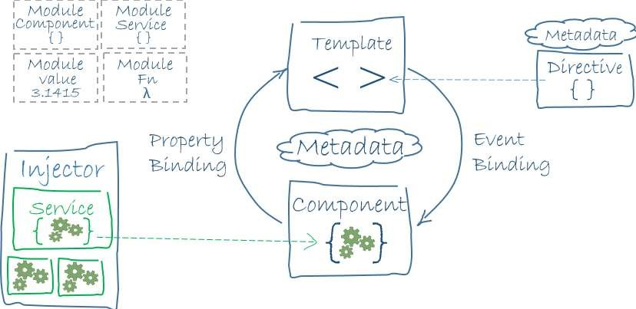
Architecture
Ng2 ships as a collection of JavaScript modules.
Each ng2 library name begins with the @angular prefix.
You install them with the node package manager and import parts of them with js import statements.
The architecture diagram identifies the eight main building blocks of an ng2 application:
Modules
Components
Templates
Metadata
Data binding
Directives
Services
Dependency injection

Slide 7
Architecture - Flow
Write Angular applications by composing HTML templates with Angularized markup.
Write component classes to manage those templates.
Adding application logic in services.
Boxing components and services in modules.
Launch the app by bootstrapping the root module.
Angular takes over, presenting your application content in a browser.
Angular responding to user interactions according to the instructions you've provided.

Slide 8

THINKING COMPONENTS

Slide 9
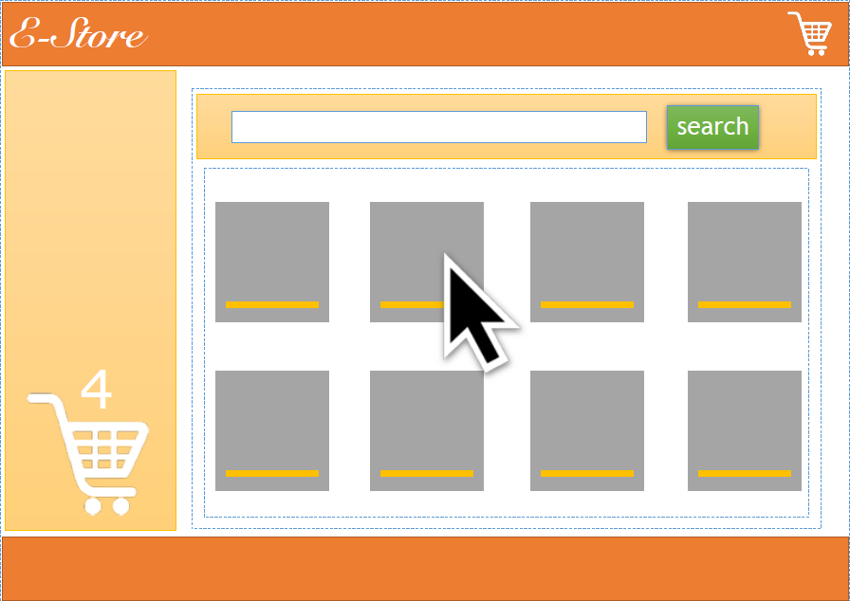

Slide 10
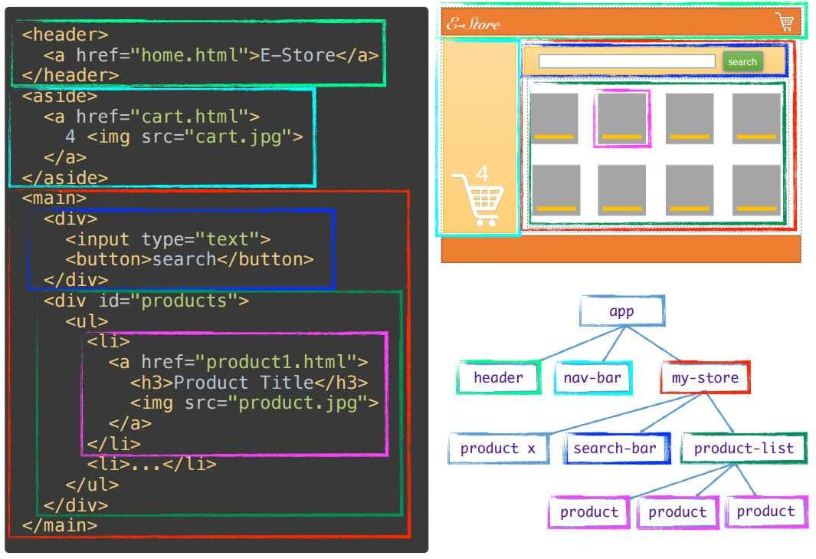

Slide 11
A component is
Controls a patch of screen called a view.
Exported as a custom HTML tag, e.g. <item></item>
Defined by an HTML template.
Enhanced using the @component decorator.
Controlled using its inputs and outputs.
Initialized by Angular Dependency Injection engine.

Slide 12
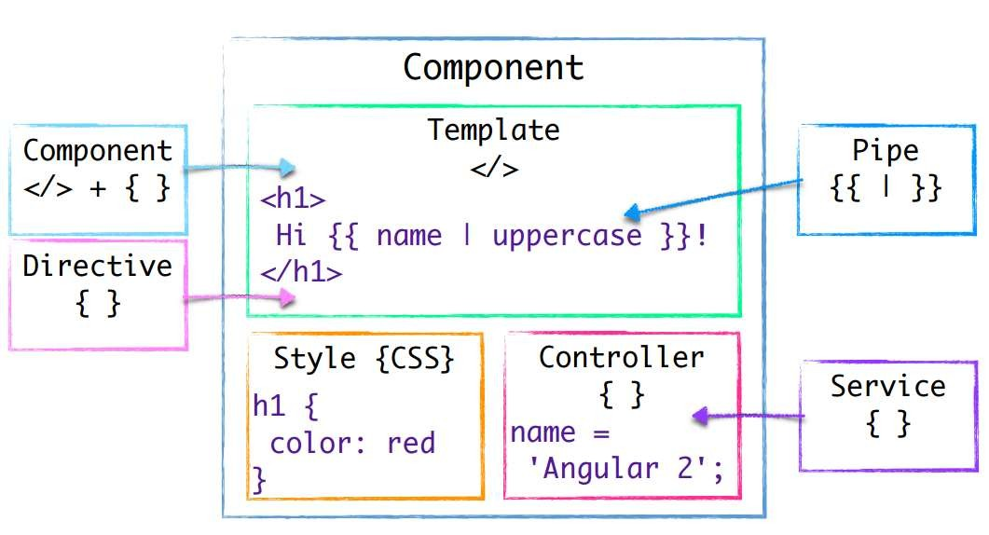

Slide 13
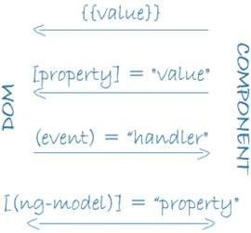
TEMPLATE syntax
Template tags: {{ expression }}. Execute arbitrary expressions like {{ x+1 }}.
Property binding: [key]=‘value’. Used to pass data to a component.
Event binding: (event)=‘expression’. Expression executed
anytime the registered event fires.
2-way binding: <input [(ngModel)]=‘u.name’> Requires to import ‘FormsModule’ to be used.

Slide 14
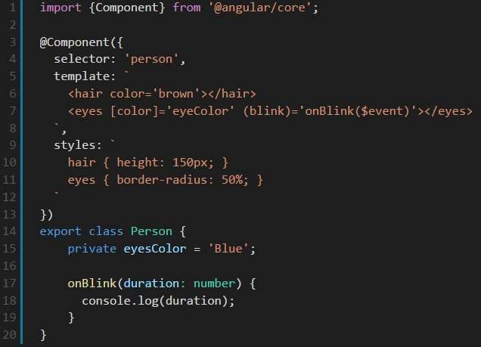
Example

Slide 15
Directive
A directive is a class with a directive metadata.
There are three kind of directives:
Component: A component is a directive-with-a-template. A @Component decorator is actually a @Directive decorator extended with template-oriented features.
Structural directive: Alter layout by adding, removing, and replacing elements
in DOM. E.g *ngIf, *ngFor, *ngSwitch.
Attribute directive: Alter the appearance or behavior of an existing element.
E.g *ngStyle, *ngClass.

Slide 16
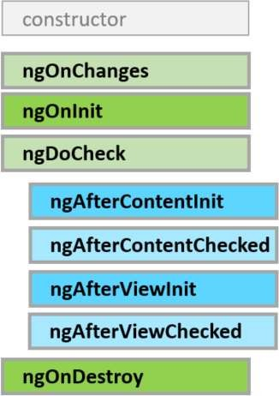
Lifecycle Hooks

Slide 17
Components & Directives shared Lifecycle Hooks
ngOnChanges Input property value changes
ngOnInit
Initialization step
ngDoCheck Every change detection cycle
ngOnDestroy
Before destruction

Slide 18

Service
A service is the mechanism used to share functionalities over components.
A services are injected using Dependency Injection mechanism.
For example:
Logging service
Data service
Message bus
Tax calculator
Application configuration

Slide 19

Pipe
Pipes transform displayed values within a template.
The pipe operator passes the result of an expression on the left to a pipe function on the right.
Many of the pipes provided by ng2 will be familiar if you've worked with
filters in ng1.x.
Built-in pipes: DatePipe, JsonPipe, UpperCasePipe, LowerCasePipe, DecimalPipe, SlicePipe, CurrencyPipe, AsyncPipe, I18nPluralPipe, PercentPipe.

Slide 20
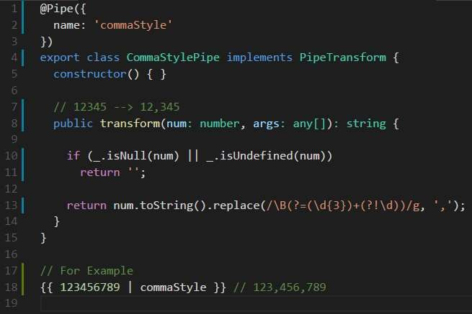
Custom Pipe - Example

Slide 21
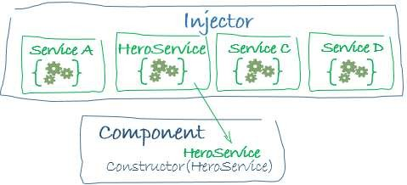
Dependency Injection
A way to supply a new instance of a class with the fully-formed dependencies it requires.
Most dependencies are services.
Angular uses dependency injection to provide new components with the services they need.
There is actually a tree of injectors that parallel an application's component tree.
Ng2 has a Hierarchical Dependency Injection system.

Slide 22
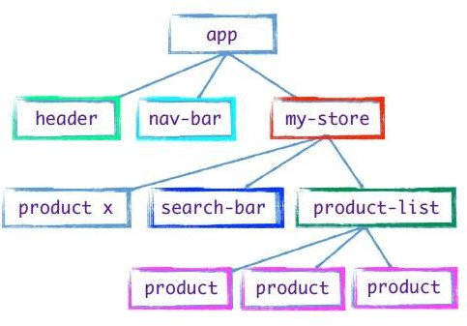
Hierarchical DI - Example

Slide 23
Angular Module
Help organize an application into cohesive blocks of functionality
Takes a metadata object that identifies the module's own components, directives and pipes.
Making some of them public so external components can use them.
May add service providers to the application dependency injectors.
Every Angular app has a root module.
Many Angular libraries are module e.g. FormsModule, HttpModule, RouterModule
Many third party libraries are available as Angular modules e.g. Angular Material 2, Ionic, ng2-bootstrap.

Slide 24
Angular Module
An Angular module is a class decorated with @NgModule metadata.
The metadata:
Declare which components, directives and pipes belong to the module.
Make some of those classes public so that other component templates can use them.
Import other modules with the components, directives and pipes needed by the components in this module.
Provide services at the application level that any application component can use.

Slide 25
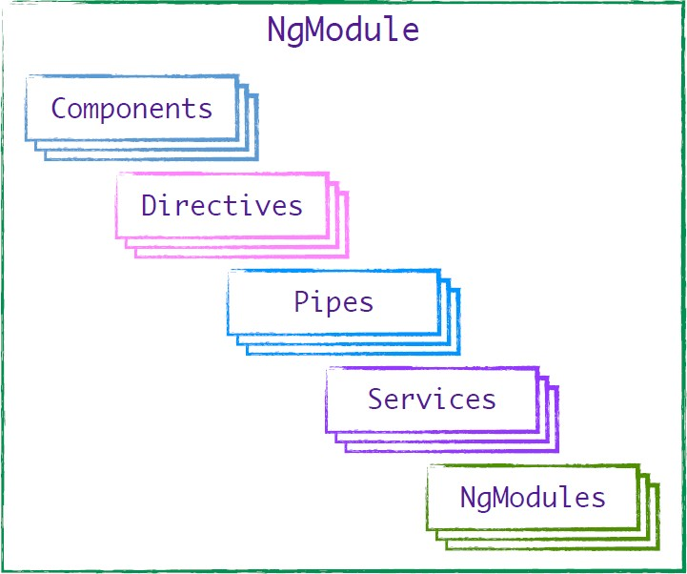

Slide 26
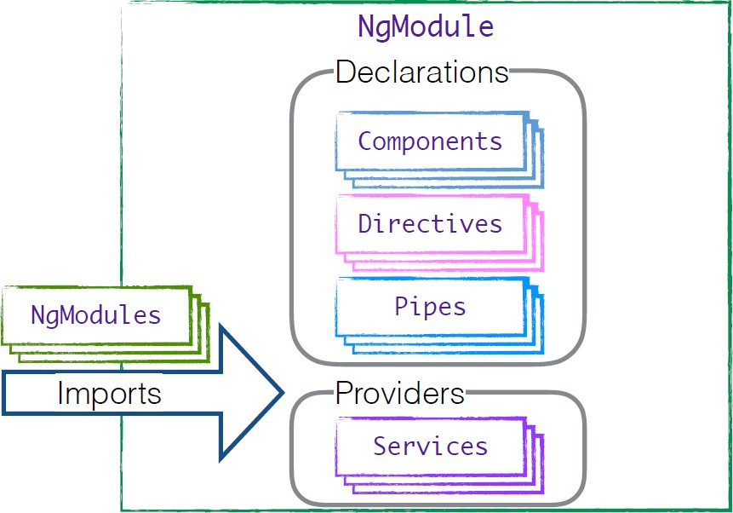

Slide 27
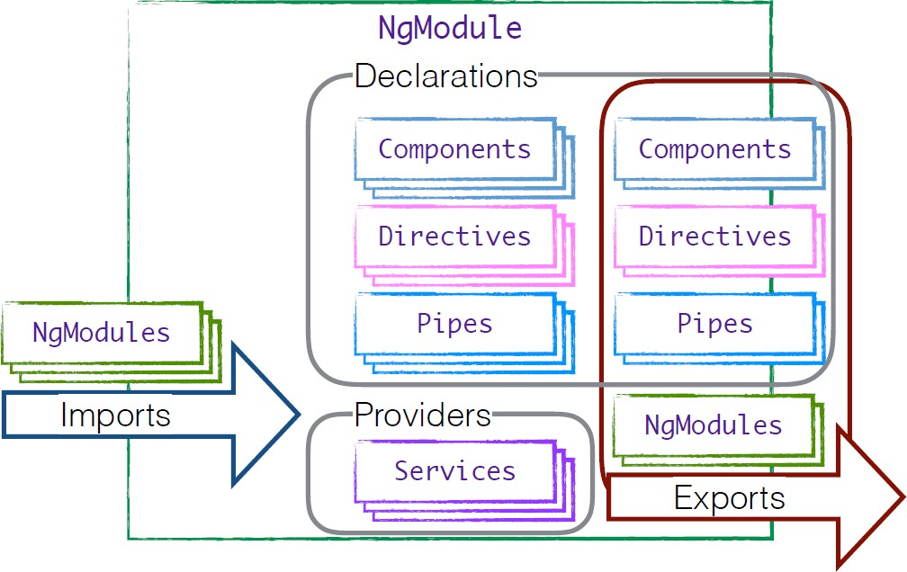

Slide 28
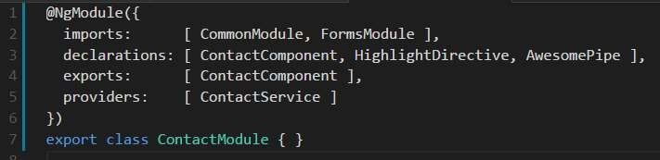
Example

Slide 29
Thank You.!

