Slide 1

Netaji Bandi
Technology Leader @Byteridge

Slide 2
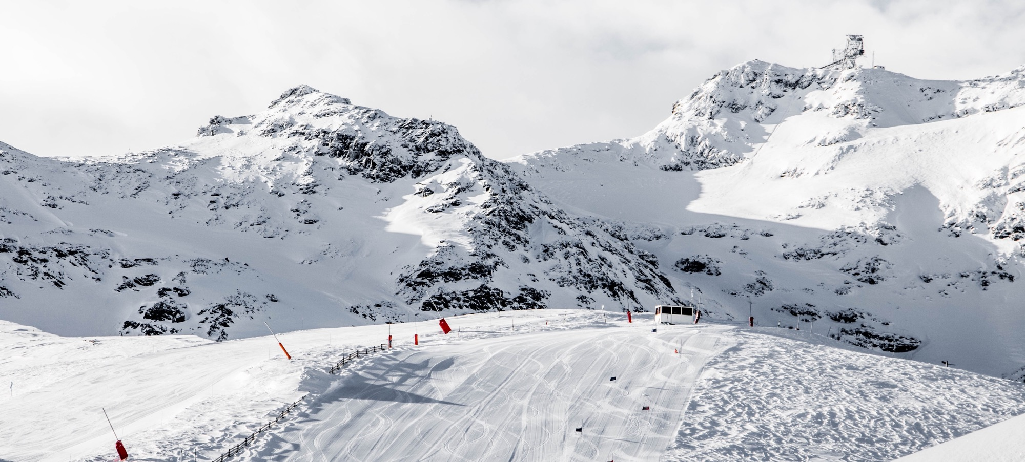
Node.JS & Angular
Introduction and HOL

Slide 3
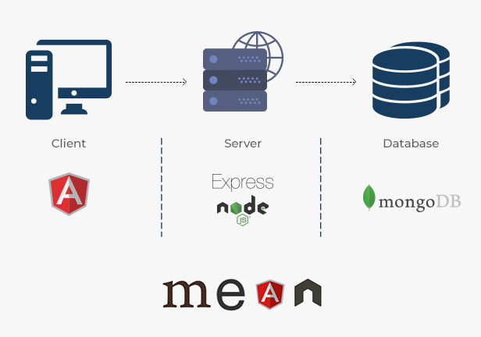

Slide 4
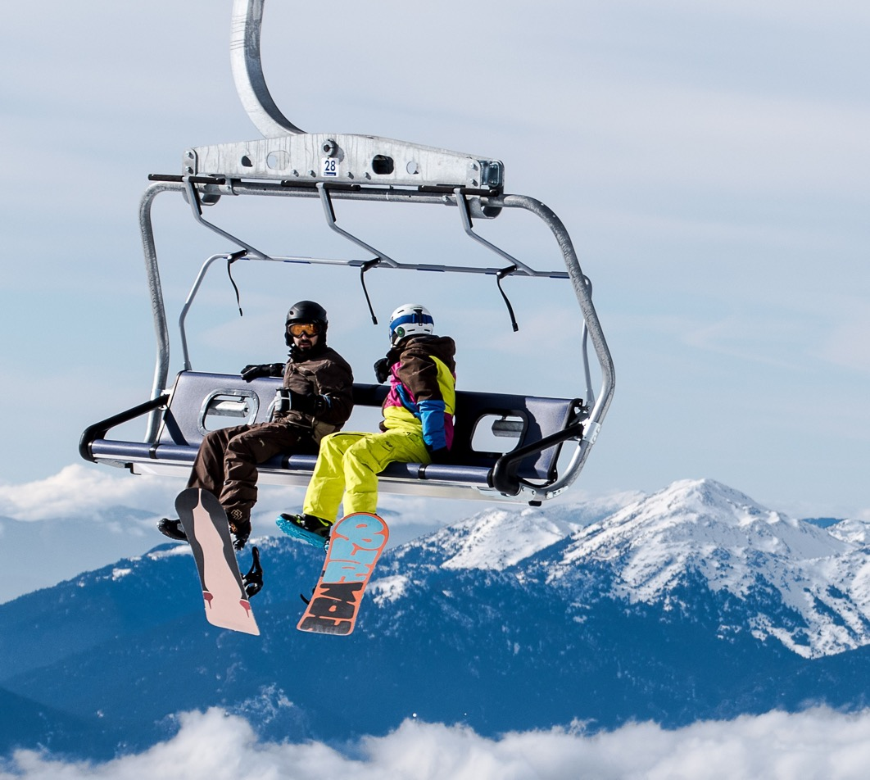
Agenda
Create an API using Node.js
Call the Node API with Angular

Slide 5

Large Image slide
Let’s ski
Notes:
© Copyright Showeet.com – Free PowerPoint Templates

Slide 6

Node.js
Run-time environment that executes JavaScript code outside of a browser.
Setup
Install Node.js, https://nodejs.org
npm install express
npm install cors

Slide 7
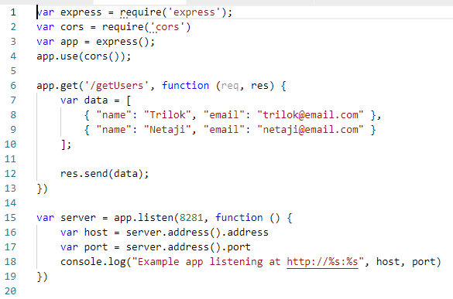
server.js
node server.js

Slide 8


Angular
Platform for building mobile and web applications.
Setup (Node.js Command prompt)
npm install -g @angular/cli
ng new angular-app
enter key for choosing defaults
ng serve -o

Slide 9
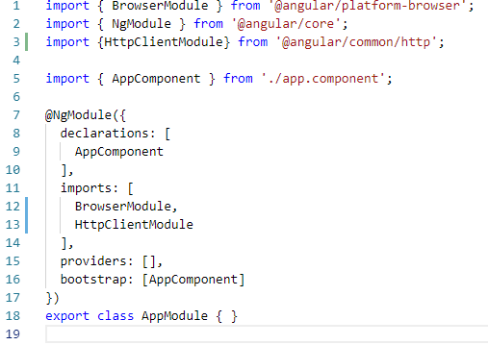
app.module.ts

Slide 10
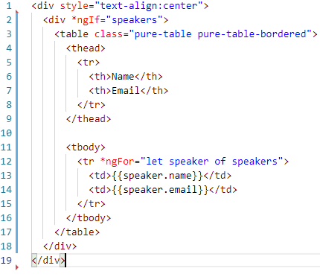
app.component.html

Slide 11
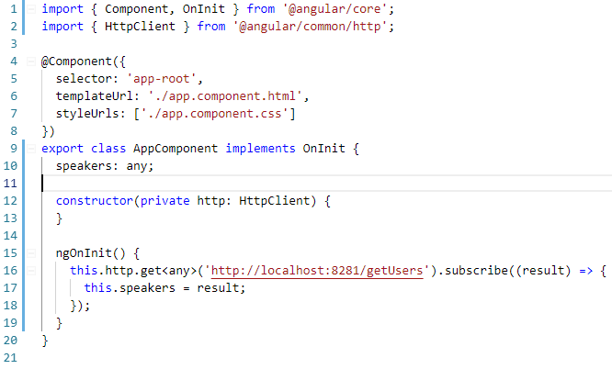
app.component.ts

Slide 12
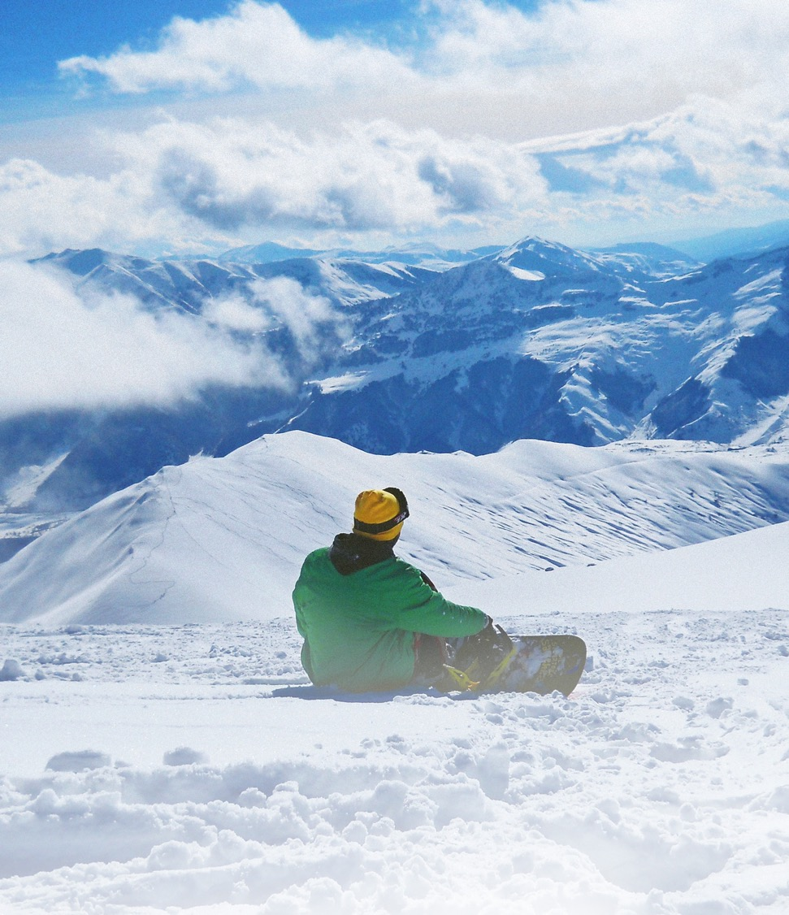
THANK YOU!
Any questions?

