Slide 1
Extend Thrust (GPU) statevector backend
Q-Accelerator

Slide 2

Goal of the project
Improve Aer unitary matrix and density matrix simulations using GPU hardware acceleration.
Typical issues with running Aer using CPU: runtime and memory consumed.
Our solution: work on offloading matrix and vector operations that require 2^n space and/or time complexity to GPU. (Parallel computing)

Slide 3
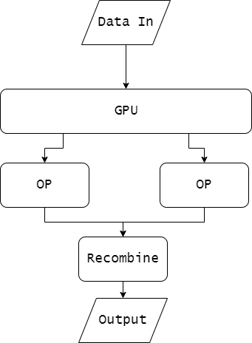
GPU Compute

Slide 4
Proof of concept
Qubitvector class has already been reimplemented with CUDA Thrust API.
Operations on statevectors are able to be run in parallel.

Slide 5
Our process
Downloading the software needed.
Studying the OpenMP and CUDA Thrust API.
Trickiest part: trying to convert code already written for OpenMP into Thrust.
Writing a benchmarking Jupyter Notebook.
Compiling the source code.

Slide 6
Results
Qubit amount: 5
GPU: 0.350s
CPU: 0.067s
Qubit amount: 6
GPU: 0.339s
CPU: 0.089s
Qubit amount: 7
GPU: 0.440s
CPU: 0.145s

Slide 7
Results
Qubit amount: 8
GPU: 0.650s
CPU: 0.232s
Qubit amount: 9
GPU: 1.981s
CPU: 0.611s
Qubit amount: 10
GPU: 5.489s
CPU: 2.604s

Slide 8
Results
Qubit amount: 11
GPU: 7.480s
CPU: 11.518s
Qubit amount: 12
GPU: 28.848s
CPU: 50.667s

Slide 9
Future Work
Improving our knowledge of the Thrust API. Many more optimisations can be made.
Improve implementation of unitarymatrix_thrust and densitymatrix_thrust
Collaborating with those with better understanding of GPU compute.

Slide 10
Thank you.
Special thanks to:
IMB Q Team and Coordinators
Q-Accelerator Team
Hiroshi Horii

