Slide 1
Short-Term Trading Strategy based on Volatility and Technical Indicators
- Osama IqbAL

Slide 2
Introduction
Get data from data-source (based on file or manual entry of tickers)
Generate portfolio based on tickers and data (EoD Data)
Plot outliers based on volatility
Generate signal filters based on SMA, ADX, RSI, BB, MACD
Devise strategy using ADX-MACD-RSI-BB
Calculate KPIs (Drawdown, Win/Loss Ration, Gain/Pain ratio etc.)

Slide 3
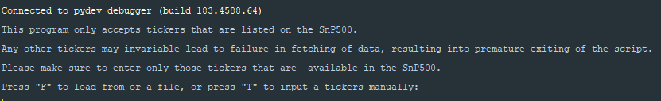
Gathering Data
User enters ticker’s manually or from a file
For manual option, choses number of stocks in the portfolio
Connects to Yahoo Finance to fetch data

Slide 4
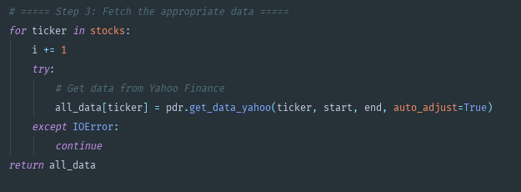
Generating Portfolio
A portfolio is constructed from the tickers that have been provided to the program
Data under consideration is EoD Data for the past year

Slide 5
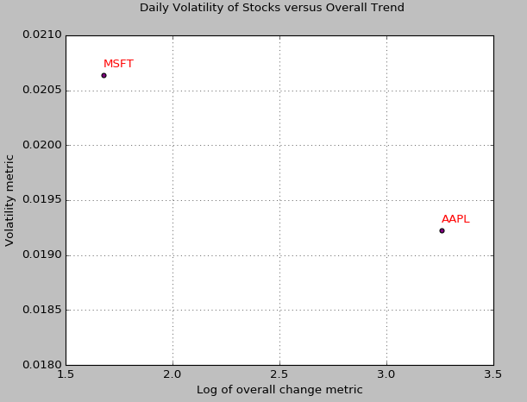
Outliers based on Volatility
Outliers are plotted based on volatility

Slide 6
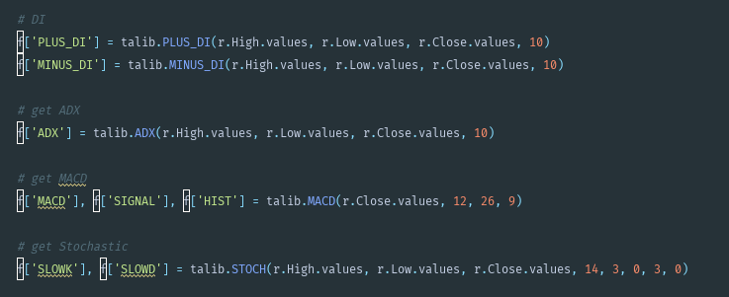
Generate Signals
Indicators based on BB, RSI ADX, MACD

Slide 7
Devise Strategy

Slide 8
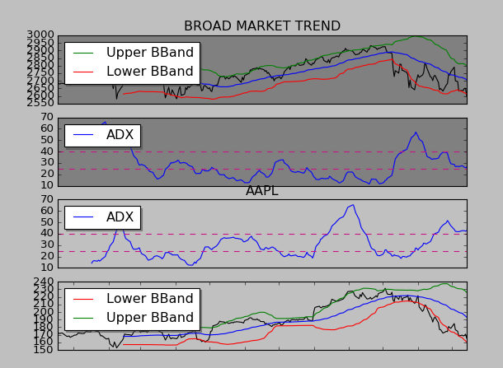
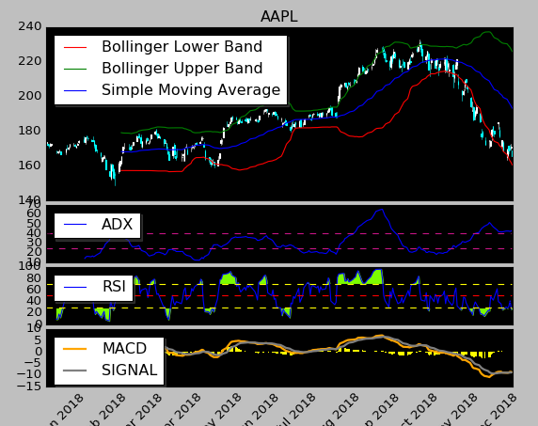
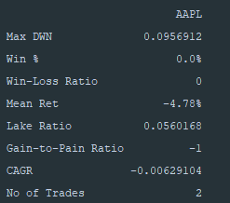
KPIs
Plot signals and display KPIs

Slide 9
Thank You

